Slide 1
Switches

Slide 2
Types of Switches
Switches exist in various incarnation.
A Switch object is used to control a push-button switch.
There are the simple mechanical switches: on/off or push button switches
There are also switches than turn on or off with various external conditions:
Temperature
infra red radiation (e.g. the Passive Infrared Sensor or PIR sensor)
Hall switches detecting magnetic field
microphone switches which turn on when a certain noise level is detected

Slide 3
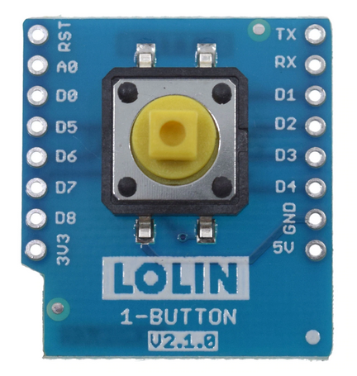
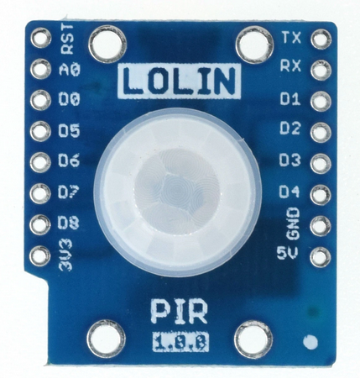
The Push Button & PIR

Slide 4
Digital Inputs
A digital input is a board pin which can read if it sees a high (on) or low (off) logic level connected to it.
For example if you connect a button to a digital input you can detect when it's pressed and released.
Also if you connect a PIR(passive infrared sensor) to a digital input, it can detect the infrared (IR) light radiating from objects in its field of view.
MicroPython makes it just as easy to use a pin digital inputs as it does outputs.

Slide 5
Push Button
The push button switch is usually used to turn on and off the control circuit, and it is a kind of control switch appliance that is widely used.
This is very similar to switching a LED on or off.
A single GPIO line is used.
The pin in programmed as input and we can add a pullup or pulldown resistor:
_PB_PIN = 22 pushButton = Pin(_PB_PIN,Pin.IN,Pin.PULL_UP)
Once the pushButton pin is defined we can get its current state with:
state = pushButton.value()

Slide 6
Pull-up Resistors
Pull-up resistors are very common when using microcontrollers (MCUs) or any digital logic device.`
The value of the pull-up resistor needs to be chosen to satisfy two conditions:
When the button is pressed, the input pin is pulled low. The value of resistor R1 controls how much current you want to flow from VCC, through the button, and then to ground.
When the button is not pressed, the input pin is pulled high. The value of the pull-up resistor controls the voltage on the input pin.

Slide 7
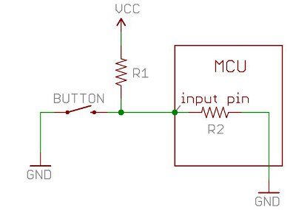

Slide 8
Interrupts
Interrupts are useful for making things happen automatically in microcontroller programs
With interrupts you don’t need to constantly check the current pin value. When a change is detected, an event is triggered (a function is called).
When an interrupt happens, the processor stops the execution of the main program to execute a task, and then gets back to the main program
This is especially useful to trigger an action whenever motion is detected or whenever a pushbutton is pressed without the need for constantly checking its state.

Slide 9
Interrupt Method
The irq() method accepts the following arguments:
trigger: this defines the trigger mode. There are 3 different conditions:
Pin.IRQ_FALLING: to trigger the interrupt whenever the pin goes from HIGH to LOW;
Pin.IRQ_RISING: to trigger the interrupt whenever the pin goes from LOW to HIGH.
3 or Pin.IRQ_FALLING | Pin.IRQ_RISING: to trigger the interrupt in both edges (this means, when any change is detected)
handler: this is a function that will be called when an interrupt is detected, in this case the handle_interrupt() function.
pushButton.irq(trigger=Pin.IRQ_RISING, handler=handle_interrupt)

Slide 10
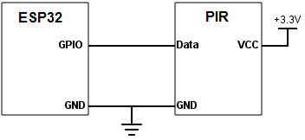
Passive infrared sensor shield.

Slide 11
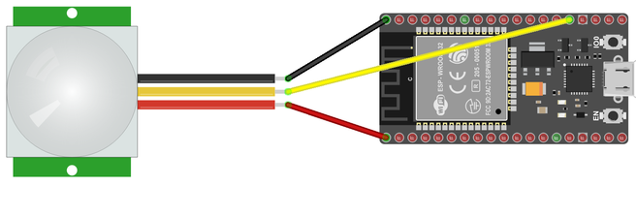

Slide 12
PIR stands for Pyroelectic Infrared Radial Sensor or Passive Infrared Sensor.
PIR is an electronic sensor which detects the changes in the infrared light across certain distance and gives out an electrical signal at its output in response to a detected IR signal.
It can detect any infrared emitting object(Objects that generate heat) such as human beings or animals if it is the range of the sensor, or moves away from the range, or moves within the range of the sensor.
The radiation of the infrared object should be strongest at a wavelength of 9.4μm.
Infrared in this range will not pass through many types of material that pass visible light such as ordinary window glass and plastic.
However it will pass through, with some attenuation, material that is opaque to visible light such as germanium and silicon.

Slide 13
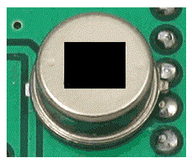
PIR sensitive crystal
The dark portion of the metal is where the IR sensitive crystal is housed,
The sensitive crystal can detect the level of infrared in the surroundings.
It actually houses two pyroelectic sensors for detecting moving objects.
If one of the sensitive crystals detects change in infrared (increment or decrement) than the other sensitive crystal,
the output gets triggered.
A dome shaped plastic structure is normally placed over this sensitive crystal which acts as lens to focus the infrared light on the sensors.

Slide 14
How it works
A single GPIO line is used.
The pin in programmed as input and we can add a pullup or pulldown resistor:
_IR_PIN = 16 pir_sensor = Pin(_PB_PIN,Pin.IN,Pin.PULL_UP)
Once the pushButton pin is defined we can get its current state with:
state = pir_sensor.value()

