Slide 1
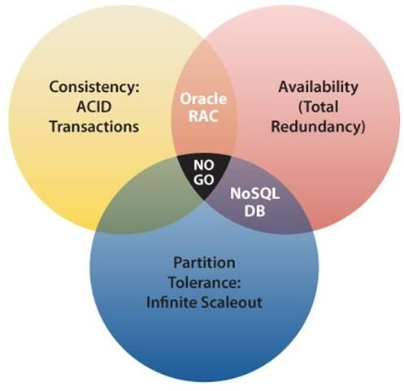
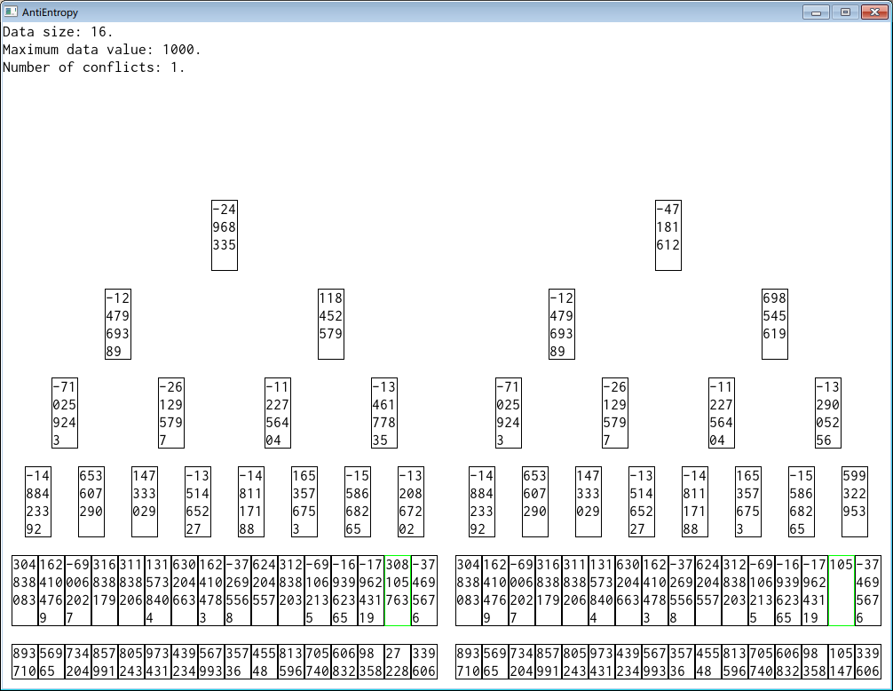
Evaluating Performance of Anti-Entropy Algorithms
Introduction
Results
Visualization
Motivation
Discussion and Further Work
Approach and Implementation
Conclusions

