Slide 1
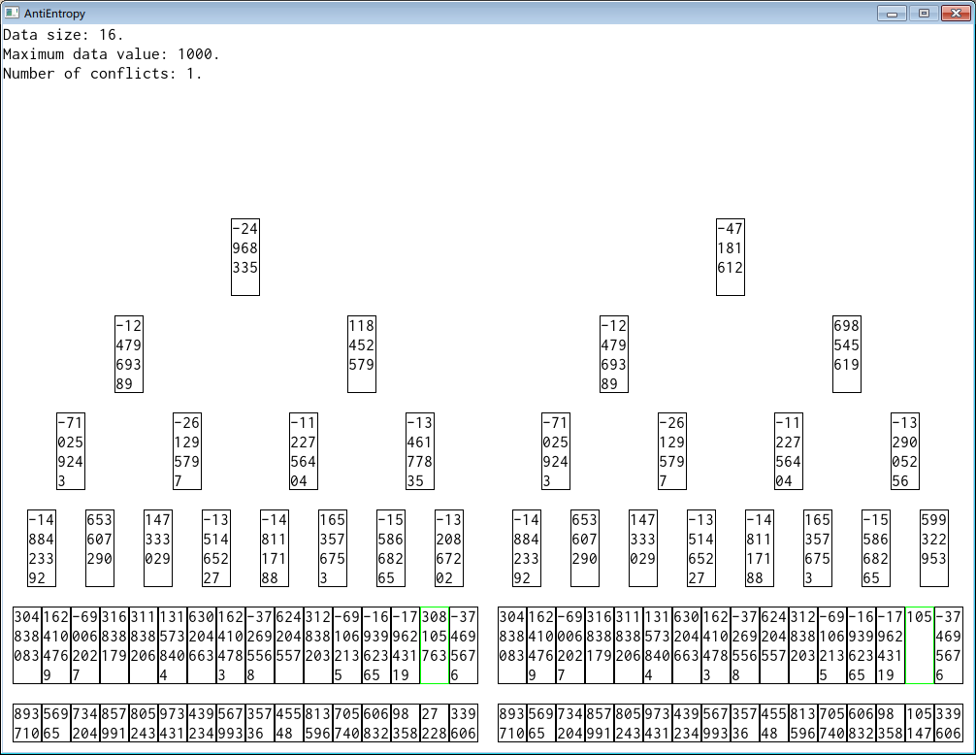
Evaluating Performance of Anti-Entropy Algorithms
Kenny Gao and Sriram Mohan
Introduction
Results
Brewer's CAP Theorem
Consistency
Availability
Partition Tolerance
Pick two.
Visualization
Algorithm visualization as a pedagogical tool
Each data point is the mean value of 100 simulations of an algorithm for some configuration of variables.
Visualization of Merkle Tree-Based Algorithm
Discussion and Further Work
Evaluating Performance
Results seem to scale with data count.
merkle outperforms naive when conflict count is low, and vice versa.
naive grows linearly with respect to conflict count, whereas merkle grows logarithmically (approximately).
Further work:
Implement remaining algorithms
Extend performance evaluation to speed (quantitative)
Extend performance evaluation to robustness (qualitative)
What performance can be:
Network usage
Speed (time)
Robustness/resistance to failure
What to measure:
Pairwise data comparison (naive)
Naive algorithm with single hash of all data
Naive algorithm with multiple layers of hashing
Standard Merkle tree algorithm (full hash tree)
Variations: non-binary trees, lazy hash computation
Approach and Implementation
Given the following variables:
# of data items stored on replicas
# of conflicts between replicas
Measure each algorithm's performance in terms of network usage.
Naive and standard Merkle tree algorithms implemented in Python and repeatedly simulated on randomly-generated data for each configuration of variables.
Conclusions
The standard Merkle tree algorithm is superior to the naive algorithm in terms of network usage provided that the conflict count is below the threshold of roughly 22% of the data count. Above the threshold, the naive algorithm is superior.

