Slide 1
Evaluating Performance of Anti-Entropy Algorithms
Kenny Gao and Sriram Mohan
Notes:
feel free to ask questions whenever

Slide 2
Distributed Databases
BigTable
Dynamo
Cassandra
Voldemort
HBase
CouchDB
MongoDB
Notes:
raise your hand if you've heard of one of these

Slide 3
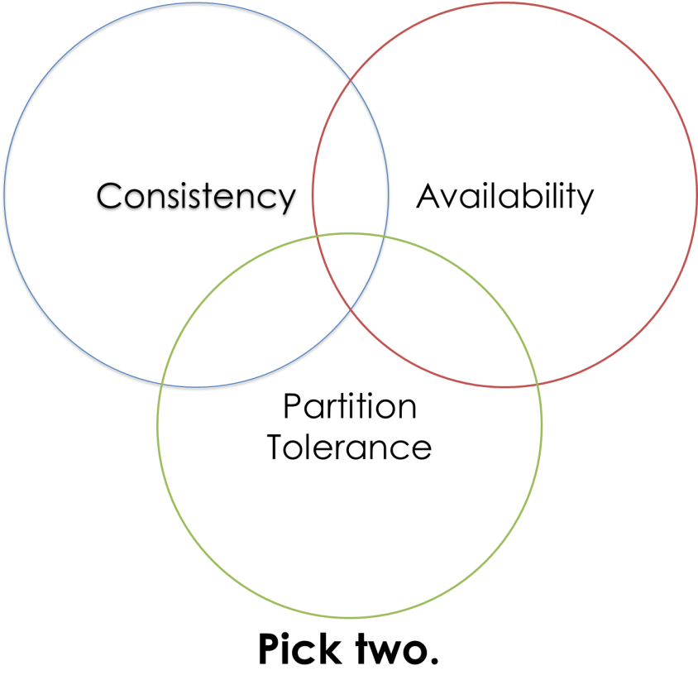
The CAP Theorem

Slide 4
Eventual Consistency
Conflicts still need to be resolved, even if only eventually
Many conflict resolution techniques exist

Slide 5
The Need for Anti-Entropy
Techniques like read-repair, write-repair, and hinted handoff cover most conflict resolution cases
Anti-entropy resolves prolonged replica failures
Notes:
without it, we would be forced to choose between slowing down i/o (read/write-repair), re-instancing the replica, or using another asynchronous conflict resolution method

Slide 6
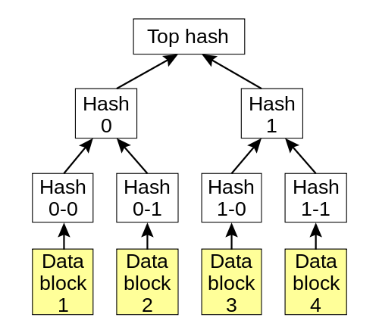
Merkle Trees
Or: hash trees
Essentially: good at diffing arrays

Slide 7
Inter-demo-mission

Slide 8
Evaluating Performance (Why?)
Why Merkle trees?
Could not find existing literature justifying the choice
Exactly how "good" are Merkle trees?

Slide 9
What Performance is

Slide 10
What Performance is
Network usage
Speed (time)
Qualitative criteria (resistance to network imperfections)
?

Slide 11
What to Evaluate
Pairwise data comparison (naive)
Naive algorithm with single hash of all data
Naive algorithm with multiple layers of hashing
Standard Merkle tree algorithm (full hash tree)
Variations: non-binary trees, short-circuiting with base case failover

Slide 12
Approach
Given the following variables:
# of data items stored on replicas
# of conflicts between replicas
Measure each algorithm's performance in terms of network usage.

Slide 13
Implementation
Implemented algorithms in python
Repeatedly simulated on randomly-generated data for each configuration of variables
Notes:
in a sense: built a "test" harness that tested anti-entropy strategies (as in strategy pattern)

Slide 14
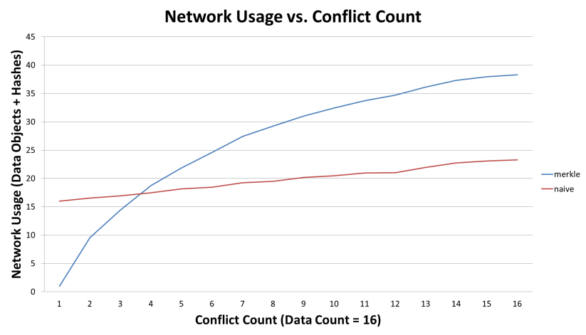
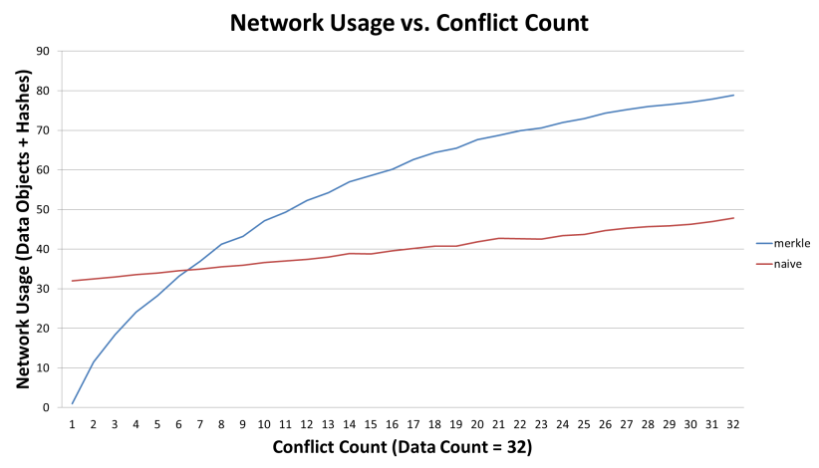
Results
Data Count = 16
Data Count = 32
Notes:
each data point is the mean value of 100 simulations of the algorithm for the given configuration of variables
results seem to scale with data count

Slide 15
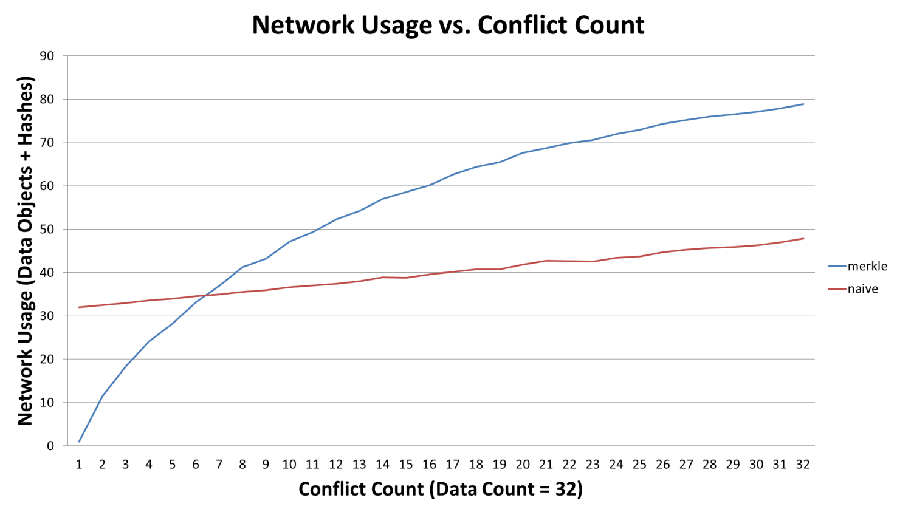
Results
Notes:
merkle outperforms naive when conflict count is low, and vice versa
naive grows linearly with respect to conflict count, whereas merkle grows logarithmically (approximately)

Slide 16
Implications
Different algorithms may be "best" at different points on the conflict count spectrum
Current anti-entropy methods could be improved by estimating the conflict count of replica pairs
Notes:
n.b. only considered network usage; merkle trees may perform well in other ways (time, space, interaction with other techniques)
n.b. only considered conflict count; other properties may also factor into performance (spacial locality)

Slide 17
Further Work
Implement remaining algorithms
Extend performance evaluation
Investigate other variables that might impact performance

Slide 18
Final Thoughts

