Slide 1


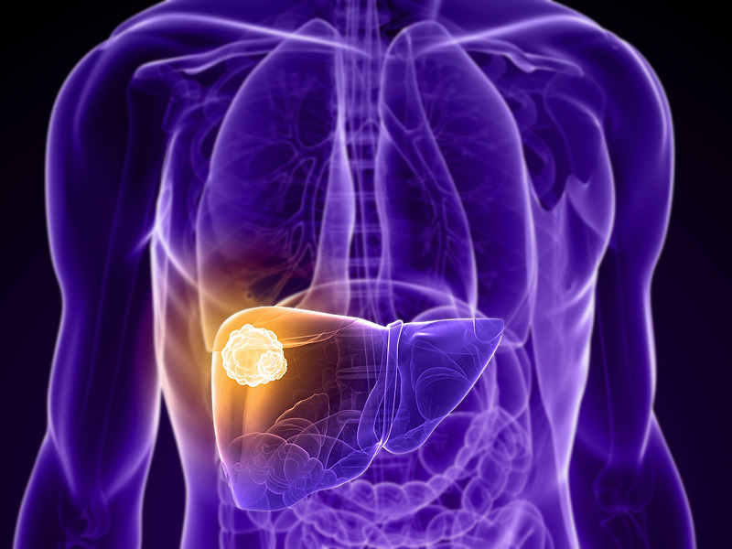
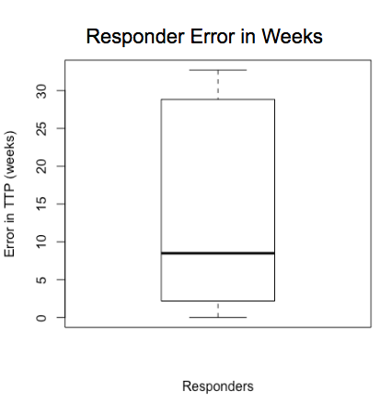
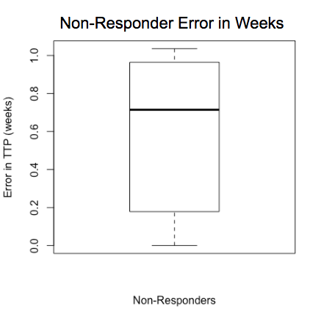
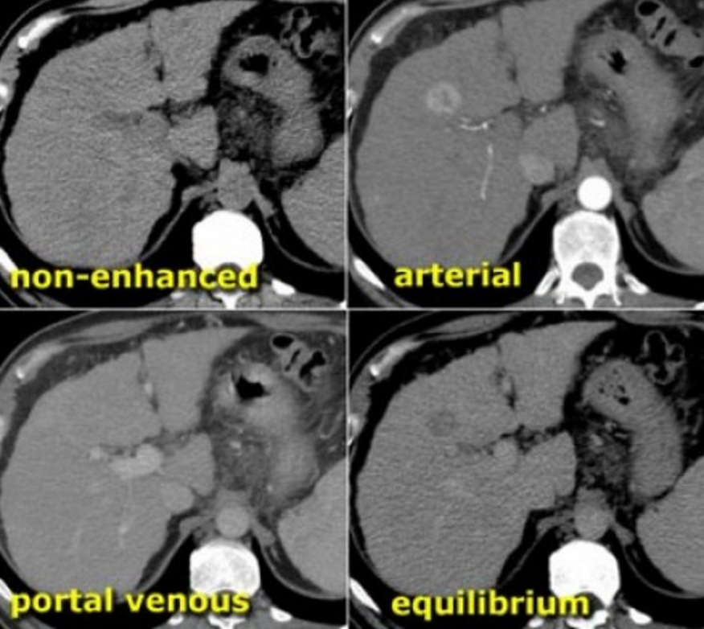
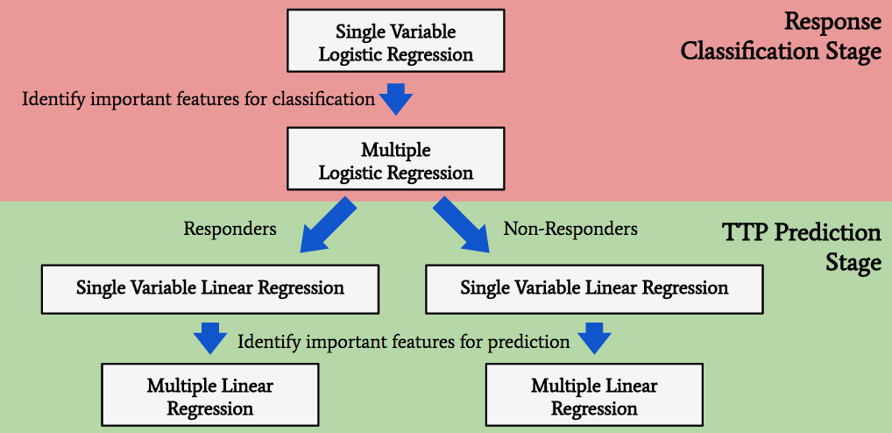
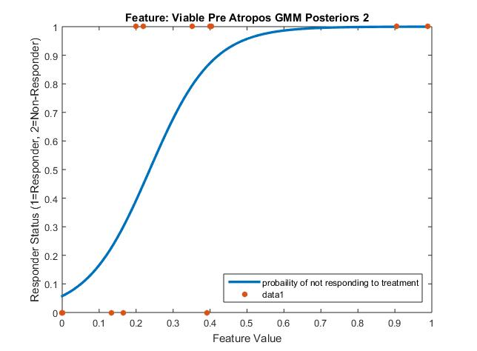
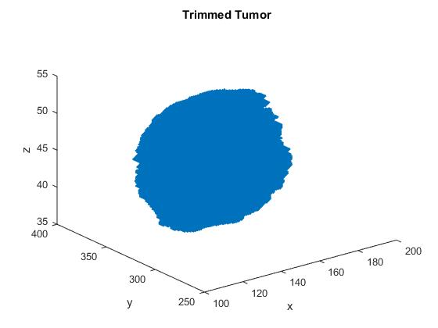
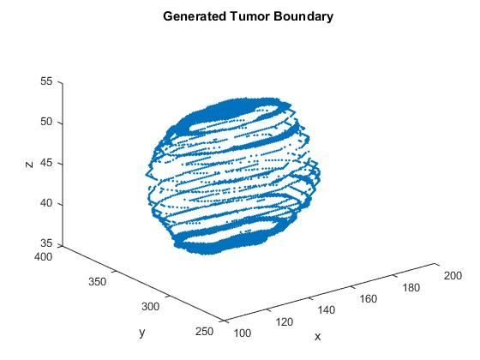
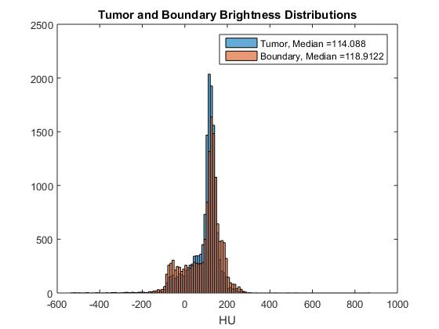
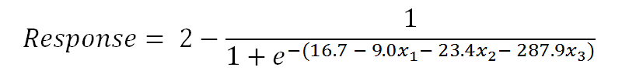
Mathematically Predicting Treatment Response of
Hepatocellular Carcinoma Patients
Team Live and Let Liver
Lucas Cadalzo, Lorenz Gahn, Ken Groszman
Department of Computational and Applied Mathematics, Rice University, Houston, TX 77005
Motivation
Regression-Based Feature Selection
TTP Prediction Stage
Hepatocellular Carcinoma (HCC) is one of the most lethal forms of cancer, with most patients not surviving more than 20 months [1]
Treatment options, such as transcatheter arterial chemoembolization (TACE) are invasive, expensive, and often ineffective in extending the lives of patients [2]
With a dataset that contains 500 features but only 20 patients, it was important to select only important features to include in the model
We used a single-variable regression-based method for selecting important features to include in our model
Method:
For each feature, perform a regression of that feature compared to a response variable:
Categorical variable – logistic regression – binary response variable
Continuous variable – linear regression – TTP is response variable
Compare R² or deviance values to determine predictive features
After patients are classified as responders or non-responders, a multiple linear regression model is used to fit to each group
Different features are significant for each case:
Important responders features:
Mean.Del_ATROPOS_GMM_POSTERIORS2
Mean.Del_ATROPOS_GMM_POSTERIORS1
Mean.Del_SKEWNESS_RADIUS_3
hep_b
Important non-responders features:
Mean.Pre_SKEWNESS_RADIUS_5
Metastasis
Responders: Mult. R-squared: 0.87, Adj. R-squared: 0.77
Non-Responders: Mult. R-squared: 0.80, Adj. R-squared: 0.75
Oncologist methodology for deciding which treatment to use are subjective and based on experience
We seek a mathematical model that predicts the responsiveness of HCC patients to TACE
Background: Hepatocellular Carcinoma (HCC)
Model Overview
Hepatocellular Carcinoma (HCC)
Third most lethal variety of cancer, often associated with cirrhosis of the liver and hepatitis [3]
Life expectancy is 6-20 months [1]
HCC causes more than 660,000 deaths per year
Common treatment is TACE, which is quite invasive, but not all patients respond to it [2]
The model was split into two stages:
1. Response-Classification Stage:
Select features for R/NR classification with logistic feature selection
Use multiple logistic regression to classify patients
2. TTP Prediction Stage
Select features for TTP prediction with linear feature selection
Use multiple linear regression to predict TTP for each group
Patient Imaging
Patients are imaged using computerized tomography (CT)
Four images are taken at different times
Contrast agent is injected into patient’s arm and flows through circulatory system, illuminating the tumor first
Description of Data
Conclusion and Future Plans
Our patient feature data comes from three sources:
CT Scan Feature Data
Each patient’s 4 CT scans were processed with software called Atropos
This generates ~450 features per patient
Patient Medical Data
Mentor provided anonymized patient medical records
Includes ~ 15 features including age, hepatitis, cirrhosis, etc.
Self-Generated Data
Some features were expected to be predictive, but were not in dataset
We generated tumor encapsulation and vascularity features in MATLAB
Tumor Encapsulation Feature:
Measures whether the tumor contains a dense boundary of connective tissue
Results:
92% classification accuracy for Responders vs. Non-Responders
Median TTP prediction errors for split models:
Responders: 8 weeks
Non-responders: 0.7 weeks
Next steps:
1. Improve classification error using multilayer perceptron neural network
2. Obtain more data and further test model
3. Hand over to MD Anderson to continue work
Response Classification Stage
Generate a multiple logistic regression model using three most important features identified by single logistic regression:
1. Del_Atropos_GMM_Posteriors3
2. viable_Pre_Atropos_GMM_Posteriors2
3. viable_Pre_Atropos_GMM_Posteriors3
Average classification accuracy of 92% using cross-validation
Next step: improve classification accuracy with multilayer neural network
Acknowledgements
We would like to acknowledge the Rice University Computational and Applied Mathematics Department, and specifically Dr. Beatrice Riviere, for their support and advice. We also want to thank Dr. David Fuentes and Dr. Ahmed Khalfe from the MD Anderson Cancer Center for their help. Finally, Dr. Erszebet Merenyi from Rice University ECE provided excellent advice with regard to neural networks.
References
[1] Forner et al. “Hepatocellular Carcinoma.” Lancet (London, England) 379, no. 9822 (March 31, 2012): 1245–55.
[2] Altekruse er al. “Hepatocellular Carcinoma Incidence, Mortality, and Survival Trends in the United States From 1975 to 2005.” Journal of Clinical Oncology 27, no. 9 (March 20, 2009): 1485–91.
[3] Chen, et al. “Risk of Hepatocellular Carcinoma Across a Biological Gradient of Serum Hepatitis B Virus DNA Level.” JAMA 295, no. 1 (January 4, 2006): 65–73.

