Slide 1
DEVELOPMENT OF A NEW SERVICE FOR Wi-Fi Direct
HE SHOUCHUN MEENAKSHY HARIKUMAR NAGA TULASI SOUJANYA VADREVU

Slide 2
Applications in Android
Applications are the top layer in the Android architecture and this is where our applications are going to fit. Several standard applications comes pre-installed with every device, such as:
SMS client app
Dialer
Web browser
Contact manager
As a developer can replace any existing system app. That is, you are not limited in accessing any particular feature. You are practically limitless and can whatever you want to do with the android (as long as the users of your app permits it). Thus Android is opening endless opportunities to the developer.

Slide 3
How an Android App is developed
Four types of application components:
Activities: An activity represents a single screen with a user interface.
A service is a component that runs in the background to perform long-running operations or to perform work for remote processes. A service does not provide a user interface.
Broadcast receivers: A broadcast receiver is a component that responds to system-wide broadcast announcements. Many broadcasts originate from the system.
activities, services, and broadcast receivers—are activated by an asynchronous message called an intent. Intents bind individual components to each other at runtime

Slide 4
The basic steps for a Wi-Fi direct application are:
Initial Setup
Discovering Peers
Connecting to Peers
Transferring Data

Slide 5
Proposed Scope
The Application has to be built over the application framework. To develop an Android Application Package (APK) for instant messaging using the Wi-Fi direct.
The application features include:
Simple text messaging
Chat Service
Multimedia content sharing i.e. image, audio, video and application
For example, image/jpeg, GIF, audio/mp3, video/mp4, and application/ msword

Slide 6
Tools:
Android SDK
Eclipse
SQL lite
Versions
Android- 4.2 Jelly bean
IEEE 802.11 a/g/n Wi-Fi CERTIFIED gear.
Eclipse 4.2

Slide 7
Implementation
User Interface
DATA MANAGER
SOCKET
Wi Fi direct

Slide 8
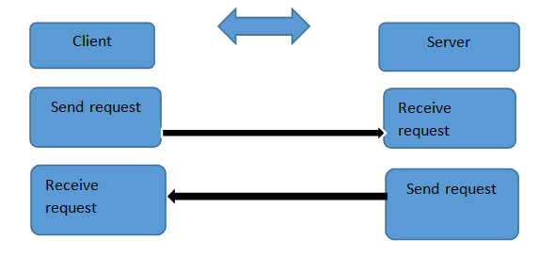
Connection

Slide 9
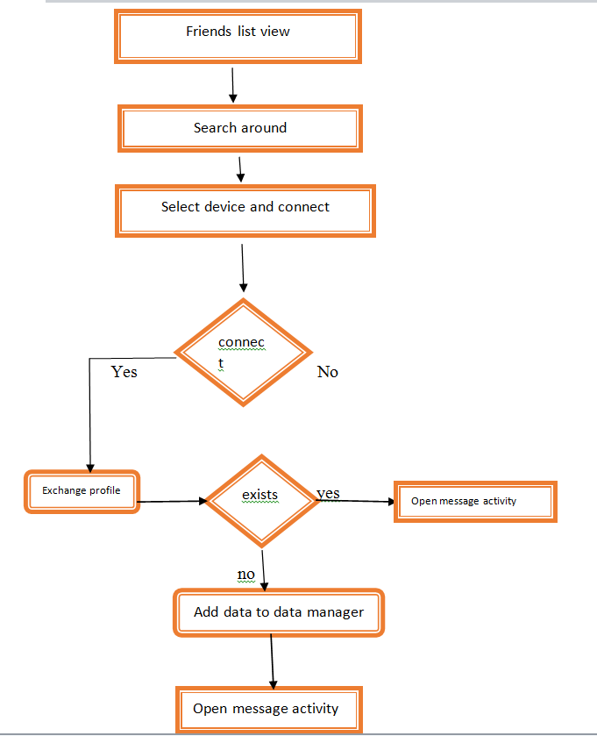

Slide 10
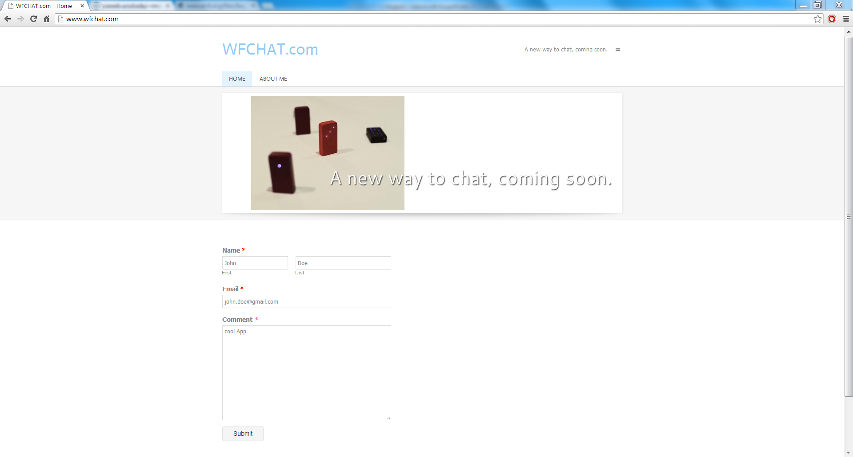
http://www.wfchat.com/

Slide 11
What we have developed now:
Discover Friends
Establish a socket connection
Save friends profile
Exchange friends profile
Send message and Receive messages

Slide 12
Compare output against hypothesis
The instant messaging application with features of chat service, save friends details worked well after establishing the socket connection. Binding this code with Wi-Fi direct layer did not return the expected results due to the hardware issues in the devices.
Due to the limitations of Wi-Fi Direct layer, extending the design for other features like exchanging the multimedia content, multiplayer games and push notifications is not possible as of now.

Slide 13
Test Cases

Slide 14
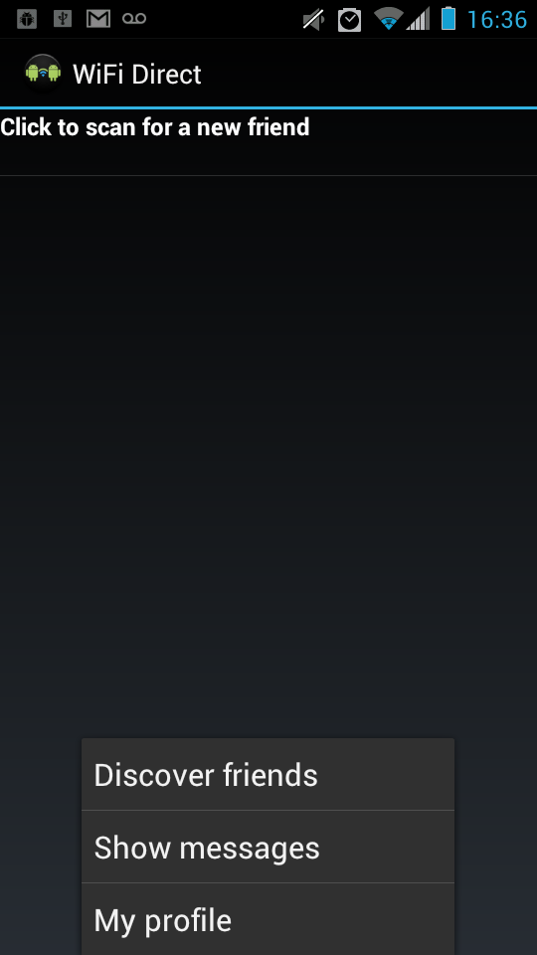
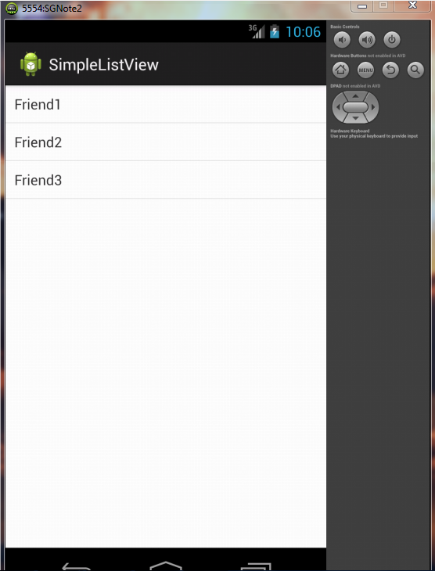
CASE 1: Make connection
CASE 2:Discover friends
CASE 3:Save friends

Slide 15
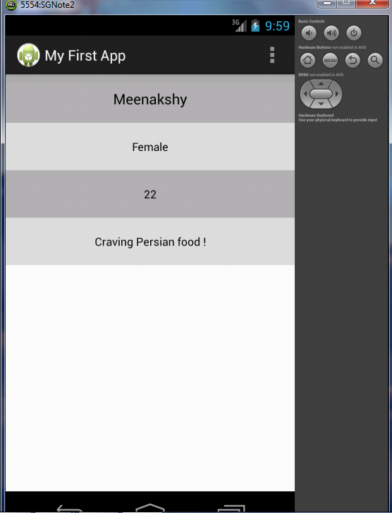
Friend information sent for authentication and verified
Friend Information
name
MAC address which is unique for authentication
Wi-Fi device name
IP
CASE 4: exchange friends profile

Slide 16
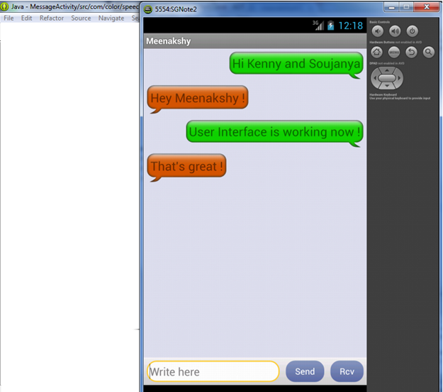
CASE 5: send message and receive message.

Slide 17

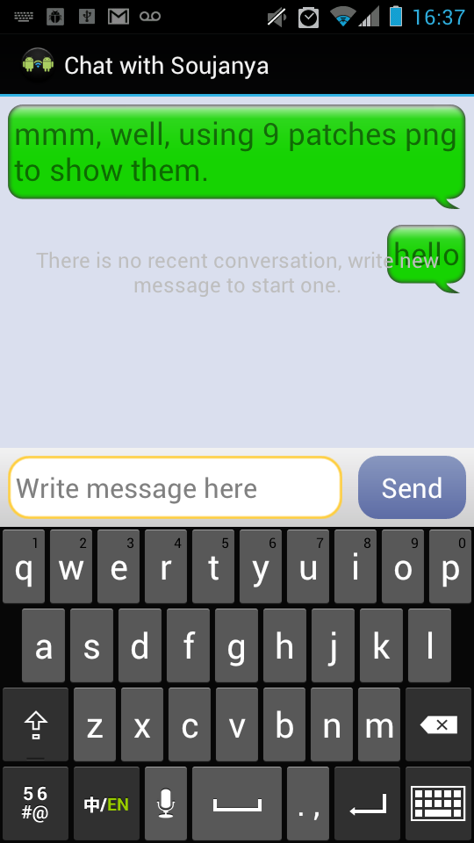
OUTPUT GENERATION

Slide 18
Problems with Wi-Fi Direct

Slide 19
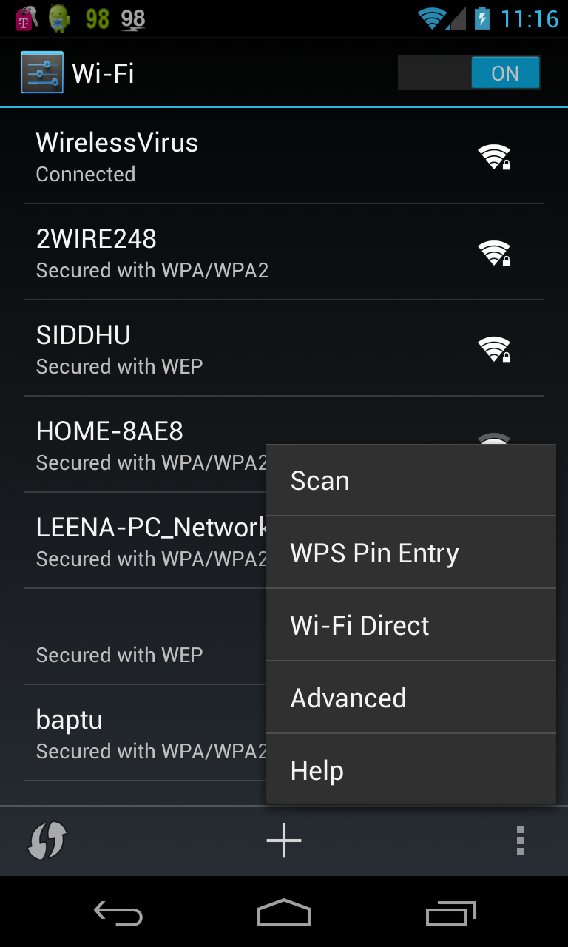
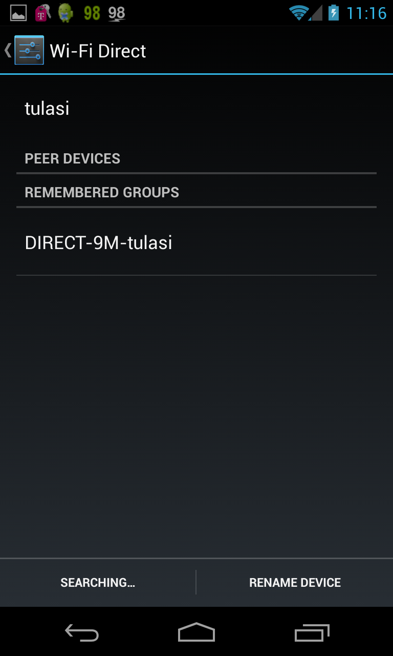
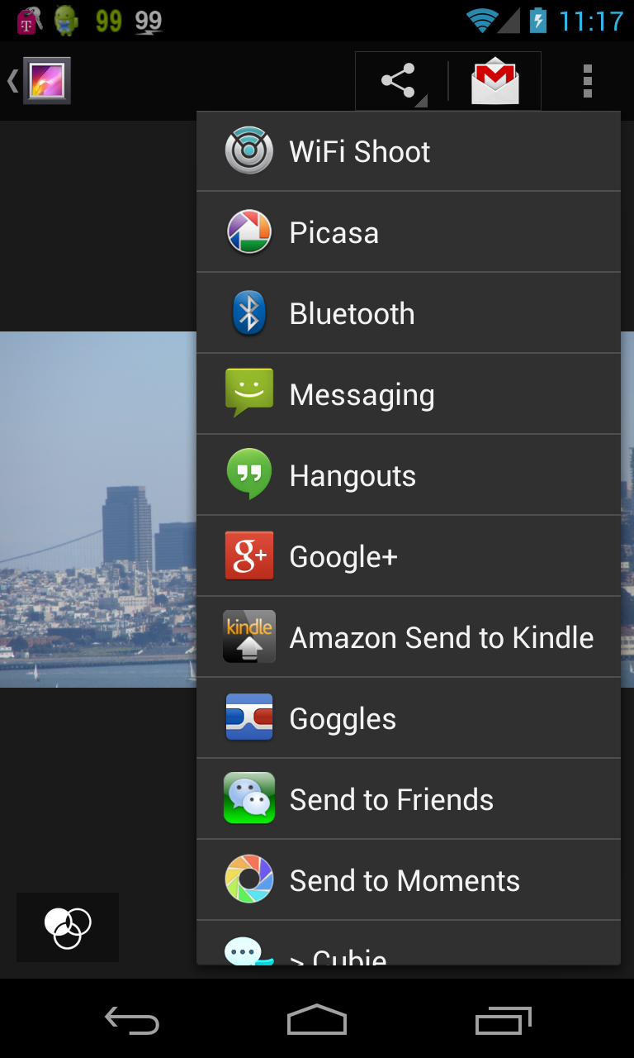

Slide 20
Connection to multiple other devices is an optional feature that will not be supported in all Wi-Fi Direct-certified devices; some devices will only make 1:1 connections.
Wi-Fi Direct-certified devices will be identifiable as Wi-Fi Direct-certified devices to infrastructure access points. APs can prevent devices currently using Wi-Fi Direct from connecting to the AP, or disconnect them if already connected, while Wi-Fi Direct is in use and/or configure their parameters including channel.
Several Wi-Fi Alliance members that make devices of limited processing capabilities contributed to the specification development process to ensure that it is applicable to such devices.
Bluetooth and Wi-Fi Direct Interference Cases: If they are on the same frequency pass band range of 22 MHZ they may interfere.

Slide 21
Future of Wi-Fi Direct
In addition to better marketing, there are several other factors that could give Wi-Fi Direct a much-needed boost in the near future.
First, the number of connected devices as a whole is on the rise, as manufacturers seek to add IP connectivity to everything from cameras to tablets and TVs. The Wi-Fi Alliance also threw its lot in with the Digital Living Network Alliance (DLNA) last November, ensuring that DLNA devices also support Wi-Fi Direct.
Second, more Wi-Fi Direct devices are still on the way. In-Stat predicts that every connected device with Wi-Fi will ship with Wi-Fi Direct by 2014. Given that Wi-Fi Direct devices are also backwards-compatible with other Wi-Fi products, that means a huge number of consumer electronics will be capable of connecting over local wireless networks without the Internet. Only one device in each wireless pairing has to be Wi-Fi Direct-enabled.
Wi-Fi Direct allows source and display devices to discover one another and provides the underlying device-to-device connectivity for Miracast. Miracast builds upon Wi-Fi Direct with mechanisms to negotiate video capabilities, setup content protection (if needed), stream content, and maintain the video session.

Slide 22
Conclusion
The limitations of Wi-Fi direct make it less user friendly now
The number of devices with Wi-Fi direct devices are very few.
The major problem a user confronts when using the Wi-Fi direct is that the devices are not compatible with each other.
Wi-Fi Direct becomes a widespread technology as expected, it faces the challenge of improving coexistence.

Slide 23
BIBLIOGRAPHY
http://www.android-app-market.com/android-architecture.html
http://www.wi-fi.org/files/faq_20101021_Wi-Fi_Direct_FAQ.pdf
http://anrg.usc.edu/ee579_2012/Group09/#wifidirect

Slide 24
