Slide 1



Slide 2

Go to Home: Put your hand out and wave 3 times to get to home
3x

Slide 3
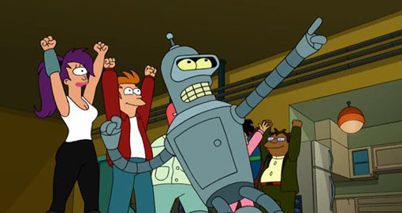
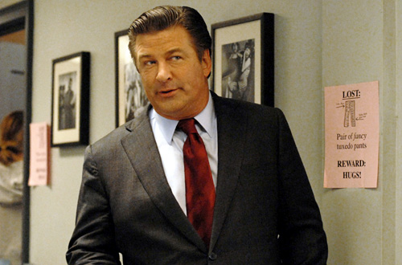

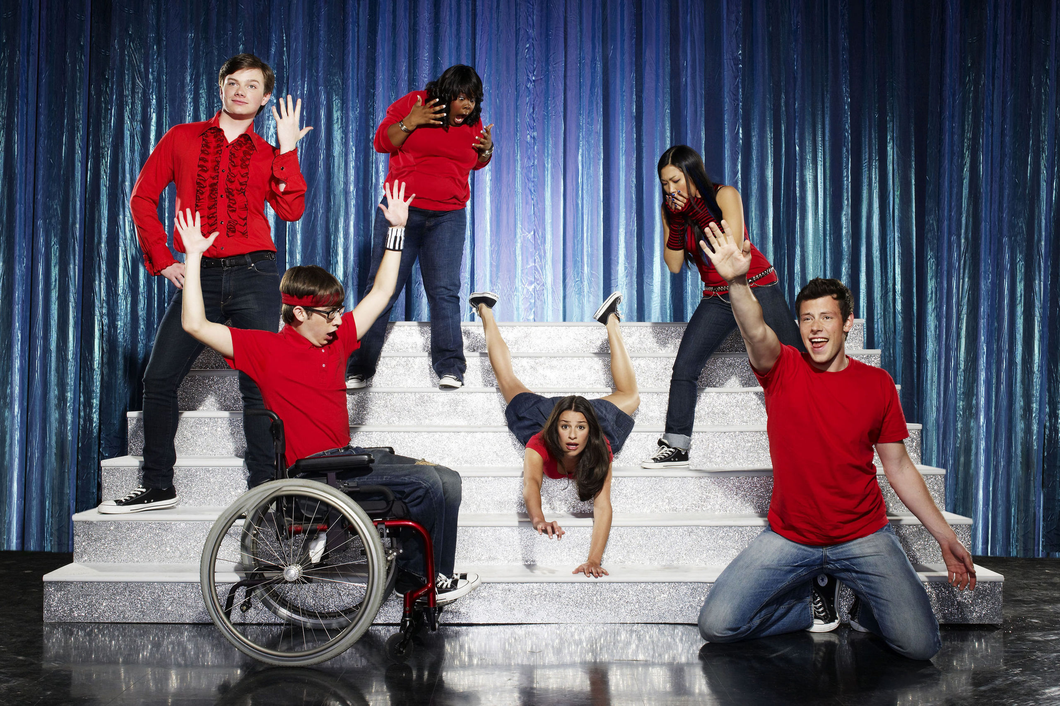

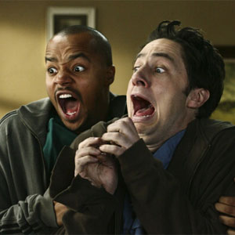
HOME
Recommendations
Futurama
30 Rock
Kindergarden Cop
Glee
The Ring
Scrubs
Browse All Shows
Highlight: Move your arm and the highlighted show/movie will change

Slide 4
HOME
Recommendations
Futurama
30 Rock
Kindergarden Cop
Glee
The Ring
Scrubs
Browse All
Select: Pull Hand towards chest to select

Slide 5
HOME
Recommendations
Futurama
30 Rock
Kindergarden Cop
Glee
The Ring
Scrubs
Browse All
Test 1: Select Glee from the recommendations

Slide 6
Test 2: Go back to Home

Slide 7
HOME
Recommendations
Futurama
30 Rock
Kindergarden Cop
Glee
The Ring
Scrubs
Browse All
Test 3: Go to the Browse All area

Slide 8
Comedy
Sci-Fi
Sports
How I Met Your Mother
Firefly
49ers vs Buccaneers
30 Rock
Mega Shark vs Giant Octopus
NHL Hockey
Futurama
Stargate SG-1
Bulls vs Celtics
Test 4: Use the interface to watch Star Trek

Slide 9
Comedy
Sci-Fi
Sports
Its Always Sunny
Stargate Atlantis
Stanford vs Cal
Seinfield
Hercules
Womens Soccer
Scrubs
Star Trek
NWBA
Test 4: Use the interface to watch Star Trek

Slide 10
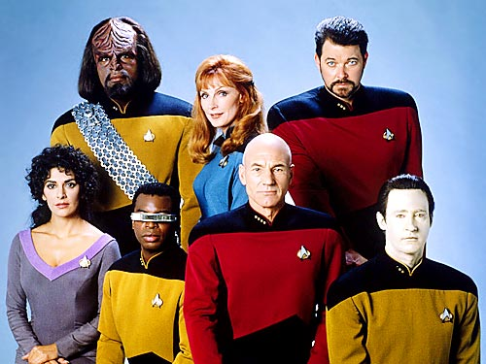

Slide 11
Test 5: Go to the Browse All area

Slide 12
HOME
Recommendations
Futurama
30 Rock
Kindergarden Cop
Glee
The Ring
Scrubs
Browse All Shows
Test 5: Go to the Browse All area

Slide 13
Comedy
Sci-Fi
Sports
How I Met Your Mother
Firefly
49ers vs Buccaneers
30 Rock
Mega Shark vs Giant Octopus
NHL Hockey
Futurama
Stargate SG-1
Bulls vs Celtics
Test 6: Find and watch the movie The Ring

Slide 14
Horror
Reality
Action
Ester
Survivor
Kindergarden Cop
The Ring
The Real World
Die Hard
Drag Me to Hell
Jersey Shore
Lethal Weapon
Test 6: Find and watch the movie The Ring

Slide 16
Test 7: Go To Home

Slide 17
HOME
Recommendations
Futurama
30 Rock
Kindergarden Cop
Glee
The Ring
Scrubs
Browse All Shows
Highlight: Move your arm and the highlighted show/movie will change

