Slide 1
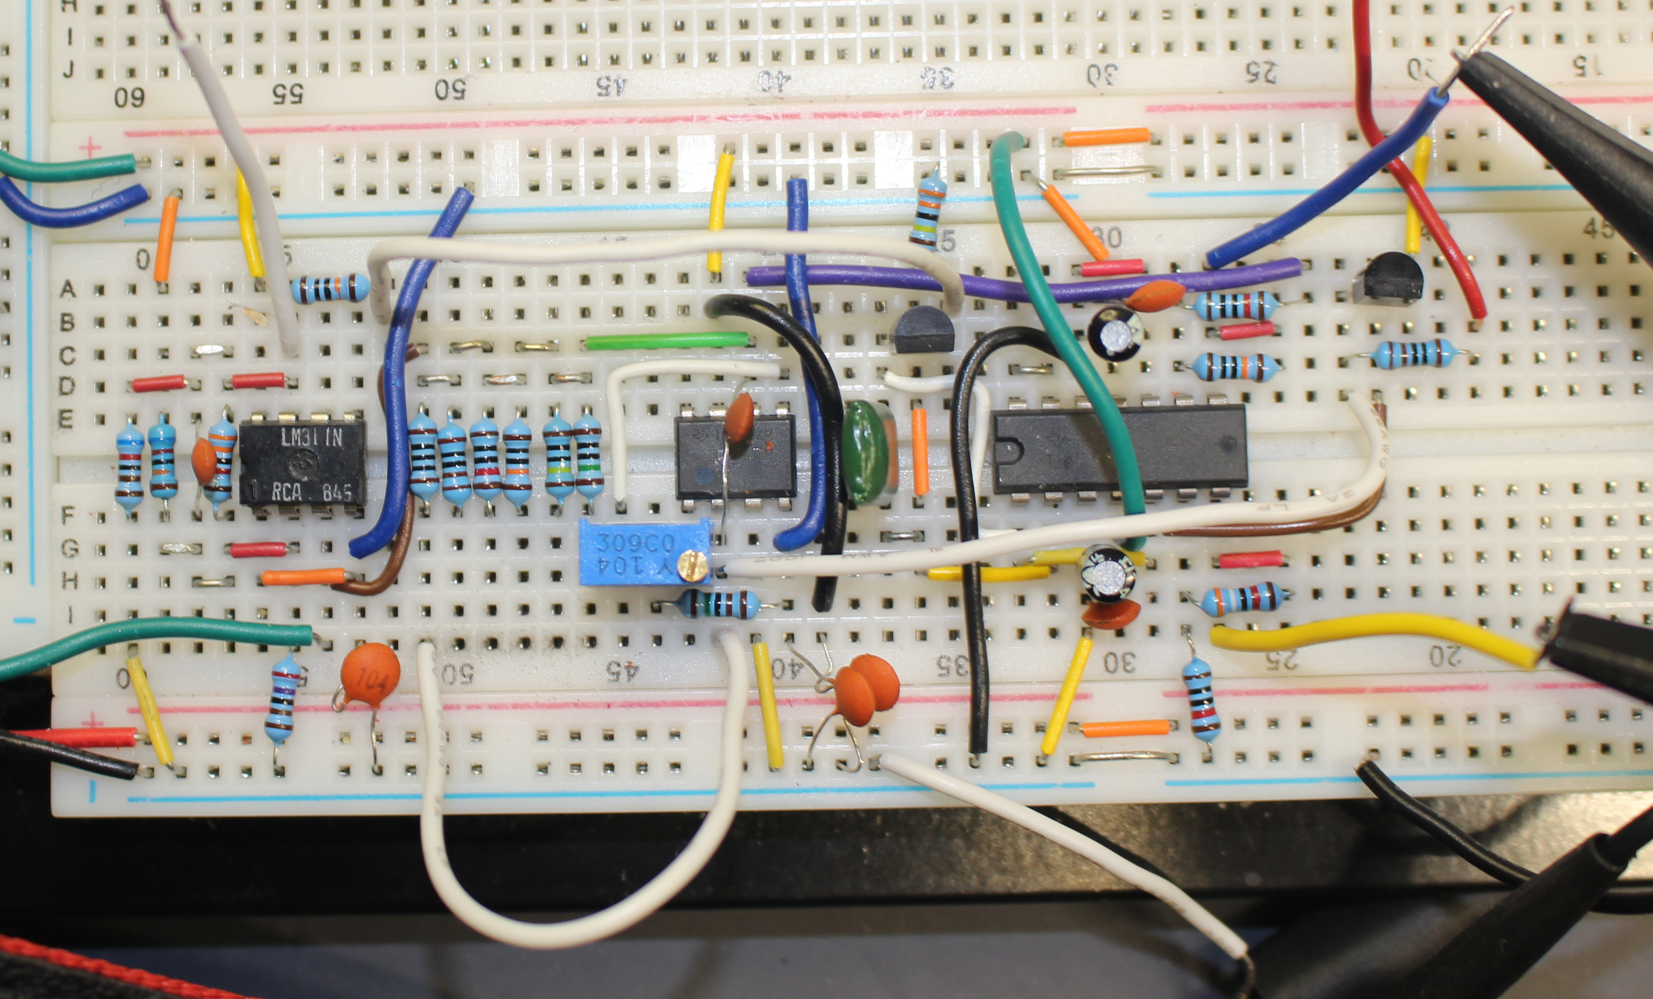

Breadboard layout
Device under test
Current sense -
to oscilloscope
Current sensing resistor R4
Capacitor added to
suppress oscillation
C1
Q1
+12V
+12V
{
U3
U2
U1
+5V
(Unused)
Ground
Voltage sense -
to oscilloscope
Jumper to select current range
Offset null potentiometer RV1

