Slide 1
Setting up MySQL on the remote server
Modified: 9/15/2023

Slide 2
SSH into your VM
The host name for your VM is coms-3090-xxx.class.las.iastate.edu
Steps:
Connect to VPN (Cisco Anyconnect to vpn.iastate.edu)
Open a terminal/command line on your computer
ssh your-netid@coms-3090-xxx.class.las.iastate.edu
Fingerprint prompt - Yes
Use the same password for your net-id

Slide 3
Accessing MySQL on VMs
MySQL (MariaDB) is already installed on the VMs. There is a README.txt file in your home directory. Use cat README.txt to read the file. ACTUALLY READ THE FILE!!
You will find the following command in the README file:
sudo /usr/local/bin/isu_mariadb_initialize
Run above command on your VM to initialize the database (only one person on the team do it)
The password for the root user of the database will be written into the README.txt file
Use mysql -u root -p on your VM to log into the database as root (enter password saved to the README.txt file)

Slide 4
Create a new user on the database
Once you enter the MariaDB command line interface, use the following command to create a new database user
MariaDB [(none)]> CREATE USER 'username'@'%' IDENTIFIED BY 'password';
The “;” is very important^^^
It should say “Query OK, 0 rows affected (0.005 sec)” if the user has been created successfully
Grant all privileges to the user you created:
MariaDB [(none)]> GRANT ALL PRIVILEGES ON *.* TO 'username'@'%' IDENTIFIED BY 'password';
To exit the MariaDB CLI: MariaDB [(none)]> exit

Slide 5
Enable firewall on VM
MySQL (MariaDB) uses port 3306 by default, to allow access to this port on the VM, do the following in the VM bash (NOT MariaDB’s CLI):
sudo bash
firewall-cmd --add-port=3306/tcp
firewall-cmd --permanent --add-port=3306/tcp
sudo service mysqld start

Slide 6
Connect DB from MySQL Workbench
MySQL Workbench is a GUI client for MySQL databases
Download MySQL Workbench at https://dev.mysql.com/downloads/workbench/
After downloading & installing it, use the following parameters to connect to your remote database (next slide)

Slide 7
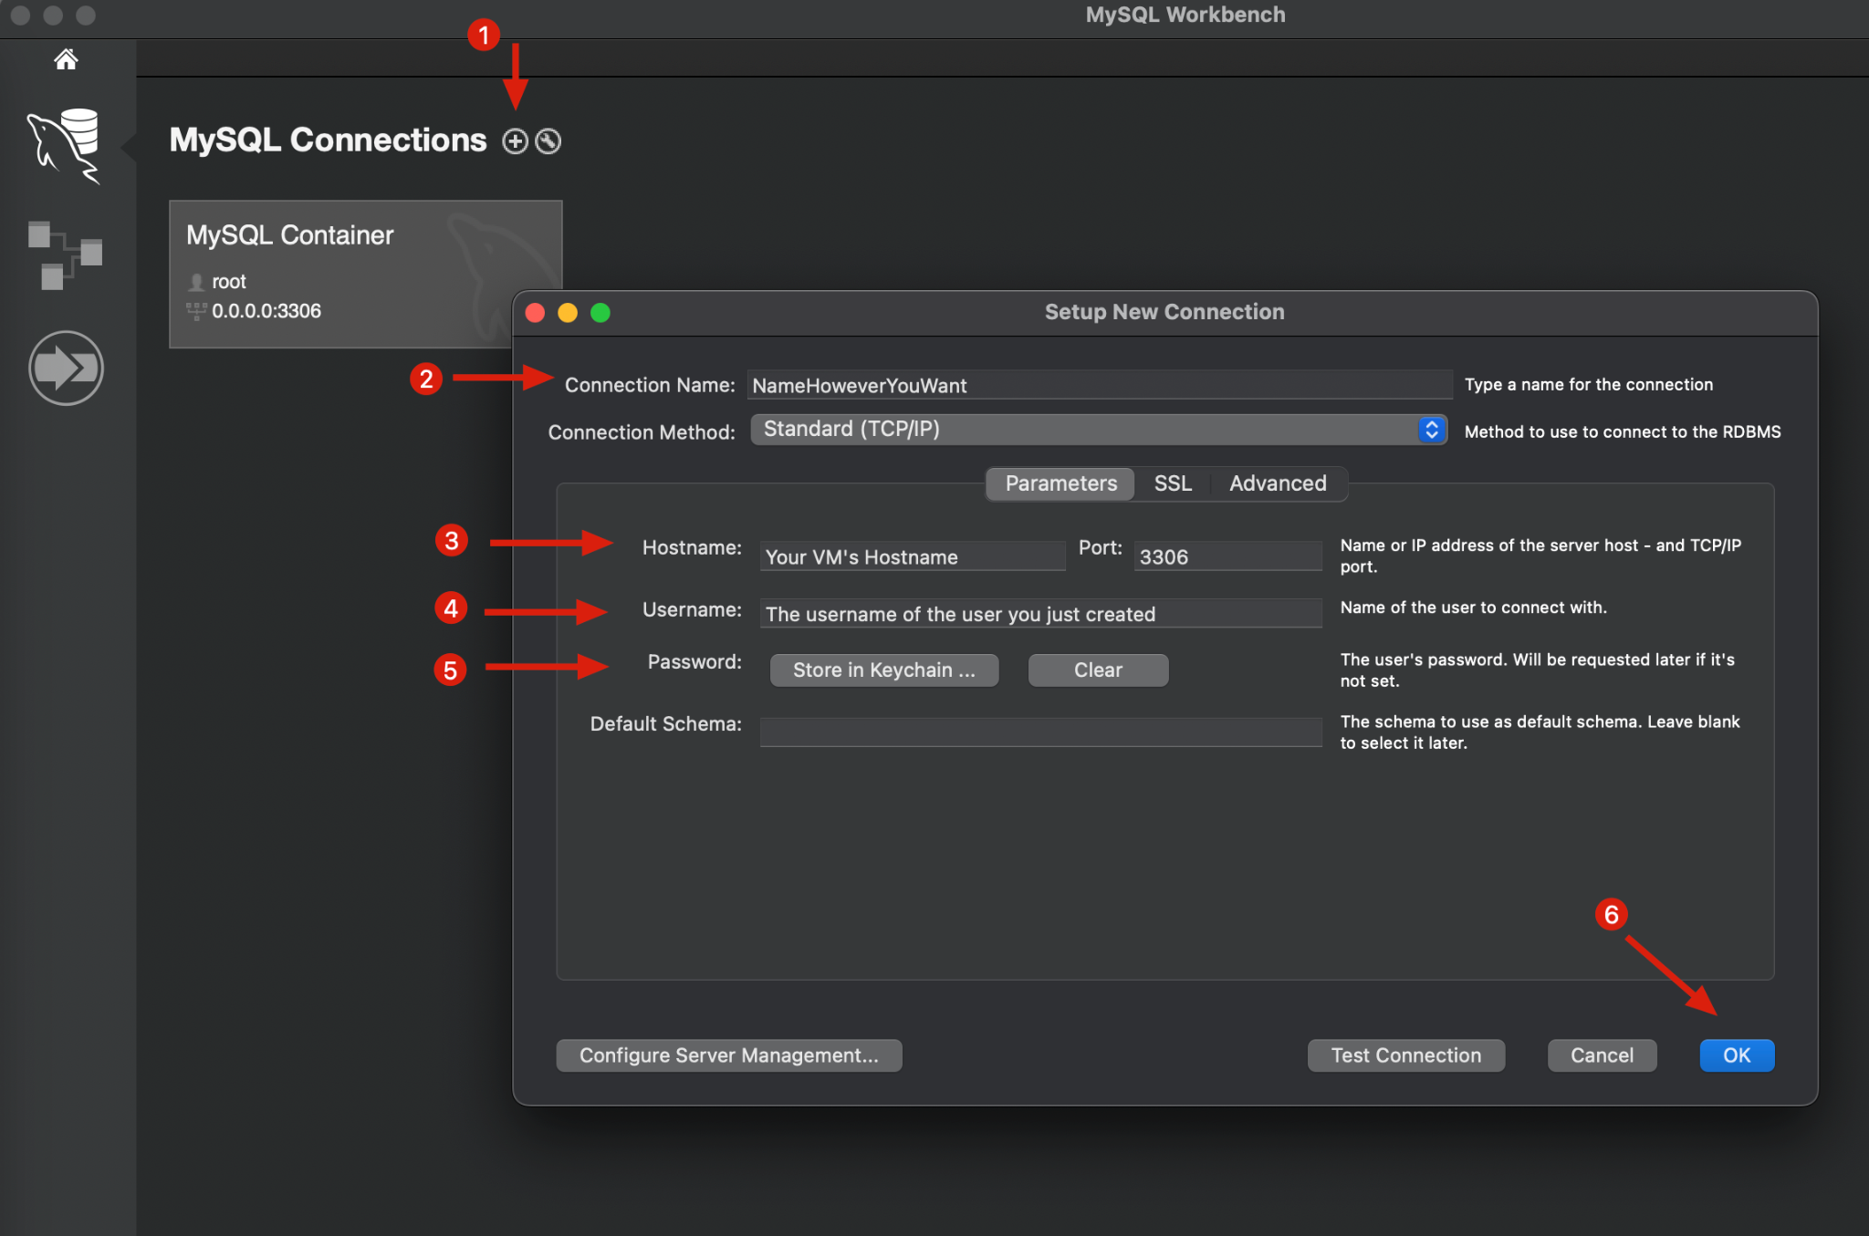
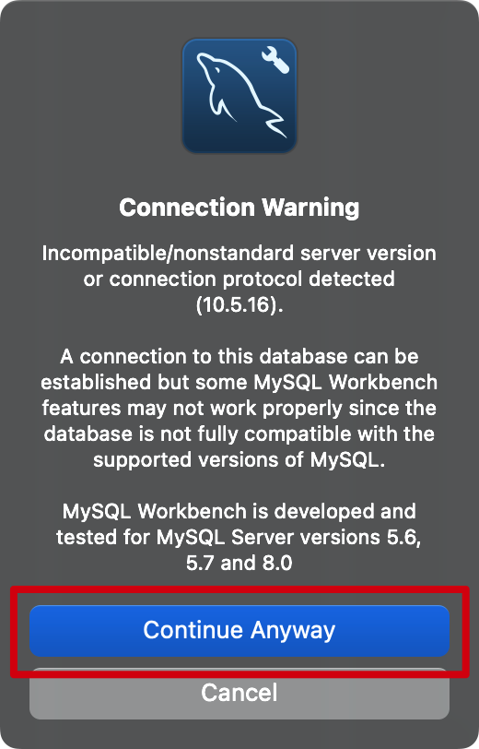
Connect DB from MySQL Workbench

Slide 8
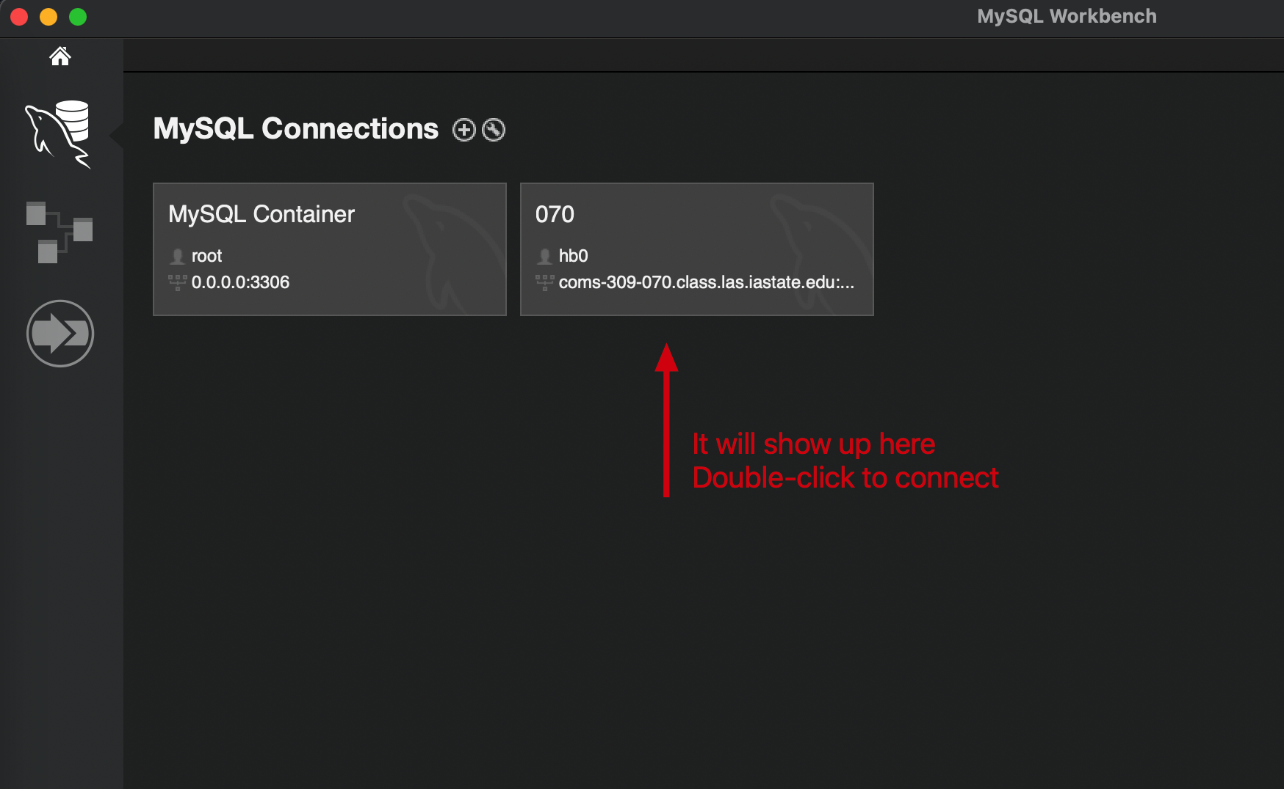
Connect DB from MySQL Workbench

Slide 9
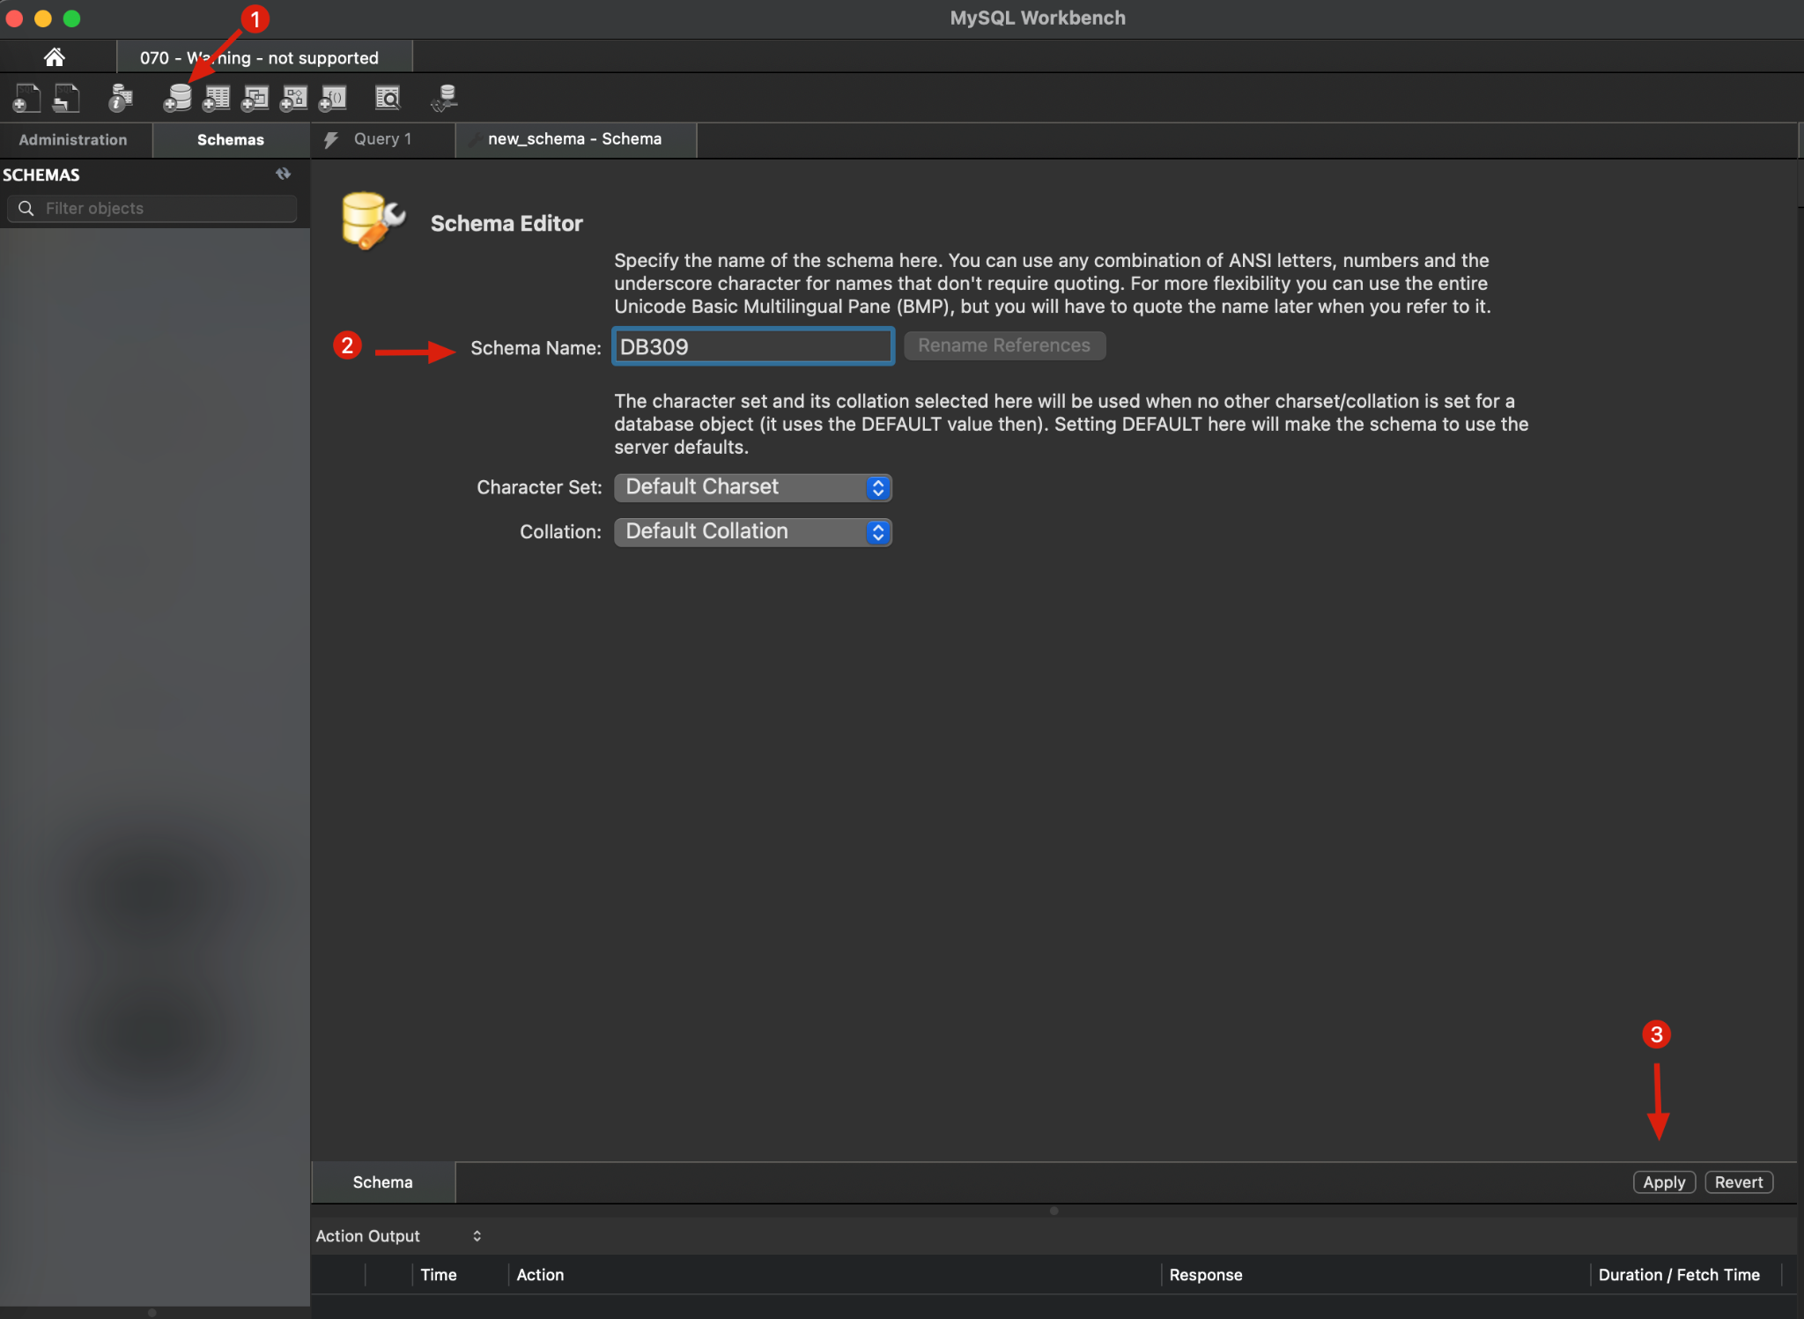
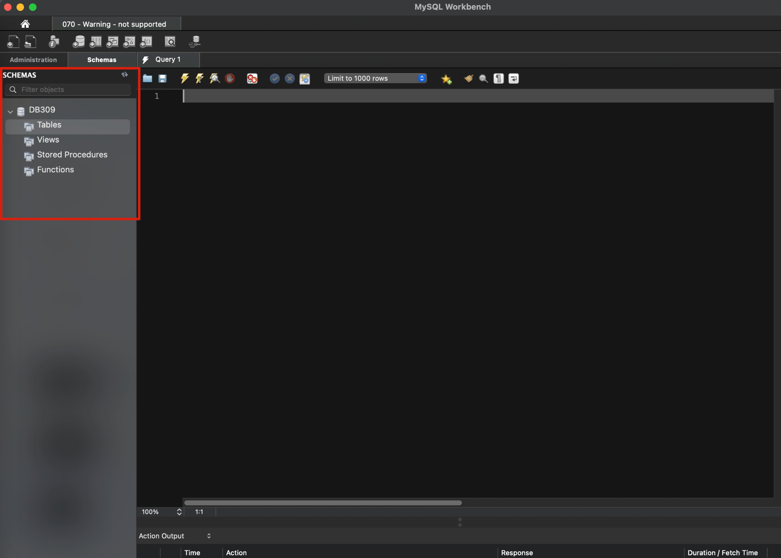
Create a new Database (schema)
No need to manually create tables for now, Hibernate JPA will automatically map your Entities as Tables after you connect your Springboot App with the database.

Slide 10
MySQL Workbench: Could not fetch tables
SSH into your server
$sudo mysql_upgrade -u root -p

Slide 11
References
https://mariadb.com/kb/en/configuring-mariadb-for-remote-client-access/

