Slide 1
Connect SB to MySQL
Modified: 10/5/2023

Slide 2
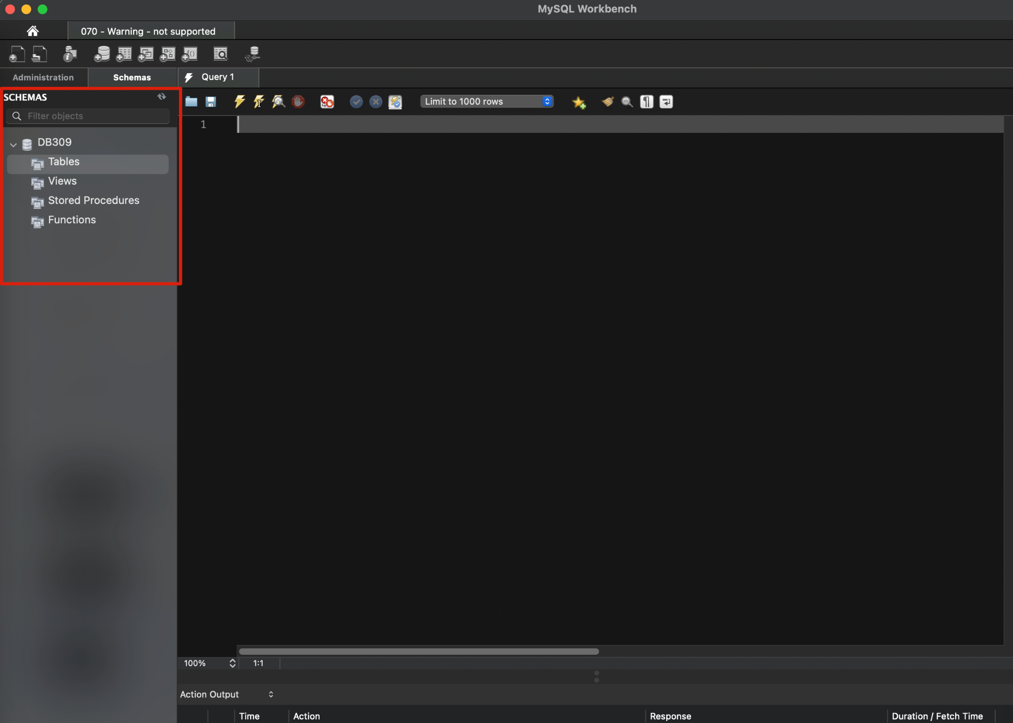
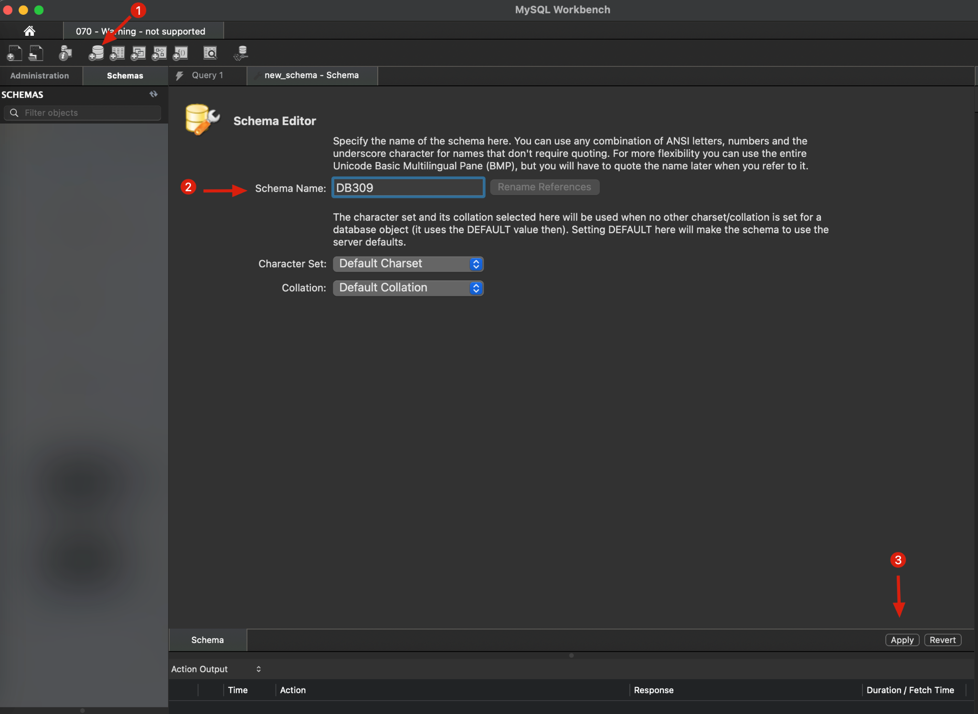
Make a schema in MySQL
No need to manually create tables for now, Hibernate JPA will automatically map your Entities as Tables after you connect your Springboot App with the database.

Slide 3
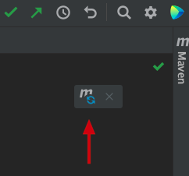
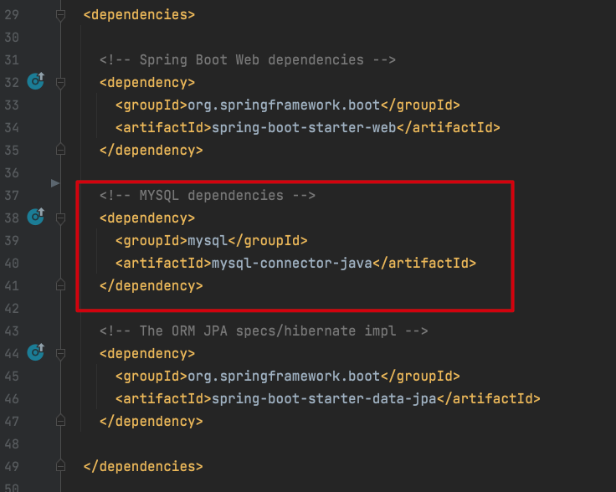
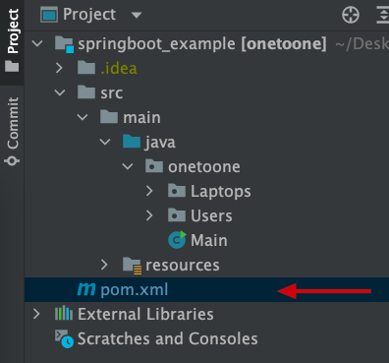
Modify pom.xml
3
Open Pom.xml in your Springboot application
Add MySQL Connector dependency
Load Maven Changes
2
1

Slide 4
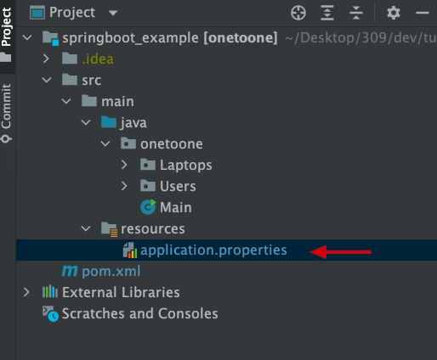
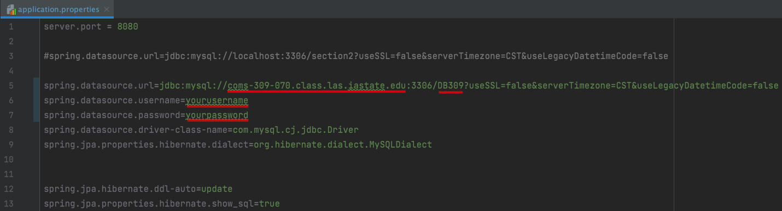
Modify application.properties
Open application.properties in your Springboot application
Modify the content to connect to your remote MySQL DB
Save the changes and run the application
Example:
1
2
3
Change to your server’s hostname
Change to the schema you created in your MySQL database
Change the username & password to the user you created

Slide 5
Complete Code Example
https://git.las.iastate.edu/cs309/tutorials/-/tree/springboot_unit2_1_onetoone_mysql

