Slide 1
How to deploy jar file to the server
Modified: 9/15/2023

Slide 2
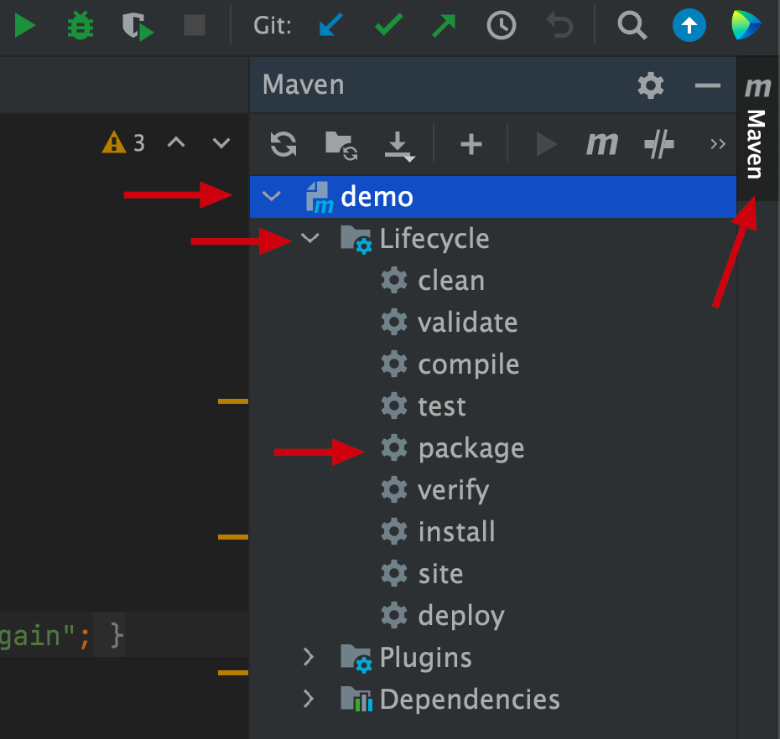
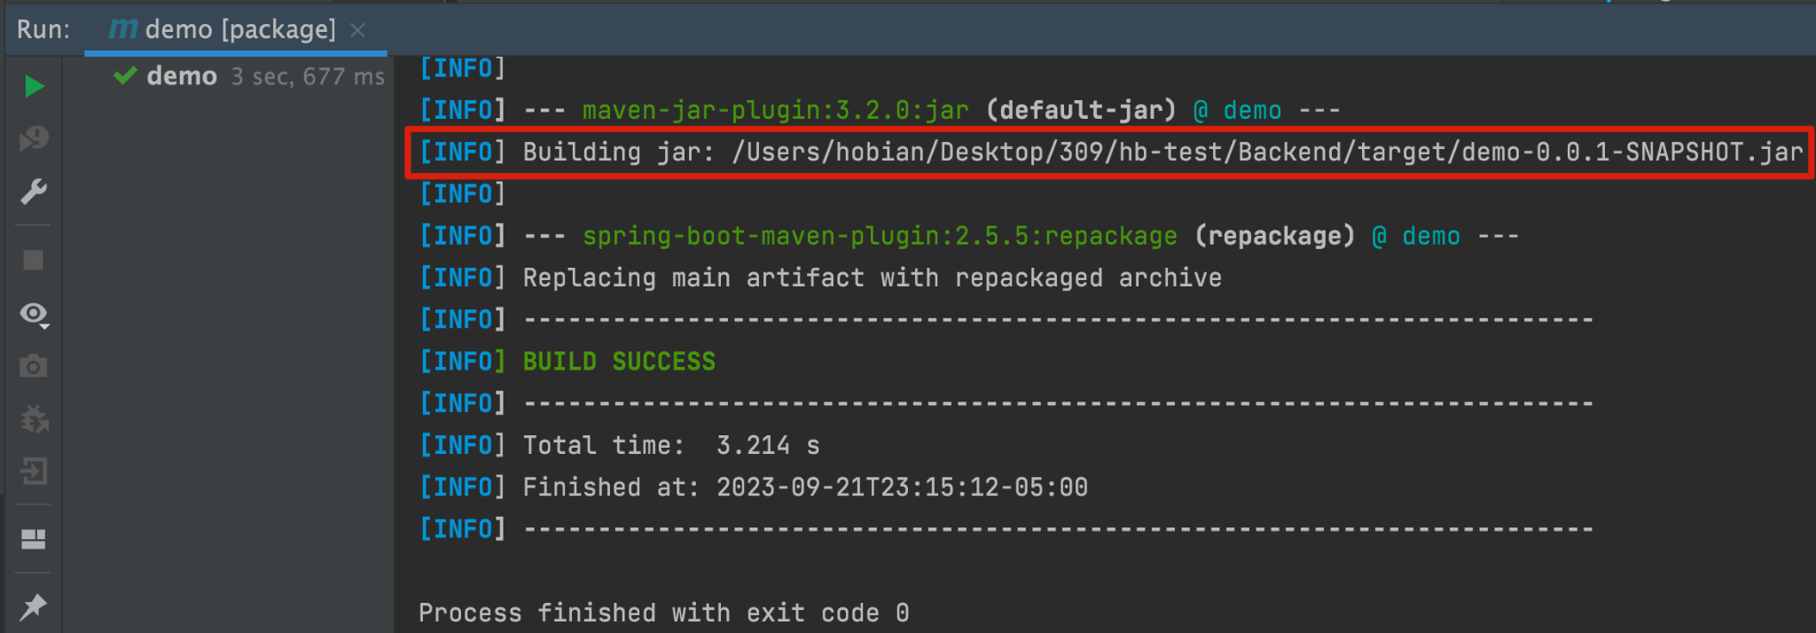
Generate jar file from IntelliJ
Make sure your app runs within IntelliJ locally. Then stop running it (green arrow button & red square button)
On the right side of IntelliJ, click on maven -> expand your project -> life cycle -> double click 'package'
Maven will build the jar; look for where it stores it in the outputs

Slide 3
Copy jar file to the server
Make sure your application is working in your local and able to connect to remote mysql database.
Two ways of copying:
Use FileZilla to copy your jar file into the VM.
Use secure copy scp command line tool

Slide 4
FileZilla
Download FileZilla: https://filezilla-project.org/download.php
Host: sftp://<server_address>
note: remove ‘<’ and ‘>’ in your actual url
Username: your netid
Password: your netid password
Port: leave it blank
Click “Quick Connect”

Slide 5
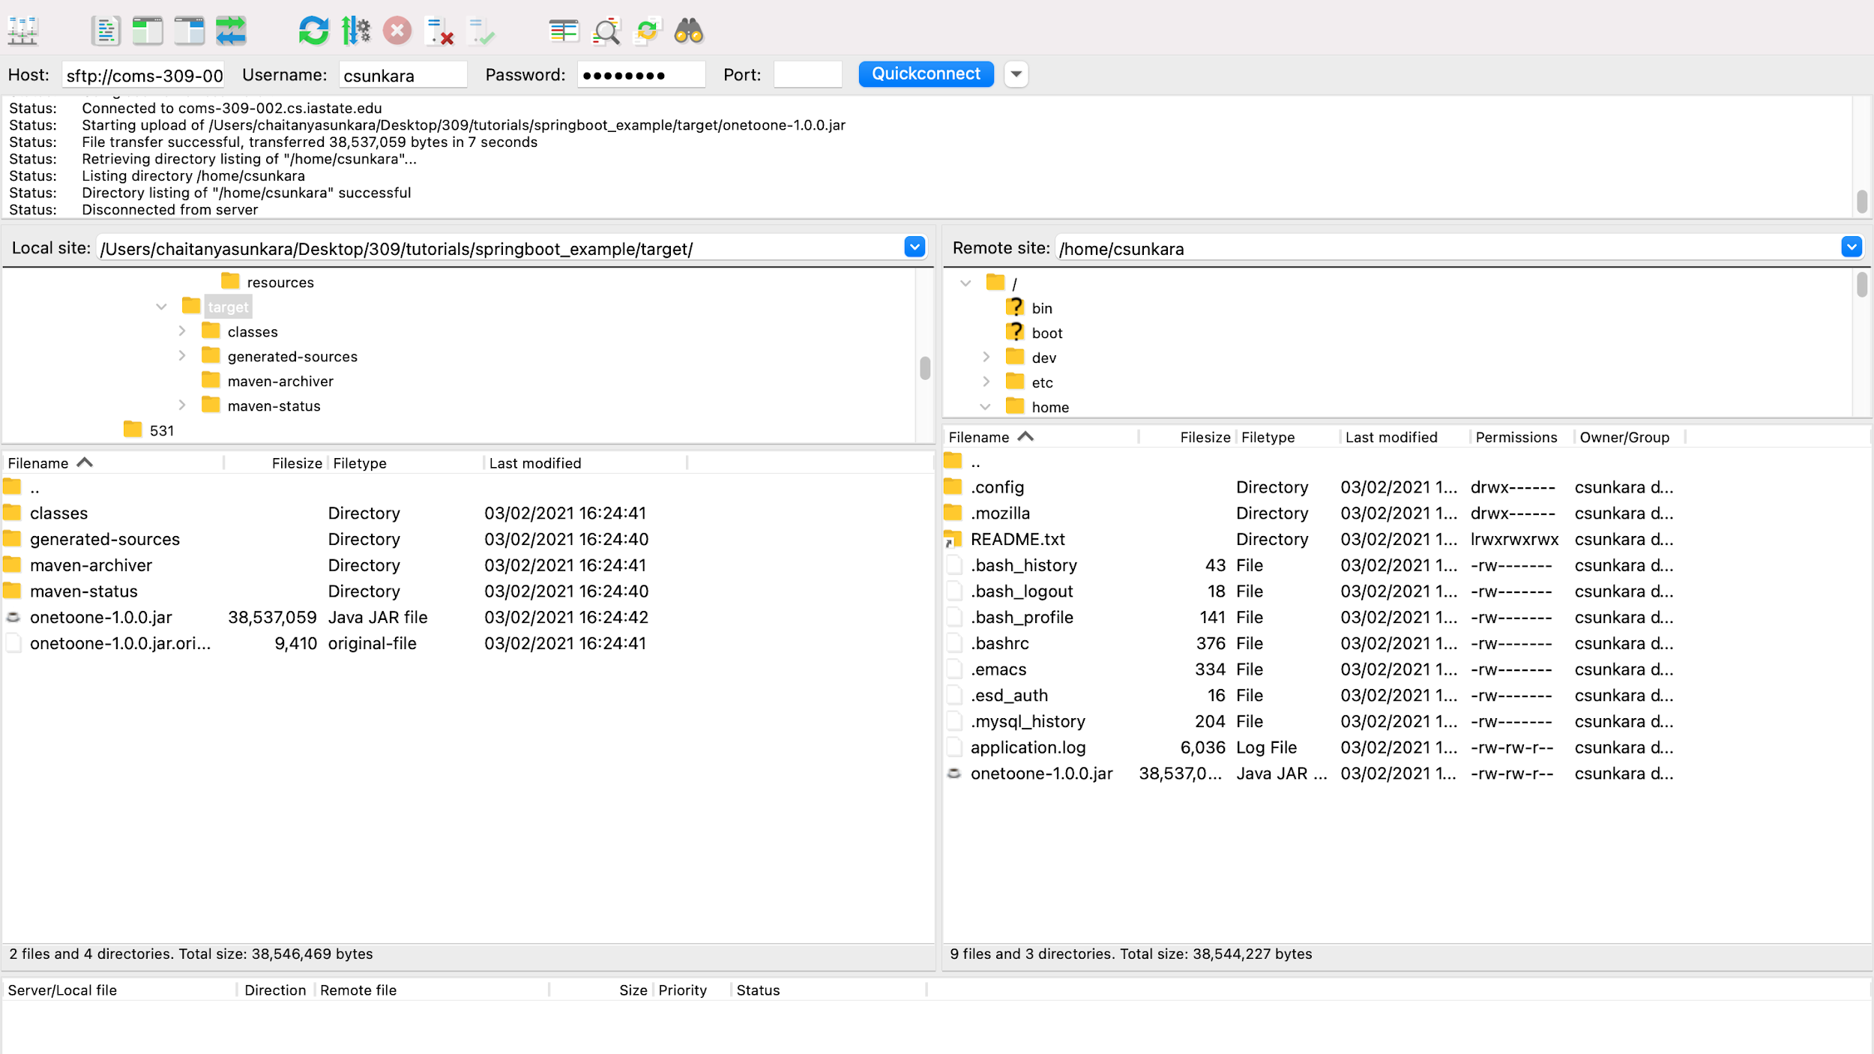
Note: you only have the privilege to upload to your home directory. In order to place the jar file outside your home directory, you will need to ssh into your server, type “sudo bash” to gain sudo privileges, then use ‘mv <move_from> <move_to>’ to move the jar file anywhere you want.

Slide 6
2. SCP
Open terminal/cmd/powershell on your local machine
Navigate to your jar file on local machine
Use the following command to upload your jar file:
scp <local_file> <username>@<remote_host>:<remote_file>
credentials: same as what you use for ‘ssh’ (netid+password)
note: remove ‘<’ and ‘>’ in your actual command
note: ‘remote_file’ will be the full path where you want to have your jar on the remote server’s filesystem
Example:
scp C:\Desktop\hellopeople\target\hellopeople-1.0.0.jar csunkara@coms-309-002.cs.iastate.edu:/tmp/

Slide 7
Run the jar
SSH into the server.
Find the jar file.
Use command “java –jar <filename>.jar” to run the application.
If it is successful, it will display a message ‘Tomcat started on port’.

Slide 8
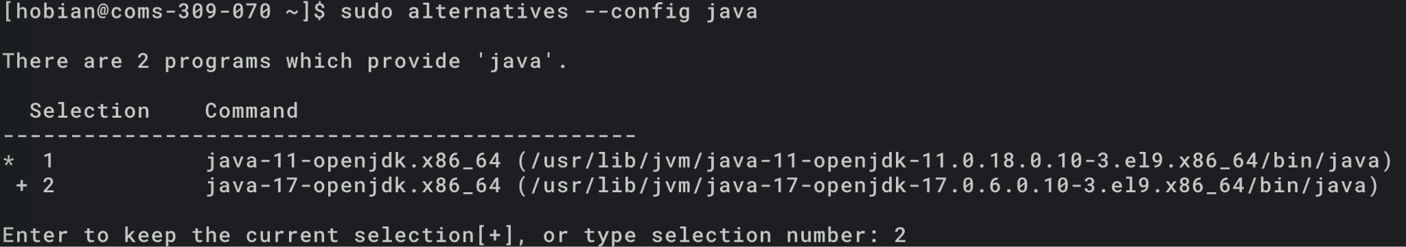
Switch to Java 17?
Use command on your server to switch between Java 11 and 17:
sudo alternatives --config java

Slide 9
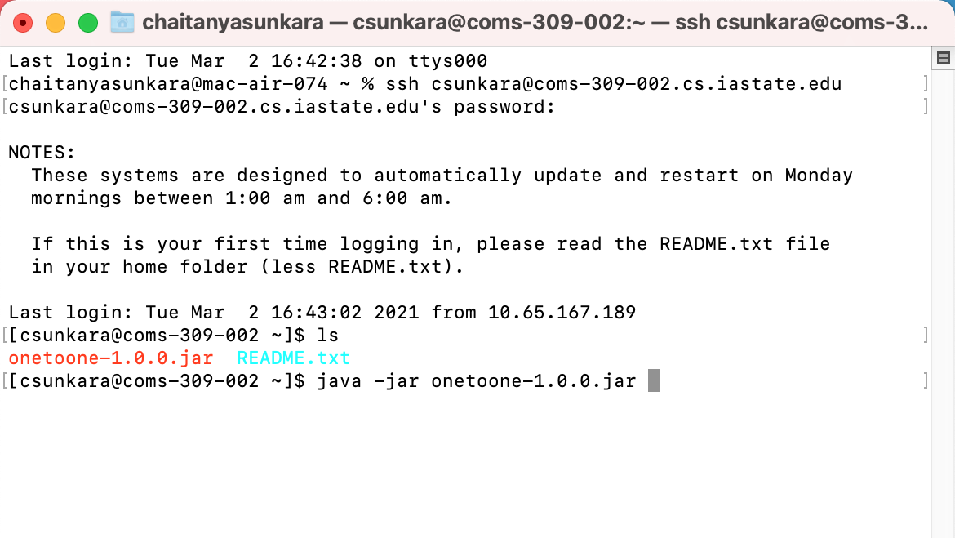

Slide 10
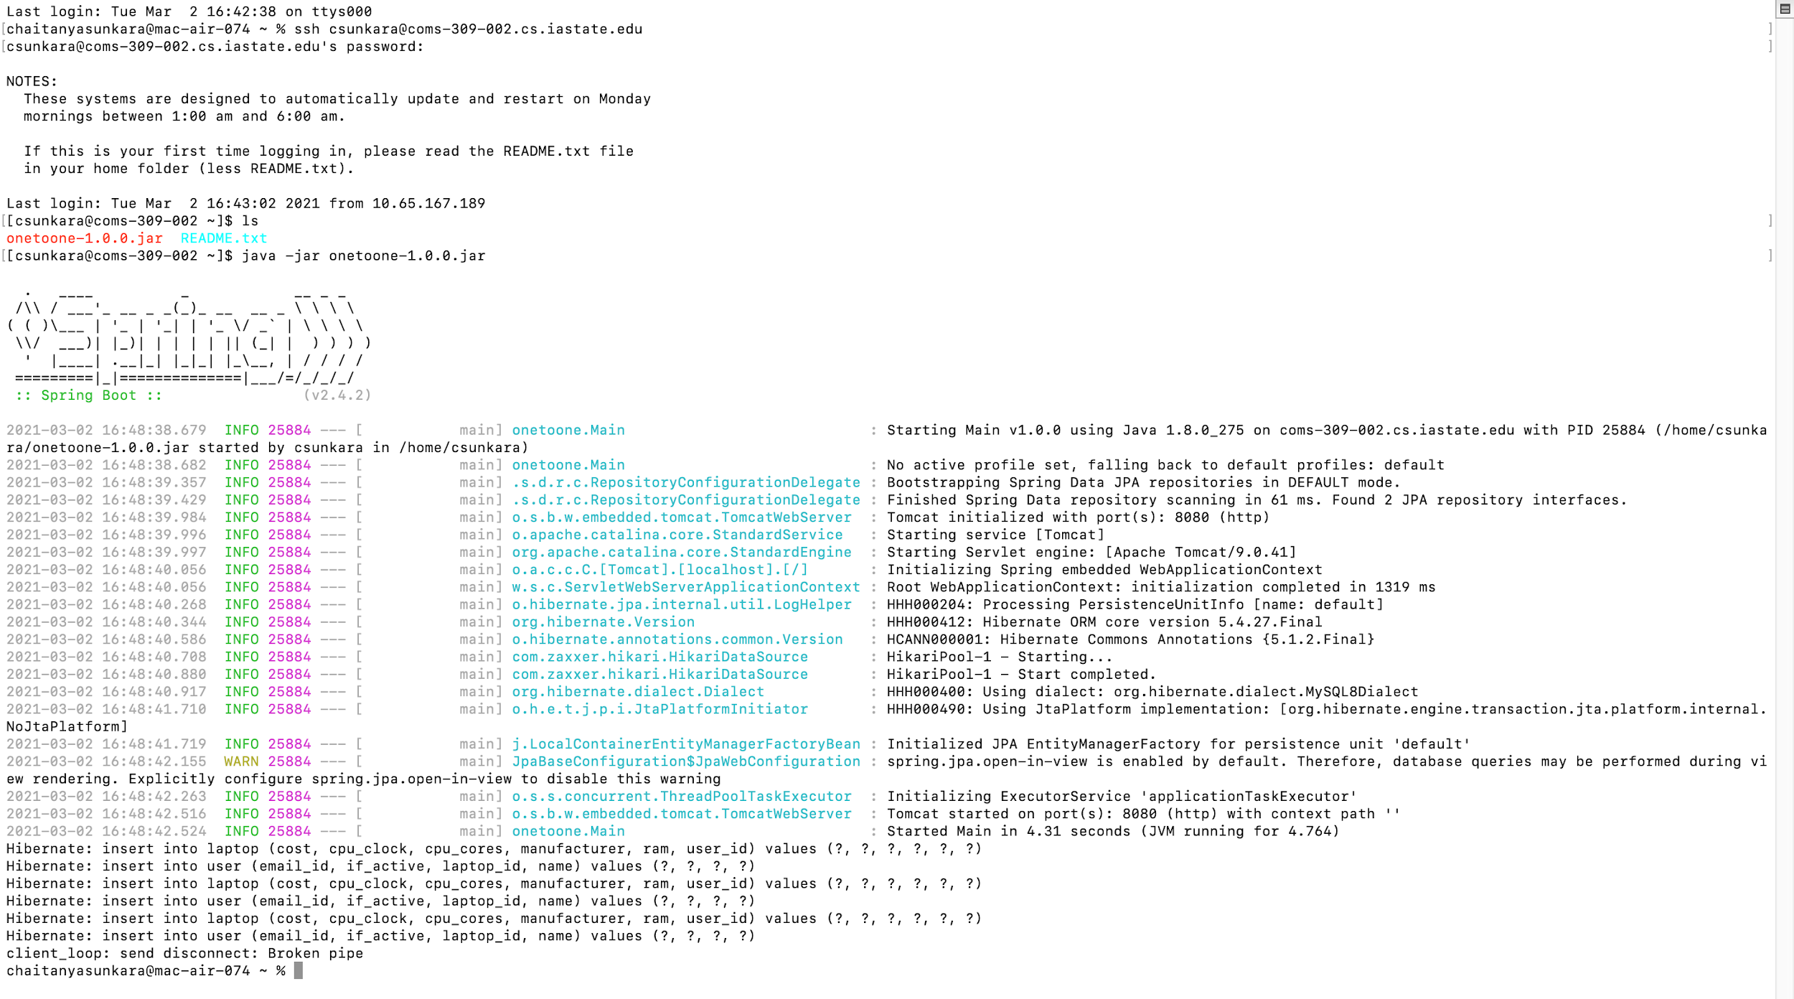

Slide 11
Verify it using postman
Open postman.
Send a GET request with the URL format
http://<server>:<port>/<path>
Example: http://coms-309-002.class.las.iastate.edu:8080/users
To kill the application use “Ctrl” + “c”.

Slide 12
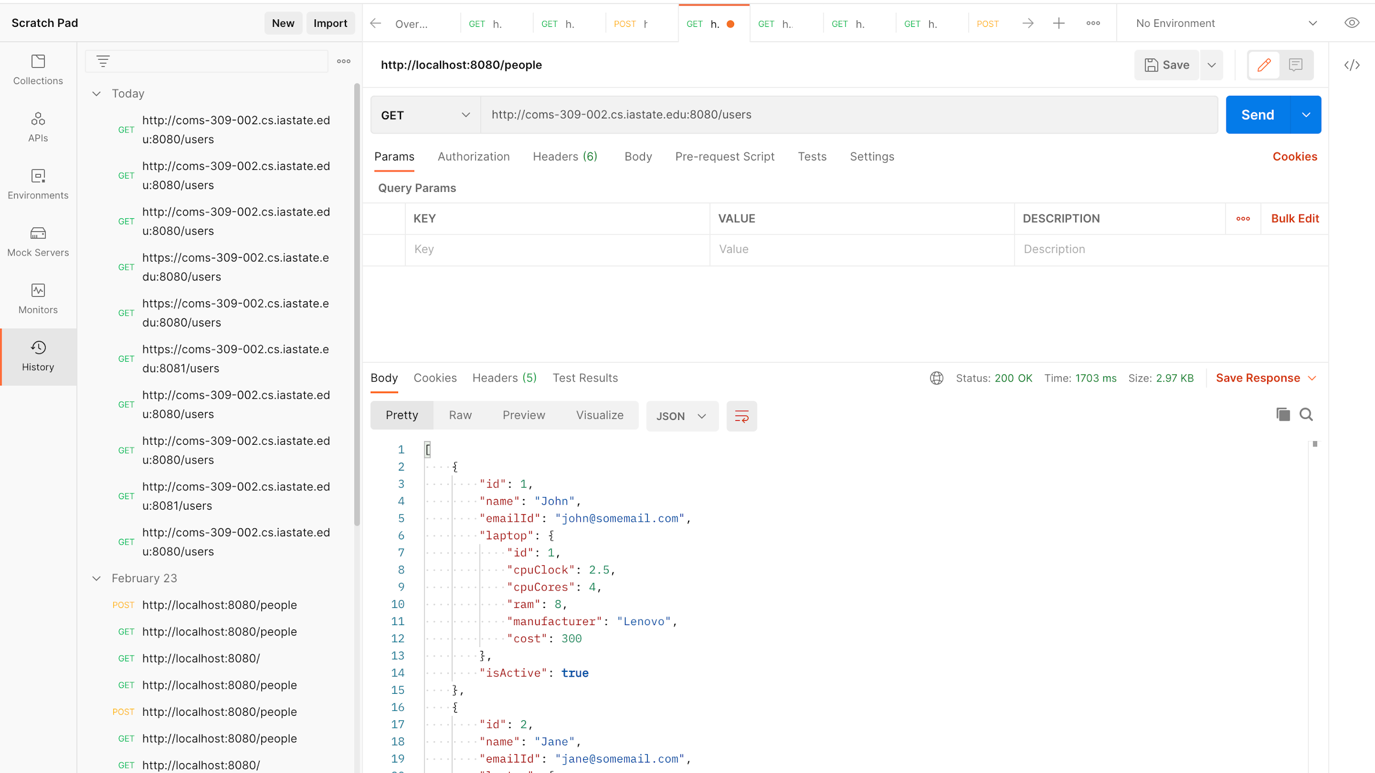
http://coms-309-002.class.las.iastate.edu:8080/users

Slide 13
Port 8080 already in use?
In case of error such as ‘port 8080 already in use’, you can use the following command to kill the process that is using the port
sudo fuser -k 8080/tcp

Slide 14
Continue execution when logged out?
ssh to your remote server.
Then, type screen <enter>
type java -jar target/<jar name> <enter>
type ctrl-a-d (keep ctrl pressed, type a and then d)
This will take you out to your command prompt - running screen in the background along with your jar file.
type exit <enter>
This will log you off your remote server

