Slide 1
#4
#17
#18
#27
#22
#23
#24
#25
CE0
#5
#6
#12
#13
#16
#19
#20
#21
SCL
TXD
CLK
CE1
SDA
RXD
MOSI
MISC
5.0v
3.3v
GND
C2
+
GND
+5
0
1
2
3
4
5
6
7
8
9
10
11
12
13
14
15
SIGNAL
PWR
GND

Slide 2
GPIO 9/
SCL
GPIO 7/ GPCLK0
GPIO 1
GPIO 13/ MISO
GPIO 11/ CE0
GPIO 22/
GPCLK2
GPIO 23/
PWM1
GPIO 24
GPIO 29/
PCM_DOUT
GPIO 15/
TXD
GPIO 0
GPIO 2
GPIO 4
GPIO 6
GPIO 10/ CE0
GPIO 21/
GPCLK1
GPIO 26/
PWM0
GPIO 27
GPIO 28/
PCM_DIN
GPIO 8/
SDA
GPIO 16/ RXD
GPIO 3
GPIO 5
GPIO 12/ MOSI
GPIO 14/ CLK
#4
#17
#18
#27
#22
#23
#24
#25
CE0
#5
#6
#12
#13
#16
#19
#20
#21
SCL
TXD
CLK
CE1
SDA
RXD
MOSI
MISO
5.0v
3.3v
GND
C2
+
GND
+5
0
1
2
3
4
5
6
7
8
9
10
11
12
13
14
15
SIGNAL
PWR
GND

Slide 3
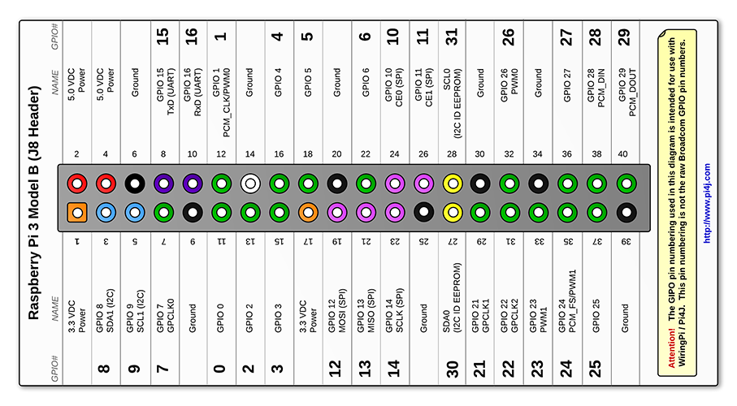
GPIO 9/
SCL
GPIO 7/ GPCLK0
GPIO 1
GPIO 13/ MISO
GPIO 11/ CE0
GPIO 22/
GPCLK2
GPIO 23/
PWM1
GPIO 24
GPIO 29/
PCM_DOUT
GPIO 15/
TXD
GPIO 0
GPIO 2
GPIO 4
GPIO 6
GPIO 10/ CE0
GPIO 21/
GPCLK1
GPIO 26/
PWM0
GPIO 27
GPIO 28/
PCM_DIN
GPIO 8/
SDA
GPIO 16/ RXD
GPIO 3
GPIO 5
GPIO 12/ MOSI
GPIO 14/ CLK
#4
#17
#18
#27
#22
#23
#24
#25
CE0
#5
#6
#12
#13
#16
#19
#20
#21
SCL
TXD
CLK
CE1
SDA
RXD
MOSI
MISO
5.0v
3.3v
GND
C2
+
GND
+5
0
1
2
3
4
5
6
7
8
9
10
11
12
13
14
15
SIGNAL
PWR
GND

Slide 4
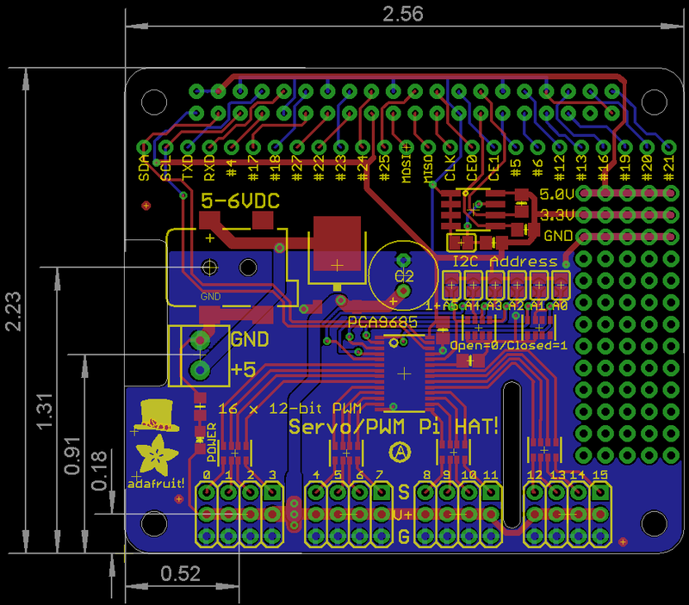

Slide 5
#4
#17
#18
#27
#22
#23
#24
#25
CE0
#5
#6
#12
#13
#16
#19
#20
#21
SCL
TXD
CLK
CE1
SDA
RXD
MOSI
MISC
5.0v
3.3v
GND
C2
+
GND
+5
0
1
2
3
4
5
6
7
8
9
10
11
12
13
14
15
SIGNAL
PWR
LED Connection Example
GND

Slide 6
#4
#17
#18
#27
#22
#23
#24
#25
CE0
#5
#6
#12
#13
#16
#19
#20
#21
SCL
TXD
CLK
CE1
SDA
RXD
MOSI
MISC
5.0v
3.3v
GND
C2
+
GND
+5
0
1
2
3
4
5
6
7
8
9
10
11
12
13
14
15
Motor Connection Example
SIGNAL
PWR
GND

Slide 7
#4
#17
#18
#27
#22
#23
#24
#25
CE0
#5
#6
#12
#13
#16
#19
#20
#21
SCL
TXD
CLK
CE1
SDA
RXD
MOSI
MISC
5.0v
3.3v
GND
C2
+
GND
+5
0
1
2
3
4
5
6
7
8
9
10
11
12
13
14
15
SIGNAL
PWR
GND

