Slide 1


PREDICTING ENROLLMENT
in Iowa Public School Districts
by Kenny Lam | DATASCI 112 Final Project

Slide 2
BACKGROUND
School districts in Iowa receive funding every year based on their enrollment figures
If districts are able to predict whether their enrollment will increase/decrease the following year, they can predict whether they will gain/lose funding
Proposal: yearly changes in enrollment are somewhat predictable based on a # of variables in a district’s current year & from past trends
Iowa Department of Education produces their own enrollment projections for future years (based on county birth rates)
Specifically focusing on district enrollment change from 2021-22 SY to 2022-23 SY
Larger data set would be ideal

Slide 3

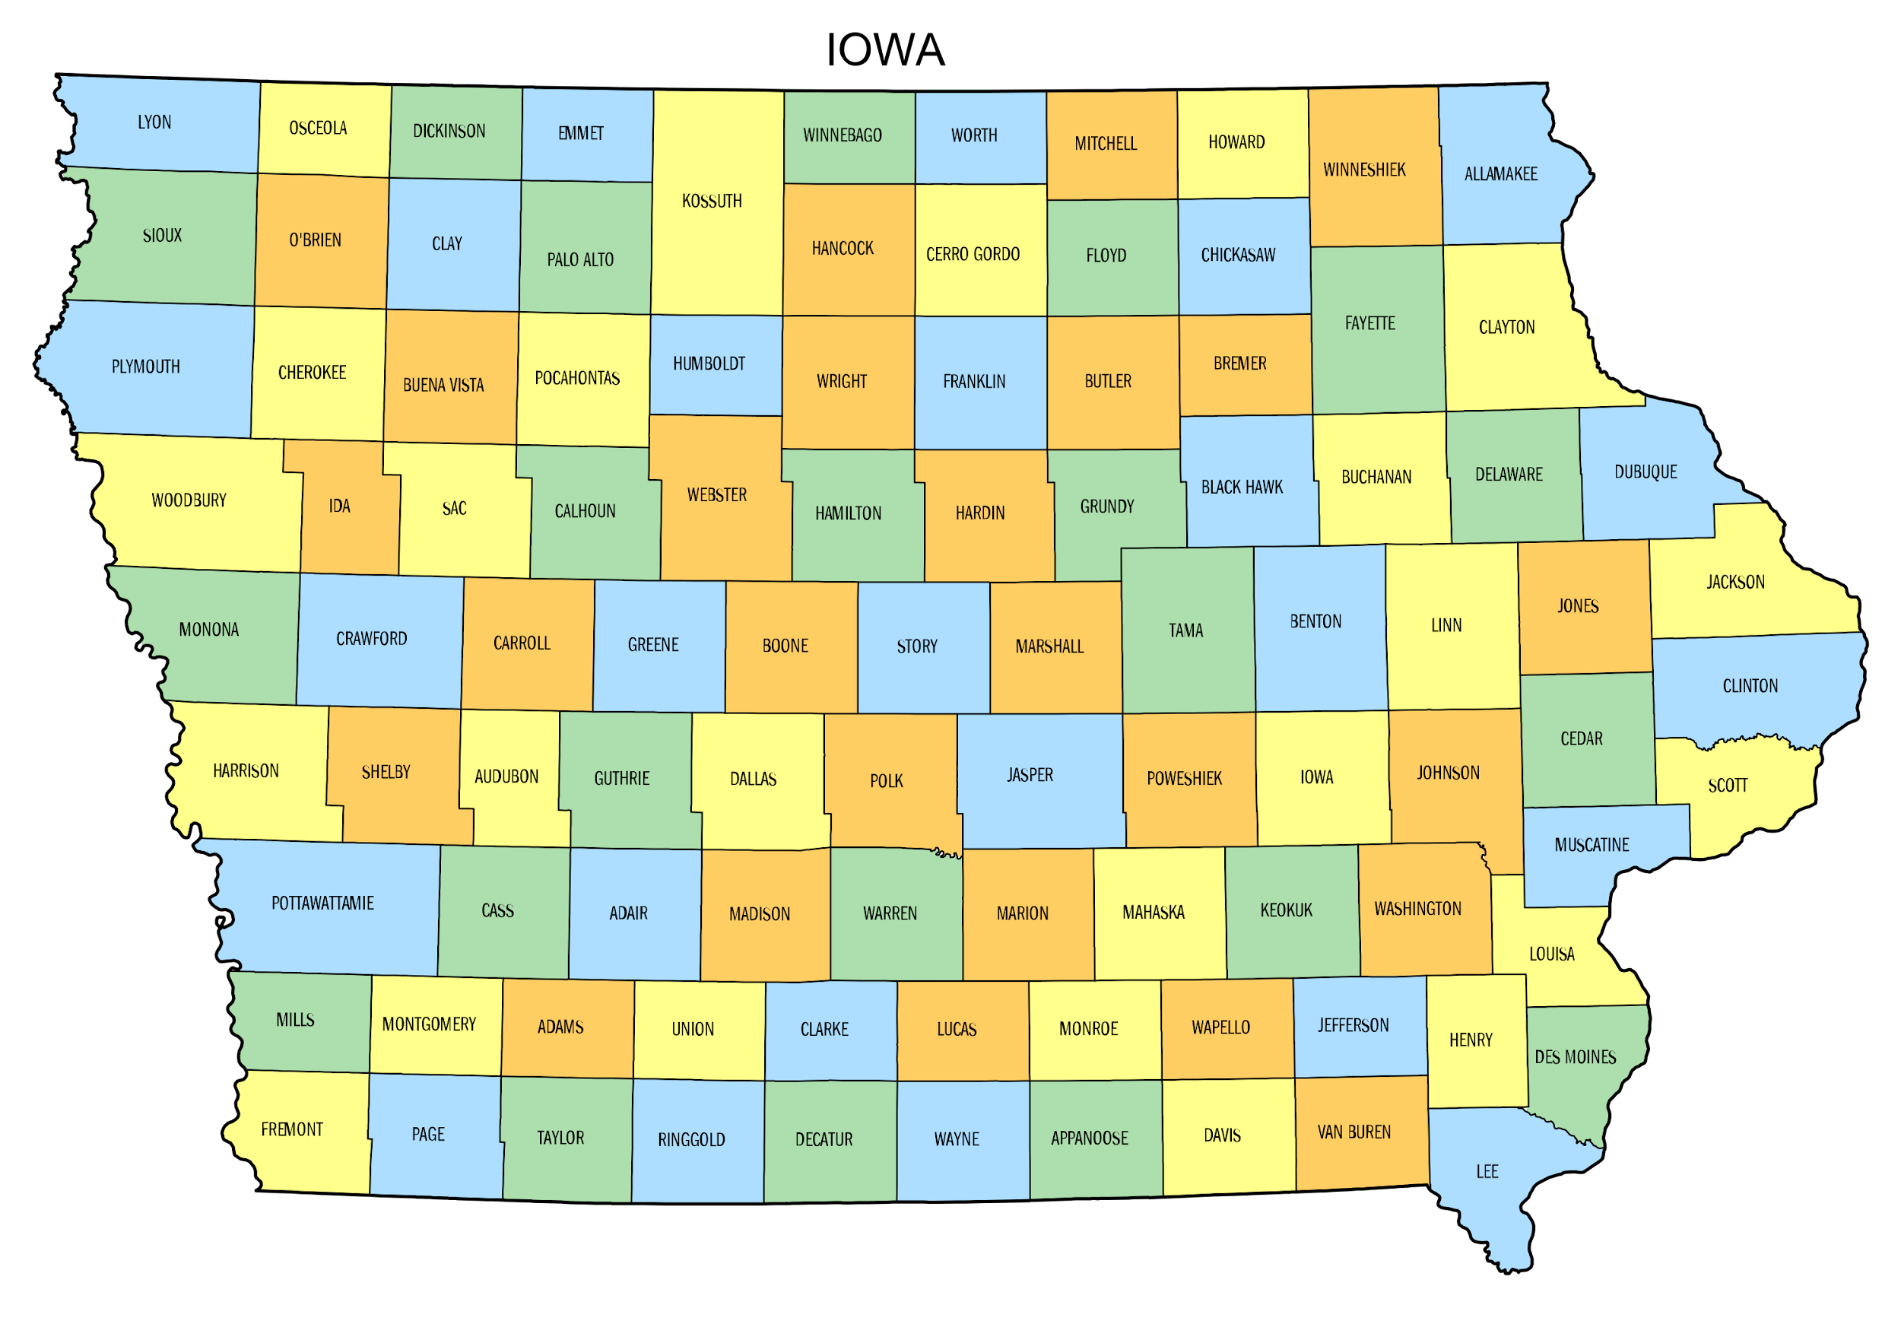
DATA COLLECTION
District metrics
Average daily attendance (ADA)
Math & ELA proficiency rates
Iowa School Performance Profile (ISPP) index ratings
Percent of students w/ for free or reduced price lunch (FRPL)
Percent of students w/ individualized education programs (IEP)
Percent of students identified as English learners (EL)
Racial demographics
Broader metrics
Previous year & 2-year enrollment changes
Previous year & 2-year county population changes
Geographic location / classification

Slide 4
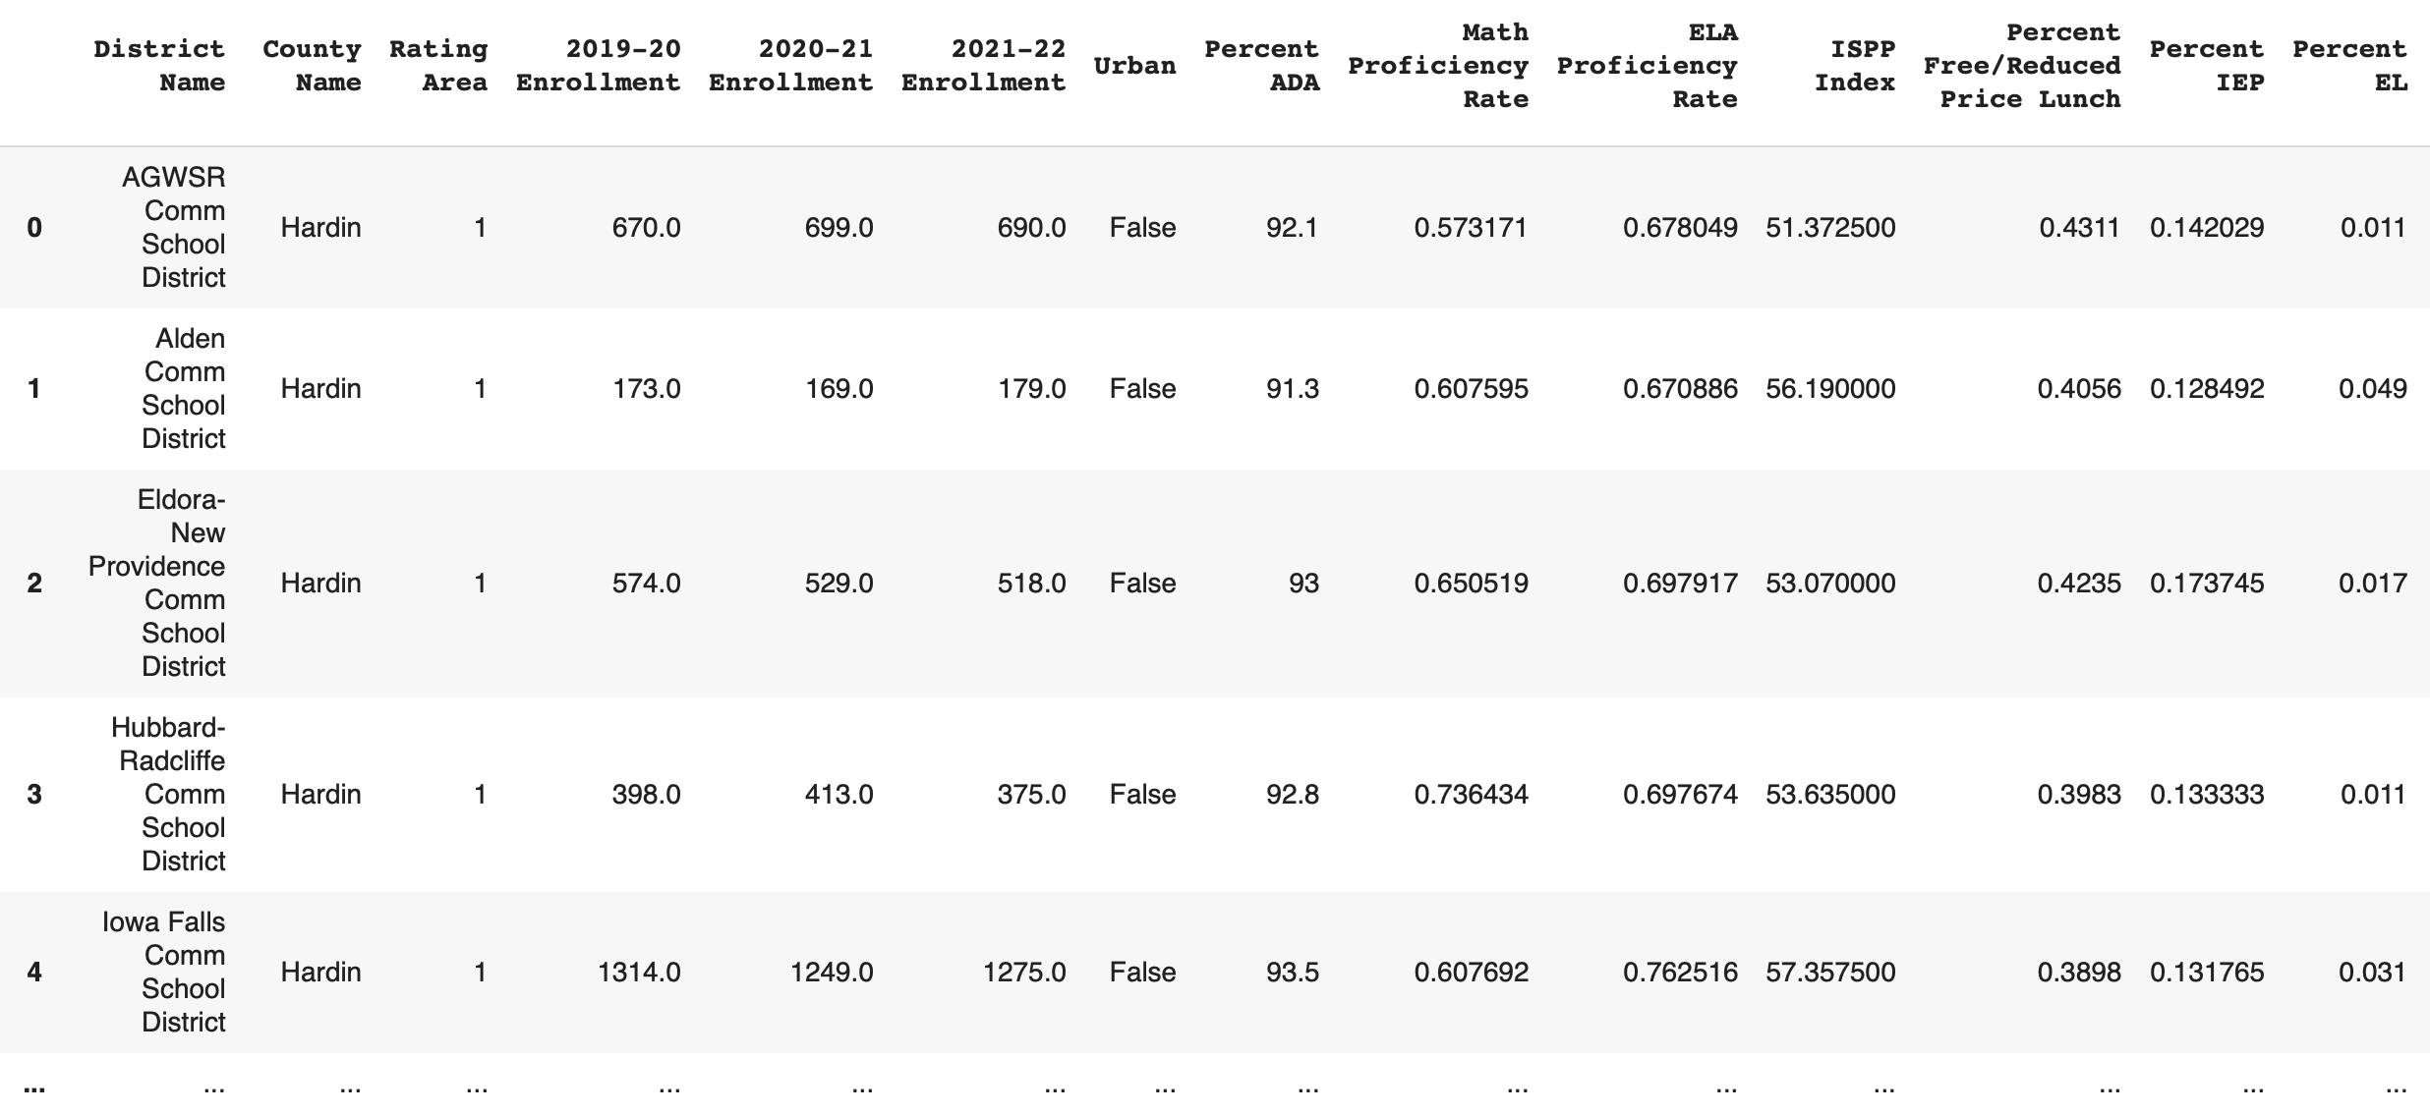
df_districts
327 rows x 26 columns total

Slide 5
How Accurate Were the State’s Enrollment Projections for 2022-23?

Slide 6
How Accurate Were the State’s Enrollment Projections for 2022-23?
Off by an average of 177 students!
(Some outliers were present in the data)

Slide 7
DATA EXPLORATION
Prediction that areas w/ population growth will experience increases in enrollment
Focusing on metrics that provide rates
Previous year enrollment & current year enrollment have a high correlation, but only because their #s are typically in the same range
Exploring differences in variables by geographic zone &
at the smaller county level

Slide 8
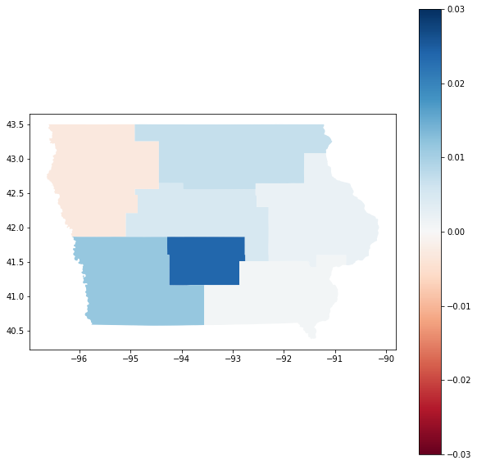
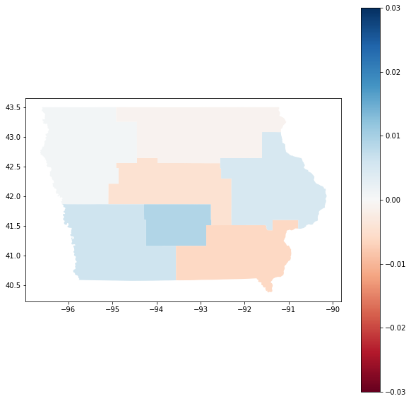
If a district’s enrollment increased the year before,
was it likely to also increase the next year?
2020-21 to 2021-22
Avg. Enrollment Change
2021-22 to 2022-23
Avg. Enrollment Change

Slide 9
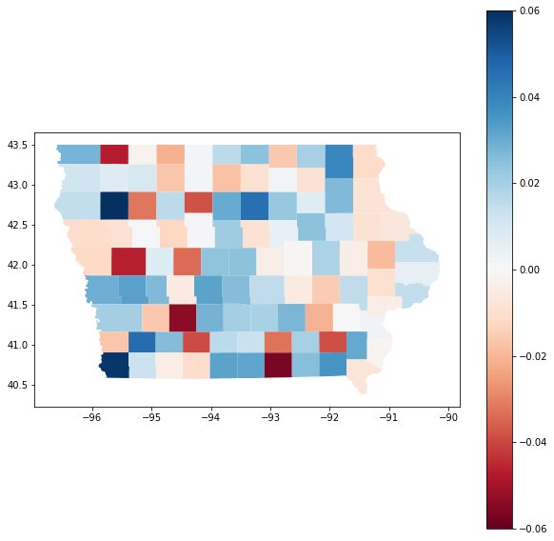
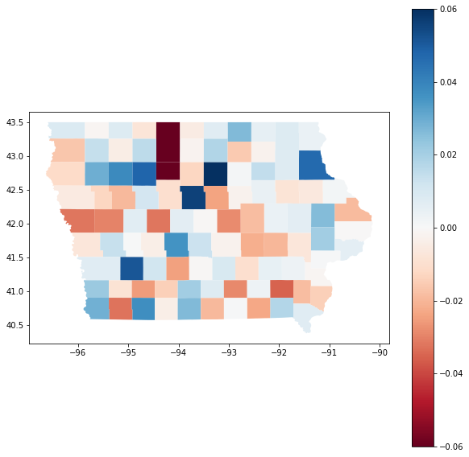
If a district’s enrollment increased the year before,
was it likely to also increase the next year?
2020-21 to 2021-22
Avg. Enrollment Change
2021-22 to 2022-23
Avg. Enrollment Change

Slide 10
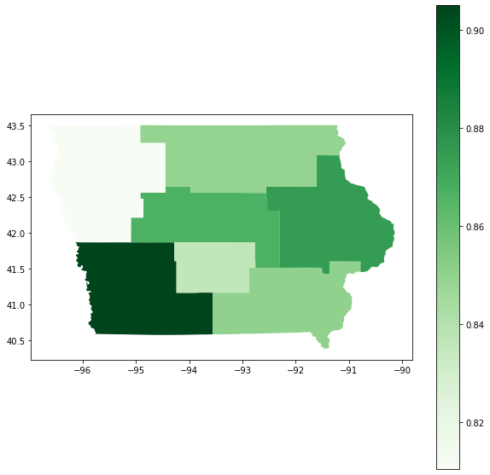
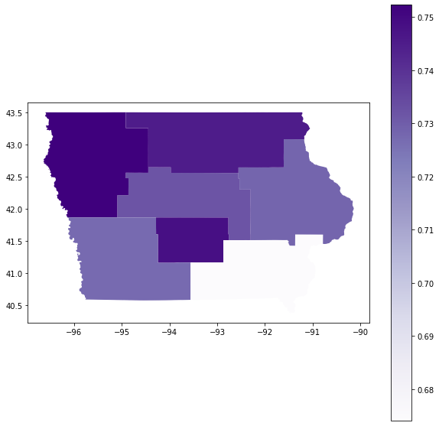
Is there a correlation between
racial demographics & test proficiency rates?
Avg. % of White Students
Avg. ELA Proficiency Rate

Slide 11
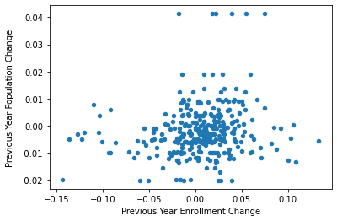
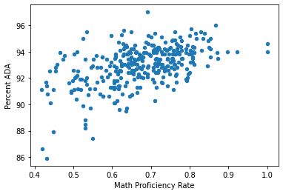
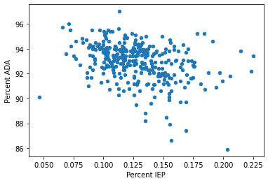
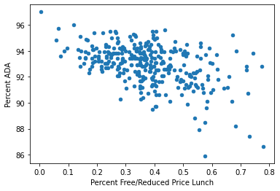
Is there a correlation between population change & enrollment change?
r = .172706
Exploring Correlations w/ ADA

Slide 12
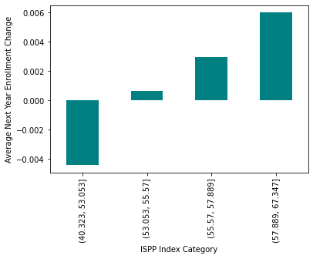
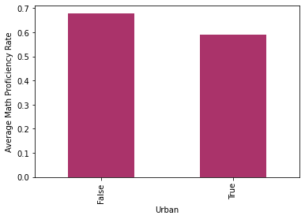
Exploring Correlations w/ Categorical Variables

Slide 13
MACHINE LEARNING
Training
Testing
Regression models
KNeighborsRegressor
DecisionTreeRegressor
KernelRidge
Voting & stacking ensemble methods
Later testing best models on
2020-21 district data & evaluating how well it predicts 2021-22 enrollment
2021- 22
2022- 23
2020- 21
2021 - 22

Slide 14
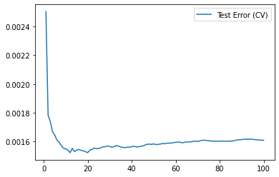
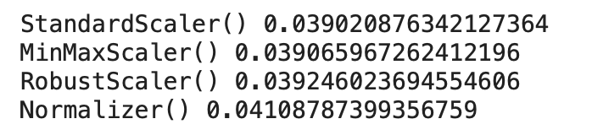
KNeighborsRegressor
Best features after testing combinations & hyperparameter tuning
Previous 2 Year Enrollment Change
Previous 2 Year Population Change
Percent ADA
Math Proficiency Rate
Percent IEP
Urban
n_neighbors = 12, Euclidean distance metric,
& StandardScaler for quantitative variables
CV RMSE = .03902 / 3.902%

Slide 15
DecisionTreeRegressor
Best features after testing combinations & hyperparameter tuning
Previous 2 Year Population Change
Percent ADA
ISPP Index
Urban
Rating Area
County Name
max_depth = 2, min_samples_leaf = 1, & random_state = 2
CV RMSE = .0405 / 4.05%

Slide 16
KernelRidge
Best features after testing combinations & hyperparameter tuning
Previous 2 Year Enrollment Change
Percent White
Percent Free/Reduced Price Lunch
Urban
alpha = 5, coef0 = 1, degree = 1,
& MinMaxScaler for quantitative variables
CV RMSE = .039908 / 3.9908%

Slide 17
VotingRegressor & StackingRegressor
Best VotingRegressor model ensembled KNN & KR model
CV RMSE = .0391 / 3.91%
Best StackingRegressor model ensembled KNN, DTR, & KR model
CV RMSE = .03996 / 3.996%

Slide 18
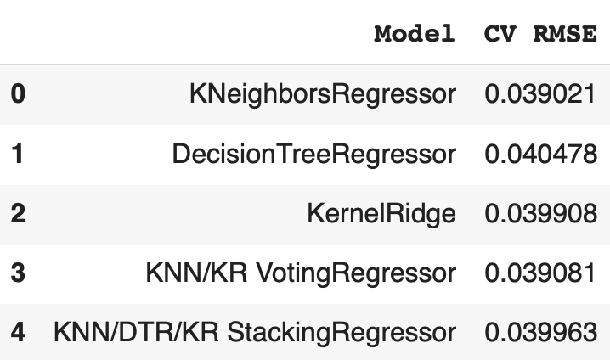
Evaluating Results
KNeighborsRegressor & KNN/KR VotingRegressor models produced the lowest CV RMSE

Slide 19
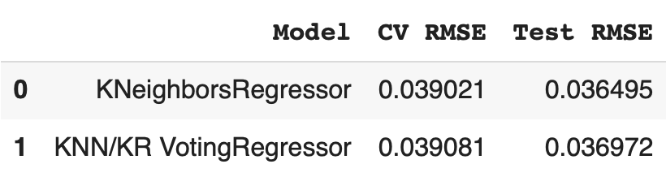
Computing Test RMSE
Test RMSEs for both models were lower than their CV RMSEs
KNeighborsRegressor had the best CV & Test RMSE

Slide 20
PREDICTING ENROLLMENT
in Iowa Public School Districts
by Kenny Lam | DATASCI 112 Final Project

