Slide 1
UJIAN BACK END
Kenny Oscar – jc9

Slide 2
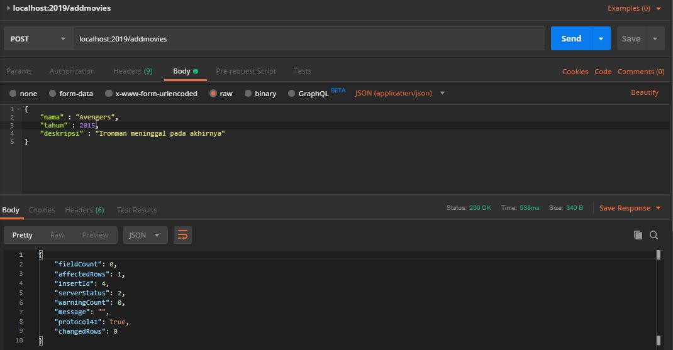
ADD MOVIES

Slide 3
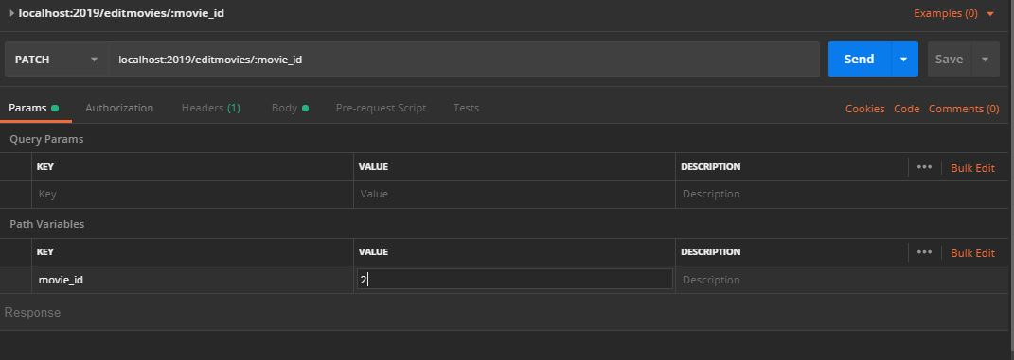
EDIT MOVIES 1

Slide 4
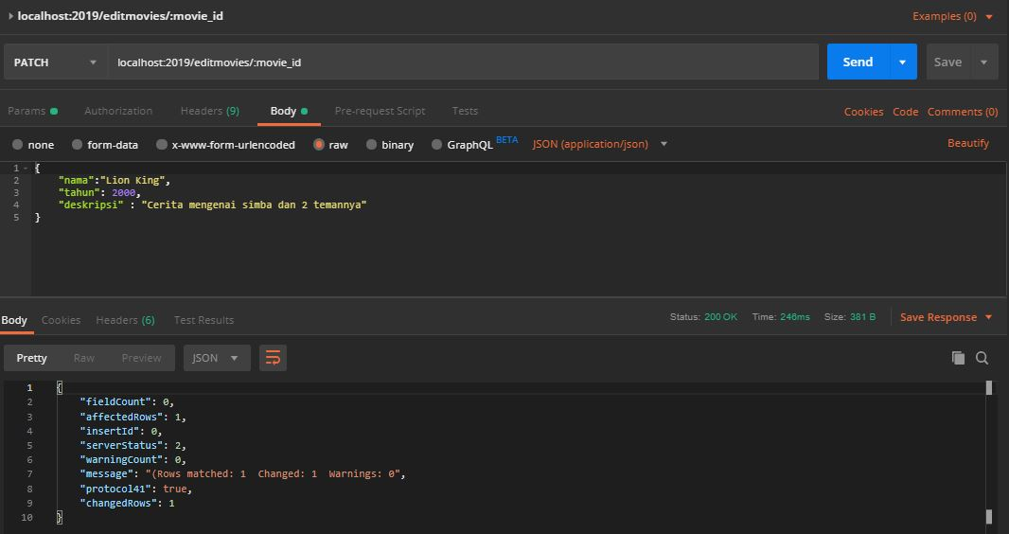
EDIT MOVIES 2

Slide 5
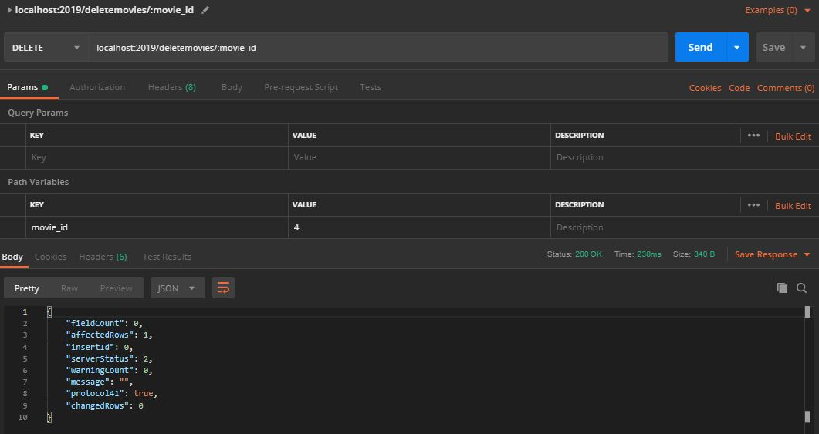
DELETE MOVIES

Slide 6
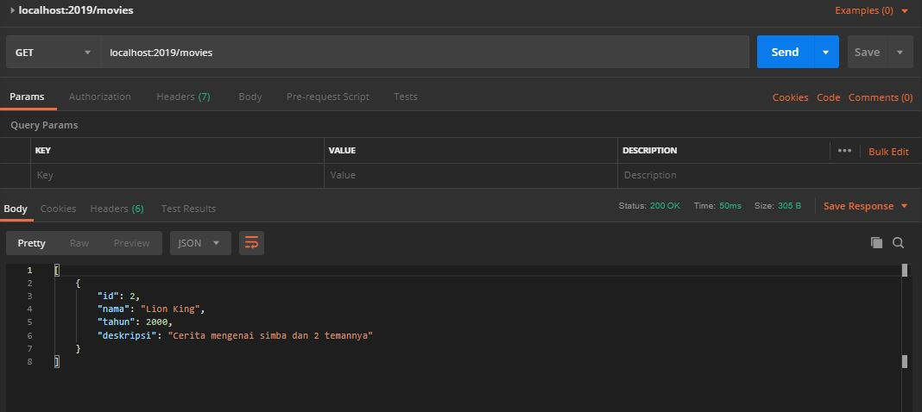
SHOW ALL MOVIES

Slide 7
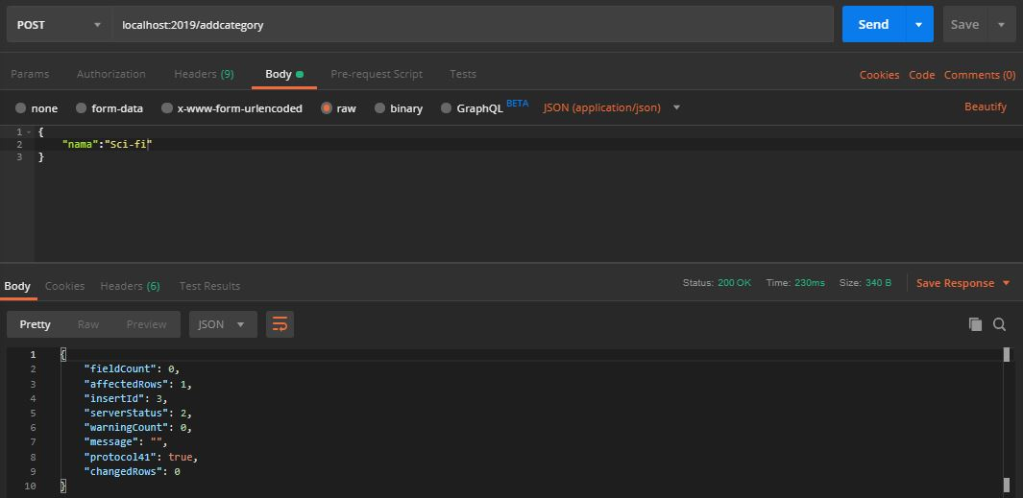
ADD CATEGORIES

Slide 8
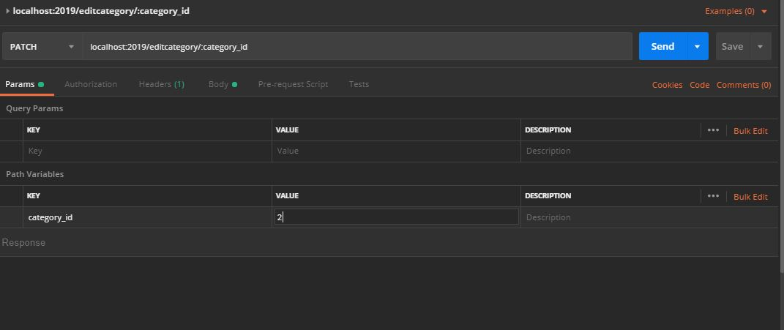
EDIT CATEGORIES 1

Slide 9
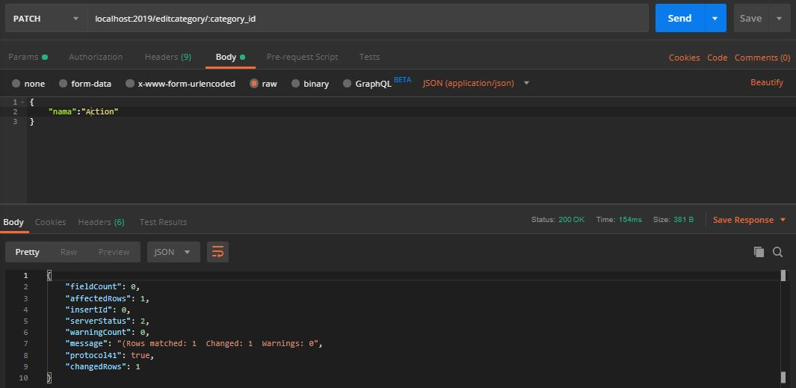
EDIT CATEGORIES 2

Slide 10
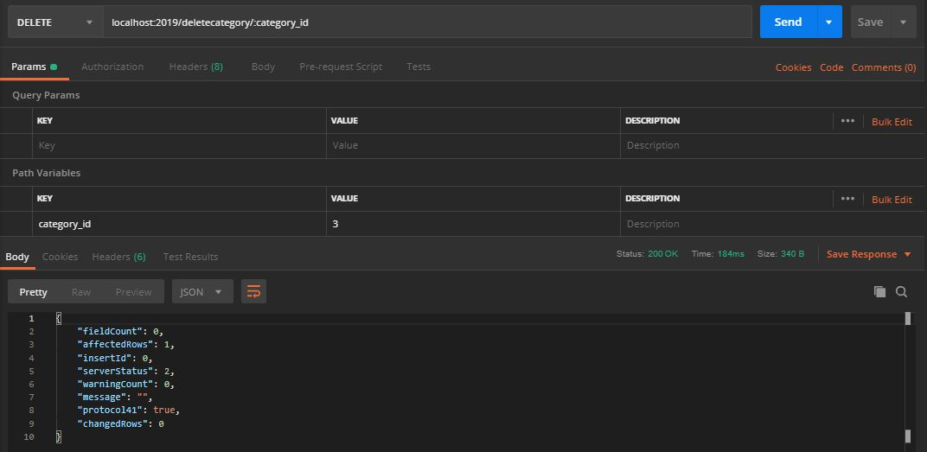
DELETE CATEGORIES

Slide 11
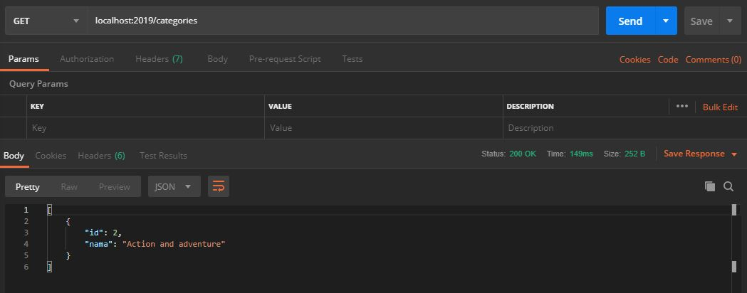
SHOW ALL CATEGORIES

Slide 12
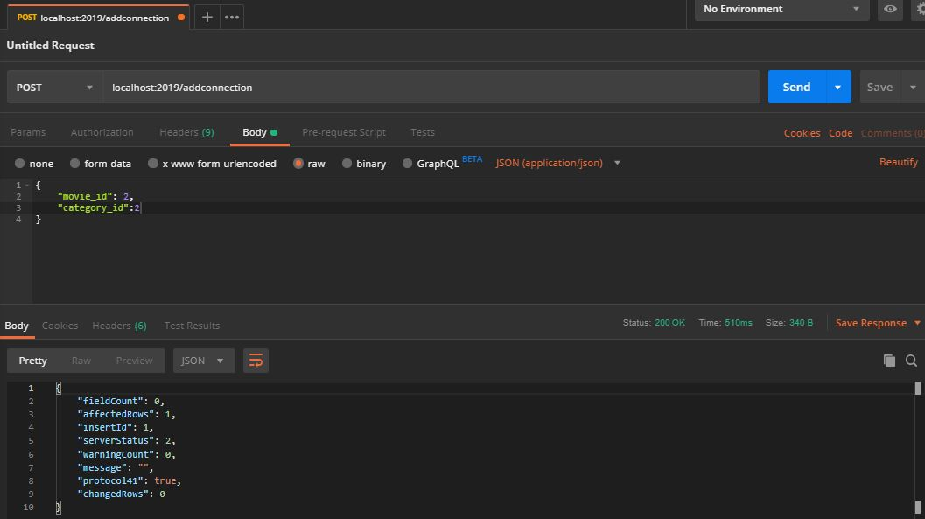
ADD CONNECTION MOVCAT

Slide 13
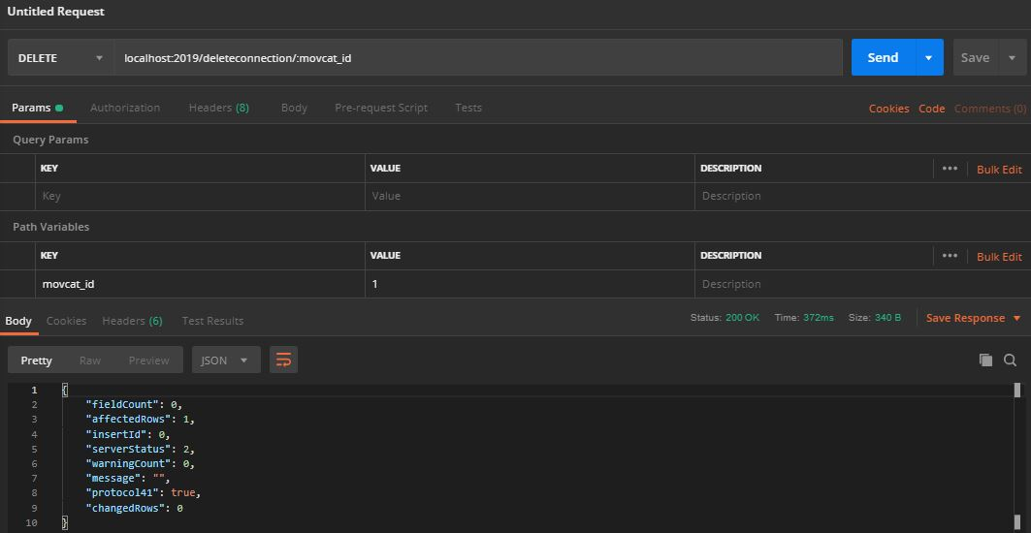
DELETE CONNECTION MOVCAT

