Slide 1
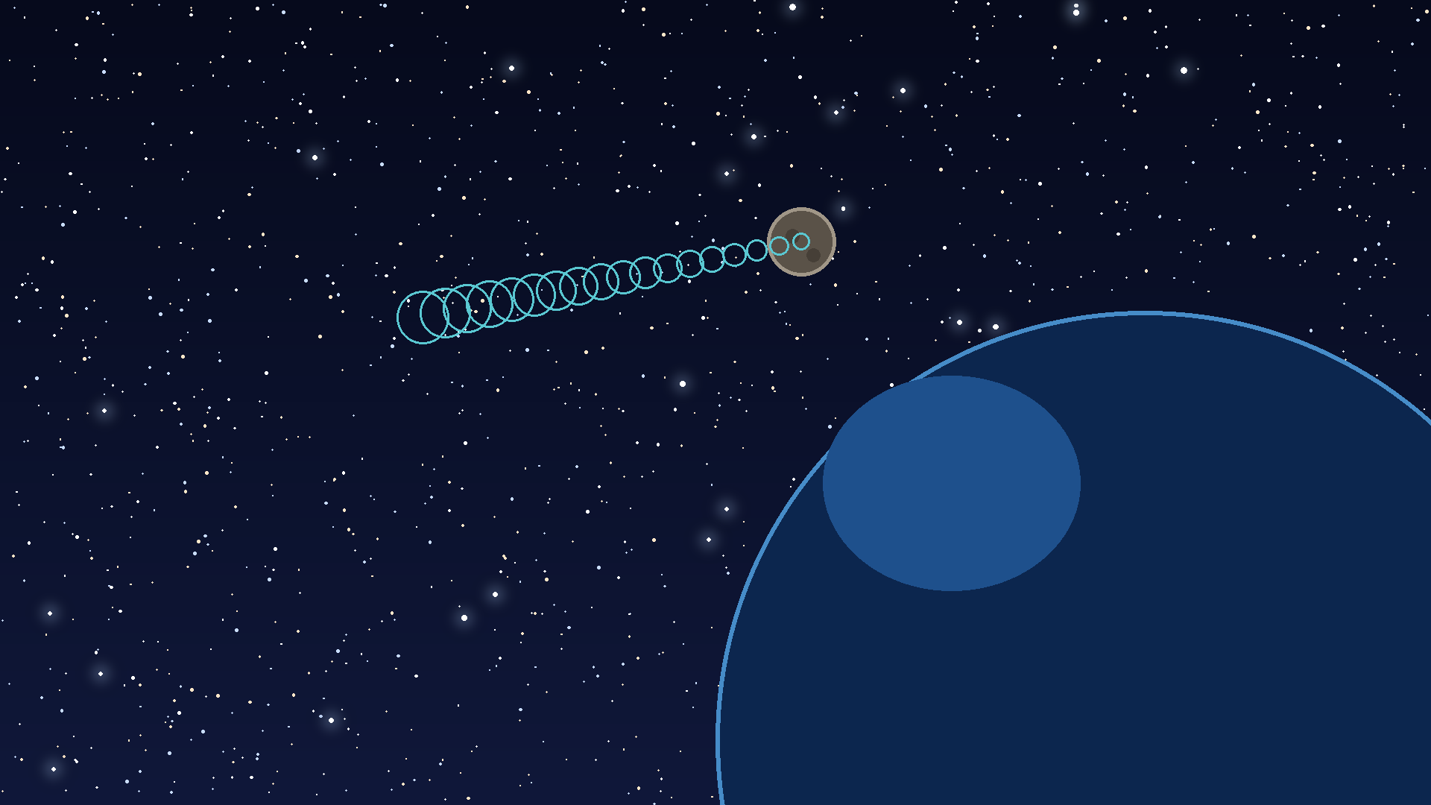
DATABASE DEVELOPMENT WITH PL/SQL
PROJECT
NIGHT WATCH
Near-Earth Asteroid Monitoring and Risk Alert System
RUKUNDO KENNY · STUDENT ID: 20252SEN454
ADVENTIST UNIVERSITY OF CENTRAL AFRICA · FACULTY OF INFORMATION TECHNOLOGY
INSTRUCTOR: ERIC MANIRAGUHA · GITHUB: [https://github.com/kennyruk/rukundo_20252SEN454_nightWatch.git]

Slide 2

THE PROBLEM
Asteroid data is growing faster than the workflow around it
01
02
03
Orbits
Approaches
Risk
Asteroid properties and orbital data
Close-approach dates and distances
Impact-risk ratings
04
MANUAL-COMBINATION BOTTLENECK
More than 40,000 near-Earth asteroids. Different formats and update schedules force manual combining for students, researchers and analysts.

Slide 3
THE OPPORTUNITY
Night Watch turns a real planetary-defense problem into a database problem
Space data is public, real and constantly growing.
Planetary defense
Database practice
Real use case
Planetary defense is a recognised national priority.
The project exercises related tables, events, alerts and auditing.
Technical interest meets a real risk-monitoring use case.

Slide 4
SYSTEM SCOPE
Collect and clean asteroid, close-approach and impact-risk data
Normalize the data into 3NF tables
Use PL/SQL procedures, functions, cursors and packages for loading, classification and reporting
Implement triggers, a restriction rule and an audit log
Build a Streamlit dashboard connected to Oracle
The system will consolidate data, classify risk and raise alerts

Slide 5
RESEARCH COMPARISON
Existing tools measure risk; Night Watch makes it queryable and auditable
Night Watch adds structured storage, alert rules and an audit trail.
Source | What it offers | Gap
Chesley et al. (2002), Palermo scale | Scientific risk metric for ranking potential impacts | Metric, not a stored queryable system
Roa et al. (2021), Sentry-II | Automated impact monitoring method | Aimed at specialists; no student-level data model
NASA/JPL Sentry (CNEOS) | Public risk table with Palermo and Torino ratings | Read-only; no user-defined alert rules or audit trail

Slide 6
DATA FOUNDATION
The data foundation is public NASA/JPL information
PRIMARY
asteroid name | diameter | orbit class | approach date | distance
[sample row 1] | [sample row 1] | [sample row 1] | [sample row 1] | [sample row 1]
[sample row 2] | [sample row 2] | [sample row 2] | [sample row 2] | [sample row 2]
[sample row 3] | [sample row 3] | [sample row 3] | [sample row 3] | [sample row 3]
JPL Small-Body Database
CSV export filtered to near-Earth objects
SUPPORTING
CNEOS close-approach data and Sentry impact risk
SIZE: [NUMBER OF NEO RECORDS] ASTEROIDS · [NUMBER OF APPROACHES] APPROACHES
EXTRACTION DATE: [DATE]
PUBLIC NASA/JPL DATA · NO PERSONAL INFORMATION

Slide 7
ARCHITECTURE
Business rules stay in Oracle; Streamlit makes them visible
1
2
3
4
Oracle Database
PL/SQL
Streamlit
User
Stores NASA data in related tables
Classifies risk and creates alerts automatically
Python connects through python-oracledb
Views data and calls PL/SQL
THE DASHBOARD DISPLAYS DATA AND CALLS PL/SQL; BUSINESS RULES STAY IN THE DATABASE.

Slide 8
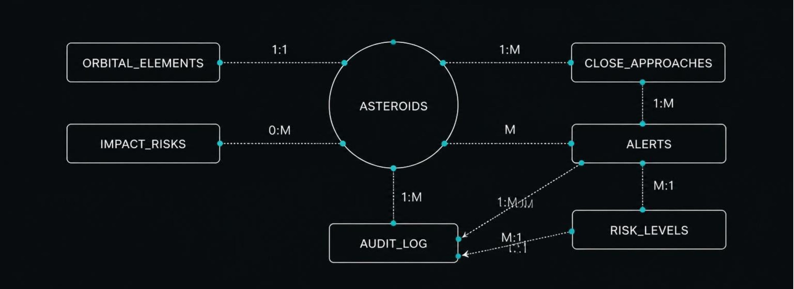
PHASE II · 3NF
Seven related tables create one traceable watch system
Final design completed in Phase II (3NF).

Slide 9
DATABASE AUTOMATION
PL/SQL turns data events into a watch list and an audit trail
Load and validate
Classify
Procedures load and validate data; acknowledge_alert is called by the dashboard.
Functions convert AU to lunar distances and return risk level.
Build the watch list
Package the logic
Cursors loop through upcoming approaches to build the watch list.
NIGHT_WATCH_PKG groups loading, classification and reporting code.
Protect the record
Triggers, restriction rules and exceptions protect alerts, thresholds and audit history.

Slide 10
CAPSTONE DEMO
The capstone demo follows one approach from insert to audit log
LIVE INSERT
DASHBOARD ACTION
Load and insert
Acknowledge
Load a real near-Earth asteroid dataset; insert a new close approach.
Streamlit displays and acknowledges the alert through PL/SQL.
1
2
3
4
DATABASE EVENT
EVIDENCE
Trigger creates alert
Audit log
The trigger creates an alert automatically.
Audit log records who changed what and when.
PROTOTYPE RISK CLASSIFIER AND ALERT WORKFLOW · NOT A REAL WARNING SYSTEM

