Slide 1
Stock Price Performance and Industry Trends: A 10-Year Retrospective Analysis
Team: Jenny Noga, Kenny Siegler, Trey Wade, Ran Ji

Slide 2
Introduction:
Why S&P 500 ?
Explain the motivation for the study
Data and Methodology:
Describe the data sources used in the study
Explain the methodology and analytical techniques employed
Industries:
11 Sectors of S&P 500
Sectors Weight analysis
4. Stock Price Performance
Yearly Return Analysis
Price-to-Earnings (P/E) Ratio Analysis
5. Industry Stability
Yearly Moving Analysis
Beta Analysis

Slide 3

Data and Methodology
Yahoo Finance
API
https://www.stockdata.org/

Slide 4
S&P 500
The S&P 500, or Standard & Poor's 500, is a widely-followed stock market index that represents the performance of 500 large-cap U.S. companies listed on the New York Stock Exchange (NYSE) or the Nasdaq. The S&P 500 is considered a benchmark for the overall U.S. stock market and a reliable indicator of the U.S. economy's health.

Slide 5
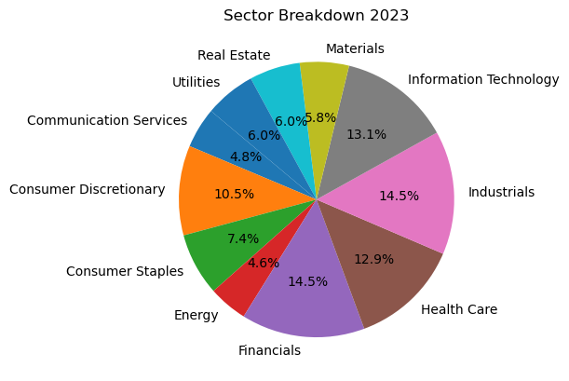
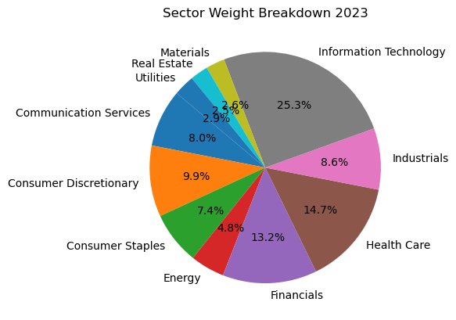
Sectors
The S&P 500 is divided into 11 sectors, each representing a specific industry group within the U.S. economy. These sectors are defined by the Global Industry Classification Standard (GICS), a system developed by MSCI and S&P Global.

Slide 6
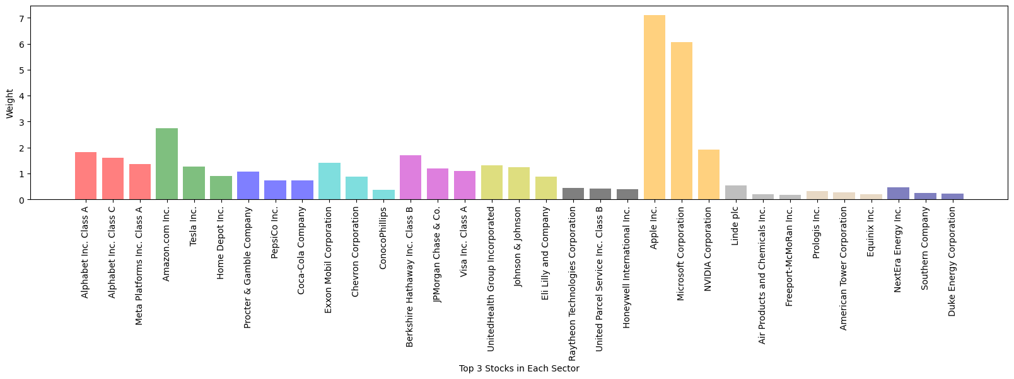
Top Companies in each sectors (2023)
'Communication Services', 'Consumer Discretionary', 'Consumer Staples', 'Energy', 'Financials', 'Health Care', 'Industrials', 'Information Technology', 'Materials', 'Real Estate', 'Utilities'

Slide 7
4. Stock Price Performance
Yearly Return
Price-to-Earnings (P/E) Ratio: Analyze the average price-to-earnings ratio of the stocks within the industry. A stable industry may exhibit a relatively consistent P/E ratio over time.

Slide 8
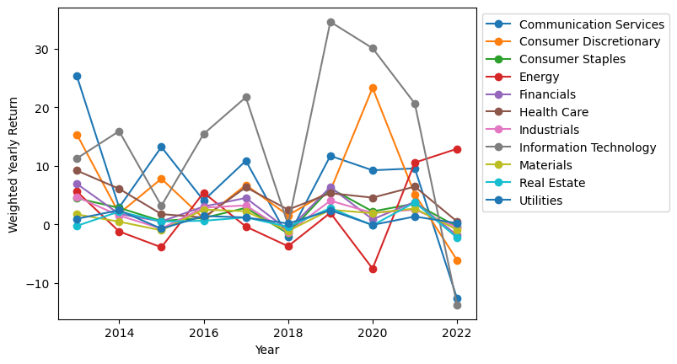
Weighted Yearly Return

Slide 9
Industry Stability
Earnings Stability: Examine the average earnings stability of companies within the industry by looking at historical earnings growth or the variability of earnings. A stable industry will typically have companies with more consistent earnings growth or less variability in earnings.
Beta: Calculate the average beta of stocks within the industry. Beta measures a stock's volatility in relation to the overall market (usually represented by a market index like the S&P 500). An industry with a lower average beta might be considered more stable than one with a higher average beta.

Slide 10
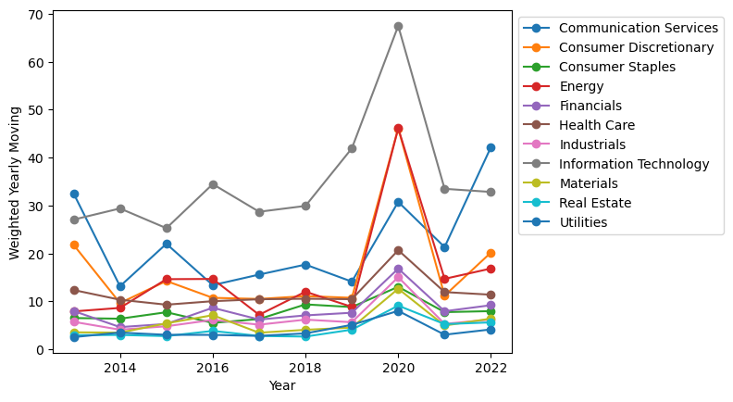
Weighted Yearly Moving

