Slide 1
Stock Price Performance and Industry Trends: A 10-Year Retrospective Analysis
Team: Jenny Noga, Kenny Siegler, Trey Wade, Ran Ji

Slide 2
Introduction:
Why S&P 500 ?
Explain the motivation for the study
Data and Methodology:
Describe the data sources used in the study
Explain the methodology and analytical techniques employed
Industries:
11 Sectors of S&P 500
Sectors Weight analysis
4. Stock Price Performance
10 Year Return Analysis
5. Industry Stability
Yearly Return Analysis
Yearly Moving Analysis

Slide 3
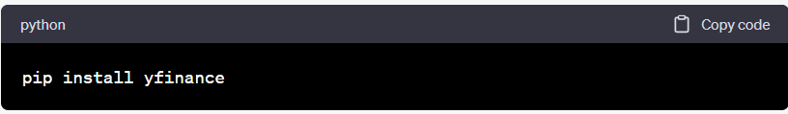
Data and Methodology
Yahoo Finance
API
https://www.stockdata.org/

Slide 4
S&P 500
The S&P 500, or Standard & Poor's 500, is a widely-followed stock market index that represents the performance of 500 large-cap U.S. companies listed on the New York Stock Exchange (NYSE) or the Nasdaq. The S&P 500 is considered a benchmark for the overall U.S. stock market and a reliable indicator of the U.S. economy's health.

Slide 5
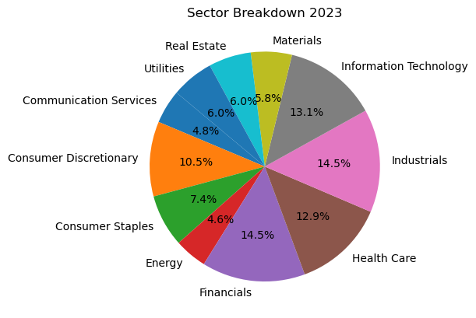
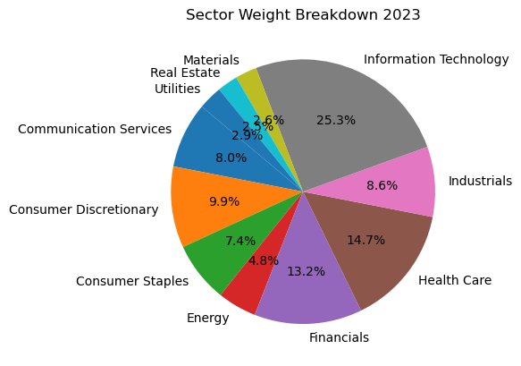
Sectors
The S&P 500 is divided into 11 sectors, each representing a specific industry group within the U.S. economy. These sectors are defined by the Global Industry Classification Standard (GICS), a system developed by MSCI and S&P Global.

Slide 6
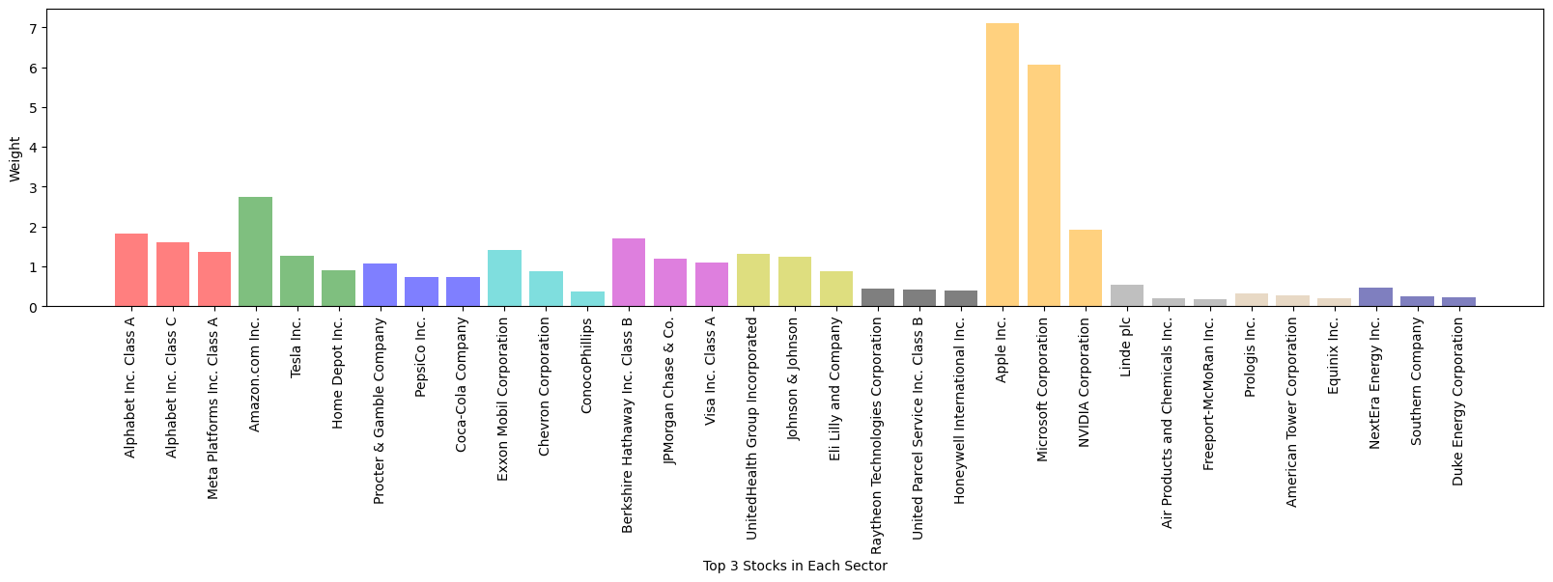
Top Weighted Companies in each sectors (2023)
''Consumer Discretionary', 'Consumer Staples', 'Consumer Staples', 'Energy', 'Financials', 'Health Care', 'Industrials', 'Information Technology', 'Materials', 'Real Estate', 'Utilities'

Slide 7
4. Stock Price Performance
10 Yearly Return
Start date = '2013-01-01’ End date = '2022-12-31’
Which sector has the highest average growth?
Which sector has the most stocks with higher average growth?

Slide 8
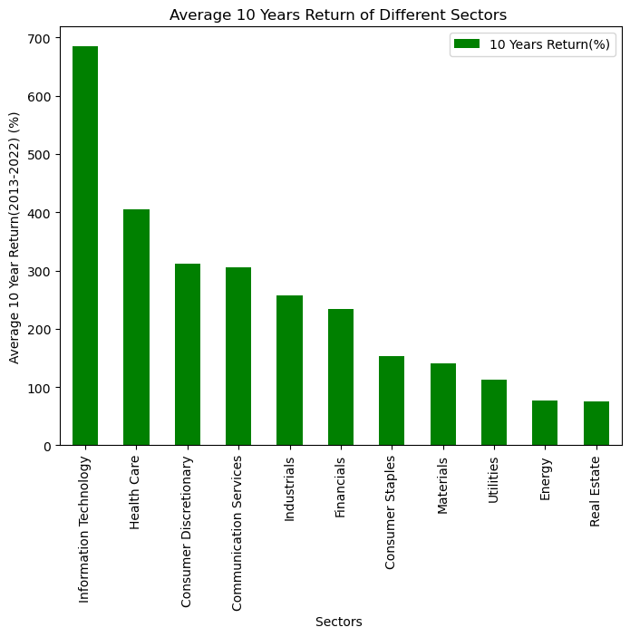
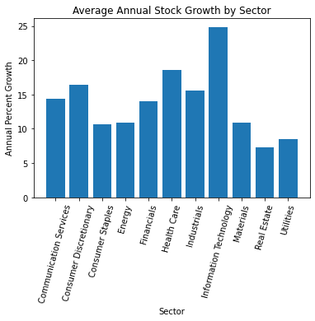
10 Year Growth Analysis
After breaking down the stocks in the S&P 500 by Sector, we did a quick analysis to see which sector grew the most over the past 10 years
We don’t have exact data on volatility but, as shown in the previous slide, IT tends to be the most volatile

Slide 9
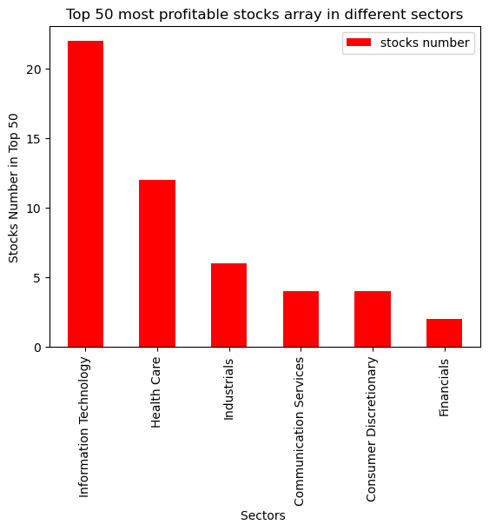
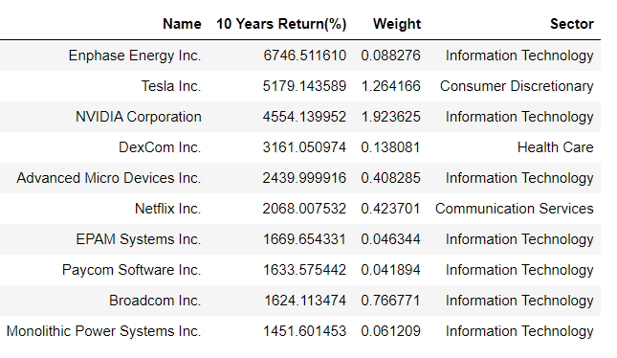
Top Returned Stocks (2013-2022)
Top 1
Enphase Energy Inc.
2013-01-04 : 3.87
2022-12-30: 264.959991
Top 10

Slide 10
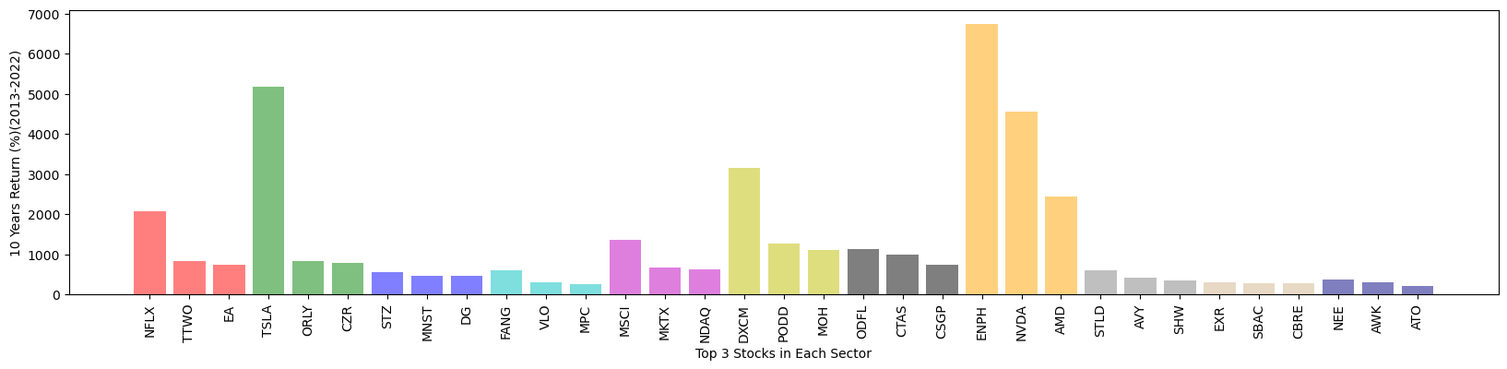
Best Returned Companies in Each Sectors (2013-2023)
'Consumer Discretionary', 'Consumer Staples', 'Consumer Staples', 'Energy', 'Financials', 'Health Care', 'Industrials', 'Information Technology', 'Materials', 'Real Estate', 'Utilities'

Slide 11
Industry Stability
Earnings Stability: Examine the average earnings stability of companies within the industry by looking at historical earnings growth or the variability of earnings. A stable industry will typically have companies with more consistent earnings growth or less variability in earnings.
Moving Stability

Slide 12
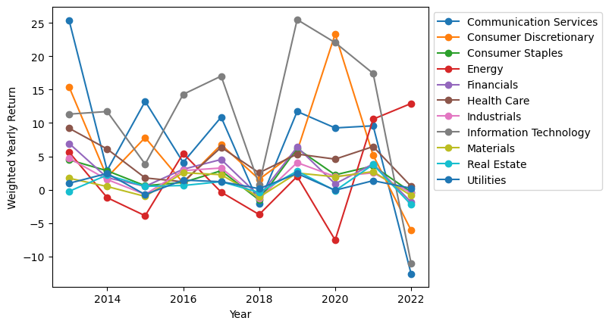
Weighted Yearly Return Analysis

Slide 13
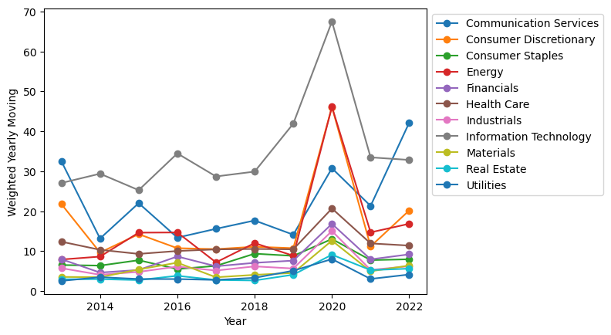
Weighted Yearly Moving Analysis

