Slide 1

Stock Price Performance and Industry Trends: A 10-Year Retrospective Analysis
Team: Jenny Noga, Kenny Siegler, Trey Wade, Ran Ji

Slide 2
We chose to Analyze the past 10 years of the S&P500 to find:
Which sectors have experienced the most significant increase in stock prices over the past ten years?
Which sectors have been the most stable in terms of stock price fluctuations over the past ten years?
Which sectors would be best for investors, given the historical data and our analysis?

Slide 3
S&P 500
The S&P 500, or Standard & Poor's 500, is a widely-followed stock market index that represents the performance of 500 large-cap U.S. companies listed on the New York Stock Exchange (NYSE) or the Nasdaq.
The S&P 500 is considered a benchmark for the overall U.S. stock market and a reliable indicator of the U.S. economy's health.
We decided to use the S&P 500 because the growth of the stocks in the S&P correlates closely with the growth of the market as a whole

Slide 4

Data and Methodology
Yahoo Finance
S&P 500 Data
https://www.ssga.com/us/en/intermediary/etfs/funds/spdr-sp-500-etf-trust-spy#holdings
API
https://www.stockdata.org/

Slide 5
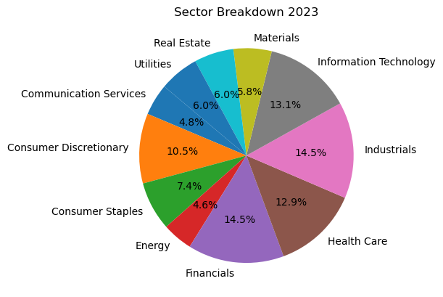
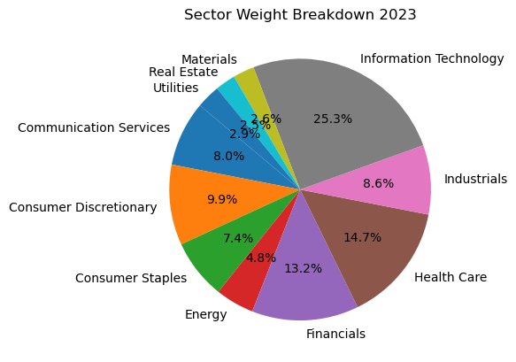
Sectors
The S&P 500 is divided into 11 sectors, each representing a specific industry group within the U.S. economy. These sectors are defined by the Global Industry Classification Standard (GICS), a system developed by MSCI and S&P Global.
The S&P 500 scales its holdings based on the market caps of each company in its fund. So more valuable companies get more representation within the fund.
Information Technology is the biggest industry right now, so its obviously very highly represented in the S&P 500

Slide 6
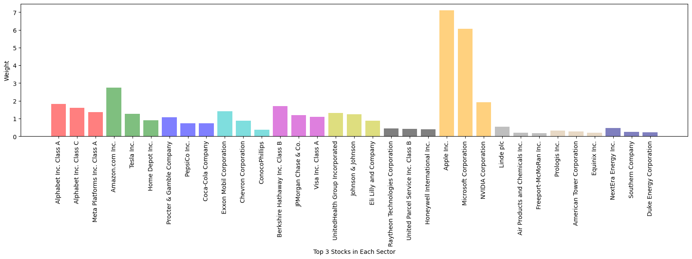
Top Weighted Companies in each sectors (2023)
' Communication Services 'Consumer Discretionary', 'Consumer Staples', 'Energy', 'Financials', 'Health Care', 'Industrials', 'Information Technology', 'Materials', 'Real Estate', 'Utilities'
Here’s a quick breakdown of the most represented companies from each sector and their relative weight within the S&P 500

Slide 7
4. Stock Price Performance
10 Yearly Return
Start date = '2013-01-01’ End date = '2022-12-31’
Which sector has the highest average growth?
Which sector has the most stocks with higher average growth?

Slide 8
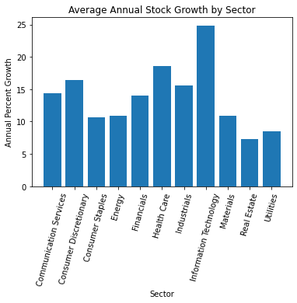
10 Year Growth Analysis
After breaking down the stocks in the S&P 500 by Sector, we did a quick analysis to see which sector grew the most over the past 10 years

Slide 9
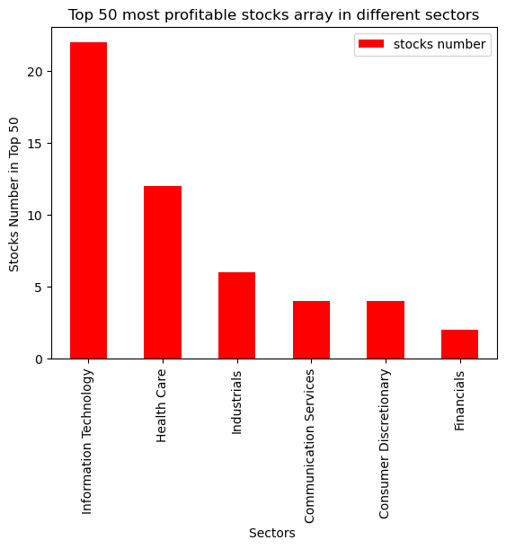
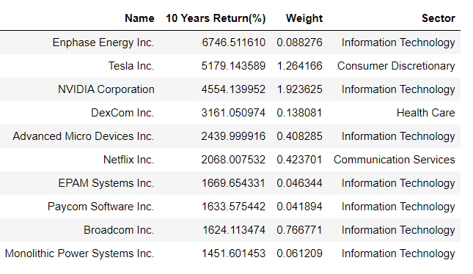
Top Returned Stocks (2013-2022)
Top 1
Enphase Energy Inc.
2013-01-04 : 3.87
2022-12-30: 264.959991
Top 10

Slide 10
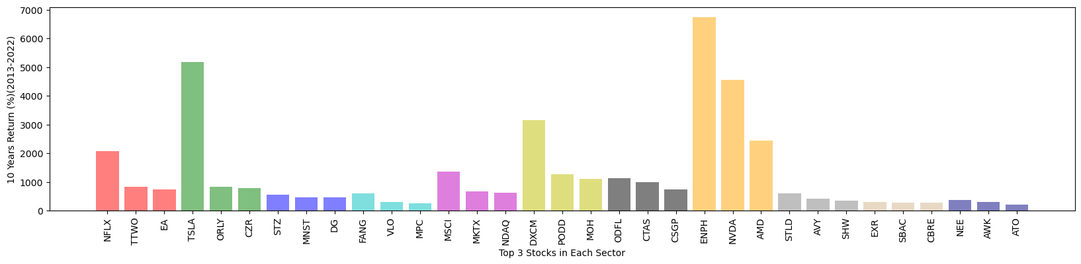
Best Returned Companies in Each Sectors (2013-2023)
We found the 3 top performing stocks for each sector and graphed their percentage growth
The weight of some of these top movers was small relative to the rest of the fund. ENPH has a weight of 0.088% in the S&P 500
' Communication Services 'Consumer Discretionary', 'Consumer Staples', 'Energy', 'Financials', 'Health Care', 'Industrials', 'Information Technology', 'Materials', 'Real Estate', 'Utilities'

Slide 11
Industry Stability
Earnings Stability: We didn’t find historical earnings data for each of these companies, but if we had we could have have analyzed this data further with a profit and earnings analysis to see which sector is expected to grow the most going forward. We could have used this information to better inform decisions about how one should invest given their risk tolerance
Moving Stability: We did analyze the in-year volatility of stock prices by comparing how much each stock changed within a given year. This isn’t as effective of a measure as an Earnings Stability report but it’s better than nothing

Slide 12
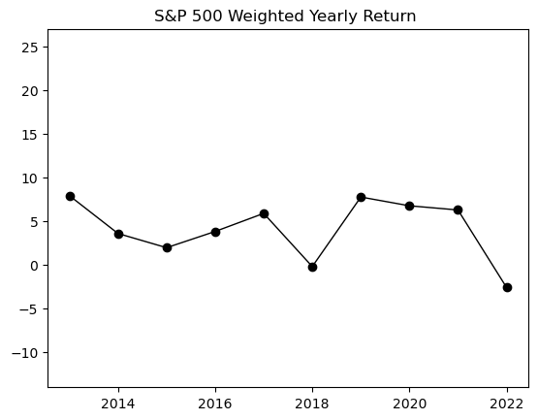
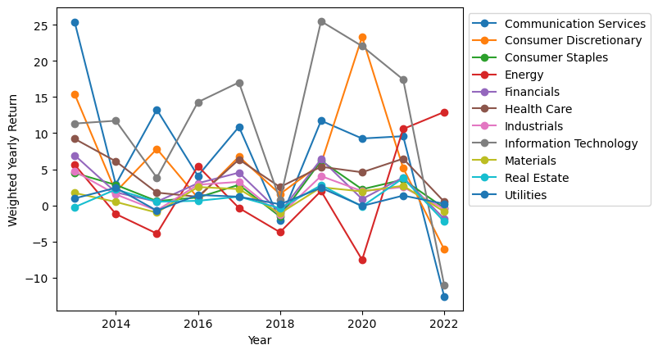
Weighted Yearly Return Analysis

Slide 13
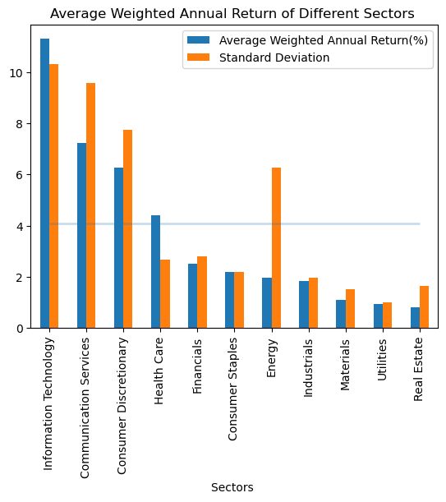
If investment strategies important?
a one-way ANOVA (analysis of variance) test
Null Hypothesis: Sectors have no effect in the return
11 Sectors
F_one-way Result:
statistic=3.3239809486729412,
p-value=0.0009308904431263252
TOP 3 Returned Sectors
Information Technology
Communication Services
Consumer Discretionary
statistic=1.2306639098853447
p-value =0.3079672553137483
LAST 3 Returned Sectors
Materials
Utilities
Real Estate
statistic=0.10647911048733989,
p-value=0.899369436807204

Slide 14
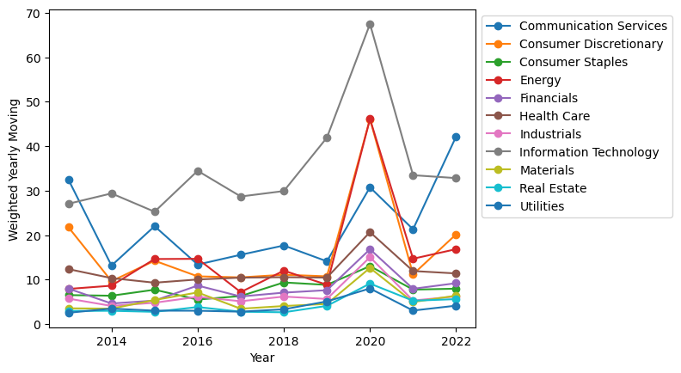
Weighted Yearly Moving Analysis

Slide 15
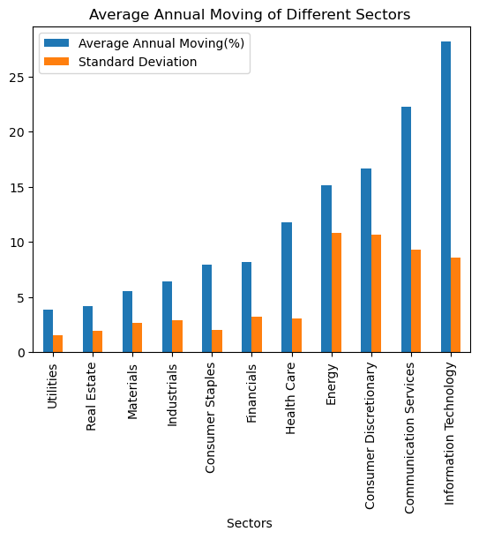
Stablest Sectors
Materials
Utilities
Real Estate
Riskiest Sectors
Information Technology
Communication Services
Consumer Discreotionary
Energy
Highest Standard Deviation
Energy

Slide 16
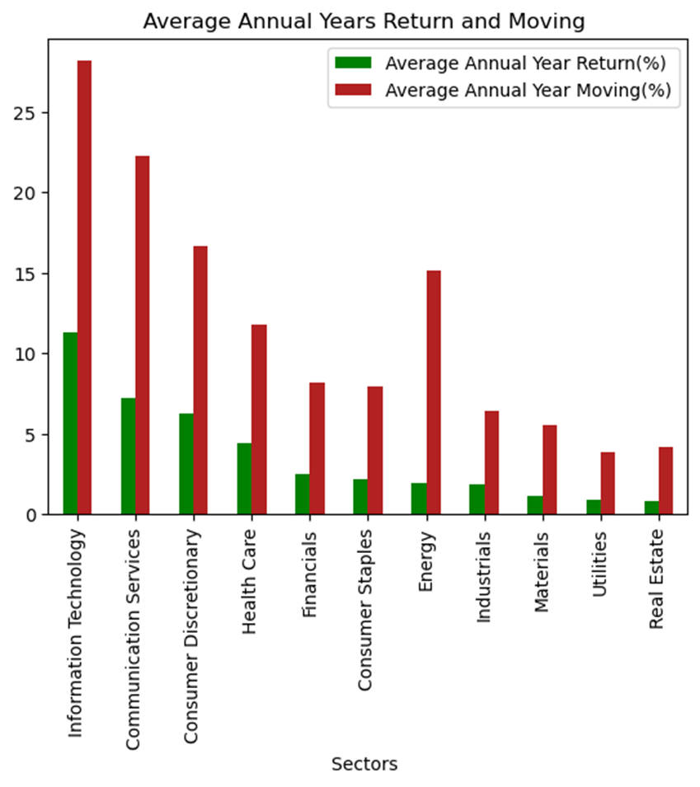
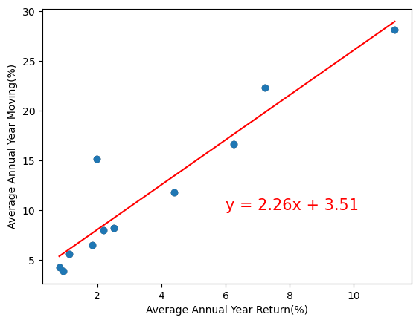
linear regression
Basic Result
Higher return with higher moving
1 return vs. 2.26 moving
Outlier
Energy
The r-squared is: 0.8889426833518573

Slide 17
Questions 1 & 2
Which sectors have experienced the most significant increase in stock prices over the past ten years?
Information Technology, Healthcare, and Consumer Discretionary
Which sectors have been the most stable in terms of stock price fluctuations over the past ten years?
Real Estate, Utilities, and Industrials

Slide 18
Question 3
It seems that if you’re younger or a riskier investor and you’re looking for bigger returns on your investments, filling your portfolio with IT, Healthcare, Energy, and Consumer Discretionary stocks is a strategy you might want to employ
If you’re a little older or you have a lower risk tolerance you might want to focus your investing towards the old school industries like Real Estate, Financials, Materials, Industrials, and Utilities. Those sectors tend not to bring the same high returns, but you’re unlikely to lose a lot of money within your portfolio.
The most sound investment strategy would be to diversify across all of these sectors, that way you can benefit from the immense growth of the more volatile sectors and avoid losing a ton of money when those sectors have poor performing years.

Slide 19

Thank You !
This is not financial advice!

Slide 20
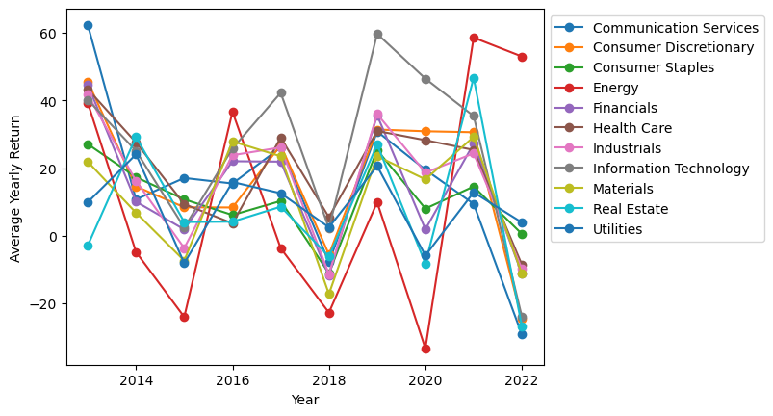

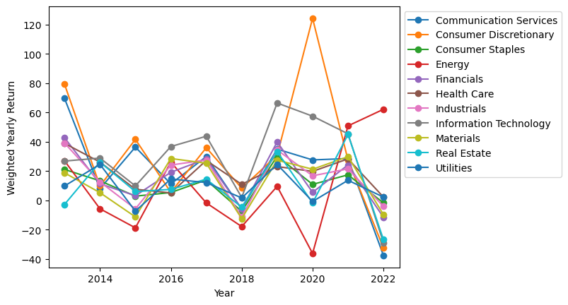
Ignore industry and company size
mean
Three kind of yearly return methods
Ignore industry size and consider company size
consider industry size and company size
Weighted-mean
weighted algorithm

