Slide 1
♥
Global COVID-19 Impact Dashboard
Confirmed Cases, Deaths & Severity Trends, January 2020 to March 2023
Timothy Kehinde | Data Analyst Intern, AnalystLab Africa
Power BI • JHU CSSE COVID-19 Data

Slide 2
Dataset Overview
Source
①
JHU CSSE COVID-19 Data Repository, three time-series files: Confirmed, Deaths, Recovered.
Coverage
②
201 countries and regions, daily records from January 22, 2020 to March 9, 2023.
Structure
③
Originally wide format (one column per date). Unpivoted, grouped, and merged into a single clean table in Power BI.
Known limitation
④
Recovered figures are unreliable for many countries after mid-pandemic, as JHU discontinued consistent recovery reporting.
AnalystLab Africa | Week 4 Capstone | 2

Slide 3
Business Problem
A health policy analyst needs to know: how did COVID-19 spread, and where did it hit hardest?
1
2
3
How fast did it spread?
Who was hit hardest?
Can the data be trusted?
Did case growth follow distinct waves, and did the pace change over time?
In absolute case volume, and separately, in relative severity (death rate).
Where are the known reporting gaps, and how should they shape the conclusions drawn?
AnalystLab Africa | Week 4 Capstone | 3

Slide 4
KPIs Defined
676.58M
6.88M
1.02%
201
Total Confirmed
Total Deaths
Death Rate %
Countries Affected
Global cumulative cases, summed by country's latest total.
Global cumulative deaths, same aggregation method.
Deaths as a share of confirmed cases, shown on a 0-5% gauge.
Distinct count of countries and regions with reported cases.
Design note
Growth indicators use inverted color logic: rising cases and deaths are flagged red, since an increase is the unfavorable outcome here, opposite of a typical sales dashboard.
AnalystLab Africa | Week 4 Capstone | 4

Slide 5
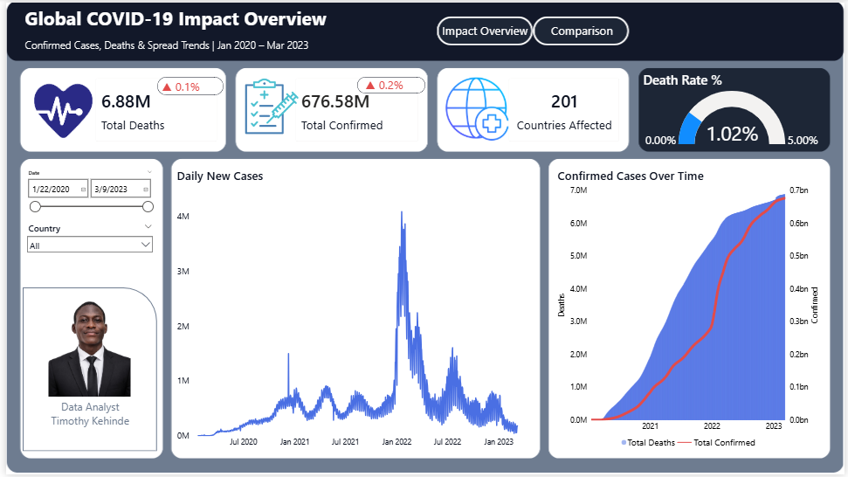
Dashboard: Global Spread & Trend
Page 1 — KPI overview, daily new cases, and cumulative growth
AnalystLab Africa | Week 4 Capstone | 5

Slide 6
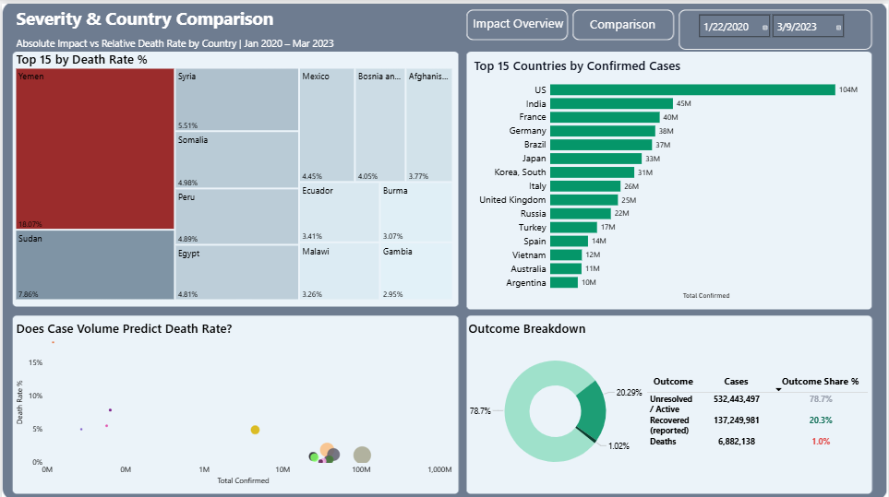
Dashboard: Severity & Country Comparison
Page 2 — Death rate severity, case volume, and outcome breakdown
AnalystLab Africa | Week 4 Capstone | 6

Slide 7
Key Insights
TREND
Case growth was concentrated in distinct waves
The Daily New Cases chart shows a dominant peak in January 2022, far above every prior wave, consistent with the Omicron surge.
SEVERITY
Case volume does not predict severity
The US and India lead in confirmed cases but sit at moderate death rates. Yemen, with far fewer confirmed cases, recorded the highest death rate at 18.07%.
DATA QUALITY
78.7% of confirmed cases remain unresolved in the data
Only 20.3% of cases are recorded as recovered and 1.0% as deaths. This gap reflects inconsistent recovery reporting, not an actual pandemic outcome.
SEVERITY
Severity is concentrated outside the highest-volume countries
Sudan, Somalia, Syria, and Peru all posted death rates above 4%, well above the 1.02% global average, despite comparatively low case counts.
AnalystLab Africa | Week 4 Capstone | 7

Slide 8
Recommendations
Treat death rate, not case count alone, as the primary severity signal when prioritizing aid or resource allocation.
1
Flag Recovered-based metrics as directional only; do not use them for country-level policy decisions without cross-checking a second source.
2
Prioritize monitoring in countries with low case volume but elevated death rate, as they may reflect limited testing capacity rather than lower actual spread.
3
Apply a minimum case-count threshold before comparing death rates across countries, since small denominators produce statistically unstable percentages.
4
AnalystLab Africa | Week 4 Capstone | 8

Slide 9
Challenges Faced
Aggregation bug undercounted global totals
An early measure used MAX() alone, which returned one country's total instead of the world's. Fixed with SUMX(VALUES(...), CALCULATE(MAX(...))) to correctly sum each country's latest cumulative value.
Wide-format source data
Each file had 1,143 date columns. Required unpivoting, grouping to country/date level, and merging three separate queries into one clean table.
Chart overcrowding
Scatter and map visuals were unreadable with 195+ countries plotted at once. Resolved with Top N filtering, a logarithmic X-axis, and a minimum case-count threshold to exclude statistically unstable outliers.
Deprecated map visual
The classic Filled Map is being retired by Microsoft. Pivoted to a Treemap for country-level severity comparison instead.
AnalystLab Africa | Week 4 Capstone | 9

Slide 10
Conclusion
This dashboard turns three raw JHU CSSE time-series files into a two-page analytical view of the pandemic. It shows that case volume and severity are separate stories, that data completeness varies significantly by country and by metric, and that any comparison across countries needs a minimum-volume safeguard to stay honest.
78.7%
of confirmed cases remain unresolved in the source data
Built with Power BI, using the JHU CSSE COVID-19 Data Repository (CC BY 4.0).
18.07%
highest death rate observed, Yemen
Timothy Kehinde | Data Analyst Intern, AnalystLab Africa

