Slide 1
$
Superstore Performance Dashboard
Sales, Profit & Discount Impact, 2014 to 2017
Timothy Kehinde | Data Analyst Intern, AnalystLab Africa
Power BI • Sample Superstore Dataset

Slide 2
Dataset Overview
Source
①
Sample Superstore retail transactions dataset, widely used for BI portfolio projects.
Coverage
②
9,994 order-line records across 4 regions, 3 categories, and 17 sub-categories, spanning 2014 to 2017.
Fields used
③
Sales, Profit, Discount, Quantity, Order Date, Region, Category, Sub-Category, Segment.
Data quality
④
No missing values or duplicates found. Clean out of the box, unlike the COVID-19 dataset built the same week.
AnalystLab Africa | Week 4 Capstone | 2

Slide 3
Business Problem
Where is the business winning and losing money, and what should we do about it?
1
2
3
Who drives profit?
Is growth real?
What's the fix?
Which regions, segments, and categories actually generate profit, not just revenue.
Is the business growing, and is that growth translating into profit or just top-line sales?
Which products or sub-categories should we stop discounting, discontinue, or double down on?
AnalystLab Africa | Week 4 Capstone | 3

Slide 4
KPIs Defined
$286K
$2M
12.5%
5K
Total Profit
Total Sales
Profit Margin %
Total Orders
Hero metric. Leads over Sales, since profit is the real business signal.
Top-line revenue across all 9,994 order lines, 2014-2017.
Profit as a share of sales. Trending down year-over-year.
Distinct order count, used alongside margin to judge real growth.
Design note
Every KPI carries a year-over-year growth pill: green for a favorable move, red for unfavorable, consistent across both dashboards built this week.
AnalystLab Africa | Week 4 Capstone | 4

Slide 5
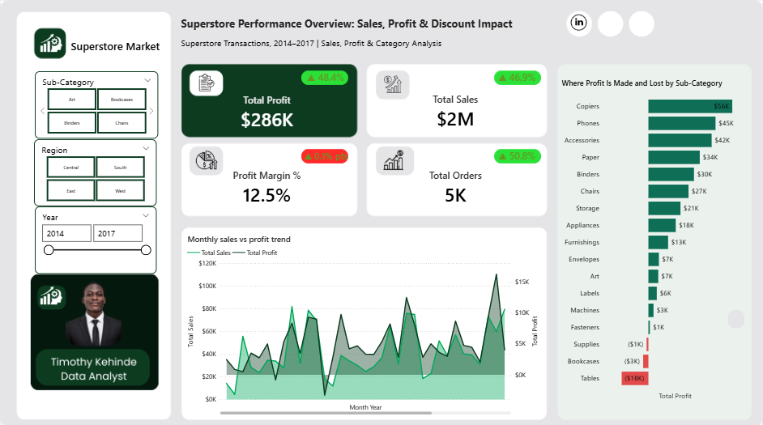
Dashboard: Performance Overview
Page 1 — KPI overview, sales vs profit trend, and sub-category profitability
AnalystLab Africa | Week 4 Capstone | 5

Slide 6
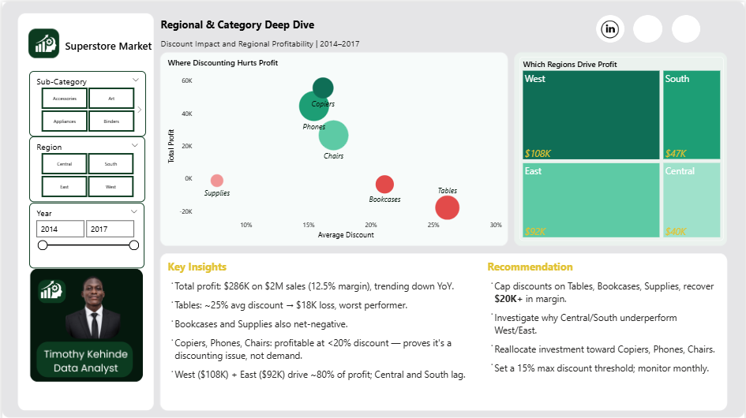
Dashboard: Regional & Category Deep Dive
Page 2 — Discount vs profit, regional performance, and recommendations
AnalystLab Africa | Week 4 Capstone | 6

Slide 7
Key Insights
PROFITABILITY
Tables is the clearest problem area
A ~25% average discount drives an $18K loss, the steepest of any sub-category in the entire dataset.
PROFITABILITY
Bookcases and Supplies are also net-negative
Both carry above-average discount rates and post losses, alongside Tables, three loss-makers hiding inside a profitable overall business.
ROOT CAUSE
Discounting, not demand, drives the losses
Copiers, Phones, and Chairs stay highly profitable at discounts under 20%, proving the issue is pricing strategy, not weak product demand.
REGIONAL
Profit is regionally concentrated
West ($108K) and East ($92K) together generate nearly 80% of total profit, while Central and South lag well behind.
AnalystLab Africa | Week 4 Capstone | 7

Slide 8
Recommendations
Cap discounts on Tables, Bookcases, and Supplies to recover an estimated $20K+ in lost margin without reducing sales volume.
1
Investigate why Central and South underperform West and East, pricing, product mix, or regional demand may differ.
2
Reallocate marketing and inventory investment toward Copiers, Phones, and Chairs, the strongest profit drivers at the lowest discount levels.
3
Set a maximum discount threshold of 15% for loss-prone sub-categories, and monitor margin monthly against this limit.
4
AnalystLab Africa | Week 4 Capstone | 8

Slide 9
Challenges Faced
Dual-axis scaling
Sales and Profit sit on very different scales; on one shared axis, Profit flattened near zero. Solved by moving Profit to a secondary axis.
Chronological sorting
The month-year field initially sorted alphabetically, distorting the trend line into a false downward slope. Fixed by sorting on a numeric Year-Month helper column.
Scatter chart overcrowding
All 17 sub-categories plotted at once buried the real insight. Filtered to the 6 sub-categories that actually prove the discounting story: 3 losers, 3 winners.
Conditional formatting edge cases
Growth pills needed distinct rules for the earliest year in the dataset, where no prior-year comparison exists, handled with an ISBLANK check to show N/A instead of a false 0%.
AnalystLab Africa | Week 4 Capstone | 9

Slide 10
Conclusion
This dashboard reframes a standard retail dataset around profit rather than revenue. It shows that a profitable business can still bleed margin through a small number of over-discounted sub-categories, and that fixing pricing discipline on just three product lines could recover meaningful profit without touching sales volume.
$286K
total profit across 2014-2017, 12.5% margin
Built with Power BI, using the Sample Superstore dataset.
$18K
loss driven by Tables' 25% avg. discount
Timothy Kehinde | Data Analyst Intern, AnalystLab Africa

