Slide 1
Advanced –AI-BASED Battery Management System For Wheeler Electric

Slide 2
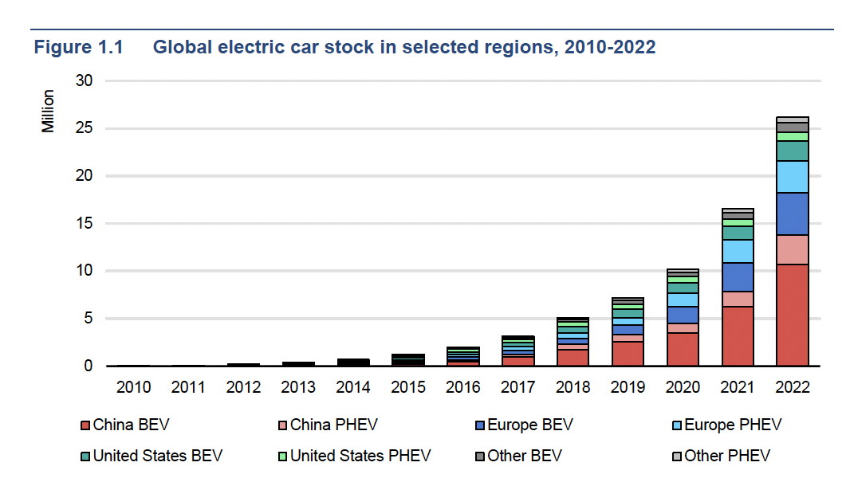
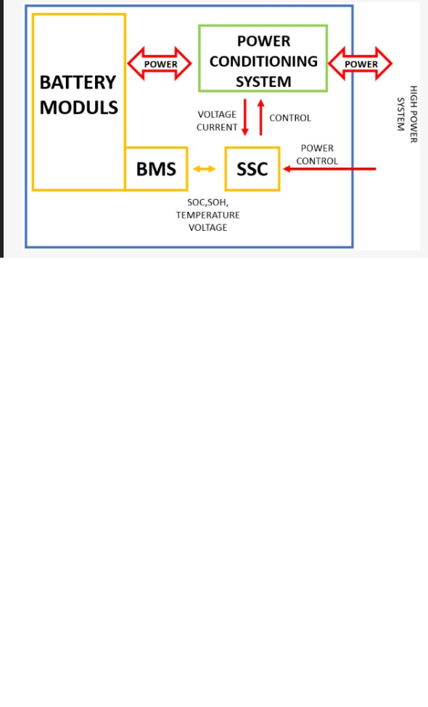
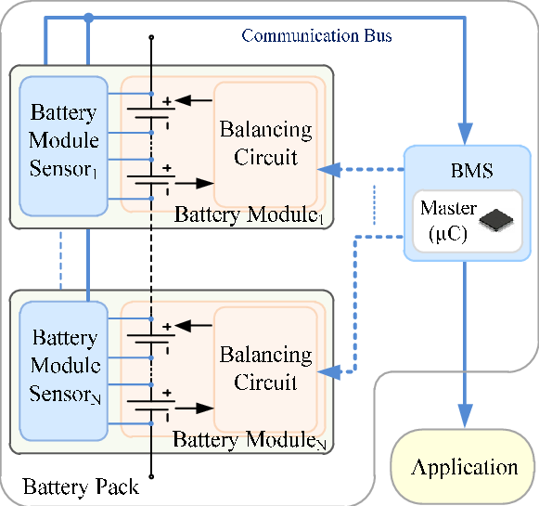
INTRODUCTION
Global EV uptake 2023
2/3 – Wheelers And Their Benefit
Battery Technology: Battery technology refers to the development of batteries that can be used to store energy and optimization of the discharge of electrical energy from the battery (Khan, 2024). It often involves a range of batteries such as lead-acid, solid-state, and lithium-ion batteries.
Battery Management System (BMS): Battery management systems (BMS) are a key component in 2/3 wheeled electric vehicles just like any other battery-powered vehicles (Ravi and Surendra, 2021). It is the unit that controls and optimizes the functions of the battery that powers EVs (Samy et al., 2014). There are two main categories of BMS: traditional BMS and model-based BMS.

Slide 3
BACKGROUND/PURPOSE
The advanced AI-based battery management system (BMS) aims to enhance the performance, lifespan, and efficiency of electric vehicle batteries by integrating complex algorithms with real-time data collection from embedded sensors, ensuring safer and more sustainable operation.
Aim
This study aims to evaluate how to integrate an AI algorithm into a battery management system for a 2/3-wheeler electric vehicle to optimize the flow of power and improve the overall performance of the vehicle.
Objectives
To develop an AI-controlled battery management system that can optimize the flow and distribution of power in 2/3 of electric vehicles.
To integrate a complex machine learning algorithm that is capable of learning and predicting the driver’s driving behavior and optimize the flow of power in 2/3 electric vehicles to suit the driver's situation.

Slide 4
Metholody
Sodium-ion battery cells or packs
Sensors and Data Acquisition Systems
Computing hardware
Software tools
Data Collection, Preprocessing, and Analysis
Machine Learning Algorithm
Optimization Processes
Simulations and modeling

Slide 5
FINDINGS/RESULTS

Slide 6
DISCUSSIONS

Slide 7
CONCLUSION AND FUTURE WORK

Slide 8
REFERENCES

