Slide 1
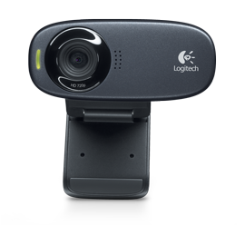
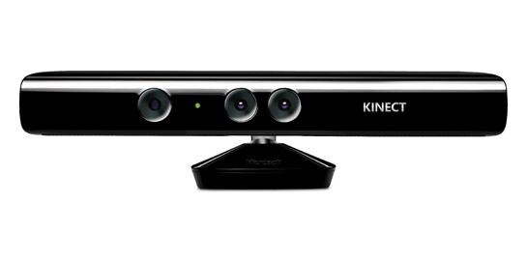
Pipeline for Improving Accuracy of Hand Gesture Detection By Kenny Yu
Motivation: Implement Kinect-like hand gesture detection capabilities using a commodity webcam (e.g. control Google Maps with your hands)
Problem: Given a poorly trained Haar cascade classifier for hand gestures, how can we improve the accuracy of the detection?

Slide 2
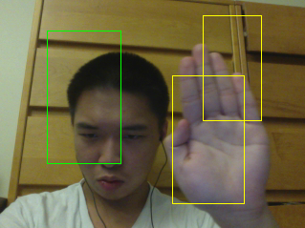
My Solution: Build a Pipeline.
1. Original Haar Cascade

Slide 3

My Solution: Build a Pipeline.
1. Original Haar Cascade
2. Remove Faces

Slide 4
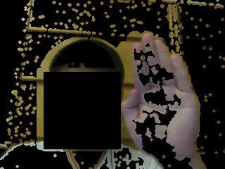
My Solution: Build a Pipeline.
1. Original Haar Cascade
2. Remove Faces
3. Background Subtraction

Slide 5
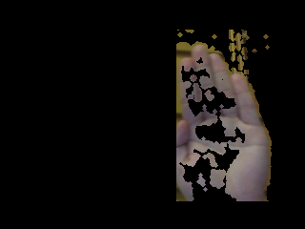
My Solution: Build a Pipeline.
1. Original Haar Cascade
2. Remove Faces
3. Background Subtraction
4. Kalman Filter Prediction

Slide 6
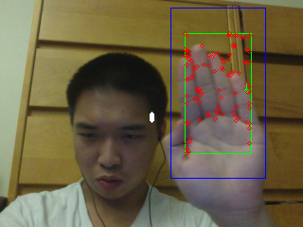
My Solution: Build a Pipeline.
1. Original Haar Cascade
2. Remove Faces
3. Background Subtraction
5. Hand Detection and Optical
Flow using Lucas-Kanade
4. Kalman Filter Prediction

Slide 7
My Solution: Build a Pipeline.
1. Original Haar Cascade
2. Remove Faces
6. Kalman Filter Update
3. Background Subtraction
5. Hand Detection and Optical
Flow using Lucas-Kanade
4. Kalman Filter Prediction

Slide 8
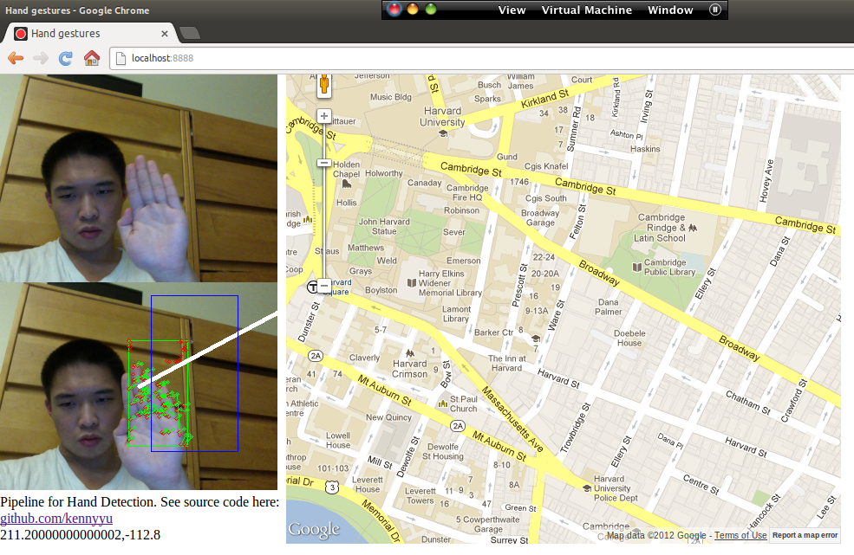
Result: Control Google Maps With Your Hand
Built using:
OpenCV
Websockets
Chrome WebRTC
(access to webcam)
Notes:
Fewer false positives
than applying Haar
cascade alone
Sensitive to moving
objects in background
Sensitive to non solid
background
Need Chrome and webcam to run demo!
Code: http://github.com/kennyyu/cs283-project
Live Demo (you can try it out!): http://goo.gl/pcNxG

