Slide 1
CS50 WEEK 10
Kenny Yu

Slide 2
Announcements
Quiz 1 Review Slides + Video Posted
Problem Set 7 Returned
Pick up your Quiz 0 from me right NOW if you have not already
My section resources are posted here:
  https://cloud.cs50.net/~kennyyu/section/
  Doug Lloyd’s practice test + answers
  Doug Lloyd’s Quiz 1 Review Guide
  Jenny Ye’s question breakdown-by-topic of the past few years’ quizzes

Slide 3
Agenda
C
  Pointers, Recursion, Structs
  Call Stack, Memory Organization, Malloc, Free
  File I/O
Data Structures
  Stacks, Queues, Linked Lists, Binary Search Trees, Tries, Hash Tables
  Linear Search, Binary Search, Merge Sort, Selection Sort, Insertion Sort, Bubble Sort, Big O
Client-Server Model
HTML
  Tags, attributes, DOM
CSS
  Selectors
JavaScript
  Associative arrays, variables, DOM objects + properties, events
PHP
  Scope, $_GET, $_POST
SQL
  SELECT, UPDATE, INSERT, DELETE
Ajax

Slide 4
C - Pointers
Pointers are addresses (their value is the address of another variable).
& address operator
* syntax
  Type definition: int *ptr; (ptr has type int *)
  Dereference: int x = *ptr;
  Dereference Assignment: *ptr = 5;

Slide 5
C - Pointers
& (address operator) and * (dereference) are inverses
  &: type -> type *
  *: type * -> type

Slide 6
Structs
typedef struct {
char *name;
int age;
} student;
// struct initialization
student s1 = {
.name = “Santa”,
.age = 12
};
// dot operator
int s1_age = s1.age;
// pointer to struct, ptr->age equivalent to (*ptr).age
student *ptr = &s1;
int s1_age_again = ptr->age;

Slide 7
Malloc/Free
Use malloc() to dynamically allocate space on the heap
  char *buffer = malloc(256 * sizeof(char));
  student *ptr = malloc(sizeof(student));
    ptr->age = 5;
All malloc’ed space must be freed
  Otherwise a memory leak!
  free(buffer);

Slide 8
Recursion
Write a recursive solution to find the n-th fibonacci number:

Slide 9
Recursion
Write a recursive solution to find the n-th fibonacci number:
int fib_rec(int n) {
if (n == 0)
return 0;
if (n == 1)
return 1;
return fib_rec(n-1) + fib_rec(n-2);
}

Slide 10
Recursion
Write a recursive solution to find the n-th fibonacci number:
int fib_rec(int n) {
if (n == 0)
return 0;
if (n == 1)
return 1;
return fib_rec(n-1) + fib_rec(n-2);
}
Why is this solution bad? What things can go wrong?

Slide 11
Recursion
Write a recursive solution to find the n-th fibonacci number:
int fib_rec(int n) {
if (n == 0)
return 0;
if (n == 1)
return 1;
return fib_rec(n-1) + fib_rec(n-2);
}
Why is this solution bad? What things can go wrong?
  Exponential Run Time
  Potential Stack Overflow with any (non-tail) recursive function

Slide 12
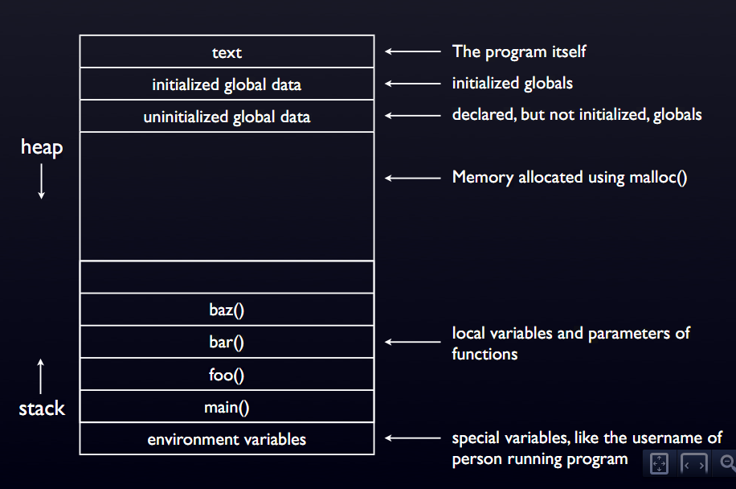
Memory Layout

Slide 13
Heap and Stack
Heap
Contains global variables.
Dynamically allocated memory reserved on heap.
Lower Memory Addresses
Memory belonging to process.
Contains local variables.
Function calls create new ‘frames’ on the stack.
Stack
Higher Memory Addresses

Slide 14
Heap and Stack
Heap
Lower Memory Addresses
Space is dynamically
allocated for “cat” in
the heap
‘c’
‘a’
‘t’
‘\0’
Memory belonging to process.
In main:
// user enters “cat”
char *s = GetString();
s
Stack
Higher Memory Addresses

Slide 15
How to Cause a Segfault
Dereferencing a NULL pointer
Accessing beyond the legal bounds of an array (sometimes)
Stack Overflow
  int main() { main(); }

Slide 16
How to Cause a Segfault
Dereferencing a NULL pointer
Accessing beyond the legal bounds of an array (sometimes)
Stack Overflow
  int main() { main(); }
(Coding in C)

Slide 17
File I/O
Know what all of these are and what they do (return values, when they are used)
  fopen
  fclose
  fread
  fwrite
  fseek
Always make sure fopen doesn’t return NULL

Slide 18
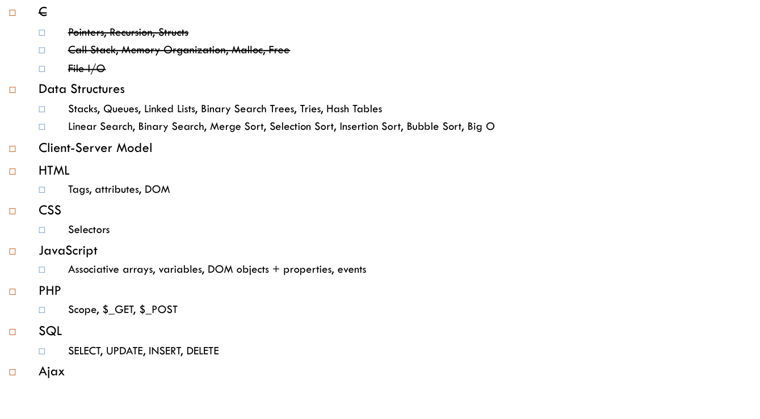
Agenda

Slide 19
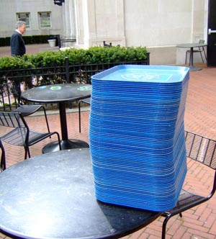
Stack
A stack is a first-in-last-out (FILO) data structure
  Think of cafeteria trays, the call stack
Operations:
  Push: we add an item onto
  the top of the stack
  Pop: we remove the top item
  of the stack
  Peek: we retrieve the top item
  of the stack without removing
  it

Slide 20
Stack – Sample Header File
/* stack.h
* contains the type definitions and function headers
* for stacks */
/* alias ‘struct stack’ to be ‘stack’; ‘struct stack’
* still needs to be defined elsewhere */
typedef struct stack stack;
/* stack operations. We can only store ints. */
void push(stack *, int);
int pop(stack *);
int peek(stack *);

Slide 21

Queues
A queue is a first-in-first-out (FIFO) data structure
  Think of waiting in a line
Operations
  Enqueue: Add an item
  to the end of the queue
  Dequeue: Remove the
  first item of the queue
  Peek: Retrieve the first
  item of the queue without removing it

Slide 22
Queue – Sample Header File
/* queue.h
* contains the type definitions and function headers
* for stacks */
/* alias ‘struct queue’ to be ‘queue’; ‘struct queue’
* still needs to be defined elsewhere */
typedef struct queue queue;
/* queue operations. We can only store ints. */
void enqueue(queue *, int);
int dequeue(queue *);
int peek(queue *);

Slide 23
Linked Lists
1
5
4
2
3
NULL

Slide 24
Linked Lists
A linked list consists of nodes, where each node has a value and a pointer to the next object (node) in the list.
struct lnode {
int value;
struct lnode *next;
};

Slide 25
Linked Lists
struct lnode {
int value;
struct lnode *next;
};
value
next
value
next
4
NULL
6
struct lnode
struct lnode

Slide 26
Adding/removing from a linked list
Can’t lose any pointers (or else we lose the rest of the list!)
value
next
4
NULL
value
next
value
next
4
6
NULL
struct lnode
struct lnode

Slide 27
Adding/removing from a linked list
Can’t lose any pointers (or else we lose the rest of the list!)
value
next
4
value
next
value
next
4
6
NULL
struct lnode
struct lnode

Slide 28
Adding/removing from a linked list
Can’t lose any pointers (or else we lose the rest of the list)
value
next
4
value
next
value
next
4
6
NULL
struct lnode
struct lnode

Slide 29
Linked Lists
If we only have a pointer to the start of the list, what are the Big O for these operations?
    Insert_first
    Insert_last
    Remove_first
    Remove_last
    find

Slide 30
Linked Lists
If we only have a pointer to the start of the list, what are the Big O for these operations?
    Insert_first – O(1)
    Insert_last – O(n)
    Remove_first – O(1)
    Remove_last – O(n)
    Find – O(n)

Slide 31
Binary Search Trees
5
3
9
1
7
6
8
NULL

Slide 32
Binary Search Trees
A binary search tree (BST) consists of nodes that has a value and two pointers, one pointer to its left child node and one pointer to its right child node
  Invariants:
    Every element in the left subtree is less than the current element
    Every element in the right subtree is greater than the current element
    Left and right child nodes are also BSTs.

Slide 33
Binary Search Trees
struct bstnode {
int value;
struct bstnode *left;
struct bstnode *right;
};
5
3
X
9
X
1
X
X
7
6
X
X
8
X
X

Slide 34
Example
typedef struct bstnode bstnode;
struct bstnode {
int value;
struct bstnode *left;
struct bstnode *right;
};
Write a function that when given a pointer to a bstnode, prints out the nodes in the tree in increasing order.
void inorder_traversal(bstnode *root) {
//TODO
}

Slide 35
Example
typedef struct bstnode bstnode;
struct bstnode {
int value;
struct bstnode *left;
struct bstnode *right;
};
Write a function that when given a pointer to a bstnode, prints out the nodes in the tree in order.
void inorder_traversal(bstnode *root) {
if (root == NULL) return;
inorder_traversal(root->left);
printf(“%d\n”,root->value);
inorder_traversal(root->right);
}

Slide 36
Binary Search Trees
A BST is balanced if every node has two children.
What are the big O for these operations in a balanced BST? What about an unbalanced BST?
  Remove
  Add
  Min
  Find

Slide 37
Binary Search Trees
A BST is balanced if every node has two children.
What are the big O for these operations?
  RemoveMin – balanced: O(log n), unbalanced: O(n)
  Add – balanced: O (log n), unbalanced: O(n)
    Traverse down the tree to find the appropriate spot
  Min – balanced: O (log n), unbalanced: O(n)
    Traverse all the way left
  Find – balanced: O (log n), unbalanced: O(n)
    Analagous to a binary search

Slide 38
Trie
0
X
1
X
1
0
X
0
X
X
1
X
X
1
X
X
1

Slide 39
Trie
A trie is a tree with N pointers and a boolean variable, is_terminating
  Each pointer represents a letter in the alphabet of N letters. The existence of a pointer, combined with is_terminating, represents the existence of that word
  is_terminating indicates whether what we’ve looked at so far is in the data structure

Slide 40
Trie – What words are in our dict?
ptrs
is_terminated
struct trie_node {
struct trie_node *ptrs[N];
bool is_terminated;
};
Here N = 2;
Alphabet: {a,b}
0
X
1
X
1
0
X
0
X
X
1
X
X
1
X
X
1

Slide 41
Trie – What words are in our dict?
ptrs
is_terminated
struct trie_node {
struct trie_node *ptrs[N];
bool is_terminated;
};
Here N = 2;
Alphabet: {a,b}
0
X
1
X
1
a
b
0
X
1
ba
X
X
1
X
X
1
X
X
1
bab
aba
abb

Slide 42
Why use a trie?
Very efficient lookup
  Especially if many words in your language share common prefixes
  Lookup for a word is O(n), where n is the length of the string—basically constant time!
Heavy memory usage

Slide 43
Hash Tables
A hash table consists of an array and a hash function
  Allows us to check whether something is contained in a data structure without checking the entire thing
A hash function maps input (in our case, a string) to a number (called the input’s hash value)
  We use the hash value as an index in the associated array
When we check to see if a string is in our dictionary, we compute the string’s hash value, and check if array[hash_value] is set

Slide 44
Hash Tables
3
4
5 | X
6
7 | X
8
...
1
2
10
11

Slide 45
Hash Tables
Good hash functions are
  Deterministic (calling the hash function on the same string always returns the same result)
  Uniformly distributed
What happens if two strings get mapped to the same hash value?
  We have a collision.

Slide 46
Hash Tables
How do we solve collisions? Several methods, here are two ways
  Separate chaining – each bucket in our hash table is actually a pointer to a linked list
    if a word hashes to a bucket that already has words, we append it to the linked list at that bucket
  Linear probing – if a word hashes to a bucket that already has words, then we keep scanning down the buckets to find the first one that is empty.

Slide 47
Hash Tables – Separate Chaining
3
4
5 | X
6
7 | X
8
...
1
3
…
10
12
…
11
X

Slide 48
Hash Tables
Assuming a good hash function with few collisions, what is the run time for these operations?
  Add
  Remove
  find

Slide 49
Hash Tables
Assuming a good hash function with few collisions, what is the run time for these operations?
  Add – O(1)
  Remove – O(1)
  Find – O(1)
All constant time!
  Tradeoff between Time and Space—must use a lot of space for a very large array

Slide 50
Big O
The Big O of a function is the asymptotic runtime of a function
  Provides us with a way of determining if one algorithm is “better” than another
O(n) : Worst Case
Ω(n) : Best Case
Θ(n) : Average (Amortized) Case

Slide 51
Big O
Faster -> Slower
O(1)
O(log n)
O(n)
O(n log n)
O(n^2)
O(5^n)
O(n!)

Slide 52
What are the big O’s of these?
Algorithm | O(n): Worst | Ω(n): Best | Θ(n): Average
Linear Search
Binary Search
Merge Sort
Selection Sort
Insertion Sort
Bubble Sort

Slide 53
What are the big O’s of these?
Algorithm | O(n): Worst | Ω(n): Best | Θ(n): Average
Linear Search | n | 1 | n
Binary Search
Merge Sort
Selection Sort
Insertion Sort
Bubble Sort

Slide 54
What are the big O’s of these?
Algorithm | O(n): Worst | Ω(n): Best | Θ(n): Average
Linear Search | n | 1 | n
Binary Search | log n | 1 | log n
Merge Sort
Selection Sort
Insertion Sort
Bubble Sort

Slide 55
What are the big O’s of these?
Algorithm | O(n): Worst | Ω(n): Best | Θ(n): Average
Linear Search | n | 1 | n
Binary Search | log n | 1 | log n
Merge Sort | n log n | n log n | n log n
Selection Sort
Insertion Sort
Bubble Sort

Slide 56
What are the big O’s of these?
Algorithm | O(n): Worst | Ω(n): Best | Θ(n): Average
Linear Search | n | 1 | n
Binary Search | log n | 1 | log n
Merge Sort | n log n | n log n | n log n
Selection Sort | n^2 | n^2 | n^2
Insertion Sort
Bubble Sort

Slide 57
What are the big O’s of these?
Algorithm | O(n): Worst | Ω(n): Best | Θ(n): Average
Linear Search | n | 1 | n
Binary Search | log n | 1 | log n
Merge Sort | n log n | n log n | n log n
Selection Sort | n^2 | n^2 | n^2
Insertion Sort | n^2 | n | n^2
Bubble Sort

Slide 58
What are the big O’s of these?
Algorithm | O(n): Worst | Ω(n): Best | Θ(n): Average
Linear Search | n | 1 | n
Binary Search | log n | 1 | log n
Merge Sort | n log n | n log n | n log n
Selection Sort | n^2 | n^2 | n^2
Insertion Sort | n^2 | n | n^2
Bubble Sort | n^2 | n | n^2

Slide 59
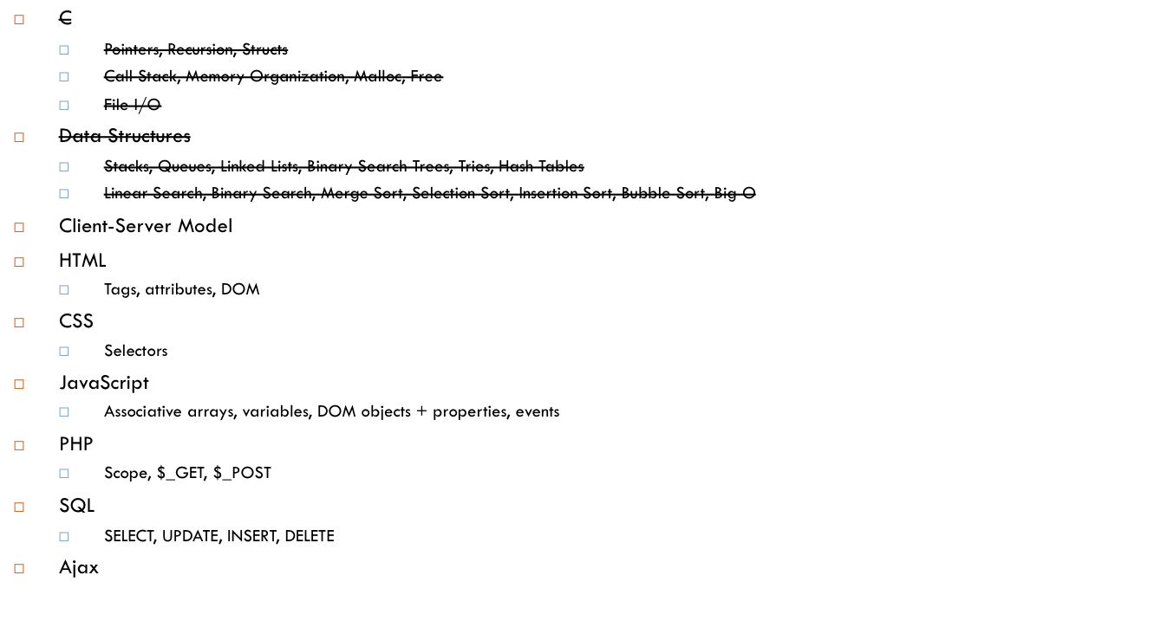
Agenda

Slide 60
Overview of the Internet
TCP (Transmission Control Protocol): convention computers use to transfer data (in “packets”) with one another (analogy: the letter you send via mail)
IP (Internet Protocol): convention computers use to route packets from one computer to another (analogy: the US Postal System)
  every computer has an I.P. Address unique to that computer (e.g. your home address)
    IPv4: ###.###.###.### where # is 0-9
DNS (Domain Name System): allows us to alias IP addresses with readable names (analogy: the Quad = 59 Shepard Street [not actually true])
    E.g. google.com = 74.125.226.208
HTTP (Hypertext Transfer Protocol) – the world wide web protocol
SSL (Secure Sockets Layer) – (https) used to encrypt data

Slide 61
Server-Client Model
HTTP GET/POST
Fetch data from database
Client
(JavaScript handles all the logic on the client-side, HTML renders the page, CSS adds style)
Server
(PHP, Python, Ruby, Java, etc. handle the logic on the server-side)
Database
(SQL)
Send HTML response
Retrieved data from database

Slide 62
Server-Client Model
Client-side (runs on your browser)
  HTML – the structure of a web page
  CSS – the style of a web page
  JavaScript – the logic of a web page
    Allows for dynamic content!
Server-side (runs across the Internet)
  PHP – accepts requests and renders the HTML response
  MySQL – database software
Ajax is a combination of all these technologies (JavaScript to send the asynchronous request, PHP to handle it and send the response)

Slide 63
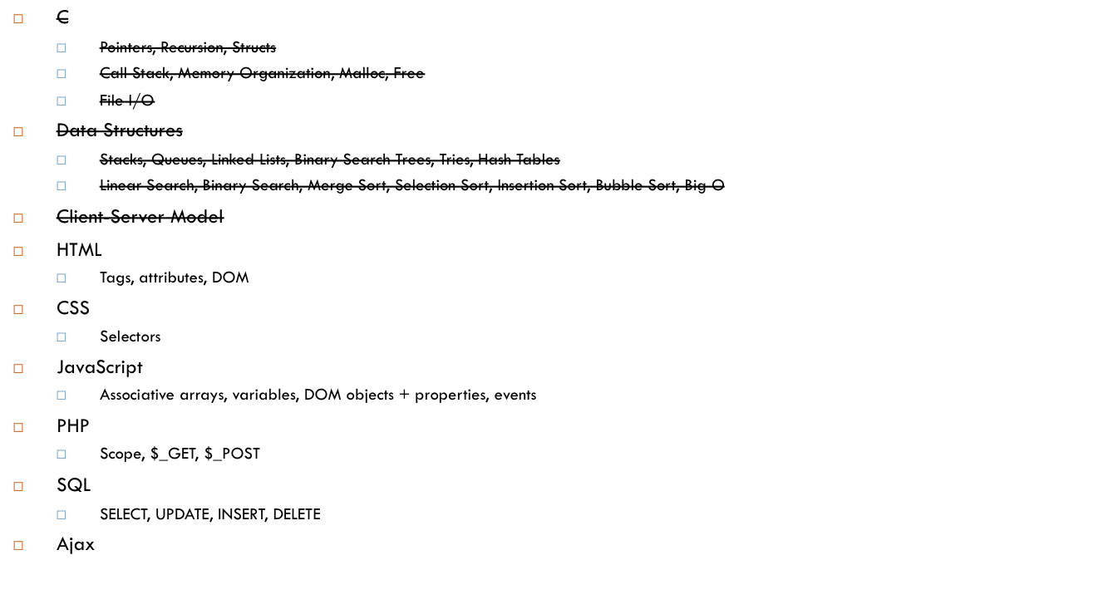
Agenda

Slide 64
HTML – the structure of a page
Some basic tags
  <html>
  <head>
  <body>
  <div>
  <img>
  <a>
  <form>
  <style>
  <link>
  <script>

Slide 65
HTML – the structure of a page
<img src=“photo.jpg” alt=“A piece of Junior’s Cheesecake” id=“cheesecake”>
  img : the tag name
  src, alt, id: the attributes
  “photo.jpg” : value
<div id=“bottom>Hello World!</div>
  “Hello World!” is the innerHTML

Slide 66
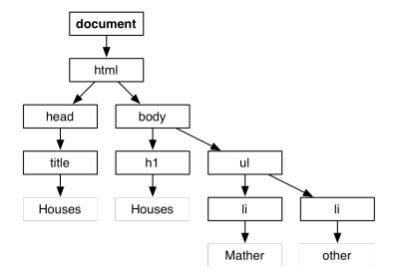
HTML
The HTML of a webpage forms a tree, which we call the DOM (Document Object Model)
Question (2010, #4): Write the HTML corresponding to this DOM

Slide 67
HTML
<html>
<head>
<title>Houses</title>
</head>
<body>
<h1>Houses</h1>
<ul>
<li>Mather</li>
<li>other</li>
</ul>
</body>
</html>
A down arrow means a child. Two nodes next to each other are siblings (they share the same parent).

Slide 68

Agenda

Slide 69
CSS – the style of a document
3 ways to include CSS
  In a separate .css file, linked to your page with a <link> tag
  In a <style> tag in the <head> of your HTML
  In the style attribute of any individual tag
    <div style=“font-size: 16px;”>

Slide 70
CSS - selectors
p // stylize all <p> tags on the page
{
font-size: 16px;
}
.student // all elements that have class “student” (eg. <div class=“student”>...</div>)
{
font-size: 17px;
}
#special // the only element on the page with id “special” (eg.<div id=“special”>…</div>)
{
font-size: 100px;
}

Slide 71

Agenda

Slide 72
JavaScript
Programming language
  Loosely typed
    var x = 5; x = “apple”;
  Interpreted
    NOT compiled like C, instead your browser directly runs the javascript code
Run on client (your browser)

Slide 73
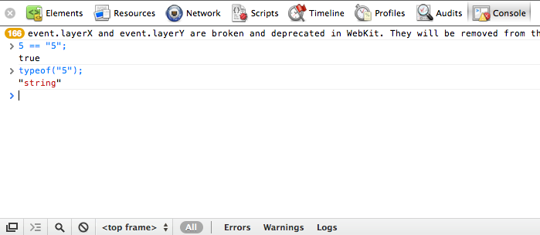
JavaScript Console
You can use your web browser’s console (supported in Chrome and Firefox, possibly others)
  Right Click > Inspect Element > Console
  allows you to enter javascript code line by line and execute it right away to see if it makes sense

Slide 74
Javascript
Global variables
  No “var” when declaring variables
+ addition, string concatenation
  var s = “cheese” + “cake”
== equality, after type juggling
  5 == “5” ➔ true
=== equality and type equality
  5 === 5 ➔ true; 5===“5” ➔ false
Typeof
  var s = typeof(5); ➔ s is “number”

Slide 75
JavaScript Arrays vs. C Arrays
Javascript | C
No need to declare size on declaration | Must declare size on declaration
Has methods var array = [“a”,”b”,”c”]; var len = array.len; array.sort(); | C arrays have no methods (given an array, there’s no way to compute the size!)
Arrays can store different types var array = [5,”cheese”]; | Arrays must store only the same type

Slide 76
JavaScript Associative Arrays
Normal arrays (lists) have square brackets []
Associate arrays (dictionaries) have curly braces {}
  var dict = {“cheese”: 5, “apple”: 7, 8: “eight”}
  var entry = dict[“cheese”];
  var entry2 = dict[8];
Dictionaries can map any type to any other type
  Eg. Strings -> numbers
  Eg. Numbers (hash values) -> strings (like pset6)

Slide 77
JSON
Javascript Object Notation – just nested dictionaries!
  A way of representing data (see the pokemon example from last week!)
{
“Quincy”: {
“lat”: 42.0,
“lng”: 22.0,
},
“Eliot” : {
“lat”: 23.0,
“lng”: 63.3,
},
“Kenny” : {
“house”: “Quincy”,
“concentration” : “Computer Science”,
},
}

Slide 78
For-each loop
var days = [“Sunday”, “Monday”, …, “Saturday”];
for (var i = 0; i < days.length; i++) {
console.log(days[i]); // outputs to browser’s
// console
}
OR
for (var day in days) {
console.log(days[day]);
}

Slide 79
JavaScript + DOM
JavaScript allows us to edit the DOM (the tree of html elements)

Slide 80
DOM Example
<html>
<head>
<script> // we can embed javascript right into our HTML!
var special_text = document.getElementById(“special”).innerHTML;
console.log(special_text); // prints Hello World to console
document.getElementById(“special”).innerHTML = “Goodbye World!”;
</script>
</head>
<body>
<div id=“special”>Hello World</div>
</body>
</html>

Slide 81
Properties of DOM Objects
innerHTML: text contained within an element
nodeName: name of the tag of the element
parentNode: parent of the current element
  Returns another DOM object
children: array of child elements (DOM objects)
style: dictionary object representing CSS properties of element
attributes: returns a dictionary mapping each DOM object’s attribute to its value.

Slide 82
Event handlers
Event handlers listen for an event (a mouse click, a key press, on hover, etc.) and then execute code when that event happens
  E.g. in your scratch project, you made an event handler: “when green flag button is pressed, do this”
  Makes your website a lot more dynamic!
http://www.w3schools.com/jsref/dom_obj_event.asp
  onclick, onselect, onload, onunload, onkeyup, onkeydown, onmouseup, …

Slide 83
Event handlers - example
<script>
function submit_clicked() {
var submitted_user =
document.getElementById(“username”).value;
alert(“Hi “ + submmitted_user + “!”);
}
</script>
...
<input type=“text” id=“username”>
<button onclick=“submit_clicked()”>Submit!</button>

Slide 84
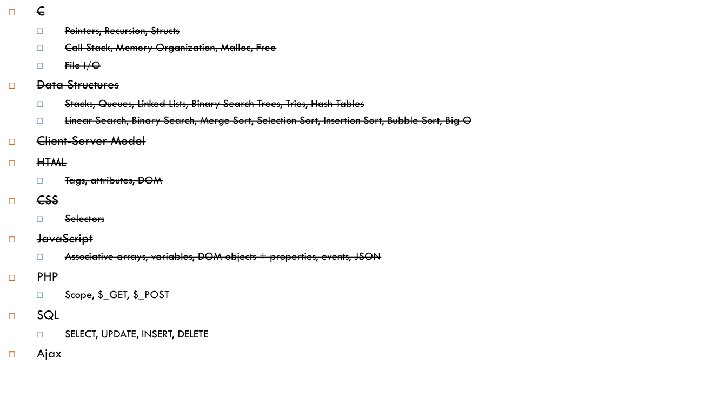
Agenda

Slide 85
PHP
Programming language
  Loosely typed
  Interpreted
  Variables prefixed with $
Run on server
Allows us to generate dynamic HTML web pages (instead of static pages that are always the same)

Slide 86
PHP
All variables are global!
if ($x == 2) {
$y = 7;
} else {
$y = 9;
}
echo $y

Slide 87
GET vs. POST
GET
  Parameters are in the URL
    E.g. foo.php?stock=CHEESE&name=Kenny
  Used to get something without writing any data to the server
  Usually to send small data
POST
  Parameters are NOT in URL
  Used to send sensitive data (eg. Passwords)
  Used to write something to the server (buying/selling stock)
  Used to send larger amounts of data (e.g. files)

Slide 88
PHP
$_GET
$_POST
These are associative arrays
Make sure to check if parameters were passed in before using them!
  E.g. if (!isset($_GET[“name”]) { //error }
Make sure to sanitize all your inputs, especially to prevent SQL injection
  $name = mysql_real_escape_string($_GET[“name”]);

Slide 89

Agenda

Slide 90
SQL
Structured Query Language
  Used to interact with database software such as MySQL
SELECT, INSERT, UPDATE, DELETE

Slide 91
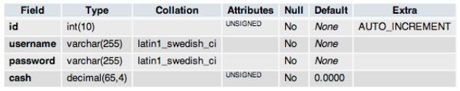
SQL – clients table (2010, #42-43)
Write a query to deduct $20 from every client that has less than $5000 cash (assume >= $20).

Slide 92
SQL – clients table (2010, #42-43)
Write a query to deduct $20 from every client that has less than $5000 cash (assume >= $20).
UPDATE clients SET cash = cash – 20 WHERE cash < 5000

Slide 93
SQL – clients table (2010, #42-43)
Write a query to delete a client whose username is “dhsen”

Slide 94
SQL – clients table (2010, #42-43)
Write a query to delete a client whose username is “dhsen”
DELETE FROM clients WHERE username = ‘dshen’

Slide 95
SQL – clients table (2010, #42-43)
Write a query to insert a new client with id 42, username kennyyu, password cheese, cash $0

Slide 96
SQL – clients table (2010, #42-43)
Write a query to insert a new client with id 42, username kennyyu, password cheese, cash $0
INSERT INTO clients (id,username,password,cash)
VALUES (42,’kennyyu’,’cheese’,0)
NOTE: don’t store passwords in plaintext!

Slide 97
SQL – clients table (2010, #42-43)
Write a query to select all clients’ usernames that have id > 42

Slide 98
SQL – clients table (2010, #42-43)
Write a query to select all clients’ usernames that have id > 42
SELECT username FROM clients WHERE id > 42

Slide 99

Agenda

Slide 100
AJAX
How do you get new data from the server without ever refreshing the webpage?
  E.g. Gmail, Google Calendar, Google Docs, Facebook, …
We load data asynchronously (out of the usual client-server order)
  No need to refresh pages to see new content!
  The client can grab data from the server and dynamically load it into webpage.

Slide 101
AJAX
http://cdn.cs50.net/2011/fall/lectures/10/src10/ajax/ajax5.html
Create “xhr” object (XMLHTTPRequest)
Construct URL to send request to
Set up handler (provide a callback function to call when the request completes)
Open request
Send request

Slide 102
Ajax – trace through
Your browser creates the XHR object (and you provide a callback function)
Request is sent to the server
The server processes the request, sends back a response (may contain data, may contain nothing)
The callback function is called on the response data
  Usually, this adds the server-response data dynamically into the webpage
https://cloud.cs50.net/~kennyyu/section/week9/pokemon_sol/

Slide 103

Agenda

Slide 104
The web is such a friggin’ hack
“Imagine if I told you we were going to build a system to run our company. We’d use a domain specific language for the data-store, a second language for the back-end code which is run on a server written in a third language, a fourth xml-based approach to explain the documents, a fifth DSL to explain the styling of said document, a sixth language to write the front-end code, and a seventh “language” that is actually a library that makes the sixth language usable for our purposes. Would anyone think I was crazy?”
http://lbrandy.com/blog/2010/10/things-that-i-think-i-think/

Slide 105
The web is such a friggin’ hack
“Imagine if I told you we were going to build a system to run our company. We’d use a domain specific language for the data-store, a second language for the back-end code which is run on a server written in a third language, a fourth xml-based approach to explain the documents, a fifth DSL to explain the styling of said document, a sixth language to write the front-end code, and a seventh “language” that is actually a library that makes the sixth language usable for our purposes. Would anyone think I was crazy?”
http://lbrandy.com/blog/2010/10/things-that-i-think-i-think/
SQL, PHP (and other languages as well), C (Unix Operating Systems), HTML, CSS, JavaScript, jQuery (not part of this course)

Slide 106
Any Questions?
?

