Slide 1
CS50 SECTION: WEEK 3
Kenny Yu

Slide 2
Announcements
Watch Problem Set 3’s walkthrough online if you are having trouble.
Problem Set 1’s feedback have been returned
Expect Problem Set 2’s feedback and scores by Friday, and future problem sets feedback on Friday hereafter.
Take advantage of resources online—scribe notes!
  Example (Week 3, Monday): http://cdn.cs50.net/2011/fall/lectures/3/notes3m.pdf)
All my resources from section will be posted online here:
  https://cloud.cs50.net/~kennyyu/section/
Please answer these weekly polls to help me improve section!
  https://www.google.com/moderator/#15/e=a9fce&t=a9fce.43
My office hours: Tuesdays 9pm-12am, Leverett Dining Hall

Slide 3
Agenda
Recursion
Asymptotic Notation
Search
  Linear
  Binary
Sort
  Insertion
  Selection
  Bubble
  Merge
GDB

Slide 4
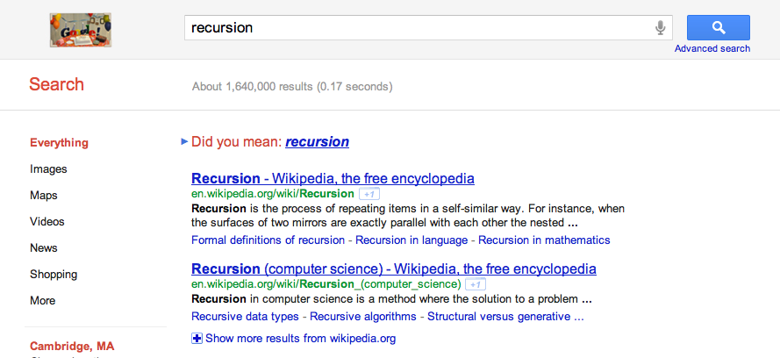
What is recursion?

Slide 5
What is recursion?
Recursion – a method of defining functions in which the function being defined is applied within its own definition
A recursive function is a function that calls itself

Slide 6
Components of a recursive function
Recursive Call – part of function which calls the same function again.
Base Case – part of function responsible for halting recursion; this prevents infinite loops

Slide 7
Factorial
Factorial Definition:
n! = 1
  n * (n-1)!
n == 1
otherwise

Slide 8
Factorial
int factorial(int num) {
// base case!
if (num <= 1)
return 1;
// recursive call!
else
return num * factorial(num - 1);
}
Factorial calls itself with a smaller input.

Slide 9
Recursive vs. Iterative
RECURSIVE WAY:
int factorial(int num) {
if (num <= 1)
return 1;
else
return num * factorial(num - 1);
}
ITERATIVE WAY:
int factorial(int num) {
int product = 1;
for (int i = num; i > 0; i--)
product *= num;
return product;
}

Slide 10
Call Stack Revisited
Each function call pushes a stack frame
  So recursive functions repeatedly push on stack frames
Functions higher on the stack must return before functions lower on the stack can return
func3()
func2()
func1()
main()

Slide 11
Animation
See Animations.ppt Slides 2-3

Slide 12
Recursion vs. Iterative
When should you use recursion?
  Sometimes, it may be really hard to do something iteratively (example: descending a binary search tree)
  It simplifies your code
  When you are already given the recursive definition of a function mathematically
When should you not?
  Can potentially lead to a stack overflow (running out of memory on the stack)
  But we can get around this by using tail recursion_x0015_: no extra stack frames are made (learn more about this in CS 51!)

Slide 13
Asymptotic Notation
A way to evaluate efficiency
Every program causes machine instructions to run
  Asymptotic notation tells us how many machine instructions have to be run (and therefore how long a program will run) based on the size of the input to the program

Slide 14
Asymptotic Notation
Big Oh notation
O(n) – Worst Case: upper bound on the runtime
Ω(n) – Best Case: lower bound on the runtime
Θ(n) – Average Case: usual runtime
We usually only care about O(n): worst case

Slide 15
Asymptotic Notation
O(1) – Constant time
O(log n) – Logarithmic time (log base two)
O(n) – Linear time
O(n log n) - Linear * Logarithmic
O(n^2) – Quadratic
O(n^p) – Polynomial
O(2^n) – Exponential
O(n!) - Factorial

Slide 16
Big O
In general:
(A > B means A is faster than B)
Constant > Logarithmic > Linear > Linear * Logarithmic > Quadratic > Polynomial > Exponential > Factorial

Slide 17
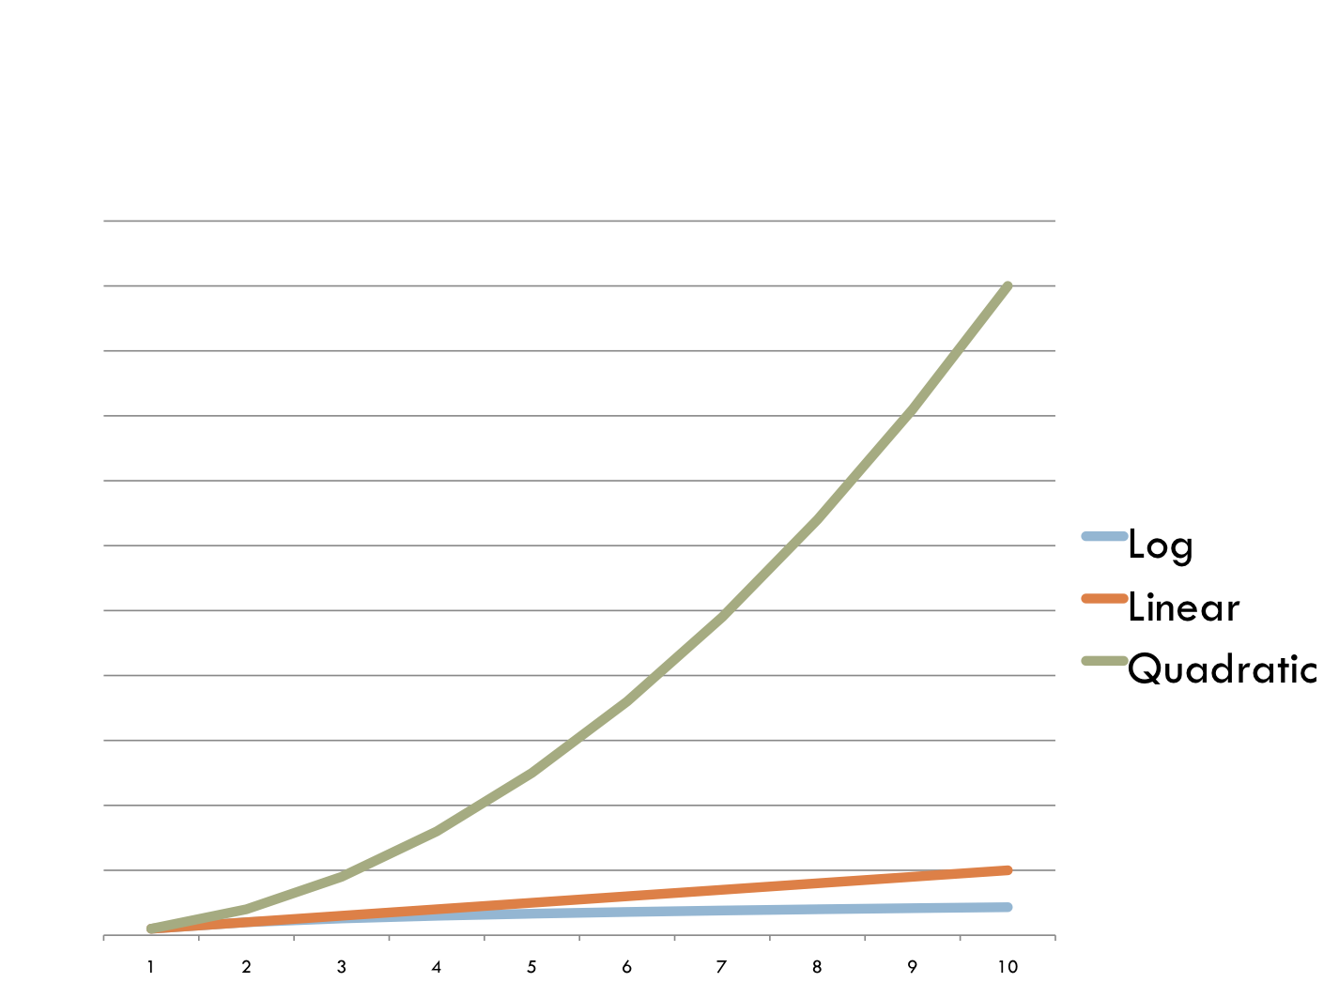
Runtime (x is size of input, y is time)

Slide 18
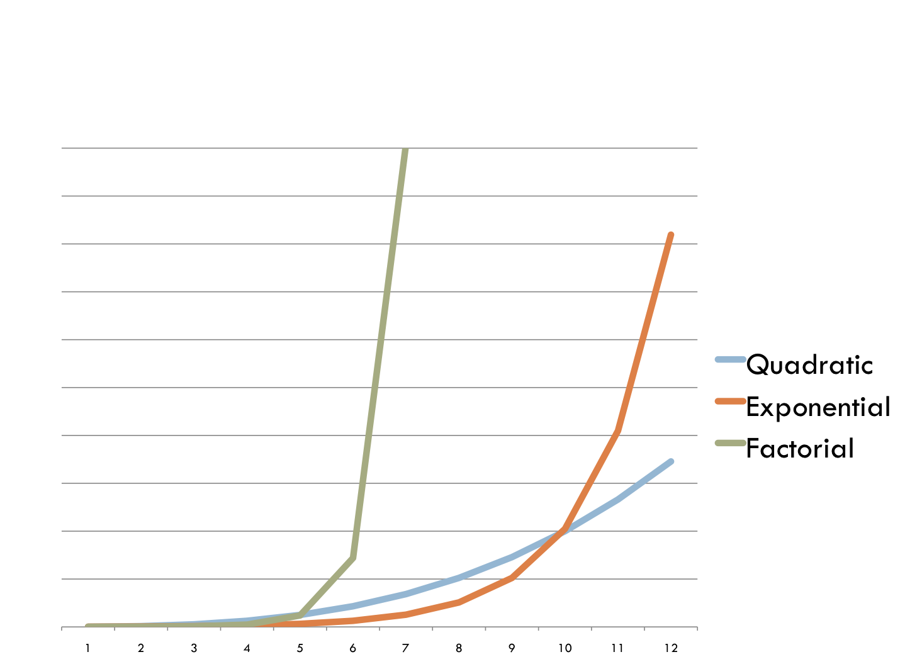
Runtime (x is size of input, y is time)

Slide 19
An example
What is the big O for this function with respect to the length of the array?
int sum(int array[], int n) {
int current_sum = 0;
for (int i = 0; i < n; i++)
current_sum += i;
return current_sum;
}

Slide 20
An example
What is the big O for this function with respect to the length of the array?
int sum(int array[], int n) {
int current_sum = 0;
for (int i = 0; i < n; i++)
current_sum += i;
return current_sum;
}
Linear time ( O(n) )!
We execute n iterations of the loop.

Slide 21
An example
What is the big O for this function with respect to the length of the array?
void print_pairs(int array[], int n) {
_x0005_ for (int i = 0; i < n; i++) {
for (int j = 0; j < n; j++) {
printf(“(%d,%d)\n”,array[i],array[j]);
}
}
}

Slide 22
An example
What is the big O for this function with respect to the length of the array?
void print_pairs(int array[], int n) {
_x0005_ for (int i = 0; i < n; i++) {
for (int j = 0; j < n; j++) {
printf(“(%d,%d)\n”,array[i],array[j]);
}
}
}
Quadratic time ( O(n^2) )!
We execute n^2 iterations of the loop.

Slide 23
An example
What is the big O for this function with respect to the length of the array?
void print_stuff(int array[], int n) {
_x0005_ for (int i = 0; i < 10; i++) {
for (int j = 0; j < 10; j++) {
printf(“(%d,%d)\n”,i,j);
}
}
}

Slide 24
An example
What is the big O for this function with respect to the length of the array?
void print_stuff(int array[], int n) {
_x0005_ for (int i = 0; i < 10; i++) {
for (int j = 0; j < 10; j++) {
printf(“(%d,%d)\n”,i,j);
}
}
}
Constant time ( O(1) )!
We execute 100 iterations of the loop, independent of n.

Slide 25
General Heuristics
A single for or while loop usually indicates linear time O(n)
Two nested loops usually indicates quadratic time
O(n^2)
Dividing in half without merging the results of both halves is usually O(log n)
Dividing in half, and then merging the results of the two halves is usually O(n log n)

Slide 26
Linear Search
We iterate through the array from beginning to end, checking whether each element is the element we are looking for
[ 1, 2, 3, 9, 10, 15, 19, 22, 56, 78, 99, 100 ]
What is the big O, with respect to the length of the list?

Slide 27
Linear Search
We iterate through the array from beginning to end, checking whether each element is the element we are looking for
What is the big O, with respect to the length of the list?
  O(n): worst case, the element we are looking for is at the end of the list
  Ω(1): best case, the element we are looking for is at the beginning of the list

Slide 28
Binary Search: Divide and Conquer
Like searching through a phonebook
We check the middle element; if it is not the element we are looking for, check either the right half or the left half, but not both
Is 78 in our list?
[ 1, 2, 3, 9, 10, 15, 19, 22, 56, 78, 99, 100 ]

Slide 29
Binary Search: Divide and Conquer
Like searching through a phonebook
We check the middle element; if it is not the element we are looking for, check either the right half or the left half, but not both
Is 78 in our list?
[ 1, 2, 3, 9, 10, 15, 19, 22, 56, 78, 99, 100 ]

Slide 30
Binary Search: Divide and Conquer
Like searching through a phonebook
We check the middle element; if it is not the element we are looking for, check either the right half or the left half, but not both
Is 78 in our list?
[ 1, 2, 3, 9, 10, 15, 19, 22, 56, 78, 99, 100 ]

Slide 31
Binary Search: Divide and Conquer
Like searching through a phonebook
We check the middle element; if it is not the element we are looking for, check either the right half or the left half, but not both
Is 78 in our list?
[ 1, 2, 3, 9, 10, 15, 19, 22, 56, 78, 99, 100 ]

Slide 32
Binary Search: Divide and Conquer
Like searching through a phonebook
We check the middle element; if it is not the element we are looking for, check either the right half or the left half, but not both
What is the big O, with respect to the length of the list?

Slide 33
Binary Search: Divide and Conquer
Like searching through a phonebook
We check the middle element; if it is not the element we are looking for, check either the right half or the left half, but not both
What is the big O, with respect to the length of the list?
  O(log n): worst case, we divide in half every time
  Ω(1): best case, the element we are looking for is the first one we check
NOTE: The array must be sorted before you do a binary search!!

Slide 34
Sorts
How can we efficiently place things in order?

Slide 35
Bubble Sort
http://www.allsortsofsorts.com/bubble/
  Made by my former CS50 TF!
The larger elements “bubble” up to the end of the array
O(n^2)
Ω(n) – If you keep track of the number of swaps
Move through the array, left to right
  If the current element is less than the element to its right, swap

Slide 36
Insertion Sort
http://www.allsortsofsorts.com/insertion/
It’s how you sort a hand of cards
  Look for smallest card in unsorted part
  You insert the card in the correct position in the currently sorted portion of the hand
O(n^2)

Slide 37
Selection Sort
http://www.allsortsofsorts.com/selection/
O(n^2)
  You find the minimum of the unsorted part of the array
  Swap the minimum to its correct position of the array

Slide 38
Merge Sort – Divide and Conquer
Split the array in half
  Recursively call merge sort on left half
  Recursively call merge sort on right half
  Merge the two halfs together
    We can easily merge two sorted arrays in linear time
O(n log n)
See Animations.ppt Slide 1

Slide 39
GNU Debugger
Especially useful when:
jharvard$ ./my_c_program
Segmentation Fault
WTF is going on here?!?!

Slide 40
GDB – useful commands
break – tell the program to ‘pause’ at a certain point (either a function or a line number)
step – ‘step’ to the next executed statement
next – moves to the next statement WITHOUT ‘stepping into’ called functions
continue – move ahead to the next breakpoint
print – display some variable’s value
backtrace – trace back up function calls

Slide 41
Fun Fun Fun
Go to this link:
https://cloud.cs50.net/~kennyyu/section/week3/week3.c

