Slide 1
CS50 WEEK 5
Kenny Yu

Slide 2
Announcements
Quiz 0 Tomorrow – You should all know your room assignments by tonight
  Old practice exams online
Problem Set 3 has been returned
My section resources are posted here:
  https://cloud.cs50.net/~kennyyu/section/
  TF-written practice exam here: https://cloud.cs50.net/~kennyyu/section/week5/

Slide 3
Agenda
Pointer Review
Structs
Review for Quiz
  Bits
  Compiling
  Types + Casting + Precision
  Loops
  Functions + Recursion
  Address Space
  Big O
  Search + Sorts
  Pointers

Slide 4
Pointer Review
All variables have a value and an address in RAM
Pointers are variables whose values are addresses of other variables.
  They “point” to the other variable
Pointer
(value = address of Variable)
Variable
(value = 5)
RAM (Random Access Memory)

Slide 5
Pointer Syntax
Declaring Pointers
  int *ptr; // really means (int *) ptr;
  int x = 5;
  int *ptr2 = &x; // declare an int pointer, and set it to the address of x.
Dereferencing Pointers
  int y = *ptr; // retrieve the value at the address in ptr (5)
  *ptr = 6; // change the value at the address of ptr
Assigning pointers to pointers
  ptr2 = ptr; // ptr2 and ptr now point to the same address

Slide 6
Types, Types, Types (Quiz 0, 2010)
jharvard$ ./a.out foo bar baz Fill out the chart:
Expression | Type | Value | Print | Output
argv |  |  | ------- | --------
argv[0] |  |  | printf("%s", argv[0])
argv[0][1] |  |  | printf("%c", argv[0][1])
argv[1][0] |  |  | printf("%c", argv[1][0])
&argv[1][1] |  |  | printf("%s", &argv[1][1])
---- | ---- |  | printf("%d", strlen(argv[0]))
&argv[0][2] |  |  | printf("%d", strlen(&argv[0][2]))
argc |  |  | printf("%d", argc)

Slide 7
Types, Types, Types (Quiz 0, 2010)
jharvard$ ./a.out foo bar baz Fill out the chart:
Expression | Type | Value | Print | Output
argv | char ** | &(first dot) | ------- | --------
argv[0] |  |  | printf("%s", argv[0])
argv[0][1] |  |  | printf("%c", argv[0][1])
argv[1][0] |  |  | printf("%c", argv[1][0])
&argv[1][1] |  |  | printf("%s", &argv[1][1])
---- | ---- |  | printf("%d", strlen(argv[0]))
&argv[0][2] |  |  | printf("%d", strlen(&argv[0][2]))
argc |  |  | printf("%d", argc)

Slide 8
Types, Types, Types (Quiz 0, 2010)
jharvard$ ./a.out foo bar baz Fill out the chart:
Expression | Type | Value | Print | Output
argv | char ** | &(first dot) | ------- | --------
argv[0] | char * | &(first dot) | printf("%s", argv[0]) | ./a.out
argv[0][1] |  |  | printf("%c", argv[0][1])
argv[1][0] |  |  | printf("%c", argv[1][0])
&argv[1][1] |  |  | printf("%s", &argv[1][1])
---- | ---- |  | printf("%d", strlen(argv[0]))
&argv[0][2] |  |  | printf("%d", strlen(&argv[0][2]))
argc |  |  | printf("%d", argc)

Slide 9
Types, Types, Types (Quiz 0, 2010)
jharvard$ ./a.out foo bar baz Fill out the chart:
Expression | Type | Value | Print | Output
argv | char ** | &(first dot) | ------- | --------
argv[0] | char * | &(first dot) | printf("%s", argv[0]) | ./a.out
argv[0][1] | char | / | printf("%c", argv[0][1]) | /
argv[1][0] |  |  | printf("%c", argv[1][0])
&argv[1][1] |  |  | printf("%s", &argv[1][1])
---- | ---- |  | printf("%d", strlen(argv[0]))
&argv[0][2] |  |  | printf("%d", strlen(&argv[0][2]))
argc |  |  | printf("%d", argc)

Slide 10
Types, Types, Types (Quiz 0, 2010)
jharvard$ ./a.out foo bar baz Fill out the chart:
Expression | Type | Value | Print | Output
argv | char ** | &(first dot) | ------- | --------
argv[0] | char * | &(first dot) | printf("%s", argv[0]) | ./a.out
argv[0][1] | char | / | printf("%c", argv[0][1]) | /
argv[1][0] | char | f | printf("%c", argv[1][0]) | f
&argv[1][1] |  |  | printf("%s", &argv[1][1])
---- | ---- |  | printf("%d", strlen(argv[0]))
&argv[0][2] |  |  | printf("%d", strlen(&argv[0][2]))
argc |  |  | printf("%d", argc)

Slide 11
Types, Types, Types (Quiz 0, 2010)
jharvard$ ./a.out foo bar baz Fill out the chart:
Expression | Type | Value | Print | Output
argv | char ** | &(first dot) | ------- | --------
argv[0] | char * | &(first dot) | printf("%s", argv[0]) | ./a.out
argv[0][1] | char | / | printf("%c", argv[0][1]) | /
argv[1][0] | char | f | printf("%c", argv[1][0]) | f
&argv[1][1] | char * | &(first o) | printf("%s", &argv[1][1]) | oo
---- | ---- |  | printf("%d", strlen(argv[0]))
&argv[0][2] |  |  | printf("%d", strlen(&argv[0][2]))
argc |  |  | printf("%d", argc)

Slide 12
Types, Types, Types (Quiz 0, 2010)
jharvard$ ./a.out foo bar baz Fill out the chart:
Expression | Type | Value | Print | Output
argv | char ** | &(first dot) | ------- | --------
argv[0] | char * | &(first dot) | printf("%s", argv[0]) | ./a.out
argv[0][1] | char | / | printf("%c", argv[0][1]) | /
argv[1][0] | char | f | printf("%c", argv[1][0]) | f
&argv[1][1] | char * | &(first o) | printf("%s", &argv[1][1]) | oo
---- | ---- |  | printf("%d", strlen(argv[0])) | 7
&argv[0][2] |  |  | printf("%d", strlen(&argv[0][2]))
argc |  |  | printf("%d", argc)

Slide 13
Types, Types, Types (Quiz 0, 2010)
jharvard$ ./a.out foo bar baz Fill out the chart:
Expression | Type | Value | Print | Output
argv | char ** | &(first dot) | ------- | --------
argv[0] | char * | &(first dot) | printf("%s", argv[0]) | ./a.out
argv[0][1] | char | / | printf("%c", argv[0][1]) | /
argv[1][0] | char | f | printf("%c", argv[1][0]) | f
&argv[1][1] | char * | &(first o) | printf("%s", &argv[1][1]) | oo
---- | ---- |  | printf("%d", strlen(argv[0])) | 7
&argv[0][2] | char * | &(first a) | printf("%d", strlen(&argv[0][2])) | 5
argc |  |  | printf("%d", argc)

Slide 14
Types, Types, Types (Quiz 0, 2010)
jharvard$ ./a.out foo bar baz Fill out the chart:
Expression | Type | Value | Print | Output
argv | char ** | &(first dot) | ------- | --------
argv[0] | char * | &(first dot) | printf("%s", argv[0]) | ./a.out
argv[0][1] | char | / | printf("%c", argv[0][1]) | /
argv[1][0] | char | f | printf("%c", argv[1][0]) | f
&argv[1][1] | char * | &(first o) | printf("%s", &argv[1][1]) | oo
---- | ---- |  | printf("%d", strlen(argv[0])) | 7
&argv[0][2] | char * | &(first a) | printf("%d", strlen(&argv[0][2])) | 5
argc | int | 4 | printf("%d", argc) | 4

Slide 15
Arrays are pointers
int array[4] = 5;
Same as
  *(array + 4) = 5;
  (you move 4 * sizeof(int) bytes away)

Slide 16
Structs
A struct is a container that can hold and organize meaningfully related variables of different types
Think of it like a super variable that can hold more than one value

Slide 17
Struct
Let’s make a struct to represent a student
struct student {
char *name; // here we declare the fields
int age; // and their types
float gpa;
}; // don’t forget the semicolon here!!!

Slide 18
Structs
int main() {
struct student s1 = { // we can declare a struct
.name = “Santa”; // using the curly brace
.age = 103; // and field notation
.gpa = 3.7;
};
}

Slide 19
Structs
int main() {
// or we can just declare it without the fields
// NOTE: must declare it in the same order as the
// struct
_x0005_ struct student s1 = {“Santa”, 103, 3.7};
}

Slide 20
Structs
int main() {
// or we can just declare it without the fields
// NOTE: must declare it in the same order as the
// struct
_x0005_ struct student s1 = {“Santa”, 103, 3.7};
}
NOTE: s1 has type struct student. We’ve created our own type of variable!

Slide 21
Structs
int main() {
// or we can just declare it without the fields
// NOTE: must declare it in the same order as the
// struct
_x0005_ struct student s1 = {“Santa”, 103, 3.7};
}
Typing “struct” every time we want a student is annoying. How can we fix this?

Slide 22
Structs
We typedef “student” to be “struct student”: “student” and “struct student” are equivalent types now!
We don’t need to type struct anymore!
typedef struct student student;
// interpret this as typedef (struct student) student
struct student {
char *name; // here we declare the fields
int age; // and their types
float gpa;
}; // don’t forget the semicolon here!!!

Slide 23
Structs
We can combine the typedef and the struct definition into one statement.
Syntax: typedef OLD_TYPE NEW_TYPE;
typedef struct {
char *name; // here we declare the fields
int age; // and their types
float gpa;
} student; // don’t forget the semicolon here!!!

Slide 24
Structs
int main() {
// or we can just declare it without the fields
// NOTE: must declare it in the same order as the
// struct
student s1 = {“Santa”, 103, 3.7};
}

Slide 25
Functions can also return structs (and struct pointers!)
student get_worst_student(int min_gpa) {
student s1;
// do some magic
return s1;
}

Slide 26
We can make arrays of structs
int main() {
student classmates[10];
classmates[0] = {“Santa”, 103, 37};
classmates[1] = …
// etc.
}

Slide 27
Dot Notation
We can access the fields of a struct variable by using the dot notation (.) followed by the name of the field
student s1 = {“Santa”, 103, 3.7};
printf(“name: %s\n”, s1.name);
printf(“age: %d\n”, s1.age);
printf(“gpa: %f\n”, s1.gpa);

Slide 28
Pointers to Structs
We can make pointers to structs just like any other primitive types
student s1 = {“Santa”, 103, 3.7};
student *ptr = &s1; // ptr is a student pointer
printf(“name: %s\n”, (*ptr).name);
printf(“age: %s\n”, (*ptr).age);
printf(“gpa: %f\n”, (*ptr).gpa);

Slide 29
Pointers to Structs
We can make pointers to structs just like any other primitive types
student s1 = {“Santa”, 103, 3.7};
student *ptr = &s1; // ptr is a student pointer
printf(“name: %s\n”, (*ptr).name);
printf(“age: %s\n”, (*ptr).age);
printf(“gpa: %f\n”, (*ptr).gpa);
This is a mouthful.

Slide 30
Pointers to Structs: Arrow Notation
If ptr is a pointer to a struct, then we can use the arrow notation to access a field of the struct pointed to by the pointer
  ptr->field is equivalent to (*ptr).field
student s1 = {“Santa”, 103, 3.7};
student *ptr = &s1; // ptr is a student pointer
printf(“name: %s\n”, ptr->name);
printf(“age: %s\n”, ptr->age);
printf(“gpa: %f\n”, ptr->gpa);

Slide 31
Malloc’ing Structs
// we allocate space on the heap for one student struct
student *ptr = malloc(sizeof(student))
ptr->name = “Santa”; // we set the fields
ptr->age = 103;
ptr->gpa = 3.7;
printf(“name: %s\n”, ptr->name);
printf(“age: %s\n”, ptr->age);
printf(“gpa: %f\n”, ptr->gpa);

Slide 32
Malloc’ing Structs
student * // return type is student *
make_student(char *n, int a, float g)
{
student *ptr = malloc(sizeof(student))
if (!ptr) // check if ptr is NULL
return NULL;
strcpy(ptr->name, n); // copy string n into ptr->name
ptr->age = a;
ptr->gpa = g;
return ptr;
}

Slide 33
Recursive Structs?
typedef stuct node node;
struct node {
int value;
struct node *next;
};
This will allow us to build more complicated data structures like linked lists and trees.
More on this later in the course.

Slide 34
Review
Back to basics

Slide 35
Bits and Bytes
Bit = binary digit, either 0 or 1
Byte = 8 bits, store numbers from 0 to 2^8 – 1.

Slide 36
Binary Notation
Binary To Decimal:
1001₂
= (1 x 2³) + (0 x 2²) + (0 x 2¹) + (1 x 2⁰)
= 9₁₀
Decimal to Binary:
Keep dividing and keep track of
the remainder. The number in decimal is
the last quotient followed by all the
remainders in order. Works for any base!
So: 12₁₀ = 1100₂
1 R 1
2
3 R 0
2
6 R 0
2
12

Slide 37
Hexadecimal Notation
We need 6 more symbols, giving us 16 different possible digits (0,1,2,3,4,5,6,7,8,9,A,B,C,D,E,F)
A₁₆ = 10₁₀, B₁₆ = 11_{10,} C₁₆ = 12₁₀
D₁₆ = 13_{10,} E₁₆ = 14_{10,} F₁₆ = 15₁₀
Hexadecimal to Decimal:
BEEF₁₆
= (11 x 16³) + (14 x 16²) + (14 x 16¹) + (15 x 16⁰)
= 48879₁₀
Decimal to Hexadecimal: Use same algorithm from before
So: 48879₁₀ = 11₁₀ 14₁₀ 14₁₀ 15₁₀
= B E E F
11 R 14
16
36 R 14
16
3054 R 15
16
48879

Slide 38
Size of types
Type | Size in bytes (32-bit machine) | Size in bytes (64-bit machine)
int | 4 | 8
char | 1 | 1
double | 8 | 8
short | 2 | 2
long long | 8 | 8
float | 4 | 4
int * | 4 | 8
char * | 4 | 8
double * | 4 | 8
On a 32-bit machine, all pointers are 4 bytes

Slide 39
Make vs. GCC
Make – program that builds other programs
GCC (GNU Compilers Collection, previously GNU C Compiler)
  Translates C code into assembly code, which can then be interpreted by the machine as machine code
Make calls gcc
kharvard$ make hello
What actually happens is:
gcc –ggdb -std=c99 –Wall -Werror hello.c -lcs50 –lm –o hello
These dashes are command line options for the compiler; allows you to change the behavior of gcc based on the flags you place.

Slide 40
Common errors
Using a library function but not including the appropriate header file
  warning: incompatible implicit declaration of built-in function ‘printf’
Including the header file, but using a library function without linking the library when compiling
  Undefined symbols:
  ”_GetString", referenced from:
  _main in ccobz1Un.o
  ld: symbol(s) not found
  Need to link the library with –lcs50

Slide 41
Casting and Type Precision
int x = 14 / 10;
// x is 1 because the decimal is truncated
float y = 14.0 / 10; // or float y = (float) 14 / 10;
// float / int -> float
// int / float -> float
// so y gets 1.4 (approximately)

Slide 42
What is wrong with this?
float amount_in_dollars = GetFloat();
int num_cents = amount_in_dollars * 100;

Slide 43
What is wrong with this?
float amount_in_dollars = GetFloat();
int num_cents = amount_in_dollars * 100;
Suppose the user enters .42
Because of imprecision with real numbers, the computer may actually store it as .4199999
So num_cents = .4199999 * 100 = 41
(.999 truncated off)

Slide 44
What is wrong with this?
float amount_in_dollars = GetFloat();
int num_cents = round(amount_in_dollars * 100);
Suppose the user enters .42
Because of imprecision with real numbers, the computer may actually store it as .4199999
So num_cents = .4199999 * 100 = 41
(.999 truncated off)

Slide 45
Loops
When to use a for loop?
When to use a while loop?
When to use a do while loop?

Slide 46
Loops
When to use a for loop?
  When you already know how many times you want to iterate (could also use while)
When to use a while loop?
  We’re not sure how many times we want to iterate, but there is some condition that needs to be true to make our loop keep running
When to use a do while loop?
  Same as while loop, but we want the code in our loop to execute at least once

Slide 47
Functions
Functions can take in arguments; does something; and may return an output
int max(int a, int b) {
if (a > b)
return a;
return b;
}

Slide 48
Recursion and recursive functions
A recursive function is a function that calls itself
Needs a base case to prevent infinite loop
int factorial(int n) {
if (n == 1)
return 1;
return n * factorial(n-1);
}

Slide 49
Big O
The Big O of a function is the asymptotic runtime of a function
  Provides us with a way of determining if one algorithm is “better” than another
O(n) : Worst Case
Ω(n) : Best Case
Θ(n) : Average (Amortized) Case

Slide 50
Big O
Faster -> Slower
O(1)
O(log n)
O(n)
O(n log n)
O(n^2)
O(5^n)
O(n!)

Slide 51
What are the big O’s of these?
Algorithm | O(n): Worst | Ω(n): Best | Θ(n): Average
Linear Search
Binary Search
Merge Sort
Selection Sort
Insertion Sort
Bubble Sort

Slide 52
What are the big O’s of these?
Algorithm | O(n): Worst | Ω(n): Best | Θ(n): Average
Linear Search | n | 1 | n
Binary Search
Merge Sort
Selection Sort
Insertion Sort
Bubble Sort

Slide 53
What are the big O’s of these?
Algorithm | O(n): Worst | Ω(n): Best | Θ(n): Average
Linear Search | n | 1 | n
Binary Search | log n | 1 | log n
Merge Sort
Selection Sort
Insertion Sort
Bubble Sort

Slide 54
What are the big O’s of these?
Algorithm | O(n): Worst | Ω(n): Best | Θ(n): Average
Linear Search | n | 1 | n
Binary Search | log n | 1 | log n
Merge Sort | n log n | n log n | n log n
Selection Sort
Insertion Sort
Bubble Sort

Slide 55
What are the big O’s of these?
Algorithm | O(n): Worst | Ω(n): Best | Θ(n): Average
Linear Search | n | 1 | n
Binary Search | log n | 1 | log n
Merge Sort | n log n | n log n | n log n
Selection Sort | n^2 | n^2 | n^2
Insertion Sort
Bubble Sort

Slide 56
What are the big O’s of these?
Algorithm | O(n): Worst | Ω(n): Best | Θ(n): Average
Linear Search | n | 1 | n
Binary Search | log n | 1 | log n
Merge Sort | n log n | n log n | n log n
Selection Sort | n^2 | n^2 | n^2
Insertion Sort | n^2 | n | n^2
Bubble Sort

Slide 57
What are the big O’s of these?
Algorithm | O(n): Worst | Ω(n): Best | Θ(n): Average
Linear Search | n | 1 | n
Binary Search | log n | 1 | log n
Merge Sort | n log n | n log n | n log n
Selection Sort | n^2 | n^2 | n^2
Insertion Sort | n^2 | n | n^2
Bubble Sort | n^2 | n | n^2

Slide 58
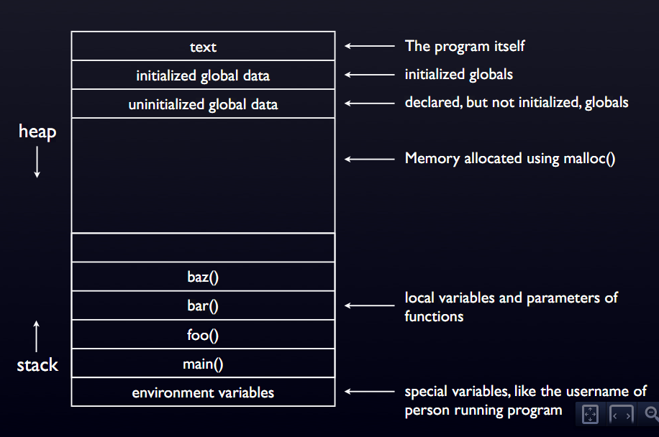
Memory Layout

Slide 59
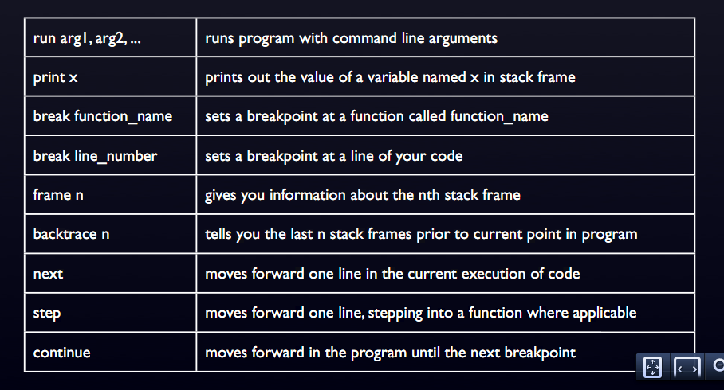
GDB Commands

