Slide 1
CS50 WEEK 6
Kenny Yu

Slide 2
Announcements
Quizzes Handed Back Now
  Any questions regarding grading of the quiz, ask me after section
Problem Set 5 Walkthrough online
Office Hours this week are at the Harvard Innovation Lab @ HBS across the river
My section resources are posted here:
  https://cloud.cs50.net/~kennyyu/section/

Slide 3
Agenda
Hexadecimal
Structs
  Typedef
  Dot (.) and arrow (->) notation
Enumerated Types
File I/O
  Man pages

Slide 4
Hexadecimal Review
Base 16, using digits 0-9, A-F where
A = 10; B = 11; C = 12; D = 13; E = 14; F = 15
1 hexadecimal digit is equal to 4 bits (1 nibble)
2 hexadecimal digit is equal to 8 bits (1 byte)
8 hexadecimal digits is equal to 32 bits (4 bytes, the size of int on a 32-bit machine)

Slide 5
Hexadecimal Review
Hex -> Bin: If we want to translate hexadecimal into binary, we can translate one hexadecimal digit at a time into 4 bits
Bin -> Hex: If we want to translate binary to hexadecimal, we can translate 4 bits at a time into one hex digit, starting on the right
1 | 0 | 0 | 1 | 1 | 1 | 1 | 0 | 0 | 1 | 1 | 1 | 0 | 0 | 0 | 1
9 |  |  |  | E |  |  |  | 7 |  |  |  | 1

Slide 6
Hexadecimal Review
Notationally, we prefix hexadecimal numbers with “0x”
The number below can be written as 0x9e71
C will let you do this!
  int x = 0x9e71; // case insensitive
1 | 0 | 0 | 1 | 1 | 1 | 1 | 0 | 0 | 1 | 1 | 1 | 0 | 0 | 0 | 1
9 |  |  |  | E |  |  |  | 7 |  |  |  | 1

Slide 7
RGB
If you use Chrome (but most other browsers also have this feature), the next time you load a page, right click and select “Inspect Element”
Look at the CSS for the HTML
  You’ll see something like
    color: #f8e6b4;
    These stand for RR GG BB in hex!

Slide 8
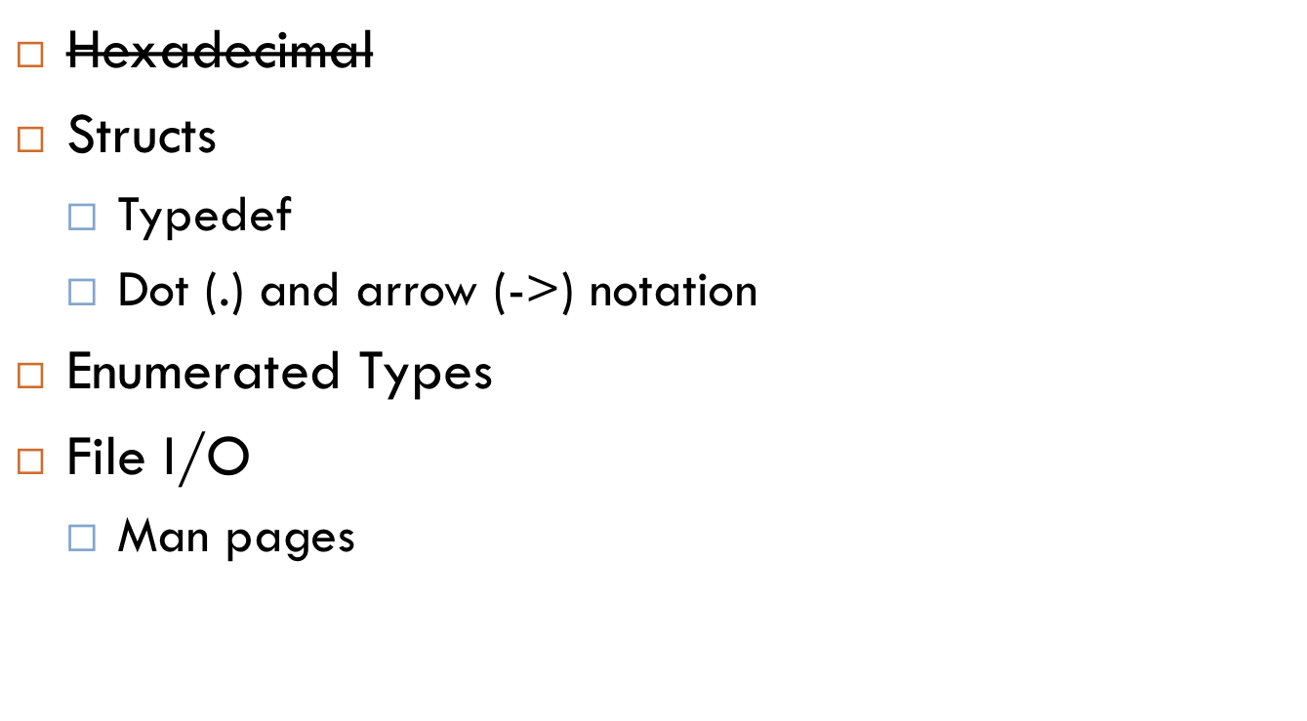
Agenda

Slide 9
Structs
A struct is a container that can hold and organize meaningfully related variables of different types
Think of it like a super variable that can hold more than one value

Slide 10
Struct
Let’s make a struct to represent a student
struct student {
char *name; // here we declare the fields
int age; // and their types
float gpa;
}; // don’t forget the semicolon here!!!

Slide 11
Structs
int main() {
struct student s1 = { // we can declare a struct
.name = “Santa”; // using the curly brace
.age = 103; // and field notation
.gpa = 3.7;
};
}

Slide 12
Structs
int main() {
// or we can just declare it without the fields
// NOTE: must declare it in the same order as the
// struct
_x0005_ struct student s1 = {“Santa”, 103, 3.7};
}

Slide 13
Structs
int main() {
// or we can just declare it without the fields
// NOTE: must declare it in the same order as the
// struct
_x0005_ struct student s1 = {“Santa”, 103, 3.7};
}
NOTE: s1 has type struct student. We’ve created our own type of variable!

Slide 14
Structs
int main() {
// or we can just declare it without the fields
// NOTE: must declare it in the same order as the
// struct
_x0005_ struct student s1 = {“Santa”, 103, 3.7};
}
Typing “struct” every time we want a student is annoying. How can we fix this?

Slide 15
Structs
We typedef “student” to be “struct student”: “student” and “struct student” are equivalent types now!
We don’t need to type struct anymore!
typedef struct student student;
// interpret this as typedef (struct student) student
struct student {
char *name; // here we declare the fields
int age; // and their types
float gpa;
}; // don’t forget the semicolon here!!!

Slide 16
Structs
We can combine the typedef and the struct definition into one statement.
Syntax: typedef OLD_TYPE NEW_TYPE;
typedef struct {
char *name; // here we declare the fields
int age; // and their types
float gpa;
} student; // don’t forget the semicolon here!!!

Slide 17
Structs
int main() {
// or we can just declare it without the fields
// NOTE: must declare it in the same order as the
// struct
student s1 = {“Santa”, 103, 3.7};
}

Slide 18
Functions can also return structs (and struct pointers!)
student get_worst_student(int min_gpa) {
student s1;
// do some magic
return s1;
}

Slide 19
We can make arrays of structs
int main() {
student classmates[10];
classmates[0] = {“Santa”, 103, 37};
classmates[1] = …
// etc.
}

Slide 20
Dot Notation
We can access the fields of a struct variable by using the dot notation (.) followed by the name of the field
student s1 = {“Santa”, 103, 3.7};
printf(“name: %s\n”, s1.name);
printf(“age: %d\n”, s1.age);
printf(“gpa: %f\n”, s1.gpa);

Slide 21
Pointers to Structs
We can make pointers to structs just like any other primitive types
student s1 = {“Santa”, 103, 3.7};
student *ptr = &s1; // ptr is a student pointer
printf(“name: %s\n”, (*ptr).name);
printf(“age: %s\n”, (*ptr).age);
printf(“gpa: %f\n”, (*ptr).gpa);

Slide 22
Pointers to Structs
We can make pointers to structs just like any other primitive types
student s1 = {“Santa”, 103, 3.7};
student *ptr = &s1; // ptr is a student pointer
printf(“name: %s\n”, (*ptr).name);
printf(“age: %s\n”, (*ptr).age);
printf(“gpa: %f\n”, (*ptr).gpa);
This is a mouthful.

Slide 23
Pointers to Structs: Arrow Notation
If ptr is a pointer to a struct, then we can use the arrow notation to access a field of the struct pointed to by the pointer
  ptr->field is equivalent to (*ptr).field
student s1 = {“Santa”, 103, 3.7};
student *ptr = &s1; // ptr is a student pointer
printf(“name: %s\n”, ptr->name);
printf(“age: %s\n”, ptr->age);
printf(“gpa: %f\n”, ptr->gpa);

Slide 24
Malloc’ing Structs
// we allocate space on the heap for one student struct
student *ptr = malloc(sizeof(student))
ptr->name = “Santa”; // we set the fields
ptr->age = 103;
ptr->gpa = 3.7;
printf(“name: %s\n”, ptr->name);
printf(“age: %s\n”, ptr->age);
printf(“gpa: %f\n”, ptr->gpa);

Slide 25
Malloc’ing Structs
student * // return type is student *
make_student(char *n, int a, float g)
{
student *ptr = malloc(sizeof(student))
if (!ptr) // check if ptr is NULL
return NULL;
strcpy(ptr->name, n); // copy string n into ptr->name
ptr->age = a;
ptr->gpa = g;
return ptr;
}

Slide 26
Recursive Structs?
typedef stuct lnode lnode;
struct lnode {
int value;
struct lnode *next;
};
This will allow us to build more complicated data structures like linked lists and trees.
typedef stuct tnode tnode;
struct tnode {
int value;
struct tnode *left;
struct tnode *right;
};

Slide 27
Linked List example
1
5
4
2
3
NULL

Slide 28
Binary Search Tree Example
5
3
9
1
7
6
8
NULL

Slide 29
Data Structures
More on these next week when you build your spell checker!

Slide 30
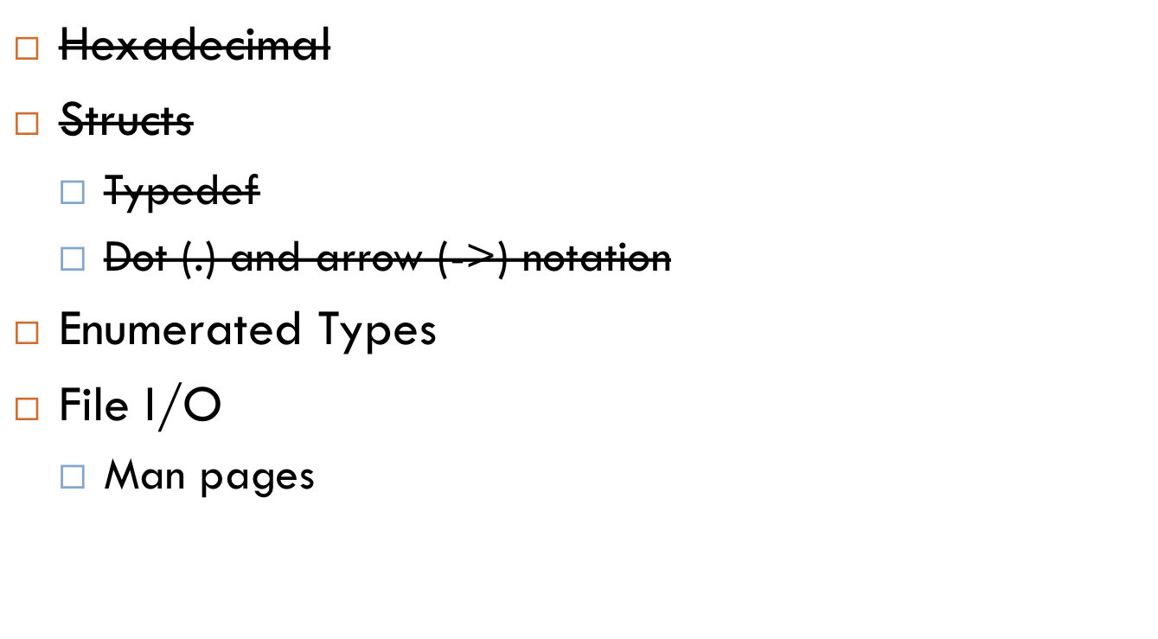
Agenda

Slide 31
Enumerated Types
Enumerated types allow us to create our own type with a finite set of possible values
Abstraction makes code easier to understand and work with
Analogy:
  int type has 2^32 possible values
  “starbucks_size” type has only 3 possible values
    {TALL, VENTI, GRANDE}

Slide 32
Examples
{WIN, LOSE, DRAW}
{YES, NO, MAYBE}
{SMALL, MEDIUM, LARGE, XL}
{WINDOWS, MAC, LINUX}
{JAN, FEB, MAR, APR, MAY, JUN, JUL, AUG, SEP, OCT, NOV, DEC}
{EMPTY_LIST_ERROR, MALLOC_FAIL_ERROR, NULL_ERROR}

Slide 33
Enum syntax
enum color {
BLUE, // better style to use all-caps for constants
RED,
GREEN,
YELLOW
}; // don’t forget the semicolon!!!

Slide 34
Enum syntax
int main(void) {
enum color b = BLUE;
enum color r = RED;
printf(“blue: %d, red: %d\n”, b, r);
}

Slide 35
Enum syntax
int main(void) {
enum color b = BLUE;
enum color r = RED;
printf(“blue: %d, red: %d\n”, b, r);
}
What gets printed out?
blue: 0, red: 1

Slide 36
Enum syntax
enum color {
BLUE,
RED,
GREEN,
YELLOW
};
What C actually does is map every different type in the enumeration to a number, starting at 0.
So BLUE == 0; RED == 1; GREEN == 2; YELLOW == 3;

Slide 37
Enum syntax
enum color {
BLUE = 42,
RED = -1,
GREEN,
YELLOW
};
You can manually assign constants to values in an enumeration, and then C will handle the rest
So BLUE == 42; RED == -1; GREEN == ?; YELLOW == ?;

Slide 38
Enum syntax
int main(void) {
enum color b = BLUE;
enum color r = RED;
printf(“blue: %d, red: %d\n”, b, r);
}
Like writing ‘struct’ all the time, writing ‘enum’ all the time is annoying.

Slide 39
Enum syntax
typedef enum color color; // alias color to be (enum color)
enum color {
BLUE,
RED,
GREEN,
YELLOW
};

Slide 40
Enum syntax
typedef enum {
BLUE,
RED,
GREEN,
YELLOW
} color;
Or do it in one go, like with structs.

Slide 41
Enum syntax
int main(void) {
color b = BLUE;
color r = RED;
printf(“blue: %d, red: %d\n”, b, r);
}
No need to write ‘enum’ anymore!

Slide 42
Enum syntax
Like with structs, defining our own enumerated types allows us to define our own types! Now we can treat them like any other primitive type.
  Return values of functions
    color favorite_color(student s) { return BLUE; }
  Arrays, pointers
    color favorites[10]; favorites[0] = BLUE;

Slide 43
When to use enumerated types
When we have a finite set of values (e.g. colors, genders, error codes)
  We can abstract this detail away into its own type
int favorite_color(student s) {
_x0005_ return 0; // bad style! Magic numbers! What is 0?
}
// better:
    color favorite_color(student s) {
    return BLUE; // this makes sense now
    }

Slide 44

Agenda

Slide 45
File I/O (Input/Output)
So far, we’ve been only reading input from the terminal (the user) and writing output to the terminal
  More formally, we have been reading from stdin (standard in) and writing to stdout (standard out)
But we can read in data from files and write data to files as well!

Slide 46
File function calls
fopen – opens a file for reading
fclose – closes a file. All opened files must be closed!
fread – read from a file
fwrite – write to a file
fseek – move the cursor position through the file
feof – check if at end-of-file

Slide 47
An aside about man pages
In reality, no one memorizes how to use these functions. People instead use man pages for reference. Manual pages provide complete documentation for C library functions and shell commands!
In your appliance (and on Macs and other LINUX/UNIX operating systems)
jharvard$ man fread
(press q to quit, use arrow keys to scroll)
In general:
jharvard$ man <section number> <C function/shell command>
jharvard$ man 3 fopen
(section 3 is for C functions)

Slide 48
fopen
FILE *fopen(char *file_name, char *mode)
  Opens a file called file_name with mode and returns a pointer to the file
  FILE *infile = fopen(“input.txt”, “r”);
Different modes – there are more than these below
  “r” – read only
  “w” – write only
  “r+” or “w+” – read & write
  “a” – append to end of file

Slide 49
fclose
int fclose(FILE *file_pointer);
  FILE *infile = fopen(“input.txt”, “r”);
  …
  fclose(infile);
All opened files must be closed!
  Very bad style (and potentially causes errors) if you don’t close a file you opened

Slide 50
fread
size_t
fread(void *ptr, size_t size, size_t nitems, FILE *stream);
Reads nitems objects, each of size size from the file stream and stores it at the address pointed to by ptr.
Returns the number of objects read
Advances the cursor through the file
FILE *infile = fopen(“input.txt”, “r”);
int number;
fread(&number, sizeof(int), 1, infile);

Slide 51
fwrite
size_t
fwrite(void *ptr, size_t size, size_t nitems, FILE *stream);
Writes nitems objects, each with size size, to the file stream, and obtains these to-be-written values from the address pointed to be ptr.
Return number of objects written on success
Advances the cursor through the file
FILE *outfile = fopen(“output.txt”, “w”);
int number[3] = {4,5,6};
int num_written = fwrite(number, sizeof(int), 3, outfile);

Slide 52
fseek
int
fseek(FILE *stream, long offset, int whence);
Advances the file position (cursor) offset bytes from the location indicated by whence (by adding)
Values for whence
  SEEK_SET – start of file
  SEEK_CUR – current position indicator
  SEEK_END – end of file
offset can be negative
Returns 0 on success, -1 otherwise

Slide 53
feof
int feof(FILE *stream);
Returns true if the current file position is at the end-of-file, false (0) otherwise
FILE *infile = fopen(“input.txt”, “r”);
char buffer[256];
while (!feof(infile)) {
fread(buffer, sizeof(char), 256, infile);
printf(“%s\n”, buffer);
}
Common errors using feof: http://www.drpaulcarter.com/cs/common-c-errors.php#4.2

Slide 54
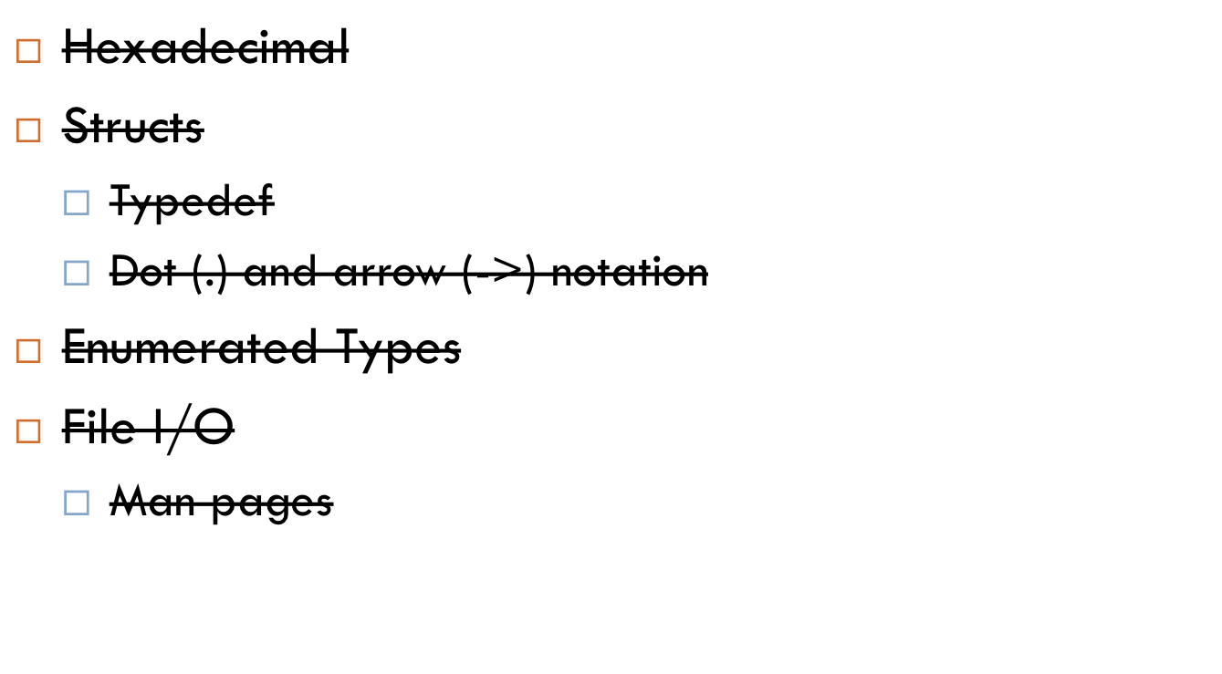
Agenda

Slide 55
Coding practice
Go to https://cloud.cs50.net/~kennyyu/section/week6/
Download pokemon.zip, or copy and paste all the files inside pokemon/ into a pokemon directory in your appliance.
Follow directions.txt.

