Slide 1
CS50 WEEK 6
Kenny Yu

Slide 2
Announcements
Problem Set 6 Walkthrough up
Problem Set 4 [Sudoku] Returned
Problem Set 5 [Bitmaps + Jpegs] to be returned soon
My section resources are posted here:
  https://cloud.cs50.net/~kennyyu/section/

Slide 3
Agenda
Data Structures
  Stacks
  Queues
  Linked Lists
  Trees
    Binary Search Trees
    Tries
  Hash Tables
Bitwise operators
  ~,|, &, ^, <<, >>
Strategies for Big Board
  Space vs. Time (vs. Correctness ?)
  Valgrind
  Compiler optimization flags

Slide 4
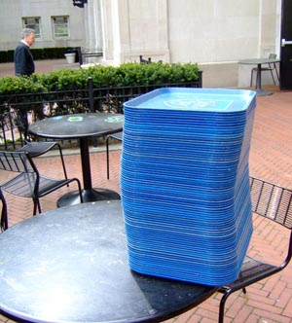
Stack
A stack is a first-in-last-out (FILO) data structure
  Think of cafeteria trays, the call stack
Operations:
  Push: we add an item onto
  the top of the stack
  Pop: we remove the top item
  of the stack
  Peek: we retrieve the top item
  of the stack without removing
  it

Slide 5
Stack – Sample Header File
/* stack.h
* contains the type definitions and function headers
* for stacks */
/* alias ‘struct stack’ to be ‘stack’; ‘struct stack’
* still needs to be defined elsewhere */
typedef struct stack stack;
/* stack operations. We can only store ints. */
void push(stack *, int);
int pop(stack *);
int peek(stack *);

Slide 6

Queues
A queue is a first-in-first-out (FIFO) data structure
  Think of waiting in a line
Operations
  Enqueue: Add an item
  to the end of the queue
  Dequeue: Remove the
  first item of the queue
  Peek: Retrieve the first
  item of the queue without removing it

Slide 7
Queue – Sample Header File
/* queue.h
* contains the type definitions and function headers
* for stacks */
/* alias ‘struct queue’ to be ‘queue’; ‘struct queue’
* still needs to be defined elsewhere */
typedef struct queue queue;
/* queue operations. We can only store ints. */
void enqueue(queue *, int);
int dequeue(queue *);
int peek(queue *);

Slide 8
Interview Question 1
QUESTION: How would you implement a queue using stacks?

Slide 9
Interview Question 1
QUESTION: How would you implement a queue using stacks?
HINT: Use two stacks.

Slide 10
Interview Question 1
QUESTION: How would you implement a queue using stacks?
SOLUTION: A queue will really be two two stacks, stack_in and stack_out.
Enqueue: when we enqueue an item onto our queue, we really push the item into stack_in
Dequeue: when we dequeue an item from our queue, we first check if stack_out has any items
(1) If stack_out is not empty, then pop the first item and return it
(2) If stack_out is empty, then we pop items from stack_in and push each item, in the same
order we pop them, into stack_out. Then do (1).

Slide 11
Interview Question 1
QUESTION: How would you implement a queue using stacks?
SOLUTION: A queue will really be two two stacks, stack_in and stack_out.
Enqueue: when we enqueue an item onto our queue, we really push the item into stack_in
Dequeue: when we dequeue an item from our queue, we first check if stack_out has any items
(1) If stack_out is not empty, then pop the first item and return it
(2) If stack_out is empty, then we pop items from stack_in and push each item, in the same order we pop them, into stack_out. Then do (1).
What is the big O of enqueue? dequeue?

Slide 12
Interview Question 1
QUESTION: How would you implement a stack using queues?
SOLUTION: A stack will really be two two queues, queue_in and queue_out.
Push: when we push an item onto our stack, we really enqueue the item into queue_in
Pop: when we pop an item from our stack, we first check if queue_out has any items
(1) If queue_out is not empty, then dequeue the first item
and return it
(2) If queue_out is empty, then we dequeue items from
queue_in and enqueue each item, in the same
order we dequeued them, into queue_out. Then do (1).
What is the big O of enqueue? dequeue?
Enqueue: O(1). Dequeue: The amortized (average) runtime is O(1).

Slide 13
Linked Lists
1
5
4
2
3
NULL

Slide 14
Linked Lists
A linked list consists of nodes, where each node has a value and a pointer to the next object (node) in the list.
struct lnode {
int value;
struct lnode *next;
};

Slide 15
Linked Lists
struct lnode {
int value;
struct lnode *next;
};
value
next
value
next
4
NULL
6
struct lnode
struct lnode

Slide 16
Adding/removing from a linked list
Can’t lose any pointers (or else we lose the rest of the list!)
value
next
4
NULL
value
next
value
next
4
6
NULL
struct lnode
struct lnode

Slide 17
Adding/removing from a linked list
Can’t lose any pointers (or else we lose the rest of the list!)
value
next
4
value
next
value
next
4
6
NULL
struct lnode
struct lnode

Slide 18
Adding/removing from a linked list
Can’t lose any pointers (or else we lose the rest of the list)
value
next
4
value
next
value
next
4
6
NULL
struct lnode
struct lnode

Slide 19
Iterating over a linked list
typedef struct lnode lnode;
/* assume the list has size greater than n */
int get_nth_value(lnode *root, int n) {
/* TODO */
}

Slide 20
Iterating over a linked list
typedef struct lnode lnode;
/* assume the list has size greater than n */
int get_nth_value(lnode *root, int n) {
lnode *current = root;
for (int i = 0; i < n; i++)
current = current->next;
return current->value;
}

Slide 21
Linked Lists
If we only have a pointer to the start of the list, what are the Big O for these operations?
    Insert_first
    Insert_last
    Remove_first
    Remove_last
    find

Slide 22
Linked Lists
If we only have a pointer to the start of the list, what are the Big O for these operations?
    Insert_first – O(1)
    Insert_last – O(n)
    Remove_first – O(1)
    Remove_last – O(n)
    Find – O(n)

Slide 23
Interview Question 2
How would you detect a cycle in a linked list with minimum space?
1
5
4
2
3

Slide 24
Interview Question 2
How would you detect a cycle in a linked list with minimum space?
Hint: Use two pointers.
1
5
4
2
3

Slide 25
Interview Question 2
How would you detect a cycle in a linked list with minimum space?
Have two pointers called hare
and tortoise. Start them off pointing
to the same node.
On every iteration, move hare 2 nodes ahead (if it can), and move tortoise one node ahead.
If they ever at some time point to the same address in memory, then there is a cycle in the list.
1
5
4
2
3

Slide 26
Doubly Linked Lists
struct lnode {
struct lnode *prev;
int value;
struct lnode *next;
};
prev
value
next
prev
value
next
prev
value
next
NULL
4
5
6
NULL
struct lnode
struct lnode
struct lnode

Slide 27
Binary Search Trees
5
3
9
1
7
6
8
NULL

Slide 28
Binary Search Trees
A binary search tree (BST) consists of nodes that has a value and two pointers, one pointer to its left child node and one pointer to its right child node
  Invariants:
    Every element in the left subtree is less than the current element
    Every element in the right subtree is greater than the current element
    Left and right child nodes are also BSTs.

Slide 29
Binary Search Trees
struct bstnode {
int value;
struct bstnode *left;
struct bstnode *right;
};
5
3
X
9
X
1
X
X
7
6
X
X
8
X
X

Slide 30
Binary Search Trees
A BST is balanced if every node has two children.
What are the big O for these operations in a balanced BST? What about an unbalanced BST?
  Remove
  Add
  Min
  Find

Slide 31
Binary Search Trees
A BST is balanced if every node has two children.
What are the big O for these operations?
  RemoveMin – balanced: O(log n), unbalanced: O(n)
  Add – balanced: O (log n), unbalanced: O(n)
    Traverse down the tree to find the appropriate spot
  Min – balanced: O (log n), unbalanced: O(n)
    Traverse all the way left
  Find – balanced: O (log n), unbalanced: O(n)
    Analagous to a binary search

Slide 32
Trie
0
X
1
X
1
0
X
0
X
X
1
X
X
1
X
X
1

Slide 33
Trie
A trie is a tree with N pointers and a boolean variable, is_terminating
  Each pointer represents a letter in the alphabet of N letters. The existence of a pointer, combined with is_terminating, represents the existence of that word
  is_terminating indicates whether what we’ve looked at so far is in the data structure

Slide 34
Trie – What words are in our dict?
ptrs
is_terminated
struct trie_node {
struct trie_node *ptrs[N];
bool is_terminated;
};
Here N = 2;
Alphabet: {a,b}
0
X
1
X
1
0
X
0
X
X
1
X
X
1
X
X
1

Slide 35
Trie – What words are in our dict?
ptrs
is_terminated
struct trie_node {
struct trie_node *ptrs[N];
bool is_terminated;
};
Here N = 2;
Alphabet: {a,b}
0
X
1
X
1
a
b
0
X
1
ba
X
X
1
X
X
1
X
X
1
bab
aba
abb

Slide 36
Why use a trie?
Very efficient lookup
  Especially if many words in your language share common prefixes
  Lookup for a word is O(n), where n is the length of the string—basically constant time!
Heavy memory usage

Slide 37
Hash Tables
A hash table consists of an array and a hash function
  Allows us to check whether something is contained in a data structure without checking the entire thing
A hash function maps input (in our case, a string) to a number (called the input’s hash value)
  We use the hash value as an index in the associated array
When we check to see if a string is in our dictionary, we compute the string’s hash value, and check if array[hash_value] is set

Slide 38
Hash Tables
3
4
5 | X
6
7 | X
8
...
1
2
10
11

Slide 39
Hash Tables
Good hash functions are
  Deterministic (calling the hash function on the same string always returns the same result)
  Uniformly distributed
What happens if two strings get mapped to the same hash value?
  We have a collision.

Slide 40
Hash Tables
How do we solve collisions? Several methods, here are two ways
  Separate chaining – each bucket in our hash table is actually a pointer to a linked list
    if a word hashes to a bucket that already has words, we append it to the linked list at that bucket
  Linear probing – if a word hashes to a bucket that already has words, then we keep scanning down the buckets to find the first one that is empty.

Slide 41
Hash Tables – Separate Chaining
3
4
5 | X
6
7 | X
8
...
1
3
…
10
12
…
11
X

Slide 42
Hash Tables
Assuming a good hash function with few collisions, what is the run time for these operations?
  Add
  Remove
  find

Slide 43
Hash Tables
Assuming a good hash function with few collisions, what is the run time for these operations?
  Add – O(1)
  Remove – O(1)
  Find – O(1)
All constant time!
  Tradeoff between Time and Space—must use a lot of space for a very large array

Slide 44
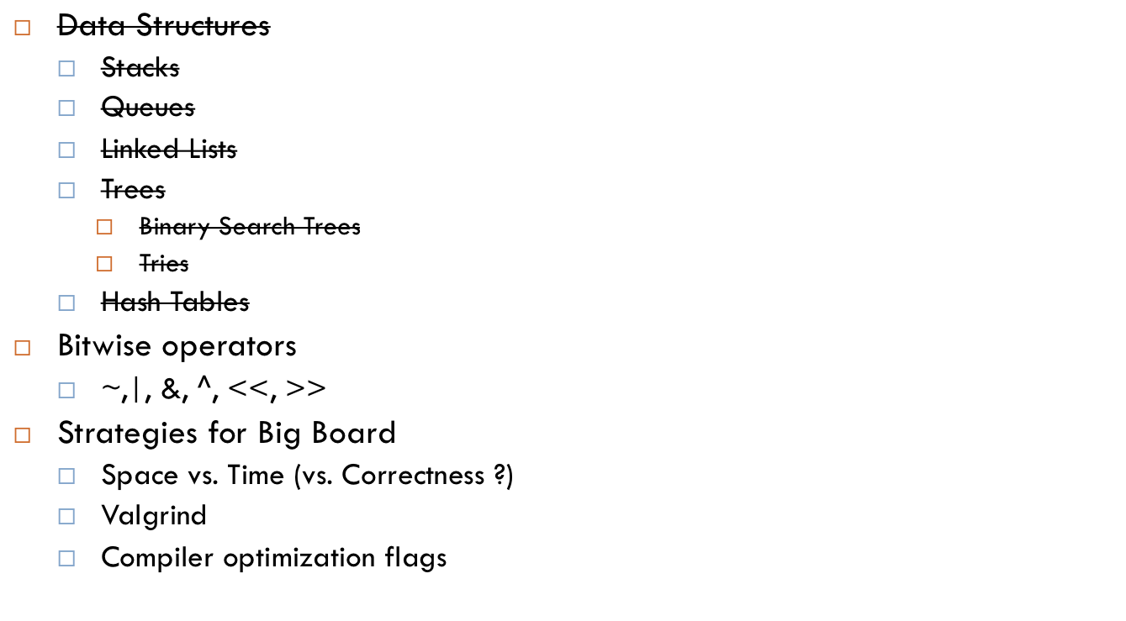
Agenda

Slide 45
Bitwise Operators
Remember: all data is represented as bits
Bitwise operators allow you to manipulate data at the bit level.

Slide 46
Bitwise Operators: ~, |, &, ^
Bitwise negation (x = ~42) Bitwise AND (x = 4 & 5)
Bitwise OR (x = 0x4 | 0x8)
~
0 | 1
1 | 0
& | 0 | 1
0 | 0 | 0
1 | 0 | 1
| | 0 | 1
0 | 0 | 1
1 | 1 | 1

Slide 47
Bitwise operators: XOR (^)
Bitwise XOR (exclusive or)
Useful properties:
  x ^ x == 0 (for any value x)
  x ^ 0 == x (for any value x)
  Associative and commutative
    y ^ x ^ y = x ^ (y ^ y) = x
^ | 0 | 1
0 | 0 | 1
1 | 1 | 0

Slide 48
Interview Question 3
How do you swap two variables without a temporary variable?

Slide 49
Interview Question 3
How do you swap two variables without a temporary variable?
HINT: use XOR

Slide 50
Interview Question 3
How do you swap two variables without a temporary variable?
HINT: use XOR
int x = 3;
int y = 4;
x = x ^ y; // (x == 3^4)
y = x ^ y; // (y == (3 ^ 4) ^ 4 = 3)
x = x ^ y; // (x == (3 ^ 4) ^ 3 = 4)

Slide 51
Interview Question 4
You have an array of length 2N – 1, which contains the numbers 0-(N-1), all repeated once except for one of the numbers. Using minimum space, find that number.

Slide 52
Interview Question 4
You have an array of length 2N – 1, which contains the numbers 0-(N-1), all repeated once except for one of the numbers. Using minimum space, find that number.
Hint: Use XOR

Slide 53
Interview Question 4
You have an array of length 2N – 1, which contains the numbers 0-(N-1), all repeated once except for one of the numbers. Using minimum space, find that number.
Hint: Use XOR
Solution: XOR all the numbers together!
  [2,3,4,3,4,1,1,0,0] -> 2 ^ (3 ^ 3) ^ (4 ^ 4) … (0 ^ 0)
  -> 2

Slide 54
Interview Question 5
Using the minimum number of instructions, write an algorithm to quickly determine whether a number is a power of 2.

Slide 55
Interview Question 5
Using the minimum number of instructions, write an algorithm to quickly determine whether a number is a power of 2.
Hint: Use AND

Slide 56
Interview Question 5
Using the minimum number of instructions, write an algorithm to quickly determine whether a number is a power of 2.
Hint: Use AND
int is_power_of_2(int n) {
return (n & (n – 1)) == 0;
}
00010000
& 00001111
00000000

Slide 57
Bit shifting
Shift left <<
  We shift all the bits over to the left, and fill in the remaining positions with 0s
  x = x << 3; // same as saying multiplying x by 8
Shift right >>
  Logical right shift – for unsigned ints, >> will shift all the bits to the right, and fill in the remaining positions with 0s
  Arithmetic right shift – for signed ints, >> will shift all the bits to the right, and fill in the remaining positions with 0s or 1s, depending on the sign of the int
  x = x >> 3;

Slide 58
Interview Question 6
You have a string that possibly contains repeats of some letter. Find, with minimum space, all the letters that are not contained in the string.

Slide 59
Interview Question 6
You have a string that possibly contains repeats of some letter. Find, with minimum space, all the letters that are not contained in the string.
HINT: Use bit vectors

Slide 60
Interview Question 6
You have a string that possibly contains repeats of some letter. Find, with minimum space, all the letters that are not contained in the string.
HINT: Use bit vectors
Instead of using an array of 26 ints (or chars), we can be even more efficient.
All we really need is 26 boolean values (T/F), which we can represent with 26 bits. Since an int is 32 bits (on a 32-bit machine), all we need is just one int!

Slide 61
Interview Question 6
unsigned int bitvector = 0;
/* the right-most position is position 0 */
void set_nth_position(int n) {
bitvector |= (1 << n); /* ‘turns on’ nth bit */
}
/* returns 0 or 1 */
int get_nth_position(int n) {
return (bitvector & (1 << n)) >> n;
}

Slide 62
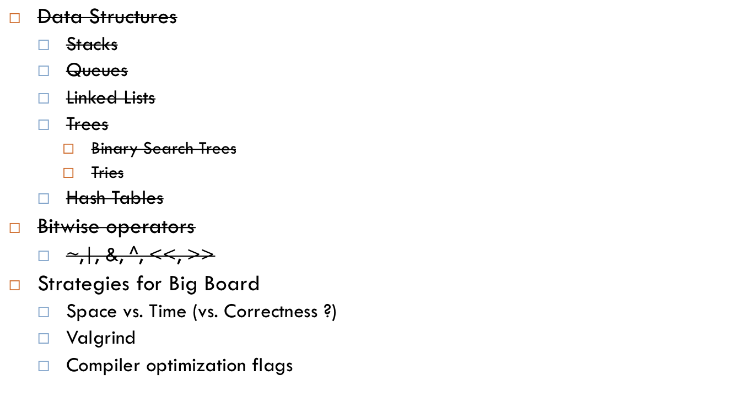
Agenda

Slide 63
Valgrind
Remember to free all the memory you malloc!
  Use valgrind to find any memory leaks
valgrind –v –leak-check=full <program_name>

Slide 64
Space vs. Time (vs. Correctness?)
So far we’ve seen tradeoffs between space and time
  BST’s have logarithmic time operations, but don’t use up too much space
  Hash tables with good hash functions have constant time operations, but use up a lot of space.
  We can often increase our memory usage to make our programs faster, or we can make our programs run a bit slower but use less memory.
But we can trade correctness to make our programs run faster/use less memory.

Slide 65
Bloom Filters (How to make your spellchecker fast)
Have one array (actually all you need is a bit vector)
Insertion
  Use multiple hash functions on one string
  Turn on the corresponding position (set the position to one), using the hash values as indices into the array.
Lookup
  Use multiple hash functions on one string
  A string is in the dictionary if and only if all the entries at the hash indices are 1.
Problems with this?

Slide 66
Bloom Filters
May get false positives! (in our case, some words that are actually misspelled will be considered to be inside our dictionary)
Example:
  Hash values of “cat” are 2, 10, 100
  Hash values of “dog” are 3, 200, 304
  Hash values of “qqmore” are 10, 100, 304
Play around with your hash functions or use more hash functions to reduce the likelihood of false positives

Slide 67
Compiler flags
gcc –o speller speller.c dictionary.c –O3 –fast –m64
-O3 : level 3 compiler optimizations
-fast (does not work on appliance): turns on all compiler speed optimizations to make your programs as fast as possible
-m64 (does not work on appliance): Compile for a 64-bit machine. 64-bit machines have more registers (and thus faster computation); make sure to check the sizes of your types!

Slide 68
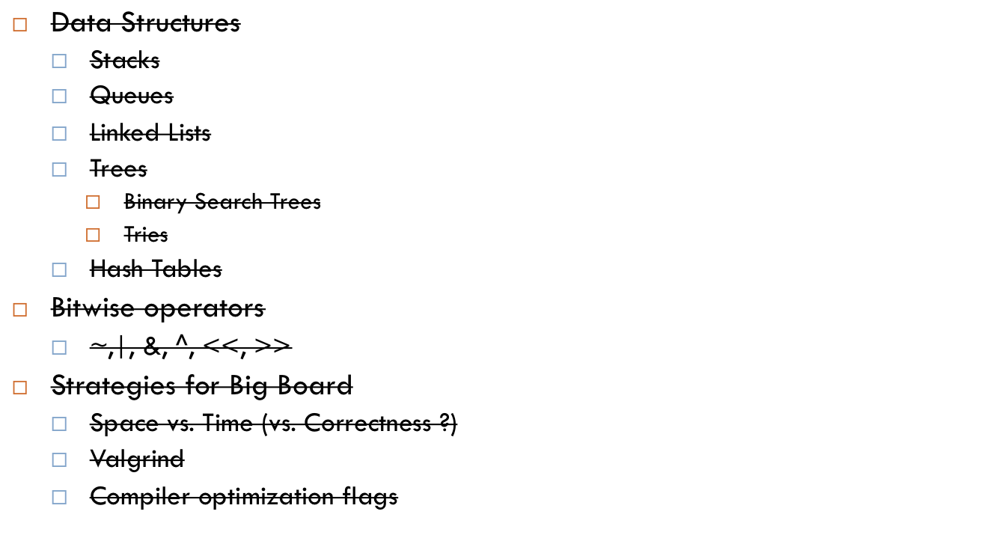
Agenda

Slide 69
Fun Fun Fun
https://cloud.cs50.net/~kennyyu/section/week7/
Open instructions.txt

