Slide 1
CS50 SECTION WEEK 8
Kenny Yu

Slide 2
Announcements
Problem Set 5 Returned.
Problem Set 7 Walkthrough up
Final Project’s Pre-proposal due 11am Monday 11/9
My section resources are posted here:
  https://cloud.cs50.net/~kennyyu/section/

Slide 3
Agenda
Chmod
Overview of the Internet
  Client-Server Model
HTML
  Tags, attributes
  doctype
CSS
  Style attribute, selectors, external stylesheet
PHP
  Handling GET and POST
MySQL
  SELECT, INSERT, UPDATE, DELETE
  phpmyadmin

Slide 4
Chmod
Allows you to restrict read, write, and execute permissions on your files and directories accessible over Internet/other users on the computer
  This is how I hide solutions to labs!
Permissions assigned by setting three octal values which correspond to permissions to ‘read’, ‘write’ or ‘execute’
  3 groups correspond to User, Group, World

Slide 5
Chmod
jharvard ~/tempdir$ ls –l
total 4600
-rw-r--r--@ 1 jharvard jharvard 2354176 Oct 31 00:18 example.c
-rwxr-xr-x@ 1 jharvard jharvard 2354176 Oct 31 00:18 a.out
a.out:
User: rwx => 111 => 7 (octal)
Group: r-x => 101 => 5 (octal)
World: r-x => 101 => 5 (octal)

Slide 6
Chmod
Can use octal values directly
  chmod 644 main.c example.c
  Sets permissions to read and write for user, read permissions for everyone else
Or use shorthand
  chmod u+x main.c example.c
  Gives executable permissions for user. The first character can be also “g” (group), “o” (other), “a” (all); the “+” can be a “-” for removing permissions; final letter can be “x”, “r”, “w”
  See man page for more details!

Slide 7
Chmod
For your appliance
  You should chmod 755 for directories, especially ~/public_html and ~
  chmod 755 for PHP files
  chmod 644 for all other files (CSS, JavaScript, Images)

Slide 8

Overview of the Internet

Slide 9
Overview of the Internet
Simply put, the Internet is a network of networks
All computers on the same network can communicate with each other using established conventions:
  TCP (Transmission Control Protocol): convention computers use to transfer data (in “packets”) with one another (analogy: the letter you send via mail)
  IP (Internet Protocol): convention computers use to route packets from one computer to another (analogy: the US Postal System)
    every computer has an I.P. Address unique to that computer (e.g. your home address)
      IPv4: ###.###.###.### where # is 0-9
      IPv6: ####:####:####:####:####:####:####:#### where # are hexademical digits
  DNS (Domain Name System): allows us to alias IP addresses with readable names (analogy: the Quad = 59 Shepard Street [not actually true])
    E.g. google.com = 74.125.226.208
  HTTP (Hypertext Transfer Protocol) – the world wide web protocol
What we refer to as the “worldwide web” (HTTP) is only a subset of what we can do with the internet!
  ssh, Skype, email (SMTP), instant messaging, more!

Slide 10
Server-Client Model
On your browser (the client), whenever you go to www.google.com, you send an HTTP request that is either GET or POST to the IP address that the DNS resolves to
  GET generally to retrieve data
  POST generally to store data
Your HTTP request gets relayed by routers until it hits Google’s servers.
  A server is a computer that simply listens to requests (could be HTTP, could be other kinds) and serves the appropriate data or files.
Google’s servers run programs that will handle the request appropriately and send an HTTP response back to you in the form of an HTML document.
Your browser renders the HTML document appropriately
  It also sends HTTP requests to retrieve any included images, CSS files, JavaScript files, etc.

Slide 11
Server-Client Model
HTTP GET/POST
Fetch data from database
Client
(JavaScript handles all the logic on the client-side, HTML renders the page, CSS adds style)
Server
(PHP, Python, Ruby, Java, etc. handle the logic on the server-side)
Database
(SQL)
Send HTML response
Retrieved data from database

Slide 12
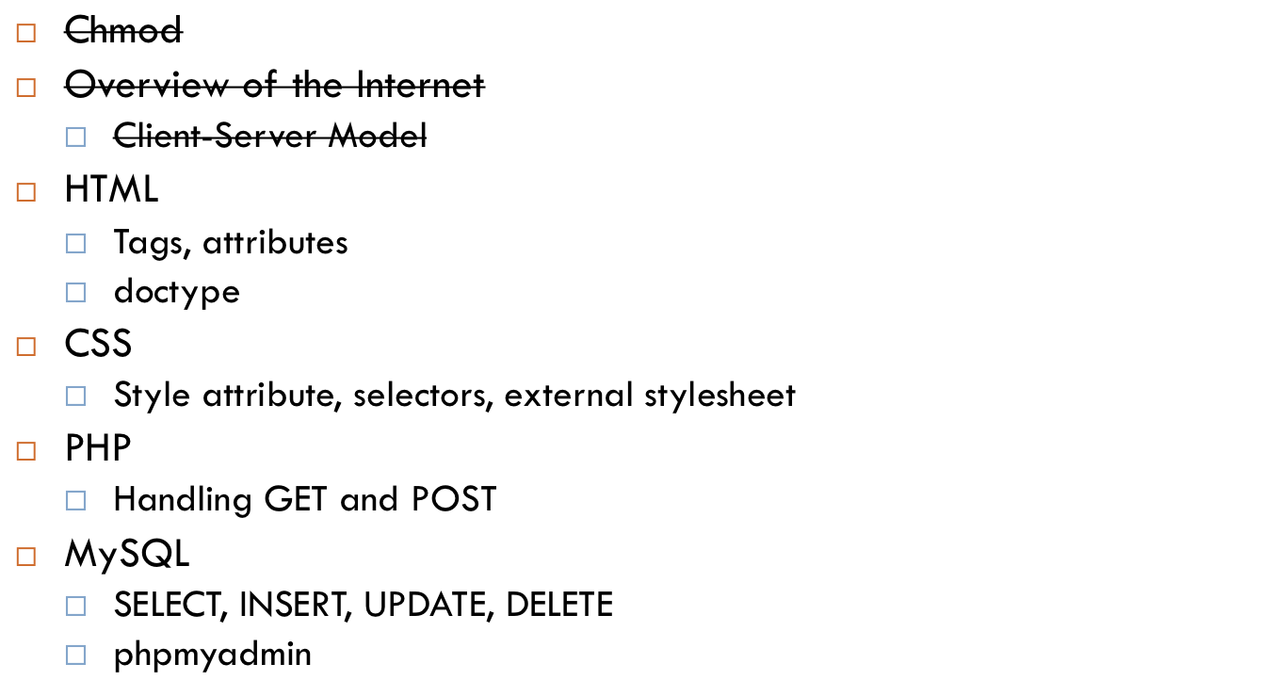
Agenda

Slide 13
HTML
HyperText Markup Language
Used to format the structure of web pages.
NOT a programming language

Slide 14
Why HTML?
Let’s say I wanted to organize all the Pokemon in a machine-human-readable format. We can organize it with a markup language like this:
<pokemon>
<name>Bulbasaur</name>
<species>Leaf</species>
<level>12</level>
<attacks>
<item>vine whip</item>
<item>solar beam</item>
<item>razor leaf</item>
</attacks>
</pokemon>
<pokemon>
<name>Charmander</name>
...
</pokemon>

Slide 15
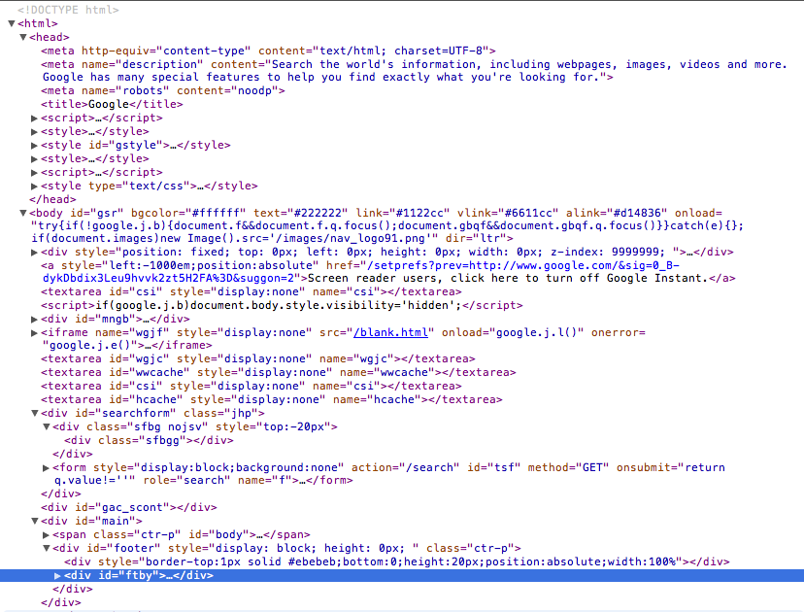
HTML
In the same way, we markup the contents of a webpage with HTML to give the content structure:

Slide 16
HTML
Tags enclose regions of a page
  E.g. <a>, <p>, <div>, <body>
Most beginning tags have ending tags (exceptions include <image> and <br> tags)
  In general, close most recently opened first
  <div><p>a paragraph!</p></div>
Tags may have attributes, which are like parameters for a tag—need quotes around the value!
  <tag attribute=“value”>Stuff</tag>

Slide 17
HTML
<!DOCTYPE html> specifies which HTML convention, here we use HTML5
<html> the html of a webpage is split into head and body
<head> head typically contains metadata and references to
external stylesheets and javascript files
<title>Welcome!</title>
<link rel="stylesheet" type="text/css" media="all" href="http://server.com/path/to/css/file.css">
<script src="http://server.com/path/to/js/file.js" type="text/javascript"></script>
</head>
<body> body typically contains the structure and content
<div class=”welcome page”> “divider” tag
<p>Hello World!</p> “paragraph” tag
</div>
</body>
</html>

Slide 18
HTML – Useful tags
<a href=“LINK”>
  Anchor tags—provides a link to another page
<h1>, <h2>, …<h5>
  Header tags, used to emphasize different text
<ul> unordered list
<ol> ordered list
<li> list item
  E.g. <ul><li>foo</li><li>bar</li></ul>
<form> forms, look up the possible options!

Slide 19
HTML Resources
http://www.w3schools.com/
Provides documentation and tutorials on HTML, JavaScript, CSS, PHP, SQL, and other Internet-related thingies.
  Learn to look up documentation!
For this class, you can use any version of HTML or XHTML as long as it validates on http://validator.w3.org/
  HTML5 (<!DOCTYPE html>) is recommended because it is becoming the new standard.

Slide 20
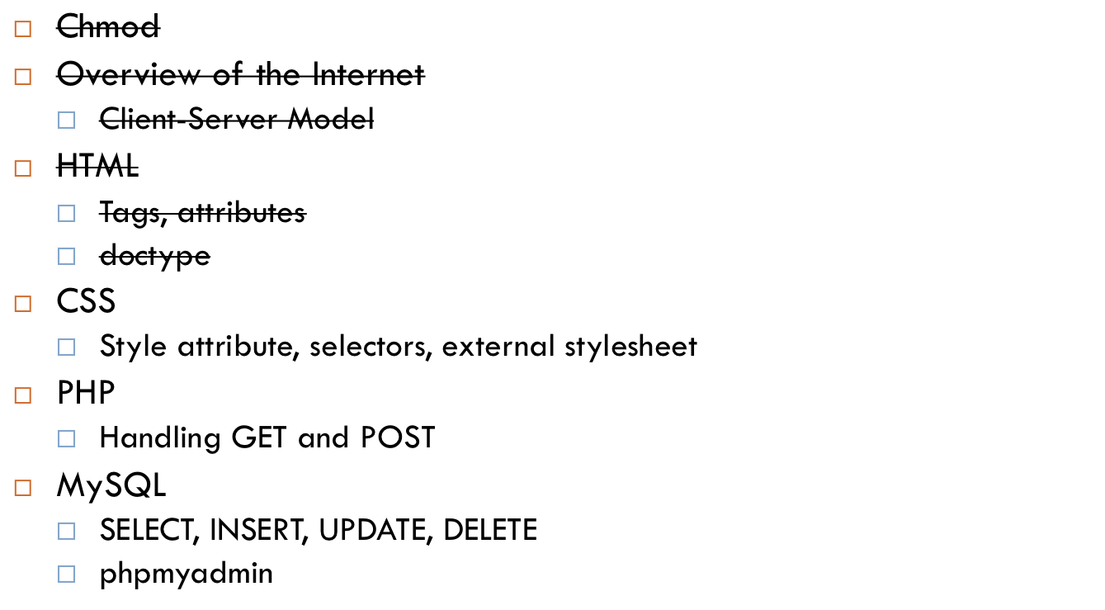
Agenda

Slide 21
?
Sure, we have the structure of a web page, but what makes it look funky and pretty? How do we stylize it?

Slide 22
CSS
CSS – Cascading Style Sheets
Allows us to create style sheets which describe how different types of tags and elements of tags should be rendered to the user
  Makes things look pretty!
May be inlined into the HTML using the “style” tag or included in a separate file

Slide 23
CSS - Inlining
Examples:
  align: center;
  font-size: 10px;
  color: #F8C67D;
  display: block;
<p style=“align: center; font-size: 10px;”>This is centered with small font. </p>

Slide 24
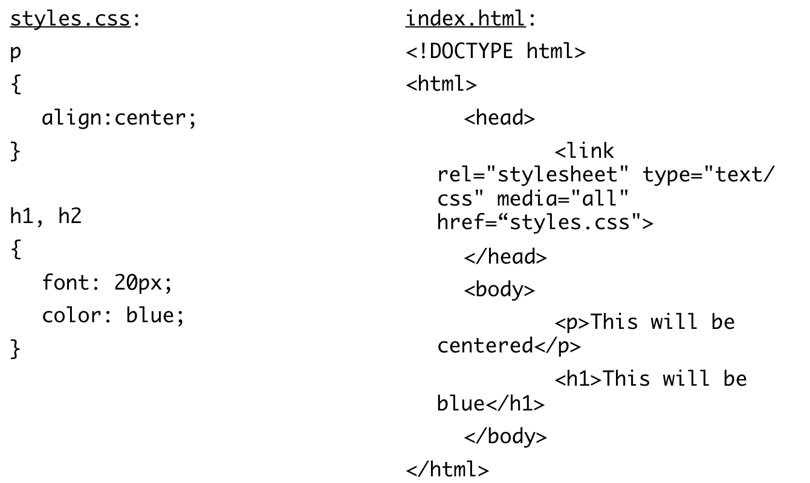
CSS – External File

Slide 25
CSS - Selectors
In general, a CSS block looks like:
selector
{
attribute: value;
}
Selectors can be lists of selectors
Ids (exactly one on a page): #myspecialparagraph
Classes (multiple on a page): .myspecialdivs

Slide 26
CSS-Selectors
…
<div class=“myspecialdivs”>
<p id=“myspecialparagraph”>Hi!</p>
</div>
<div class=“myspecialdivs”>
<p>just another lame paragraph</p>
</div>

Slide 27

Agenda

Slide 28
?
Now that we have rendering the HTML and CSS down, how did the server generate the HTML in the first place?

Slide 29
PHP: PHP Hypertext Processor
When accessed, PHP dynamically generates a webpage which it then outputs to the browser
PHP code is executed by the server, not by the browser
  Next week, you’ll see JavaScript, which is executed by the client (your browser)
PHP code is enclosed in <? ?> tags
All PHP variables are prefaces by $
  You do NOT declare variables with a type!

Slide 30
PHP
C | PHP
Compiled | Interpreted
Statically Typed | Dynamically Typed
- Compiled on gcc, then run
executable
- Each variable is declared with a type
at compile time.
You cannot (without casting) mix and
match data types:
int a = 3;
char *s = “hello”;
s = a; // compiler will produce a warning
- Doesn’t get compiled; whole program
generally interpreted line by line – really
slow compared to C!
- Variables don’t have types (actually, types
Figured out at runtime)
You can do weird mixings of types:
$a = 3;
$s = “hello”;
$s = $s . $a; // “hello3”

Slide 31
PHP GET and POST
Client can send parameters GET and POST requests to the server
  GET (bookmarkable) – the parameters are in the URL
    Parameters start after ?, name=value, separated by &
    www.example.com/index.php?q=cheese&type=awesome
  POST – used for sending larger data or secure data
    Files
    Passwords, credit card numbers

Slide 32
PHP
Special variables $_GET and $_POST which are associative arrays (dictionaries!)
  Map the parameter name to the parameter value
  $name = $_GET[“name”];
  $password = $_POST[“pswd”];
Must check if these fields are set first!
  if (!empty($_POST[“name”]) { if not empty…}

Slide 33
PHP
. string concatenation
  $s = “hello” . “apple”; ==> “helloapple”
  $s = “hello” . 4; ==> “hello4”
== equality, after type juggling
  4 == “4” ==> true
=== equality, and if they are of the same type
  4 === 4 ==> true
  4 === “4” ==> false

Slide 34
PHP
Overall flow
You fill out a form on index.html
The form submits the data via POST or GET to magic.php
magic.php handles the POST and GET parameters appropriately and generates the HTML page
The response is sent back to your browser.

Slide 35
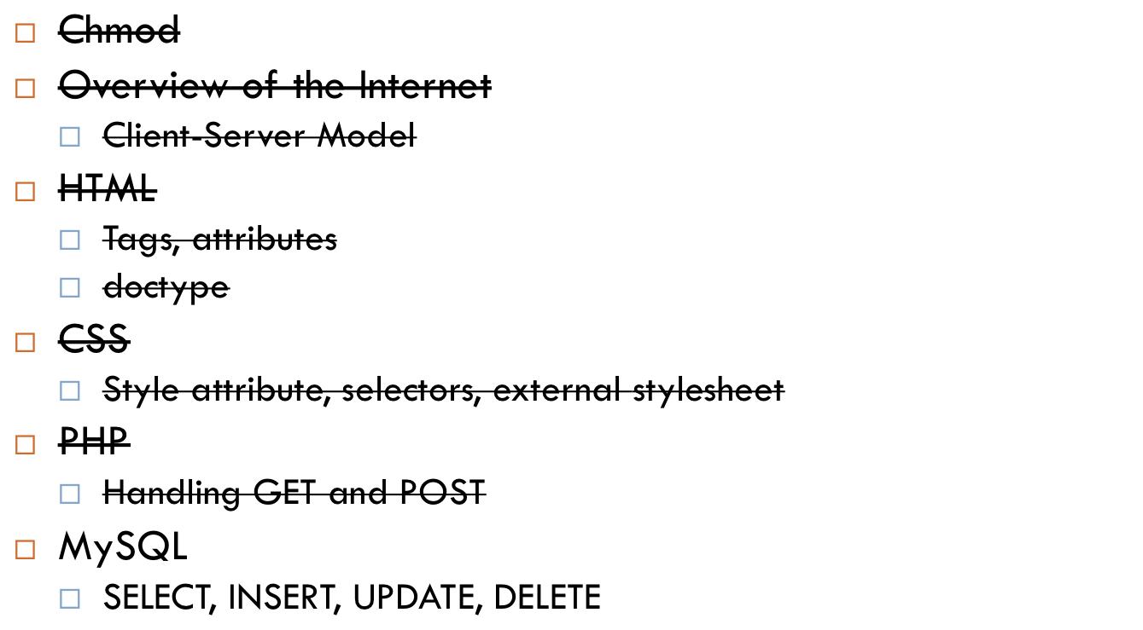
Agenda

Slide 36
?
Okay, so the server generates HTML and all that jazz. But how does it keep track of all the data I send it? How does Google remember my 123871280379 emails?

Slide 37
MySQL
SQL – Structured Query Language
MySQL is a database software that allows us to efficiently store a collection of data as entries containing a set of distinct fields containing values
  Use SQL to interact with the software
Databases contain tables, which contain rows, which contain fields
Note: MySQL is just one of many open source database software options. Google actually uses their own system called BigTable.

Slide 38
MySQL Queries
INSERT : inserts a new entry
  INSERT INTO students (name, id) VALUES (‘Kenny’, 5);
DELETE : removes an existing entry
  DELETE FROM students WHERE id = 5;
SELECT : select one or more entries
  SELECT * FROM students WHERE name = ‘Kenny’
UPDATE : update the fields of an existing entry
  UPDATE students SET name = ‘LENNY’ WHERE id = 5;

Slide 39
MySQL – students example
id | name | year | house
0 | Kenny | 2014 | Quincy House
1 | John | 1636 | Crimson Yard

Slide 40
MySQL – students example
INSERT INTO students (id, name, year, house)
VALUES (2, ‘Kenny’, 1999, ‘Eliot House’);
id | name | year | house
0 | Kenny | 2014 | Quincy House
1 | John | 1636 | Crimson Yard
2 | Kenny | 1999 | Eliot House

Slide 41
MySQL – students example
SELECT * FROM students;
-> returns all fields of all rows
SELECT name FROM students WHERE id >= 1;
-> returns John and Kenny
SELECT id, year FROM students WHERE name = ‘Kenny’;
-> returns (0,2014) and (2,1999)
id | name | year | house
0 | Kenny | 2014 | Quincy House
1 | John | 1636 | Crimson Yard
2 | Kenny | 1999 | Eliot House

Slide 42
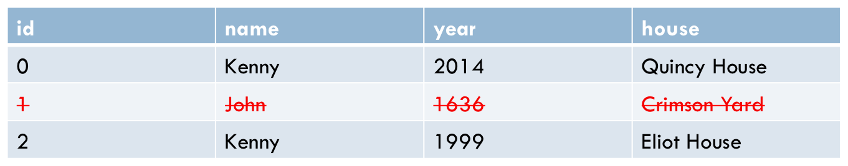
MySQL – students example
DELETE FROM students WHERE name = ‘John’;

Slide 43
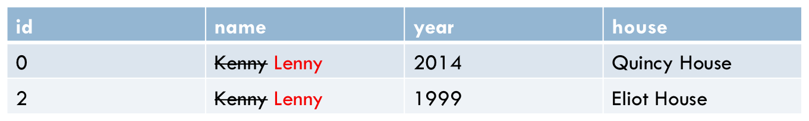
MySQL – students example
UPDATE students SET name = ‘Lenny’ WHERE name = ‘Kenny’;

Slide 44
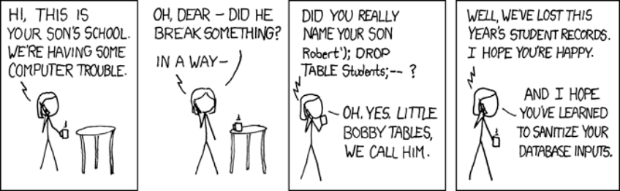
mysql_real_escape_string
Always assume the user input is malignant
  What if for the name field, someone wrote as a name:
    ‘); DROP students;
    SQL injection attack!
Use mysql_real_escape_string to escape user input

Slide 45
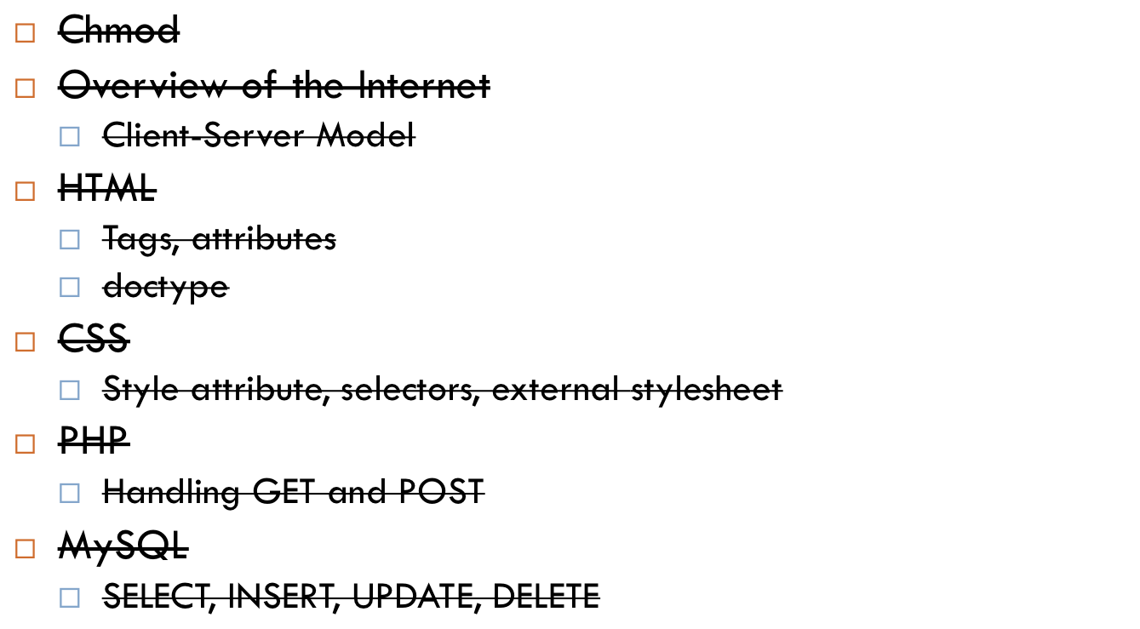
Agenda

Slide 46
HTML, CSS, PHP, (JavaScript)?!!?
This is a lot of languages to learn in a very little amount of time
Don’t worry, most people don’t memorize, they just read the documentation
  Or do a google search (other people probably have the same problem as you)
Resources
  http://www.w3schools.com/
  http://www.php.net/docs.php
  http://w3resource.com/sql/tutorials.php

Slide 47
The web is such a friggin’ hack
“Imagine if I told you we were going to build a system to run our company. We’d use a domain specific language for the data-store, a second language for the back-end code which is run on a server written in a third language, a fourth xml-based approach to explain the documents, a fifth DSL to explain the styling of said document, a sixth language to write the front-end code, and a seventh “language” that is actually a library that makes the sixth language usable for our purposes. Would anyone think I was crazy?”
http://lbrandy.com/blog/2010/10/things-that-i-think-i-think/

Slide 48
The web is such a friggin’ hack
“Imagine if I told you we were going to build a system to run our company. We’d use a domain specific language for the data-store, a second language for the back-end code which is run on a server written in a third language, a fourth xml-based approach to explain the documents, a fifth DSL to explain the styling of said document, a sixth language to write the front-end code, and a seventh “language” that is actually a library that makes the sixth language usable for our purposes. Would anyone think I was crazy?”
http://lbrandy.com/blog/2010/10/things-that-i-think-i-think/
You will know what all of these are by the end of this class!
SQL, PHP (and other languages as well), C (Unix Operating Systems), HTML, CSS, JavaScript, jQuery (not part of this course)

Slide 49
Fun Fun Fun
More pokemon!
  Grab source code here:
    https://cloud.cs50.net/~kennyyu/section/week8/
  Working example here:
    https://cloud.cs50.net/~kennyyu/section/week8/pokemon/

