Slide 1
CS50 SECTION WEEK 9
Kenny Yu

Slide 2
Announcements
Problem Set 6 Returned.
Problem Set 8 Walkthrough up
Final Project’s Proposal due 11am Monday 11/14
My section resources are posted here:
  https://cloud.cs50.net/~kennyyu/section/

Slide 3
Agenda
Client-Server Model, revisited
JavaScript
  Overview
  Event handlers
  Variables
  Functions
  Document Object Model (DOM)
  Asynchronous JavaScript And XML (AJAX)
Application Programming Interfaces (APIs)
  Brief overview of Google Maps
jQuery

Slide 4
Server-Client Model
HTTP GET/POST
Fetch data from database
Client
(JavaScript handles all the logic on the client-side, HTML renders the page, CSS adds style)
Server
(PHP, Python, Ruby, Java, etc. handle the logic on the server-side)
Database
(SQL)
Send HTML response
Retrieved data from database

Slide 5
Server-Client Model
Client-side (runs on your browser)
  HTML – the structure of a web page
  CSS – the style of a web page
  JavaScript – the logic of a web page
    Allows for dynamic content!
Server-side (runs across the Internet)
  PHP – accepts requests and renders the HTML response
  MySQL – database software

Slide 6
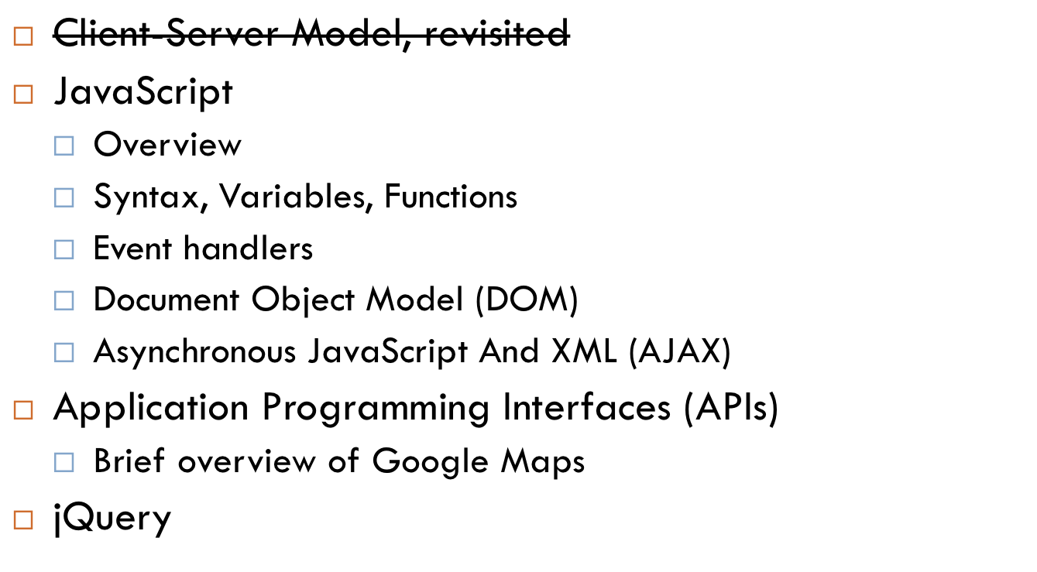
Agenda

Slide 7
JavaScript - Overview
Programming language (unlike HTML and CSS) used in web design
Run on the client side
JavaScript code is included in HTML passed to the browser
  Sometimes embedded into the HTML using <script> </script> tags
  More often included in separate .js files
  Usually a mix of both

Slide 8
JavaScript - Overview
JavaScript | PHP
Interpreted | Interpreted
Loosely-typed | Loosely-typed
Client-side execution | Server-side execution

Slide 9
JavaScript – linking in
Like CSS, can be included in the HTML, or referenced in another file
external .js file:
<head>
<script type=“text/javascript” src=“file.js”>
</script>
</head>

Slide 10
JavaScript - Syntax
Very similar to C and PHP
  if, else, for, while, etc.
  Strings are built into the language like PHP
    E.g. var x = “cheese”;
No types for variables
  Local variables (initializations need the var)
    var my_local_var = 5;
  Global variables (initializations don’t need the var)
    GLOBAL_VAR = 100;

Slide 11
JavaScript - Syntax
No types for functions
function increment(x) {
return x + 1;
}
Data Types
  Ints, floats, boolean, string, object, undefined, null

Slide 12
JavaScript – Syntax
  function sum_between(x,y) {
  var z = 0;
  for (var i = x; i <= y; i++) {
  z += i;
  }
  return z;
  }

Slide 13
Side note: Functions are values
You can pass around functions like any other value!
function increment(x) {
return x + 1;
}
var my_func = increment;
console.log(my_func(5)); // prints out 6 to console

Slide 14
Side note: You can return functions (closures)
// add is a function that when given x, returns a function that when given a number y, adds x to y.
function add(x) {
return function(a) {
x + a;
}; // returning an anonymous function!
}
var add_four = add(4); // function that adds 4
var x = add_four(5); // x is 9.
You can do functional programming in JavaScript! You will learn all about this in CS51.

Slide 15
JavaScript Operators
+
  Addition on numbers
  String concatenation
    var x = “cheese” + “cake”; // x ==> “cheesecake”
==
  Equality, can compare across types!
    5 == “5” ==> true
typeof()
  Gives data type of value stored in variable
    typeof(“5”) returns string

Slide 16
JavaScript Arrays (Lists)
Declaring arrays – no longer need to specify length!
  var cars = [“Saab”,”Volvo”,”BMW”];
Retrieving/Setting elements
  var car1 = cars[0];
Array properties (can access using dot notation) and Methods (functions)
  length, concat(), indexOf(), join(), pop(), push(), reverse(), shift(), splice(), sort(), toString(), unshift(), valueOf(), etc.
    http://www.w3schools.com/jsref/jsref_obj_array.asp
  var len = cars.length;
  cars.push(“Toyota”); // adds Toyota to end of list
  See reference for more examples

Slide 17
For-each loop
var days = [“Sunday”, “Monday”, …, “Saturday”];
for (var i = 0; i < days.length; i++) {
console.log(days[i]); // outputs to browser’s
// console
}
OR
for (var day in days) {
console.log(days[day]);
}

Slide 18
JavaScript – Associative arrays (dictionaries)
initialization
  foo = {“c”: 1, “d”: 3};
    same as foo[“c”] = 1; foo[“d”] = 3;
  “c” and “d” are keys in the associate array (or dictionary) foo.
Retrieving (same as PHP)
  var val = foo[“c”]; // val == 1

Slide 19
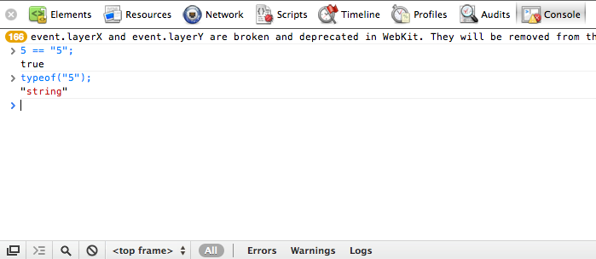
JavaScript Console
You can use your web browser’s console (supported in Chrome and Firefox, possibly others)
  Right Click > Inspect Element > Console
  allows you to enter javascript code line by line and execute it right away to see if it makes sense

Slide 20
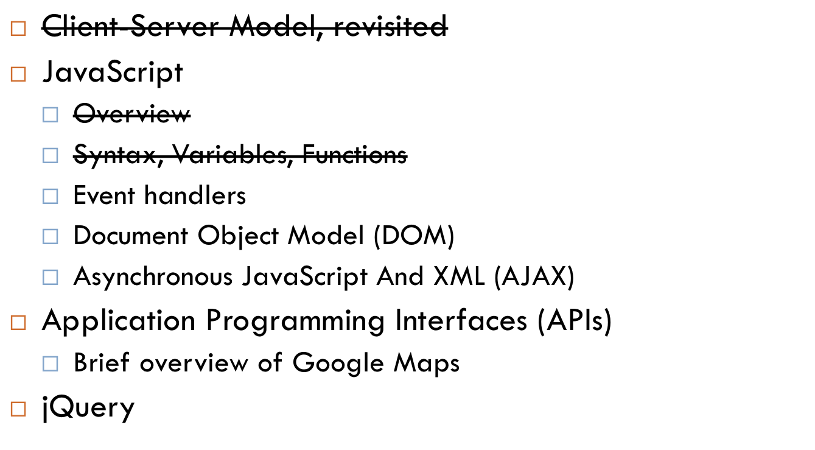
Agenda

Slide 21
Document Object Model (DOM)
We can represent the HTML of a webpage as a tree whose nodes are the nested tags
  We call this tree the document object model (DOM)
Javascript allows us to access individual elements by id and get or change their contents!

Slide 22
DOM Example
<html>
<head>
<script> // we can embed javascript right into our HTML!
var special_text = document.getElementById(“special”).innerHTML;
console.log(special_text); // prints Hello World to console
</script>
</head>
<body>
<div id=“special”>Hello World</div>
</body>
</html>

Slide 23
Properties of DOM Objects
innerHTML: text contained within an element
nodeName: name of the tag of the element
parentNode: parent of the current element
  Returns another DOM object
children: array of child elements (DOM objects)
style: dictionary object representing CSS properties of element
attributes: returns a dictionary mapping each DOM object’s attribute to its value.

Slide 24

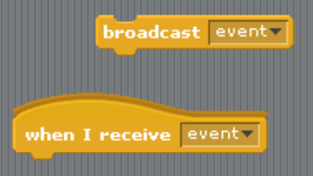
Event Handling

Slide 25
Event handlers
Event handlers listen for an event (a mouse click, a key press, on hover, etc.) and then execute code when that event happens
  E.g. in your scratch project, you made an event handler: “when green flag button is pressed, do this”
  Makes your website a lot more dynamic!
http://www.w3schools.com/jsref/dom_obj_event.asp
  onclick, onselect, onload, onunload, onkeyup, onkeydown, onmouseup, …

Slide 26
Event handlers - example
<script>
function submit_clicked() {
var submitted_user = document.getElementById(“username”).innerHTML;
alert(“Hi “ + submmitted_user + “!”);
}
</script>
...
<input type=“text” id=“username”>
<button onclick=“submit_clicked()”>Submit!</button>

Slide 27
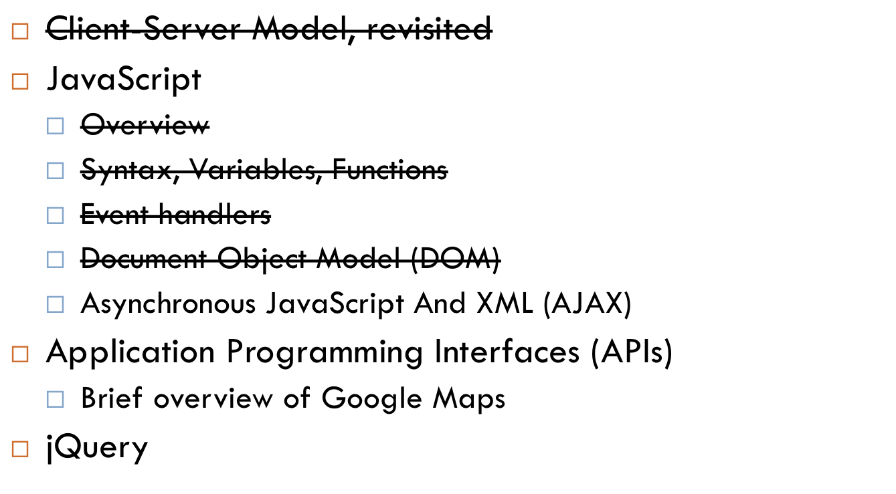
Agenda

Slide 28
AJAX
How do you get new data from the server without ever refreshing the webpage?
  E.g. Gmail, Google Calendar, Google Docs, Facebook, …

Slide 29
AJAX
How do you get new data from the server without ever refreshing the webpage?
  E.g. Gmail, Google Calendar, Google Docs, Facebook, …
We load data asynchronously (out of the usual client-server order)
  No need to refresh pages to see new content!
  The client can grab data from the server and dynamically load it into webpage.

Slide 30
AJAX
Asynchronous JavaScript and XML
  Ajax is no longer an acronym; not limited to XML and Javascript
  Can also send JSON data (JSON is explained in your problem set)
Steps (http://cdn.cs50.net/2011/fall/lectures/10/src10/ajax/ajax5.html)
  (1) Create “xhr” object (XMLHTTPRequest)
  (2) Construct URL to send request to
  (3) Send out xhr
    Set up handler (provide a callback function to call when the request completes)
    Open request
    Send request

Slide 31
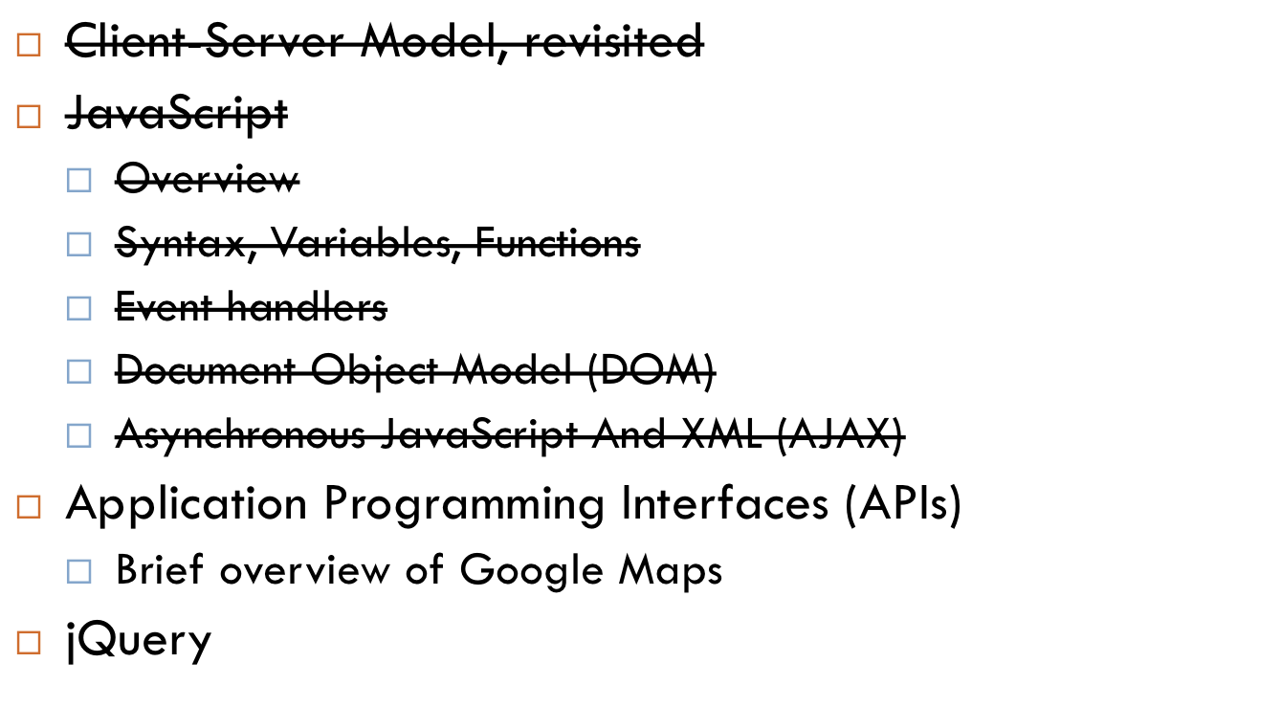
Agenda

Slide 32
APIs
What can you do with a car?

Slide 33
APIs
What can you do with a car?
  Press Gas
  Press Brake
  Turn the steering wheel
  Go in reverse

Slide 34
APIs
What can you do with a car?
  Press Gas
  Press Brake
  Turn the steering wheel
  Go in reverse
Consider this: Do you really need to know how all the parts of a car works in order to use it?
No!

Slide 35
APIs
In the same way, many websites and software companies provide application programming interfaces so that other developers can utilize their product without having to know how the interface calls are implemented
  Analogy: the API for a car would be “gas, brake, steer, reverse”
An interface allows us to separate how something works with how people use it.
  Analogy: A driver knows how to drive a car without having to know how the car company made it.
Examples: Facebook API, Twitter API, Yahoo stocks API, Google Maps API, Harvard Courses API, Shuttleboy API, …

Slide 36
APIs
Web-based APIs usually consist of structured URLs that you can send HTTP requests to
  E.g. https://manual.cs50.net/Shuttleboy_API
  E.g. https://developers.facebook.com/docs/reference/api/

Slide 37
Side note: useful command line tool
jharvard$ curl http://shuttleboy.cs50.net/api/1.2/stops?output=csv
stop,lat,lng
"114 Western Ave",,
"Boylston Gate",42.373078,-71.117578
"Harvard Square",42.373226,-71.119527
"HBS Rotary",42.365290,-71.122905
...
jharvard$ curl –F "name=daniel;password=cheese” url.com
// allows you to POST data.

Slide 38
Google Maps API
Hello World Tutorial here:
  http://code.google.com/apis/maps/documentation/javascript/tutorial.html
Several easy steps
  (1) Copy and paste this into your <head></head>
<script type="text/javascript"
src="http://maps.googleapis.com/maps/api/js?sensor=set_to_true_or_false">
</script>

Slide 39
Google Maps API
Several easy steps
  (2) Copy and paste this into your <head></head>
<script type="text/javascript">
function initialize() {
var latlng = new google.maps.LatLng(-34.397, 150.644);
var myOptions = {
zoom: 8,
center: latlng,
mapTypeId: google.maps.MapTypeId.ROADMAP
};
var map = new google.maps.Map(document.getElementById("map_canvas"),
myOptions);
}
</script>

Slide 40
Google Maps API
Several easy steps
  Copy and paste this as your <body></body>
<body onload="initialize()">
<div id="map_canvas" style="width:100%; height:100%"></div>
</body>

Slide 41
Google Maps API
Read the Google Maps API documentation and problem set specification thoroughly
  It’ll help a long way!
  http://code.google.com/apis/maps/documentation/javascript/basics.html

Slide 42
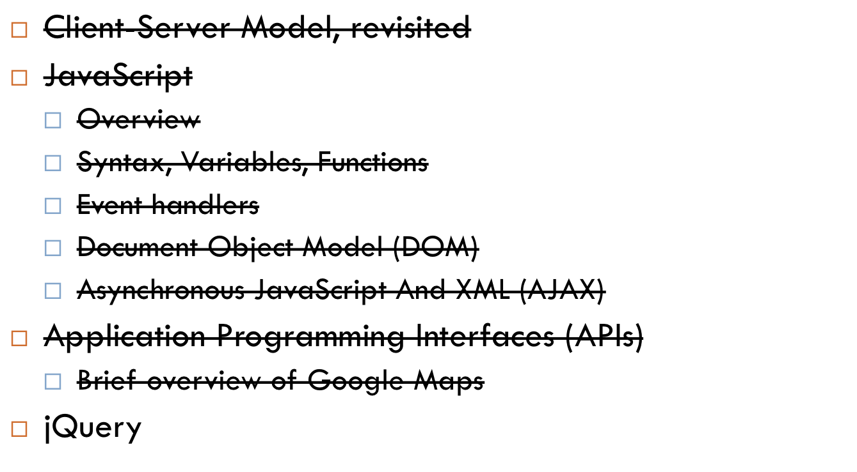
Agenda

Slide 43
The web is such a friggin’ hack
“Imagine if I told you we were going to build a system to run our company. We’d use a domain specific language for the data-store, a second language for the back-end code which is run on a server written in a third language, a fourth xml-based approach to explain the documents, a fifth DSL to explain the styling of said document, a sixth language to write the front-end code, and a seventh “language” that is actually a library that makes the sixth language usable for our purposes. Would anyone think I was crazy?”
http://lbrandy.com/blog/2010/10/things-that-i-think-i-think/
You will know what all of these are by the end of this class!
SQL, PHP (and other languages as well), C (Unix Operating Systems), HTML, CSS, JavaScript, jQuery (not part of this course)

Slide 44
The web is such a friggin’ hack
“Imagine if I told you we were going to build a system to run our company. We’d use a domain specific language for the data-store, a second language for the back-end code which is run on a server written in a third language, a fourth xml-based approach to explain the documents, a fifth DSL to explain the styling of said document, a sixth language to write the front-end code, and a seventh “language” that is actually a library that makes the sixth language usable for our purposes. Would anyone think I was crazy?”
http://lbrandy.com/blog/2010/10/things-that-i-think-i-think/

Slide 45
Side note: jQuery.
JavaScript library that makes writing JavaScript A LOT more painless.
  http://jquery.com/
Simply download the file, include a path to the jquery js file with
<script text=“text/javascript” src=“jquery.js”></script>
and you can start using it!

Slide 46
Jquery
From ~60 lines of normal javascript code to:
  http://cdn.cs50.net/2011/fall/lectures/10/src10/ajax/ajax6.html
<script src="http://code.jquery.com/jquery-latest.js"></script>
<script>
$(document).ready(function() {
$("#form").submit(function() {
$.ajax({
url: "quote3.php",
data: {
symbol: $("#symbol").val()
},
success: function(data) {
$("#price").html(data.price);
$("#high").html(data.high);
$("#low").html(data.low);
}
});
return false;
});
});
</script>

Slide 47
jQuery
I highly recommend you learn jQuery for your final projects
  My TF last year had an awesome seminar in jQuery and other cool Web 2.0 stuff—I highly recommend watching it!
  https://manual.cs50.net/Seminars#Modern_Client-Side_Web_Programming
To help you easily create good user interfaces, I suggest jQuery UI (http://jqueryui.com/)

Slide 48

Agenda

Slide 49
Fun Fun Fun
Autocomplete!
  Grab source code here:
    https://cloud.cs50.net/~kennyyu/section/week9/
  Working example here:
    https://cloud.cs50.net/~kennyyu/section/week9/pokemon/
Example of something you can do (something I had written for another class):
  https://cloud.cs50.net/~kennyyu/section/week9/books/

