Slide 1

PERSONALIZE SETTINGS
name:
password for computer:
N95 SETUP
micro x
next
back

Slide 2
micro x
N95 SETUP
PASS CODE
Type the n95 pass code.
micro x
OEM
N95 SETUP
next
back

Slide 3
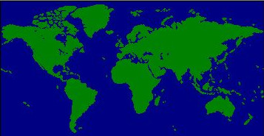
Time zone
TIME ZONE
[Gmt - 8.00]pasific time (US & canada)
N95 SETUP
micro x
Automaticaly adjest clock for daylight saving changes
next
back

Slide 4
DESKTOP ICONS
Hint: tick the desktop icons you want for n95.
Notepad
Image viewer
N95 SETUP
Recycle bin
Home
Control panel
Toolbar shortcut
Get started
Pixal box
Micro X bunny Internet explorer
Tea box
micro x
Tea cooker toy
next
back

Slide 5
CONTROL PANEL SETTINGS
Server:
none
Power:
sleep
N95 SETUP
Power saver (profile 1)
micro x
next
back

Slide 6
ADDINGS
Hint: tick what you like to add to n95.
network
printer
N95 SETUP
Serial port 2
Serial port 3
Serial port 4
Paralal port 2
Paralal port 3
Paralal port 4
Sound card
Radio card
micro x
Network card
next
back

Slide 7
RESTART COMPUTER & FLOPPY CONTROLLER
Where is the floppy controller?
IDE 1
I am ready to restart my computer.
N95 SETUP
Preparing to restart your computer.
76%
micro x
next
back

Slide 8
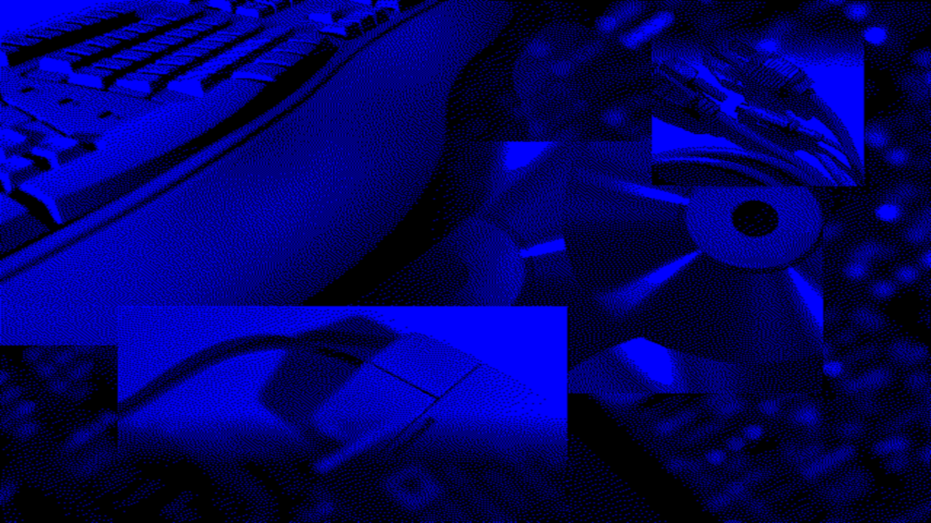
GETTING READY TO RUN N95 FOR THE FIRST TIME…

Slide 9

micro x
N95

Slide 10

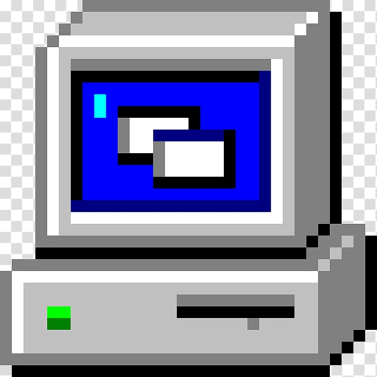

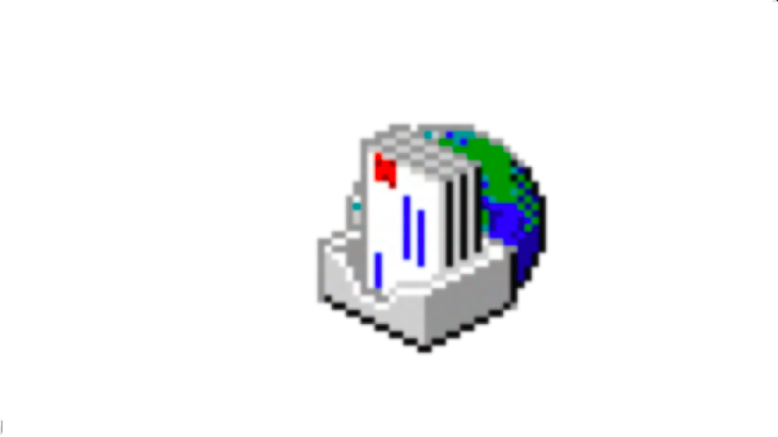

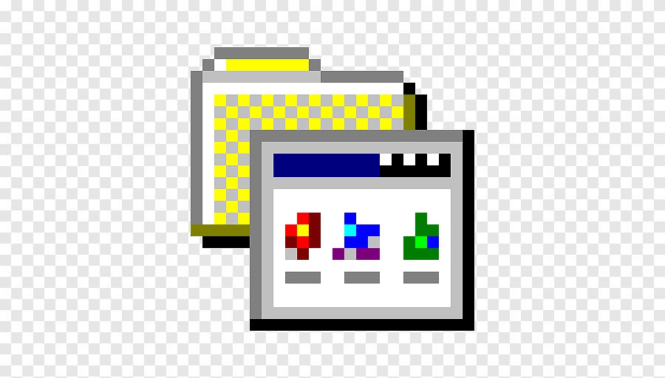


My computer
reacycle bin
inbox
the internet
program files
notepad
start
10.35 am

