Slide 1
Model Context Protocol (MCP)
PRESENTED BY Sihan Dong
04/29/2025

Slide 2
What Is MCP?
Open standard (JSON‑RPC 2.0) introduced by Anthropic Nov 2024.
Defines how an AI client requests context from a server (uses a tool)
Goal: One protocol, many tools—swap LLM vendors or data sources without new glue.

Slide 3
Why We Need MCP
LLM apps traditionally require bespoke connectors for every API, DB, or SaaS tool.
Integrations become brittle and hard to audit as feature counts grow.
Teams lose time reinventing work flows, error handling, and data validation.

Slide 4
Core Components
Role | Lives In | Purpose
MCP Client | Host app / agent | Packages model calls into MCP messages
MCP Server | External service wrapper | Advertises Capabilities
Capabilities | Tools · Resources · Prompts | Declarative metadata + JSON Schema

Slide 5
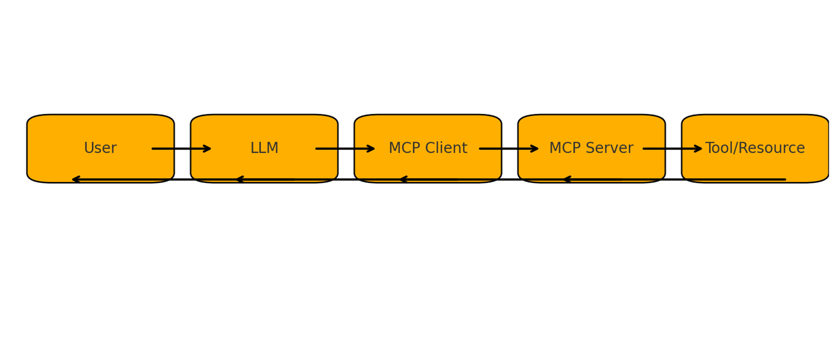
Request/Response Flow

Slide 6
The Magic: How LLMs decides which tool
System Prompting with Tools List: LLM is informed about available tools at conversation start. Each tool has a name, description, and input/output schema.
Internal Planning (Chain-of-Thought) Model reasons if it needs external help: "I can't guess weather — I must call get_weather."

Slide 7
A Sample Tool Call
LLM outputs a special tool_call Token
Formatted in json to reduce hallucination
{
"tool_call": {
"name": "get_weather",
"arguments": { "location": "Paris" }
}

Slide 8
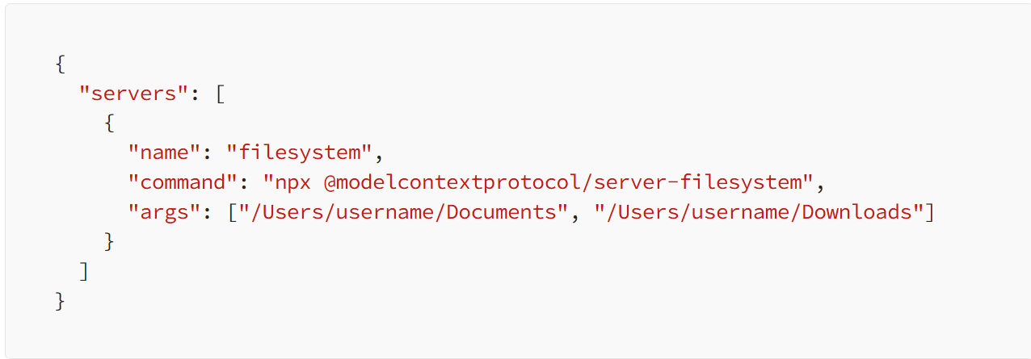
Real-World Example: Organizing Files with Claude MCP
If we have messy project folder: .py, .txt, .md, .csv files.
User wants Claude to organize local file folders
Download Claude desktop which has mcp feature
Connect to a local file MCP server using this configuration:

Slide 9
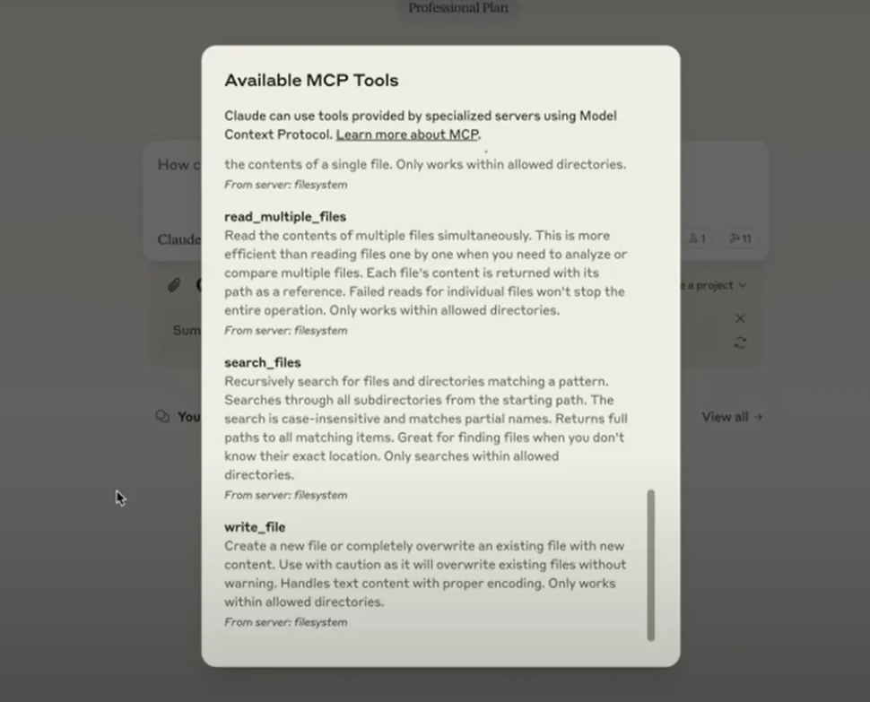
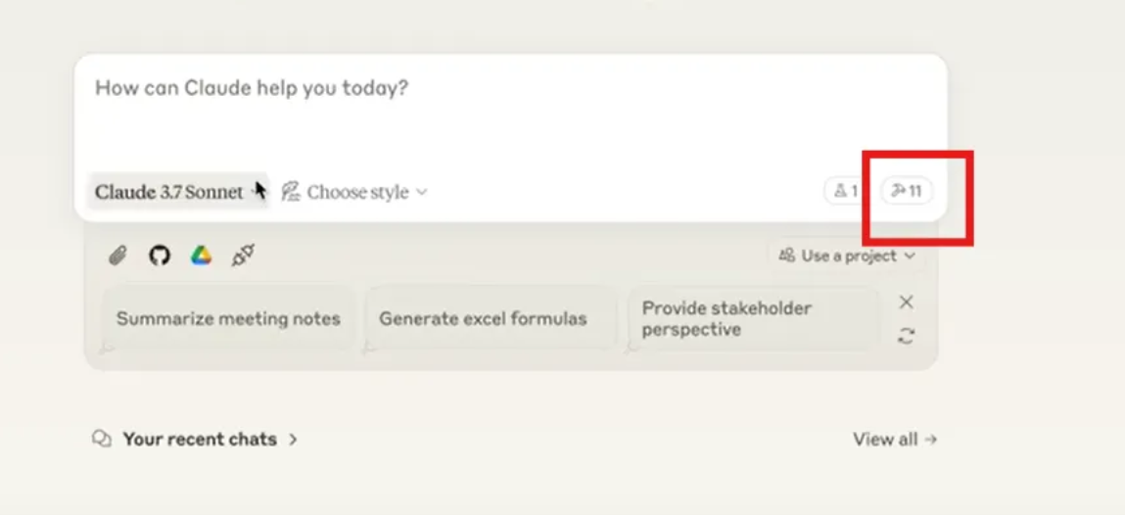
Now we can ask claude: "Organize files: scripts to /scripts, documents to /docs, data to /data."

Slide 10
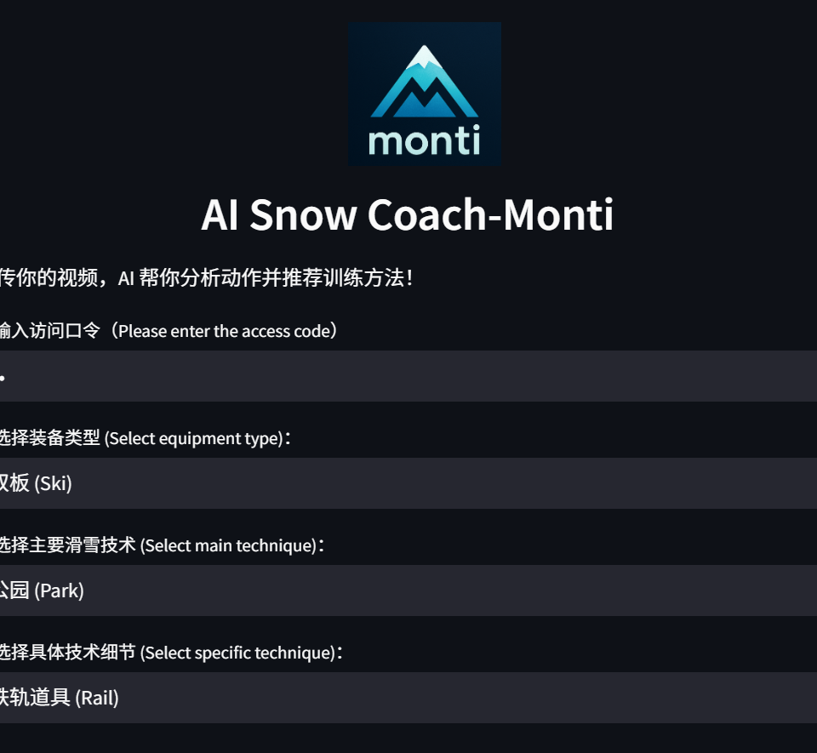
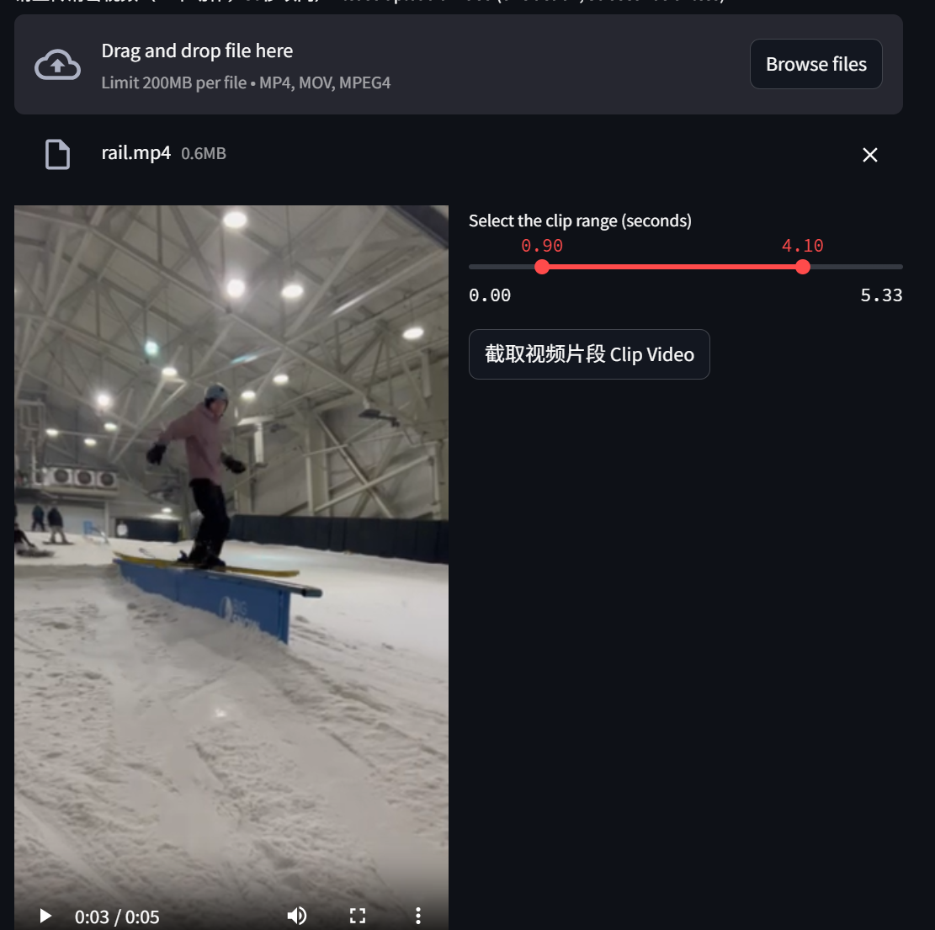
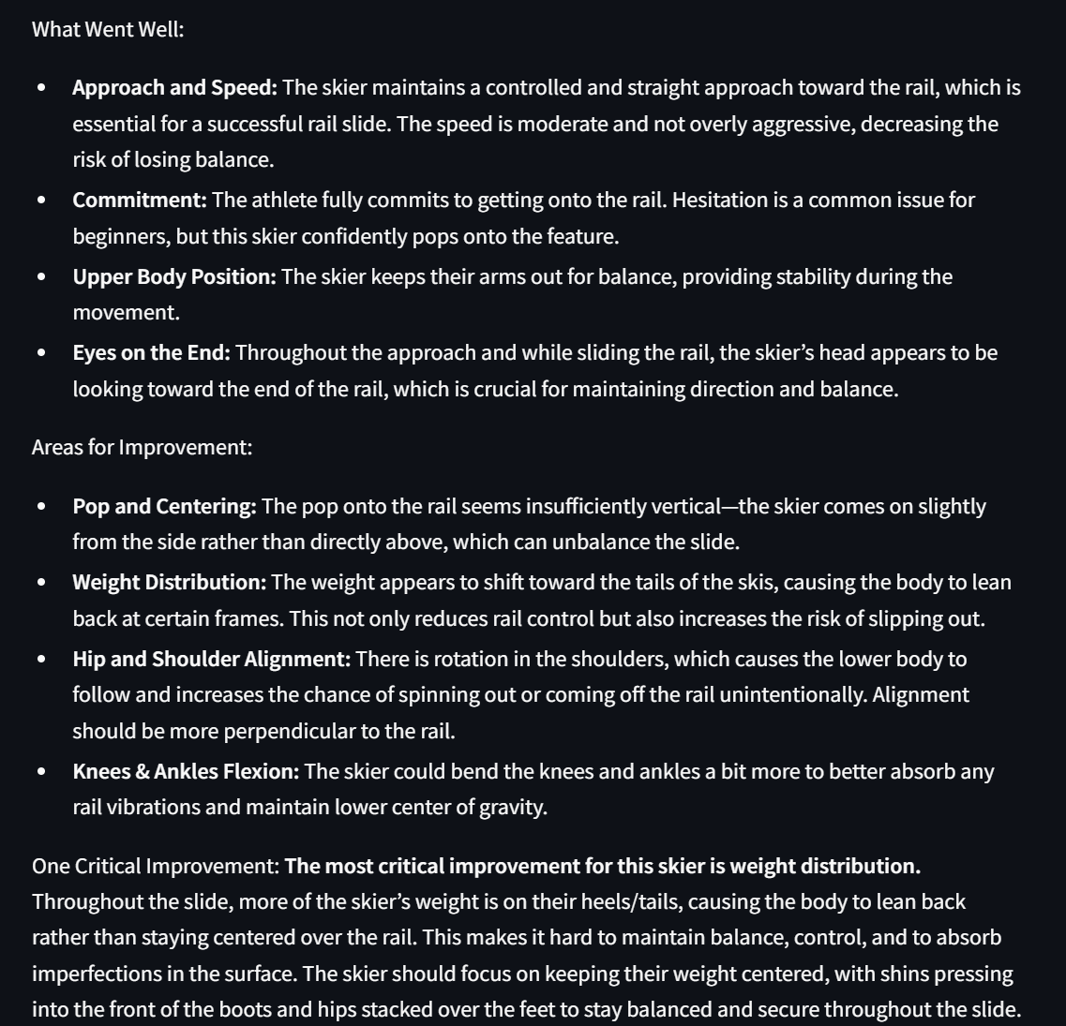
A little AD: AI Snow Coach
https://snowcoach.streamlit.app

Slide 11
References
https://sebastian-petrus.medium.com/mcp-server-claude-work-with-local-files-594f332a7084

