Slide 1
Enterprise AI

Slide 2
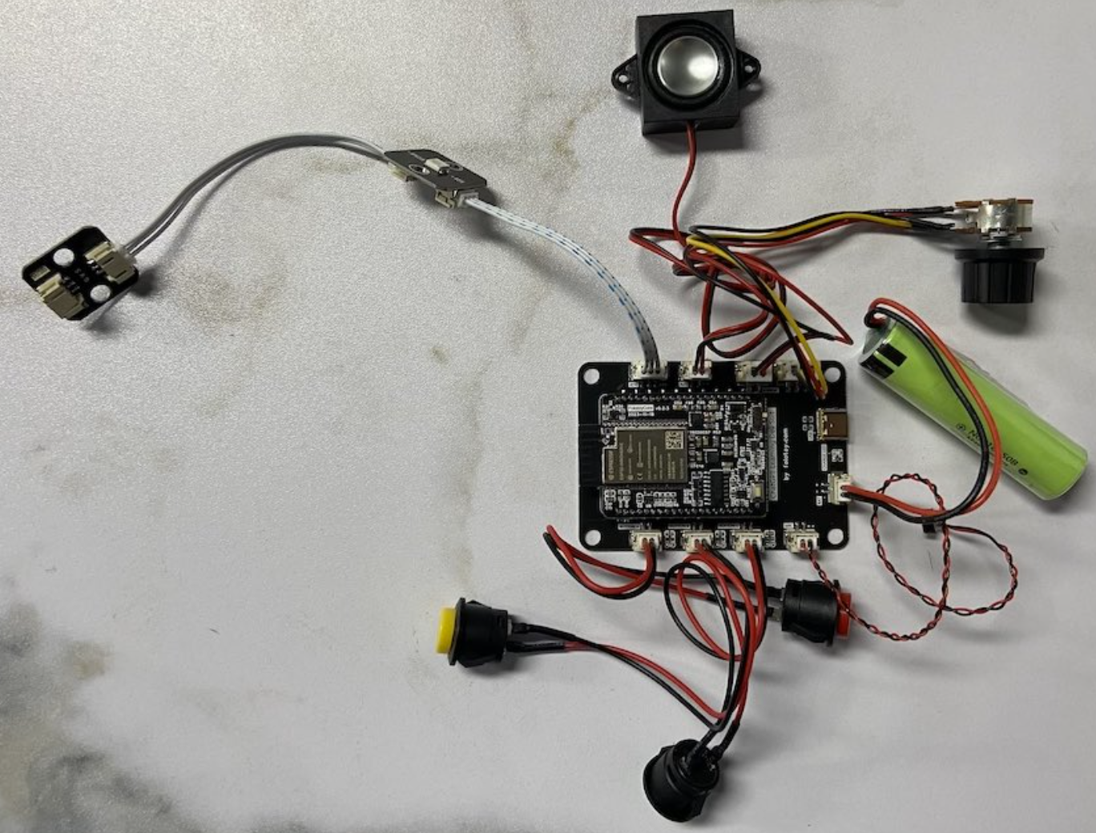



ChatBot Pipeline
OpenAI Speech API
OpenAI Chat API
OpenAI Transcriptions API
ASR(Auto Speech Recognition) Service
LLM Service
TTS (Text To Speech) Service
Audio Input
OneAPI
IPEX
xFT

Slide 3
Meeting Summary Pipeline
OpenAI Speech API + Speakers
OpenAI Chat API
OpenAI Transcriptions API
ASR + Segments + diarize
(WhisperX)
RAG Service
LLM Service
TTS (Text To Speech) Service
Audio Input
OneAPI
IPEX
xFT

Slide 4
ASR(Auto Speech Recoginition) Service
OpenAI Speech API
Run Test：
curl -X 'POST' http://localhost:5500/v1/audio/speech \
-d '{ "input": "人民是我们党执政的最大底气，是我们共和国的坚实根基，是我们强党兴国的根本所在" }' \
-H 'accept: application/json' \
-H 'Content-Type: application/json' --output test55.mp3
ASR(Auto Speech Recoginition) Service
Run Service via Docker：
docker run -it -p 5500:5500 registry.cn-hangzhou.aliyuncs.com/kenplusplus/openvoice-server:latest

Slide 5
TTS (Text To Speech) Service
OpenAI Transcriptions API
Run Test：
curl -X 'POST' -F "file=@/path/to/file" http://localhost:5000/v1/audio/transcriptions
TTS (Text To Speech) Service
Run Service via Docker：
docker run -it -p 5500:5500 registry.cn-hangzhou.aliyuncs.com/kenplusplus/openvoice-server:latest

