Slide 1
Enterprise AI

Slide 2
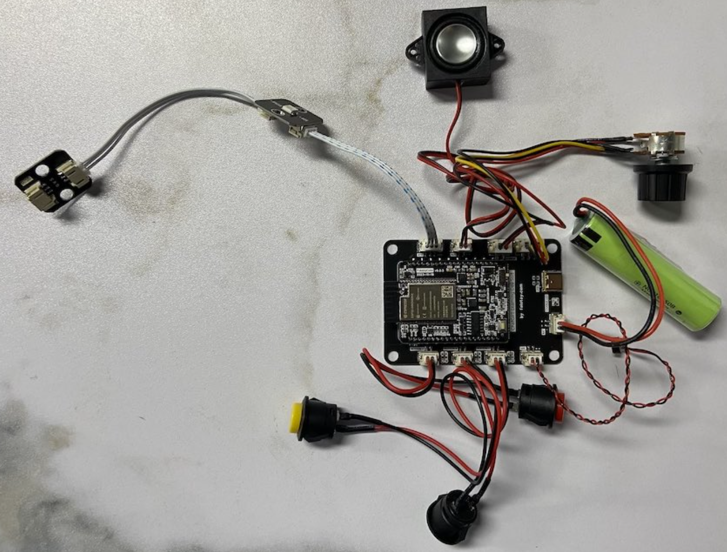



ChatBot Pipeline
API Gateway
OpenAI Speech API
OpenAI Chat API
OpenAI Transcriptions API
Audio Input
ASR(Auto Speech Recognition) Service
LLM Service
TTS (Text To Speech) Service
Optimized AI Server
OneAPI
IPEX
xFT

Slide 3
Meeting Summary Pipeline
API Gateway
OpenAI Speech API + Speakers
OpenAI Chat API
Audio Input
ASR + Segments + diarize
(WhisperX)
RAG Service
LLM Service
Mail Service
Optimized AI Server
OneAPI
IPEX
xFT

Slide 4
ASR(Auto Speech Recoginition) Service
OpenAI Speech API
Run Test：
curl -X 'POST' http://localhost:5500/v1/audio/speech \
-d '{ "input": "人民是我们党执政的最大底气，是我们共和国的坚实根基，是我们强党兴国的根本所在" }' \
-H 'accept: application/json' \
-H 'Content-Type: application/json' --output test55.mp3
ASR(Auto Speech Recoginition) Service
Run Service via Docker：
docker run -it -p 5500:5500 registry.cn-hangzhou.aliyuncs.com/kenplusplus/openvoice-server:latest

Slide 5
TTS (Text To Speech) Service
OpenAI Transcriptions API
Run Test：
curl -X 'POST' -F "file=@/path/to/file" http://localhost:5000/v1/audio/transcriptions
TTS (Text To Speech) Service
Run Service via Docker：
docker run -it -p 5500:5500 registry.cn-hangzhou.aliyuncs.com/kenplusplus/openvoice-server:latest

