Slide 1
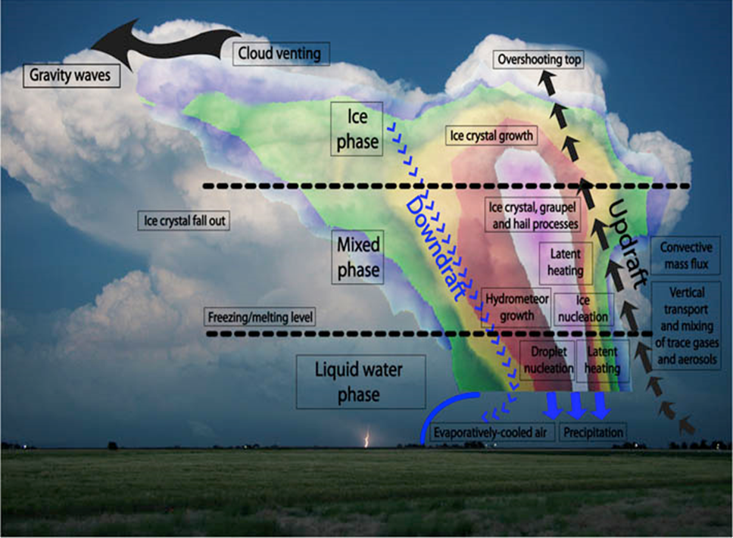
Chapter 2: Theoretical Background
Downburst Microphysical and Thermodynamic Processes
The power of the downdraft also increases in proportion to the relative concentration of smaller particles.
In conjunction with precipitation loading, the melting of frozen hydrometeors and subcloud evaporation of liquid precipitation results in the cooling and negative buoyancy that accelerate the downdraft in the unsaturated layer promoted by a significant temperature lapse rate (Srivastava 1985, 1987).
The melting of ice-phase precipitation, subsequent evaporative cooling, and the resulting downdraft strength are enhanced by sizeable liquid water content and the related water surface available for evaporation.
F
1) Precipitation loading
2) Latent cooling
3) Negative buoyancy (F)
4) Downdraft acceleration
Srivastava (1985, 1987)
Notes:
The power of the downdraft also increases in proportion to the relative concentration of smaller particles.
In conjunction with precipitation loading, the melting of frozen hydrometeors and subcloud evaporation of liquid precipitation results in the cooling and negative buoyancy that accelerate the downdraft in the unsaturated layer promoted by a significant temperature lapse rate (Srivastava 1987).
The melting of ice-phase precipitation, subsequent evaporative cooling, and the resulting downdraft strength are enhanced by sizeable liquid water content and the related water surface available for evaporation.

Slide 2
Chapter 2: Theoretical Background
Knupp (1989, 1996) refined the understanding of the
downburst generation’s physical and dynamic processes:
Downdrafts are closely controlled by the arrival of precipitation at low levels. In the storm middle levels, air flows quasi-horizontally around the updraft flanks and converges into the downshear flank (i.e. wake).
The intrusion of drier air into the wake’s precipitation region also enhances the evaporation/sublimation process. Diabatic cooling from melting and evaporation is most effective at levels below the melting level.
A comprehensive understanding of the downdraft initiation process is closely related to the precipitation initiation and transport process within clouds and is observable in passive microwave imagery, as shown in the following case studies.
Downshear wake entrainment
Knupp (1989, 1996)
F
Notes:
Downdrafts are closely controlled by the arrival of precipitation at low levels. In the storm middle levels, air flows quasi-horizontally around the updraft flanks and converges into the downshear flank, referred to as the wake.
Within the wake region, where entrainment reduces positive buoyancy and associated updraft strength, precipitation at middle levels (where it is grown most effectively) is then allowed to descend to lower levels.
The intrusion of drier air into the wake’s precipitation region also enhances the evaporation/sublimation process. Diabatic cooling from melting and evaporation is most effective at levels below the melting level.
Therefore, a comprehensive understanding of the downdraft initiation process is closely related to the precipitation initiation and transport process within clouds and is observable in passive microwave imagery, as shown in the following case studies.

Slide 3
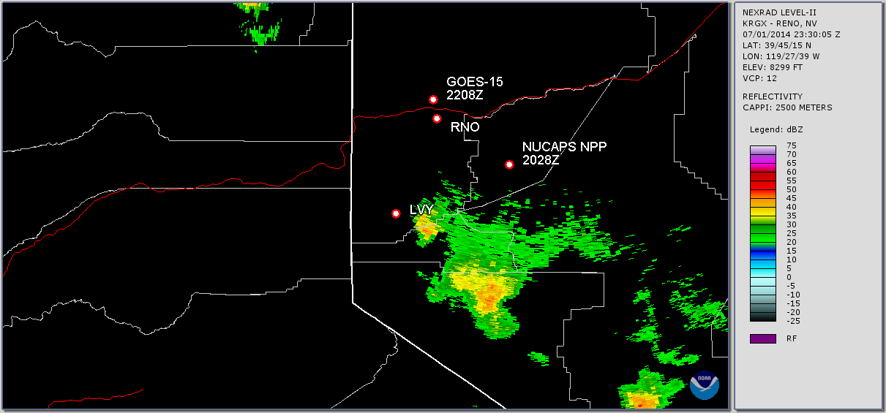
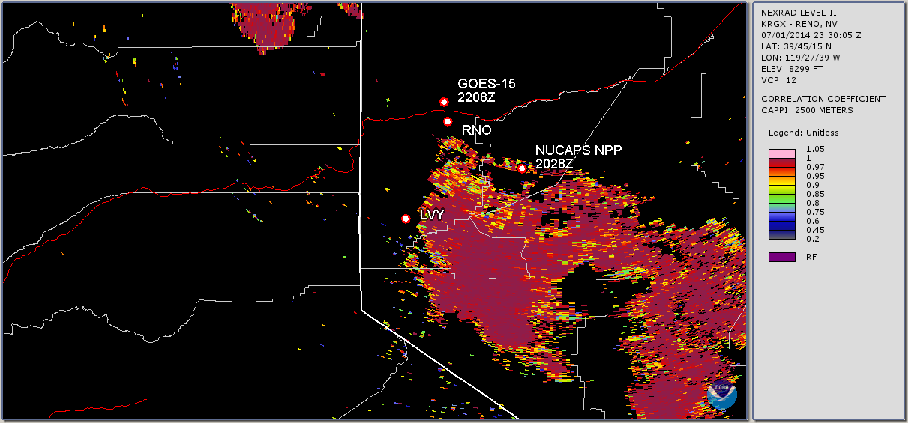

Slide 4
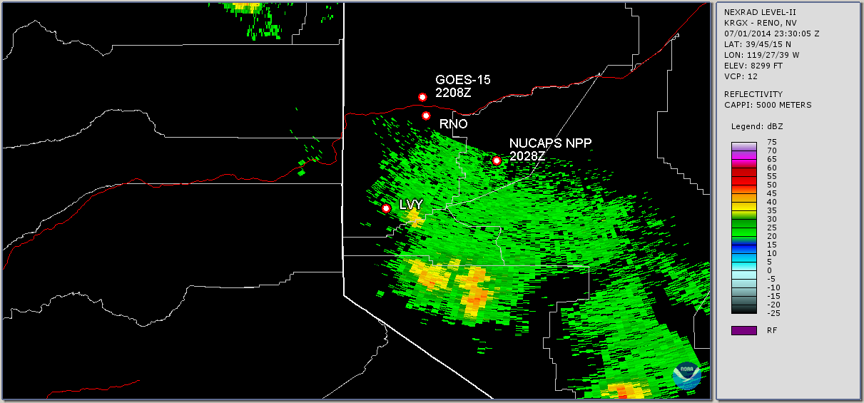
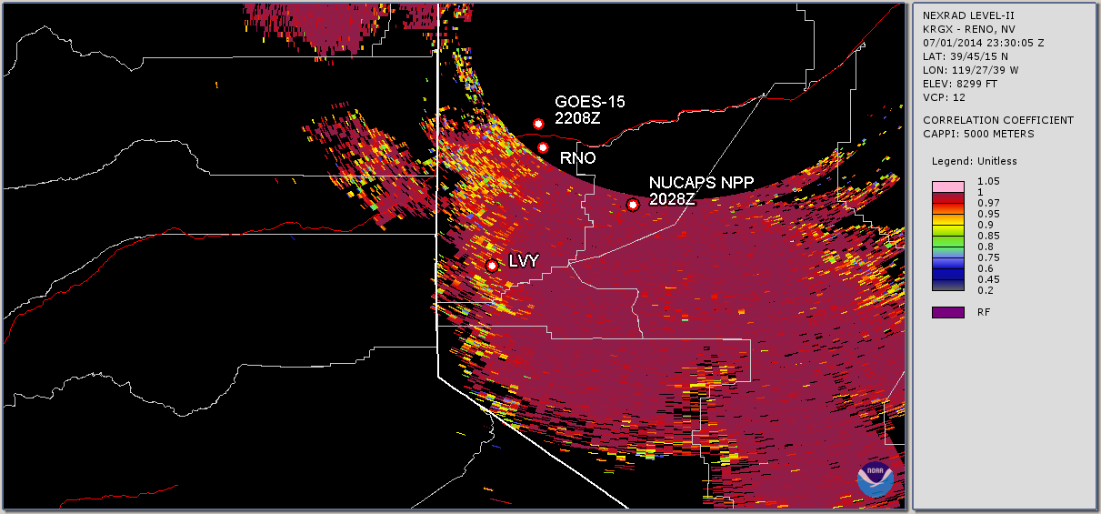

Slide 5
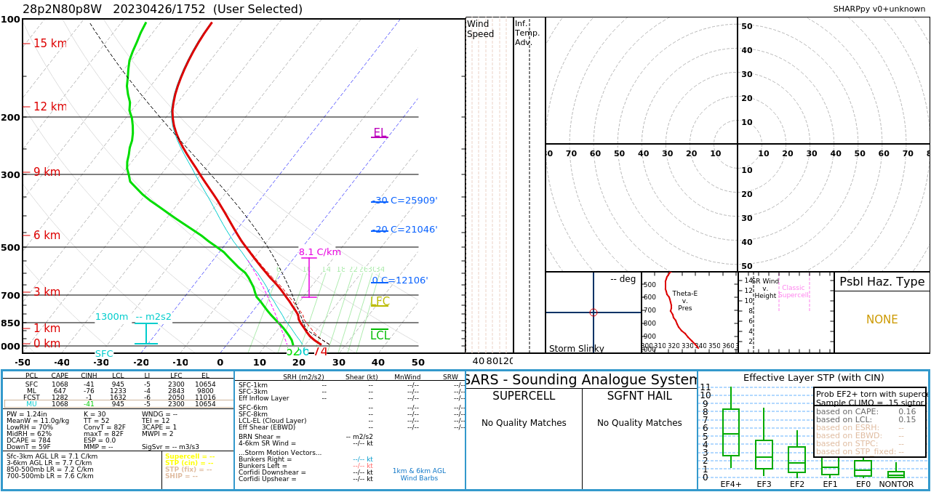

Slide 6
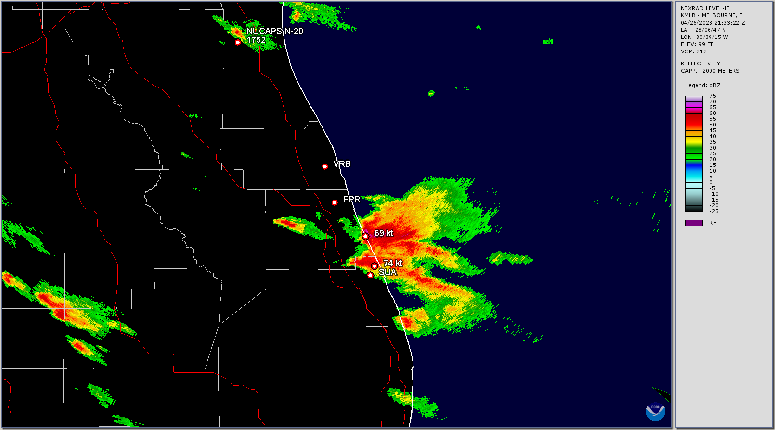
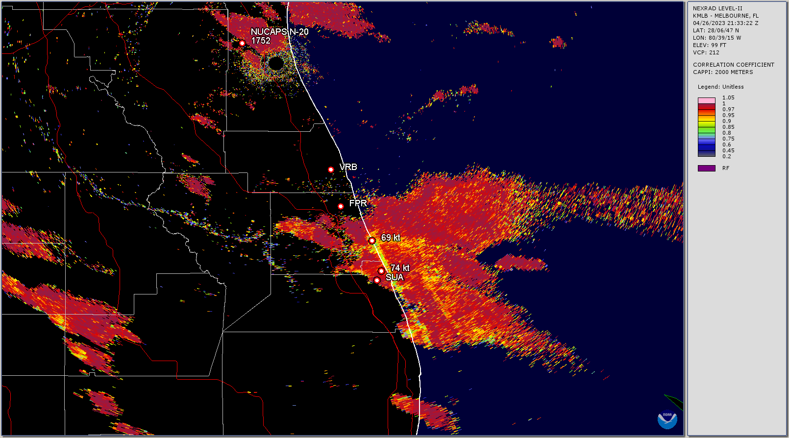

Slide 7
