Slide 1
CS 35L Software Construction Lab
Teaching Assistant: Rucha Rangnekar
Week 2- Lecture 1

Slide 2
Revision: sort
What does sort do?
Examples:
Sort –o
Sort –r
Sort –u
Example:
File1.txt:
abc
Xyz
Def
Abc
def
xyz
Notes:
-o: writes to standard output
-r: sorted in reverse order
-u: removes duplicates

Slide 3
Some more commands: tr
tr
translate or delete characters
echo "password a1b2c3" | tr -d [:digit:]
echo “abc” | tr [:lower:] [:upper:]
echo "Welcome To Lab 2" | tr [:space:] '\t'
Notes:
echo "password a1b2c3" | tr -d [:digit:] -> password abc
echo “abc” | tr [:lower:] [:upper:] -> ABC
echo "Welcome To Lab 2" | tr [:space:] '\t’ -> Welcome To Lab 2

Slide 4
Some more commands: grep
grep
Searches for a pattern in a file and displays all matched lines
Where is it used?
Examples:
lab2.txt
This is the second lab.
We are studying commands.
Their uses are many.
THIS LAB IS TEACHING US COMPUTER SCIENCE.
Soon this can help us do great things there.
Commands:
$grep -i ”THis" lab2.txt
$grep -c ”this" lab2.txt
$grep -w ”us" lab2.txt
$grep –e “their” –e “there” lab2.txt
Notes:
-w helps us match whole words.

Slide 5
Some more commands: awk
Awk
define text patterns that are to be searched for in each line of a document and the action that is to be taken when a match is found within a line
Working of awk: (a) Scans a file line by line (b) Splits each input line into fields (c) Compares input line/fields to pattern (d) Performs action(s) on matched lines
Syntax:
awk options 'selection _criteria {action }' input-file > output-file

Slide 6
Built-in variables in awk
NR: NR command keeps a current count of the number of input records
NF: NF command keeps a count of the number of fields within the current input record.
FS: FS command contains the field separator character which is used to divide fields on the input line. The default is “white space”.
RS: RS command stores the current record separator character.

Slide 7
awk Examples
lab2_awk.txt
Alfa student undergrad CS
Bravo TA grad EE
Charlie student undergrad EE
Delta TA grad CS
Commands:
$ awk '{print}’ lab2_awk.txt
$ awk ‘/student/ {print}’lab2_awk.txt
$ awk '{print $1,$3}’ lab2_awk.txt
$ awk '{print $0}’ lab2_awk.txt
$ awk '{print NR,$0}’ lab2_awk.txt

Slide 8
Some more commands: sed
sed
Stream editor
can perform lot’s of function on file like, searching, find and replace, insertion or deletion( mainly used for substitution and find-and-replace)
Syntax:
sed OPTIONS... [SCRIPT] [INPUTFILE...]

Slide 9
sed Examples
lab2.txt
Alfa student undergrad CS
Bravo TA grad EE
Charlie student undergrad EE
Delta TA grad CS
Commands
$sed ‘s/TA/student/’ lab2.txt
$sed ‘s/TA/student/2’ lab2.txt
sed 's/\(\b[A-Z]\)/\(\1\)/g’ lab2.txt
$sed '3 s/TA/student/’ lab2.txt
$sed ‘1,3 s/TA/student/’ lab2.txt
$ sed '5d’ lab2.txt

Slide 10
UNIX Wildcards
A wildcard is a character that can stand for all members of some class of characters
The * wildcard
The character * is a wildcard and matches zero or more character(s) in a file (or directory) name. ( ls list* or ls *list)
The ? Wildcard
The character ? will match exactly one character. (ls ?list OR ls list?)
The [] Wildcard
A pair of [] represents any of the characters enclosed by them (ls *[0-9]*)

Slide 11
Regular Expressions
Notation that lets you search for text with a particular pattern:
For example: starts with the letter a, ends with three uppercase letters, etc.
Open http://regexpal.com/

Slide 12
Regular Expressions (regex)
What is a regex: A regex is a special text string for describing a certain search pattern
Quantification
How many times of previous expression?
Most common quantifiers: ?(0 or 1), *(0 or more), +(1 or more)
Alternation
Which choices?
Operators: [] and |
E.g Hello|World , [A B C]
Anchors
Where?
Characters: ^(beginning) and $(end)

Slide 13
regex contd…
^ start of line
$ end of line
\ turn off special meaning of next character
[] match any of enclosed characters, use – for range
[^ ] match any characters except those enclosed in []
. match a single character of any value
* match 0 or more occurrences of preceding character/expression
+ match 1 or more occurrences of preceding character/expression

Slide 14



regex Example
Examples:
tolstoy:
^tolstoy
tolstoy$
^tolstoy$
[Tt]olstoy
tol.toy
tol.*toy
The seven letters tolstoy, anywhere on a line
The seven letters tolstoy, at the beginning of a line
The seven letters tolstoy, at the end of a line
A string containing exactly the seven letters tolstoy
The seven letters Tolstoy or tolstoy, anywhere on a line
The three letters tol, any character, and the three letters toy, anywhere on a line
The three letters tol, any sequence of zero or more characters, and the three letters toy, anywhere on a line (e.g., toltoy, tolstoy, tolWHOtoy, and so on)

Slide 15
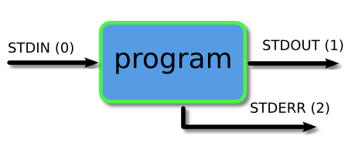
Piping and Redirection
Every program we run on the command line automatically has three data streams connected to it.
STDIN (0) - Standard input (data fed into the program)
STDOUT (1) - Standard output (data printed by the program, defaults to the terminal)
STDERR (2) - Standard error (for error messages, also defaults to the terminal)
Piping and redirection is the means by which we may connect these streams between programs and files to direct data in useful ways.

Slide 16
More About Piping and Redirection
Basic I/O Redirection
Most programs read from stdin
Write to stdout
Send error messages to stderr
Try: $ cat // With no arguments, read standard input, write standard output
Task: Piping and Redirection
Create a file test.txt with numbers 1-5 in descending order in each line
Delete all the new line characters (with tr command and redirection) and redirect output to test1.txt
Now, first sort the file and then repeat the above step; but instead of redirection, now append the output to test1.txt

Slide 17
The Shell and OS
What is a shell?
Outermost cover of the kernel
User’s interface to the OS
Use it to run your programs

Slide 18
Compiled Languages v/s Scripting Languages
Compiled Languages
Examples?
C, C++,Java
First Compiled
Source code to object code; then executed
Run faster
Applications:
Typically run inside a parent program like scriptscan be compiled and used on any platform (eg. Java)
Scripting Languages
Examples?
Python, JavaScript, Shell Scripting
No compilation required. Directly interpreted!
Interpreter reads program, translates into internal form and executes
Runs slower than a high level lang
Applications:
Automation, Extracting information from a data set, Less code intensive

Slide 19
Shell Script
A computer program designed to be run on a shell (UNIX/Linux)
All shell commands can be executed inside a script
Why use a shell script?
Simplicity
Portability
Ease of development

Slide 20
Basic Shell Constructs
Shell recognizes three fundamental kinds of commands:
Built-in commands: Commands that the shell itself executes (e.g.: echo)
Shell functions: Self-contained chunks of code, written in shell language
External Commands: mainly external utilities; backtick often associated
number=`ll | wc -l` // This is an external command
echo $number

Slide 21
Self-Contained Scripts: The #! First Line
When the shell runs a program, it asks the kernel to start a new process and run the given program in that process.
It knows how to do this for compiled programs but for a script, the kernel will fail, returning a “not executable format file” error so it’ll start a new copy of /bin/sh (the standard shell) to run the program.
But if there is more than one shell installed on the system, we need a way to tell the kernel which shell to use for a script
#! /bin/csh –f
#! /bin/awk –f
#! /bin/sh

Slide 22
Task: Understanding a Shell Script
Create a file testFile.sh
Write a statement to print “Hello World” inside it
Run the File with ‘sh testFile.sh’. What do you observe?
Now, add #!/bin/sh to the first line and repeat the above step
Did you see any difference?
Why?
Now, rename the file to testFile.txt and run it again.
Did you see any difference?
Why?

Slide 23
Variables in shell script
Start with a letter or underscore and may contain any number of following letters, digits, or underscores
Hold string variables
$var1=“Hello World”
$ echo $myvar
first=rucha middle=h last=rangnekar Multiple assignments allowed on one line
fullname="$first $middle $last" Double quotes required here, for concatenating
fullname=“abc xyz mno" Use quotes for whitespace in value
oldname=$fullname Quotes not needed to preserve spaces in value

Slide 24
Variables in shell script contd…
Escape Character \ - Literal value of following character
echo \|
Single Quote - Literal Meaning of all within ‘’
$hello=1
$str=‘$hello’
echo $str -> $hello
Double Quote - Literal meaning except for $, ` and \.
$hello=1
$str=“abc$hello”
echo $str -> abc1

Slide 25
Variables in shell script contd…
Special Variables: certain characters reserved as special variables
$: PID of current shell
#: number of arguments the script was invoked with
n: nth argument to the script
?: exit status of the last command executed
echo $$; echo $#; echo $2; echo $?;
scalar variable vs array variable:
array_name[index]=value; echo ${array_name[index]}

Slide 26
Loops
for var in list_values
do
command 1
..
command n
done
while condition
do
command 1
..
command n
done
ALL=`ls -a $dir | sort`
declare -a ARRAY
count=0
for FILE in $ALL
do
ARRAY[$count]=$FILE
…..
done
for i in "${ARRAY[@]}”
do
…
done

Slide 27
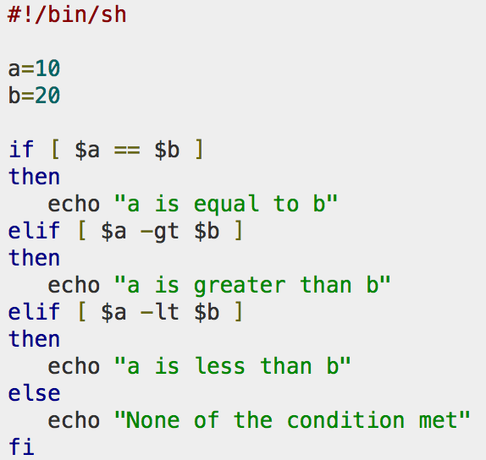
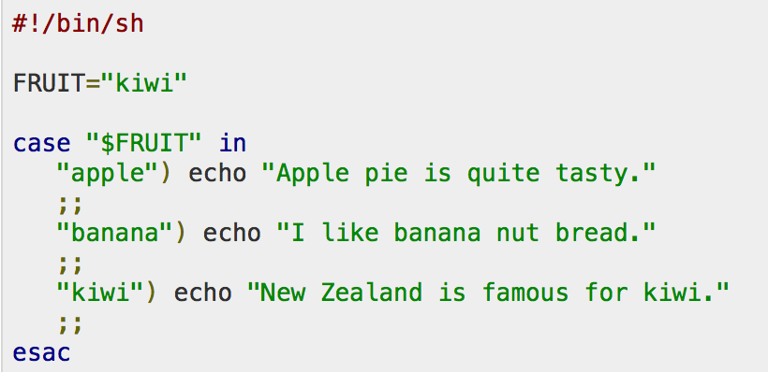
Conditional and Unconditional Statements
Conditional
if…then…fi
if…then…else…fi
if…then…elif..then…fi
case…esac
Unconditional
break
continue

