Slide 1
Image Recognition Training via Reddit
Kenneth Sanders

Slide 2
The Main Idea
Reddit is a link aggregation site
Subreddits are topic oriented sub-sites that users can post to.
Many subreddits are comprised of mostly image links.
Subreddit moderation usually ensures that links are on-topic.
Image recognition models require large, labeled training sets of images
These datasets must be verified to be accurately labeled
Hand annotation is time consuming, costly, and not very productive.
Can we use the (pre-labeled) images in a subreddit as a dataset?

Slide 3
How?
Reddit provides an extensive API for interacting with most aspects of their site.
Many libraries provide easy access to this API.
PRAW (Python Reddit API Wrapper) is the most notable.
Unfortunately, this changed majorly as of 4/11/18, but it’s ok.
Image recognition neural network models have become readily available in the past decade.
Most use Tensorflow or a similar computer vision library.
I used TFlearn, an extension of Tensorflow.

Slide 4
The Plan
Generate a dataset to compare to a public, hand annotated dataset.
Split those datasets in two, a testing set and a training set.
Train an Image Recognition model on each training dataset.
Evaluate the trained models on each of the testing sets.
Compare the results, try to determine if the Reddit datasets produce similar trained networks.

Slide 5
Dogs Vs. Cats
Used the Kaggle Dogs Vs. Cats training set for the known “Good” dataset (25,000 images)
Generated equal sized Reddit dataset from multiple subreddits (r/cats, r/dogs, and a few other smaller ones).
Split them into testing and training sets.
Fed training sets to 2 different models.
Simple CNN
Inception V3

Slide 6
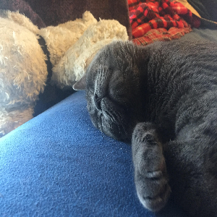
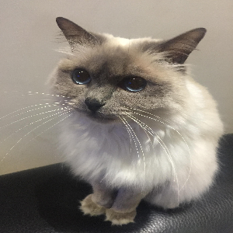
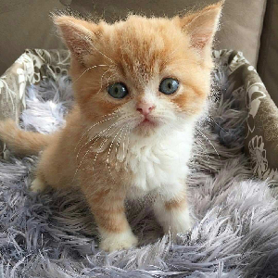
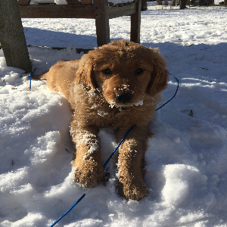
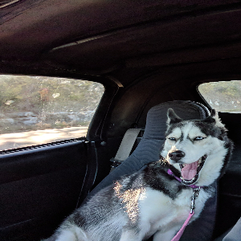
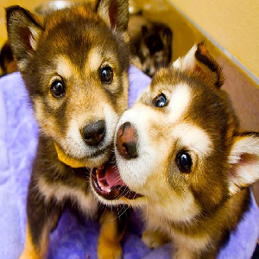

Slide 7
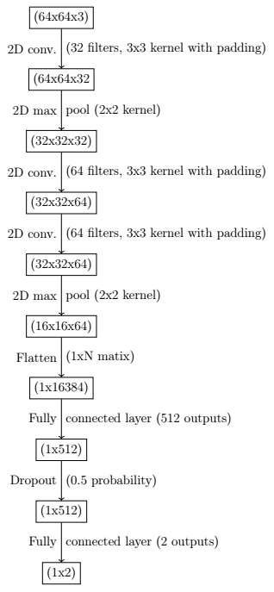
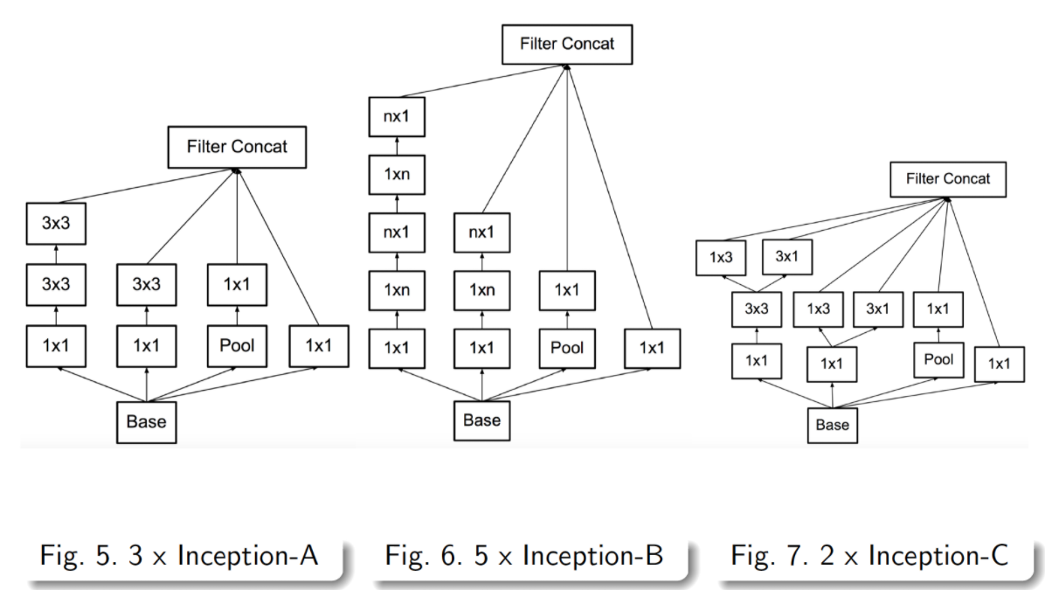
Neural Nets
Notes:
https://norman3.github.io/papers/images/google_inception/f14.png for inception net

Slide 8
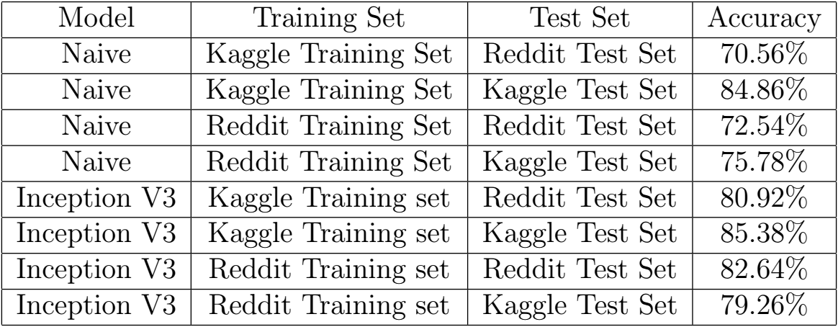
Dogs Vs. Cats Results

Slide 9
Expansion to CIFAR10
Obtain CIFAR10 dataset
60,000 images
10 categories – Dog, Cat, Truck, Car, Plane, Frog, Deer, Horse, Ship, and Birds
Generate “Reddit10” dataset
Same categories
Had some issues finding enough images
Some subreddits aren’t that popular – Frogs and Deer namely.
Split both datasets into 90% training, 10% test.
Same models as Dogs Vs. Cats, although different output tensor shape.

Slide 10
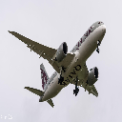
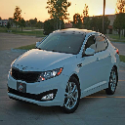
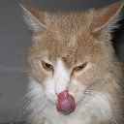
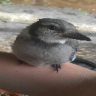
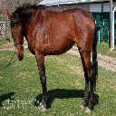
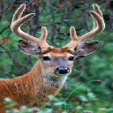
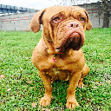
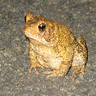
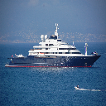
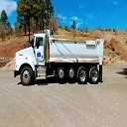

Slide 11
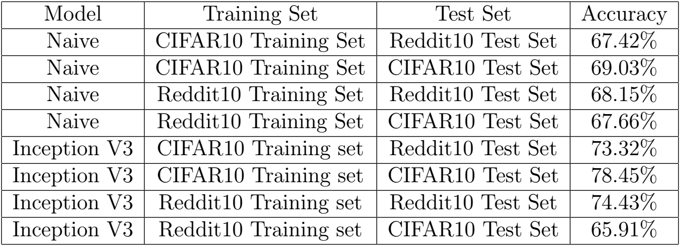
CIFAR10 Results

Slide 12
Conclusion
Reddit does prove to be a valuable source of data for image recognition.
The method used to gather data is no longer available, but others are.
The Reddit trained models are good at image recognition on Reddit images.
Not as good as networks trained on curated-sets at recognizing “Non-Reddit” images & vice versa.
Possible applications for Reddit & its users
Not as applicable on “real-world” problems, but still somewhat effective.

