Slide 1
Collaborative Speech Acts Modeling
By:
Kense
Abdallah Itani
Kevin Adea

Slide 2
Overarching Goal
Goal: To make conversation go smoothly from the beginning to the end of the conversation.
Context: Modelling a collaborative conversation between two people working on a common goal.
Notes:
How: Creating a model that reflects the data provided by Sunny in the Psychology department.

Slide 3
Resources
Coding Scheme of the collaborative acts, provided by Sunny.
Collaborative Data, in excel format.
Process Mining Textbook.

Slide 4
Schedule
First half of the semester:
Representing the data as a model.
Second half of the semester:
Checking the model and applying it to solve problems.
Notes:
Coding in second half

Slide 5
Session Goals
Overall big-picture of goals and concepts.
Learning background information regarding the field.
Figuring out the best model for our project.

Slide 6
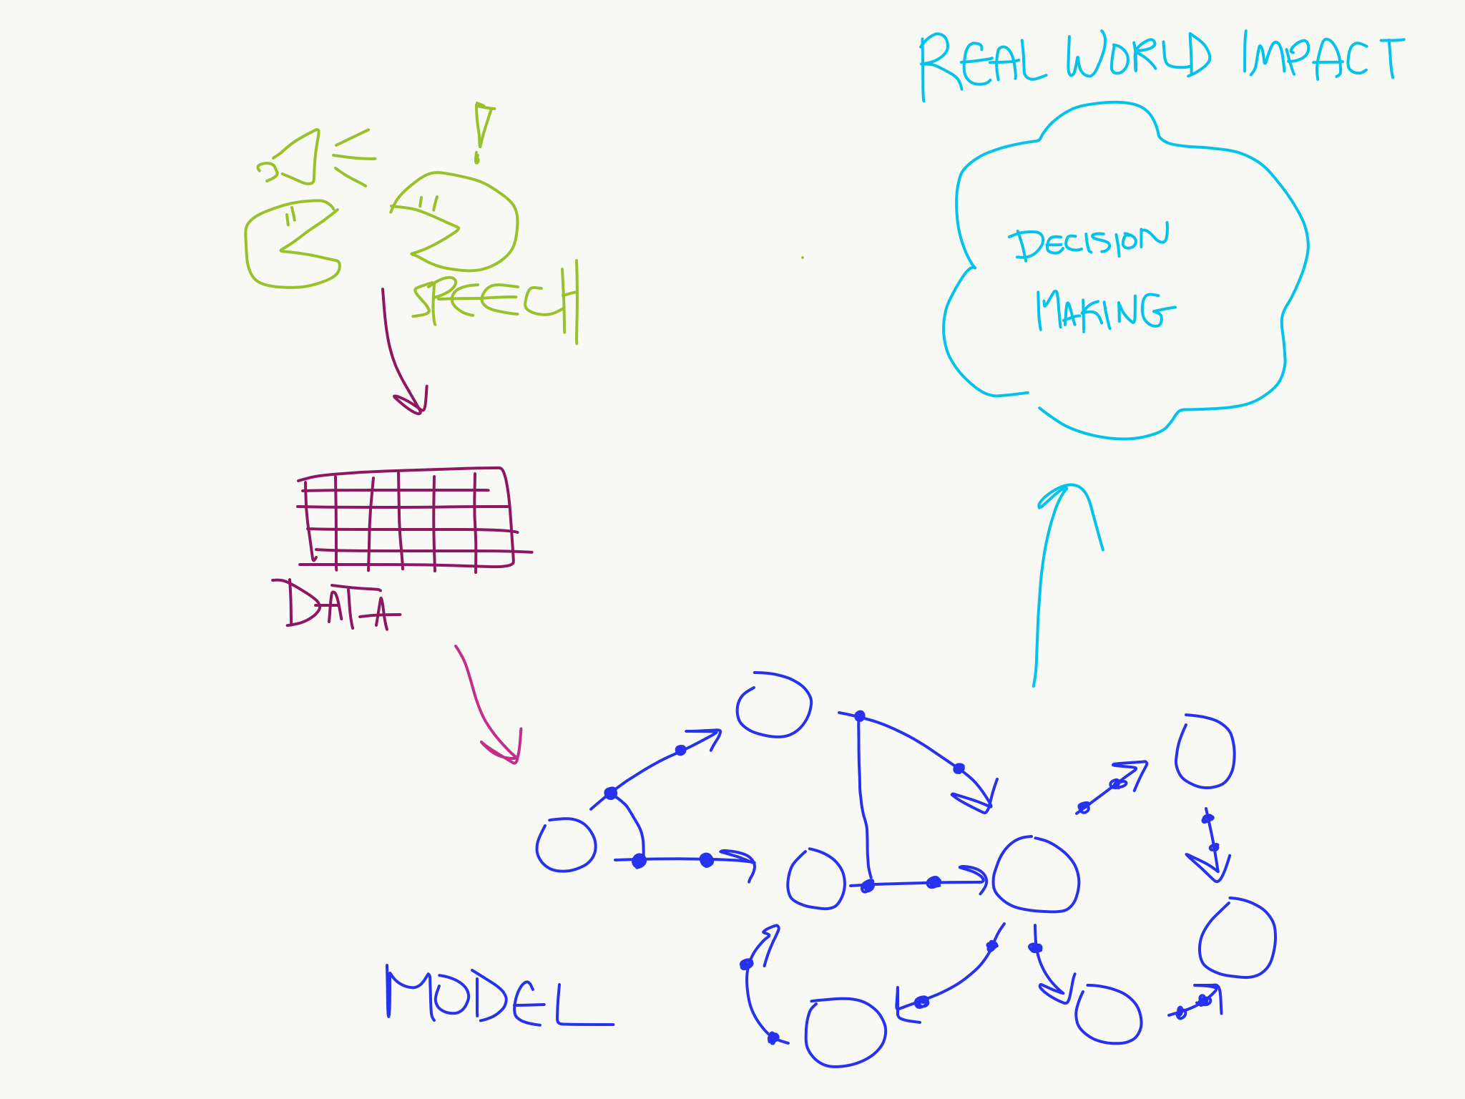
Flowchart – Semester Goals

Slide 7
Collaborative Speech Act
Speech utterances involved in the process of collaboration between two people.
Many categories: Relationship Management, Interaction Management, Information Management, Argumentation Management, Task Management, Tool Management, Other, Outside Activity.
Many different acts within those categories: Check comprehension, Elicit Opinion, Agree, etc.

Slide 8
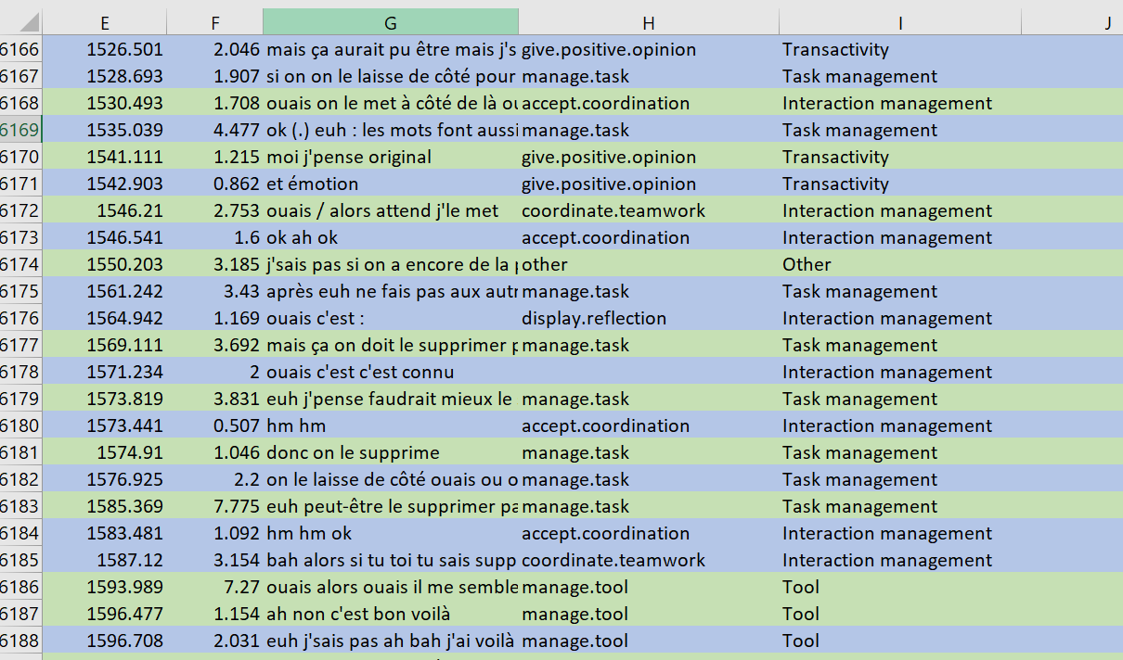
Notes:
Notice time and duration (col E and F) as well as notice the categories and actions (col I and H respectively)

Slide 9
Linear Temporal Logic
Similar to the CTL we examined before in class.
Addition of new logics:
Release (R)
Weak Until (W)
Strong Release (M)
“Give Recall releases Check Reception” as an example

Slide 10
Process Mining
“Process Mining aims to exploit event data […] to provide insights, identify bottlenecks, anticipate problems, […] and streamline processes.” - Wil van der Aalst
Discovery and Conformance
Notes:
Discovery: To generate a model to reflect events seen (what we will be doing with the speech act data we are given (i.e: blue in flowchart)
Conformance: Checking whether a model and seen events reflect one another (i.e: can be used to anticipate problems, or predict collaboration paths)

Slide 11
Causal Nets
Nodes and Causal Dependencies
Input/output Bindings
$C=(A, a_{i},a_{o},D,I,O)$
A is the finite set of activities
$a_{i}$ is the start activity
$a_{o}$ is the end activity
D is a dependency relation
I is the possible input bindings
O is the possible output bindings
Notes:
Nodes represent activities and arcs represents causal dependencies

Slide 12
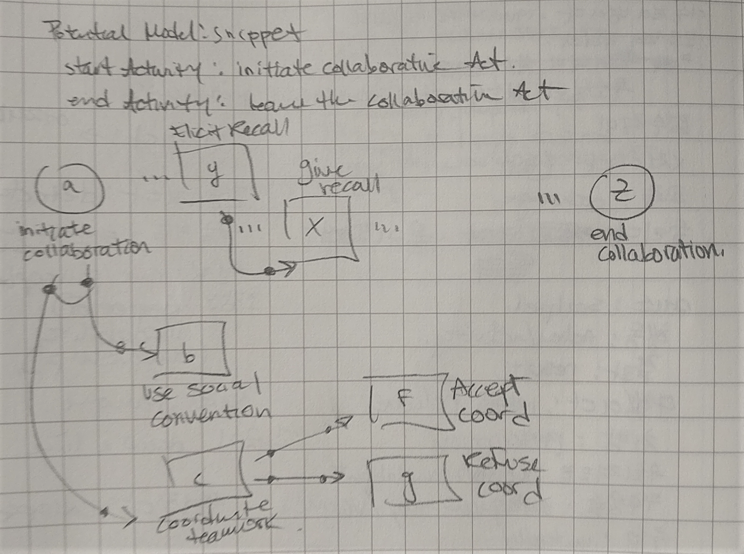

Slide 13
Causal Nets - Review
//insert drawing of causal nets
Notes:
C = (A, ai, ao, D, I, O)
- Go over each of the parts of the Causal Net again as a reminder, this time with better formalisms, referencing the image
- Be more specific this time on D, which is the dependency aspect as well as the definition of AS

Slide 14

Causal Nets – New
$AS=\left\{x⊆Ρ\left(A\right)\right| x=\left\{∅\right\}∨∅∉x\}$
$B=\left\{\left(a, {as}^{I}, {as}^{O}\right) ∈A ×P\left(A\right)×P\left(A\right) \right| {as}^{I}∈I\left(a\right)∧{as}^{O}∈O(a)\}$
Notes:
Explain how this definition of AS is really just a guarantee that only ai and ao have the ending states
Explain briefly how this definition of AS includes Powerset, which just means sets of sets (meaning a set of set of activities)
Explain B is the activity bindings, represented as a tuple, or a binding sequence

Slide 15

Causal Nets - Soundness
Binding Sequence
$S= ℬ(A×A)$, state space
$s∈S$, a state
$Ψ\left(σ\right)$, state after executing binding sequence $σ$
Notes:
The net is causality based, so we have to have some notion of predecessor bindings agreeing with successor bindings
This brings us to the notion of states
Mention that there is a really extensively formal definition for states, but its mostly a definition for the implementation of checking soundness, which we will look at in detail at a later point in time

Slide 16
Causal Nets – Soundness
//maybe a small image here
Managing obligations of the net
Input bindings remove obligations
Output bindings create obligations
Notes:
Predecessor bindings and success bindings need to agree

Slide 17
Process Discovery
Event Log
Discovery Algorithm
Process Model
//drawing here of how it connects
Notes:
Remind that this is the first step in our goals!
Put things into context, our choice of process model is causal nets!
We have to consider how to simplify/adapt our event logs (data)!

Slide 18
Process Discovery – Algorithm

