Slide 1
Collaborative Speech Acts Modeling

Slide 2
Objective
Solidify a method of reasoning about a session of collaborative acts.
Determining which modeling logic is appropriate to represent this type of domain

Slide 3
Resources
Coding Scheme of the collaborative acts, provided by Sunny.
Collaborative Data, in excel format.
Process Mining Textbook.

Slide 4
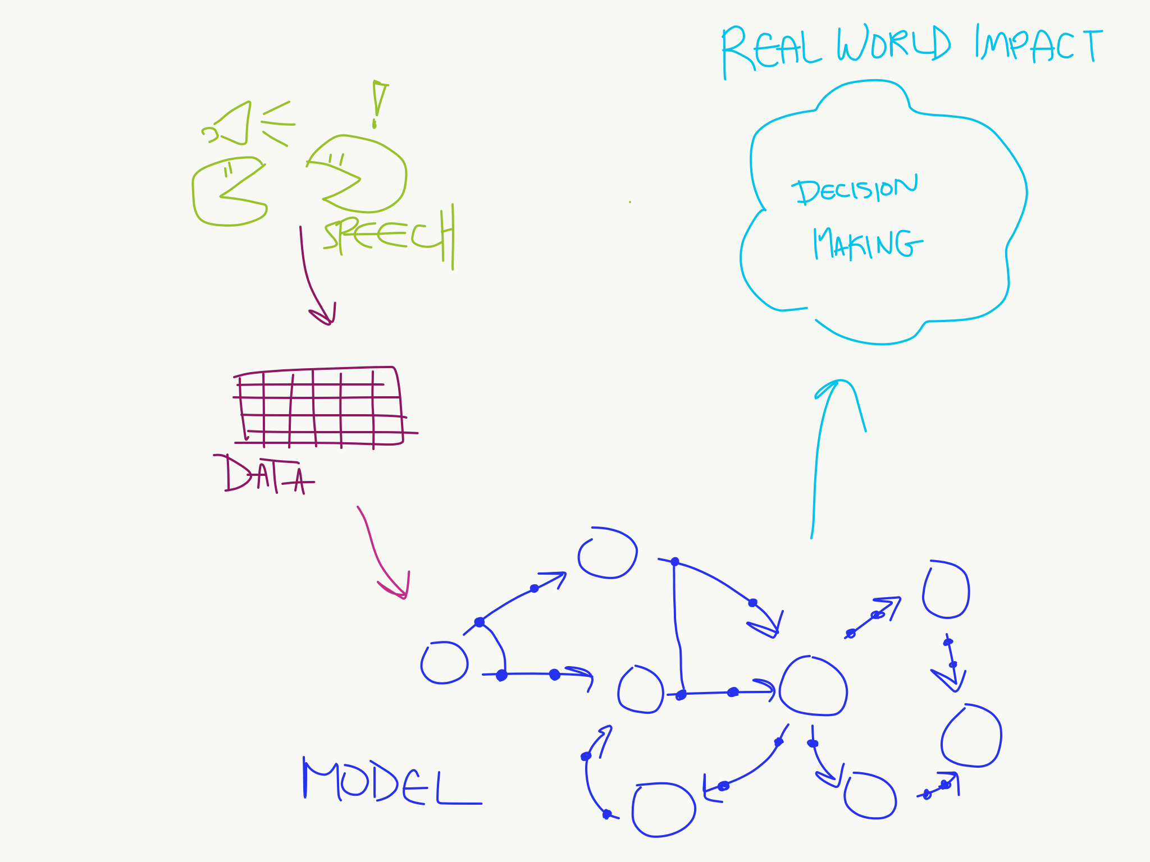
Flowchart – Semester Goals

Slide 5
Collaborative Speech Act
Speech utterances involved in the process of collaboration between two people.
Many categories: Relationship Management, Interaction Management, Information Management, Argumentation Management, Task Management, Tool Management, Other, Outside Activity.
Many different acts within those categories: Check comprehension, Elicit Opinion, Agree, etc.

Slide 6
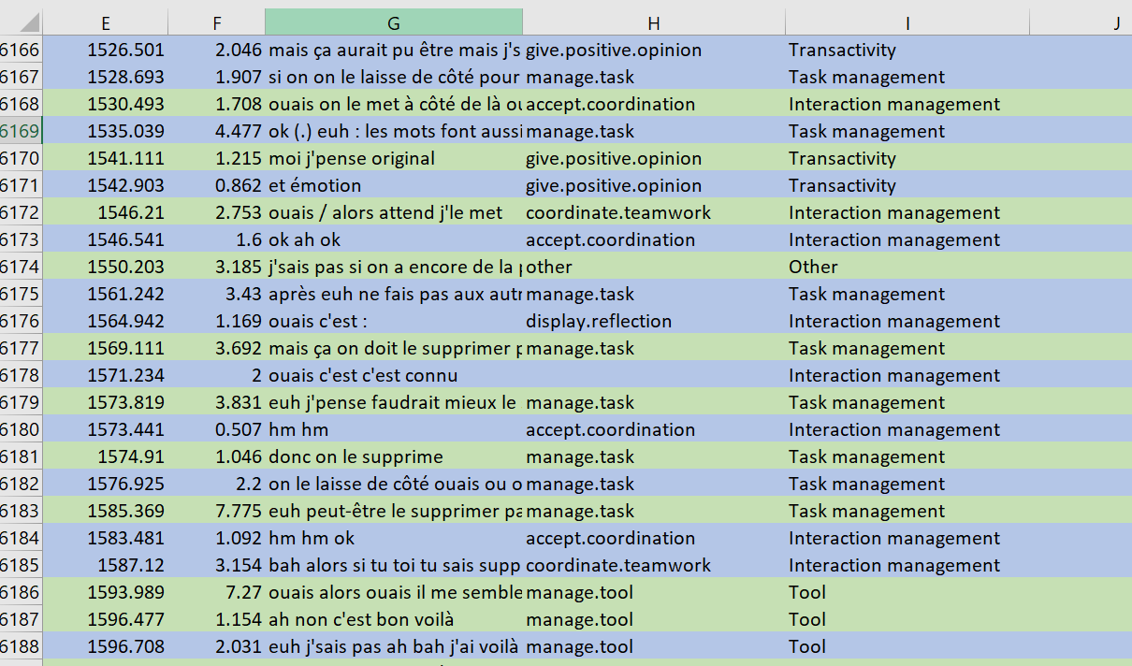

Slide 7
Linear Temporal Logic
Similar to the CTL we examined before in class.
Addition of new logics:
Release (R)
Weak Until (W)
Strong Release (M)
“Give Recall releases Check Reception” as an example

Slide 8
Process Mining
“Process Mining aims to exploit event data […] to provide insights, identify bottlenecks, anticipate problems, […] and streamline processes.” - Wil van der Aalst
Discovery and Conformance
Notes:
Discovery: To generate a model to reflect events seen (what we will be doing with the speech act data we are given (i.e: blue in flowchart)
Conformance: Checking whether a model and seen events reflect one another (i.e: can be used to anticipate problems, or predict collaboration paths)

Slide 9

Causal Nets
Nodes and Causal Dependencies
Input/output Bindings
$C=(A, a_{i},a_{o},D,I,O)$
A is the finite set of activities
$a_{i}$ is the start activity
$a_{o}$ is the end activity
D is a dependency relation
I is the possible input bindings
O is the possible output bindings

Slide 10
//I will add a snippet of a causal net here

Slide 11
Status Update
Overall big-picture of goals and concepts.
Background information regarding the field.
Snippet of a model to get a feel for the data.

Slide 12
Goals
Find an appropriate method to automate creation of model.
Apply logic and model to data.

