Slide 1
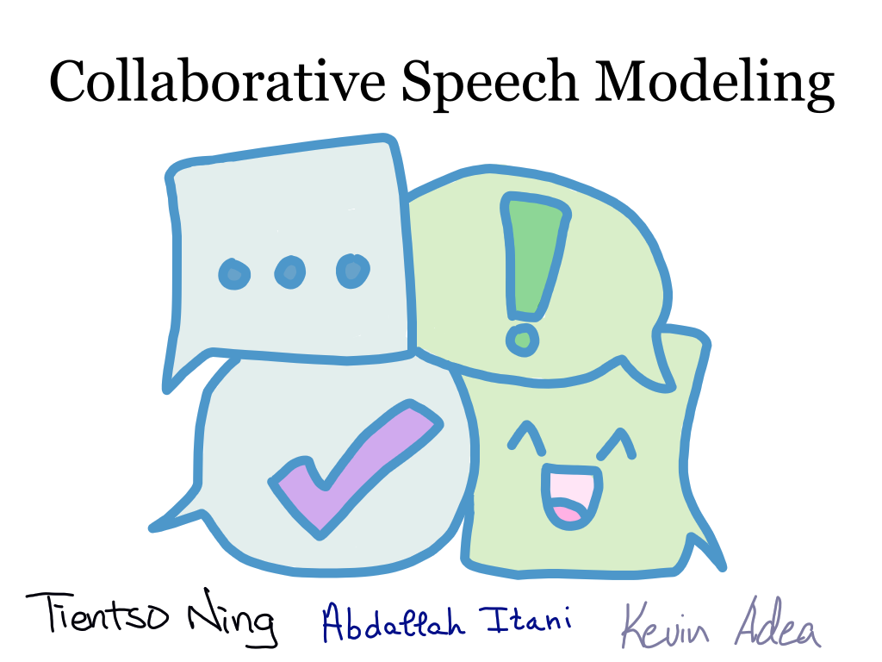

Slide 2

Flowchart – Semester Goals

Slide 3
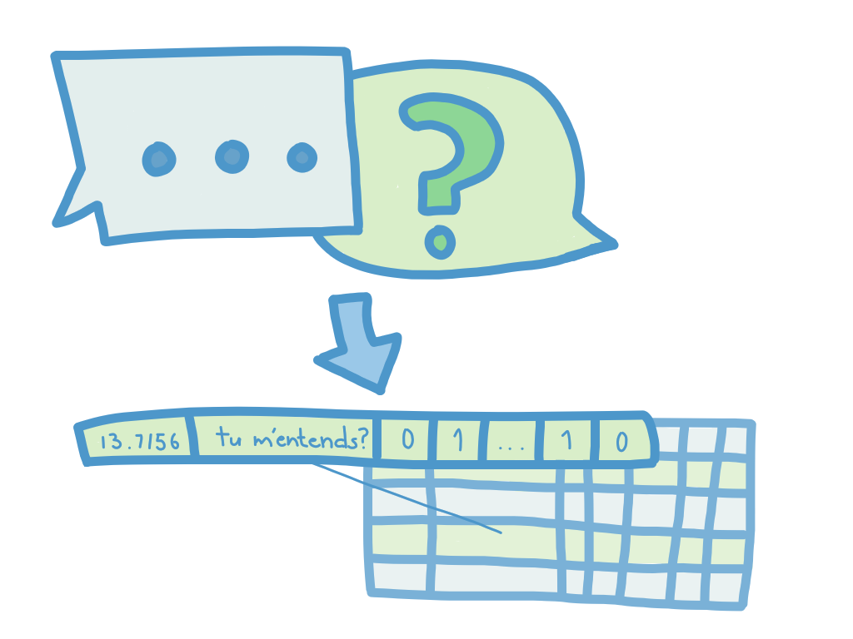
Flowchart – Semester Goals

Slide 4
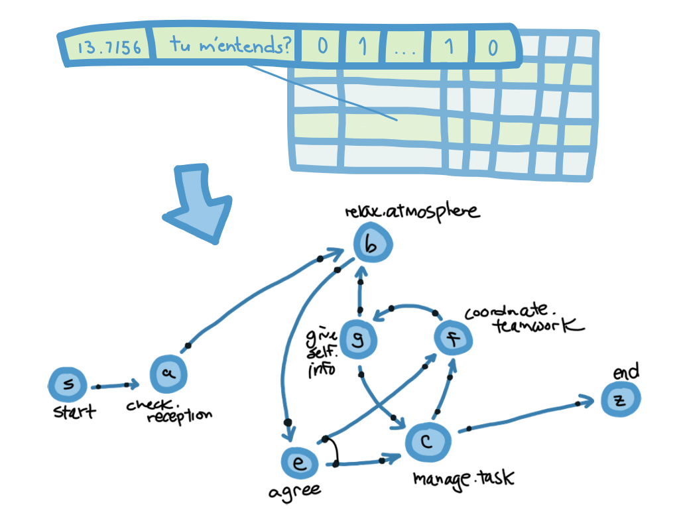
Flowchart – Semester Goals

Slide 5
Process Discovery – Sample Model

Slide 6
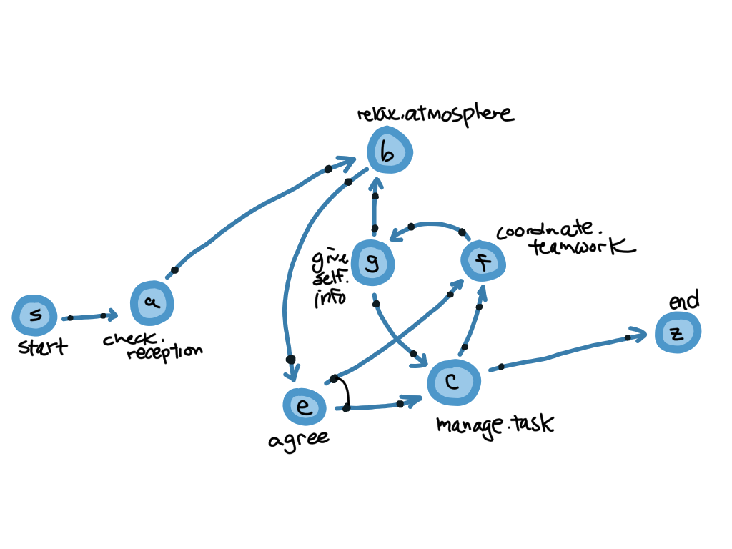

Slide 7
Process Discovery –

