Slide 1
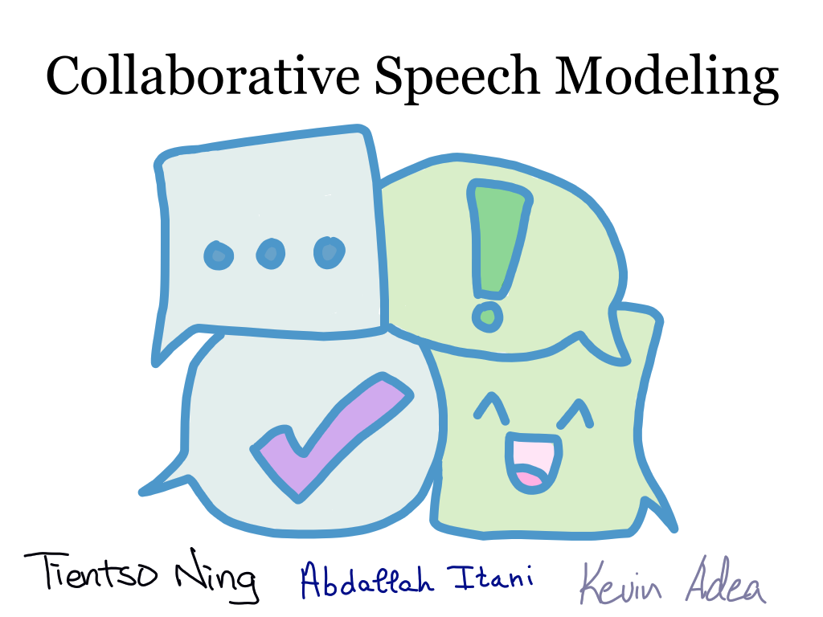

Slide 2
Overarching Goal
Goal: To make conversation go smoothly from the beginning to the end of the conversation.
Context: Modelling a collaborative conversation between two people working on a common goal.
Notes:
How: Creating a model that reflects the data provided by Sunny in the Psychology department.

Slide 3
Session Goals
Previously: Collaborative Speech Acts, LTL, Causal Nets & Algorithms, Process Discovery, Coding considerations.
Currently: Process Discovery, Final coding considerations & demos.

Slide 4

Flowchart – Semester Goals

Slide 5
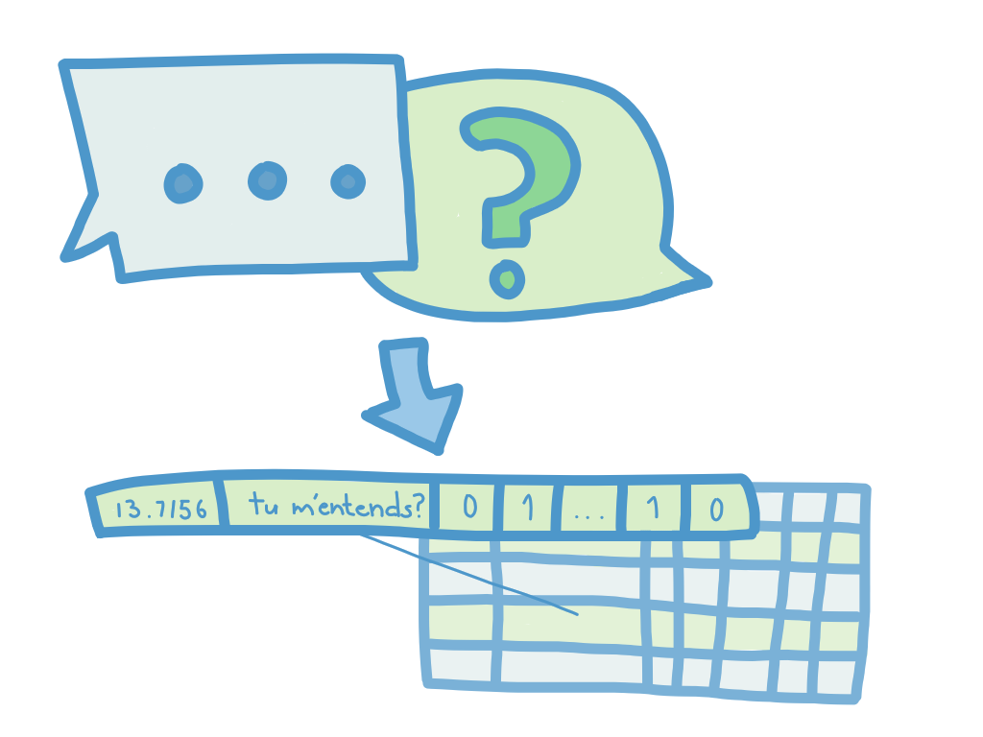
Flowchart – Semester Goals

Slide 6
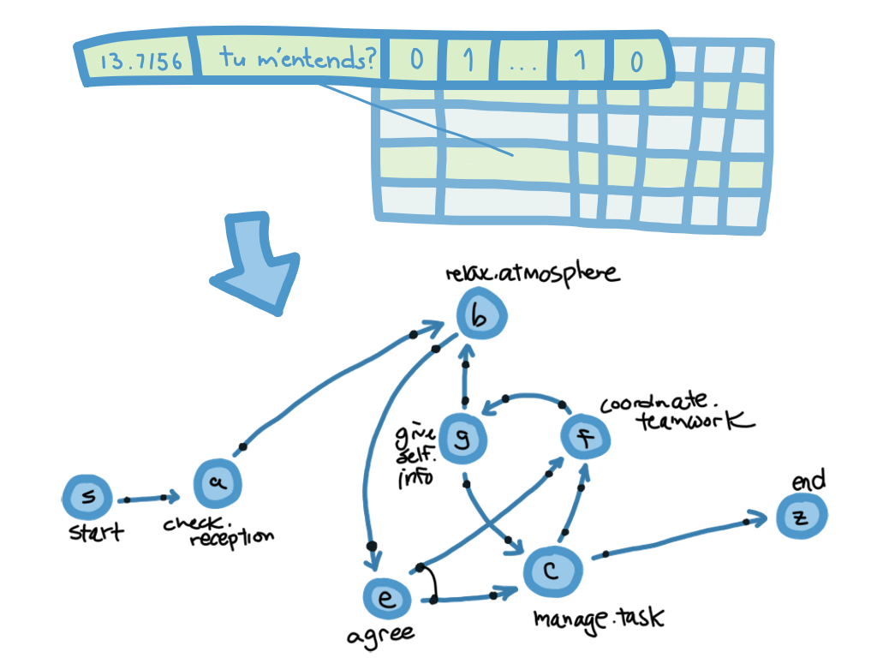
Flowchart – Semester Goals

Slide 7
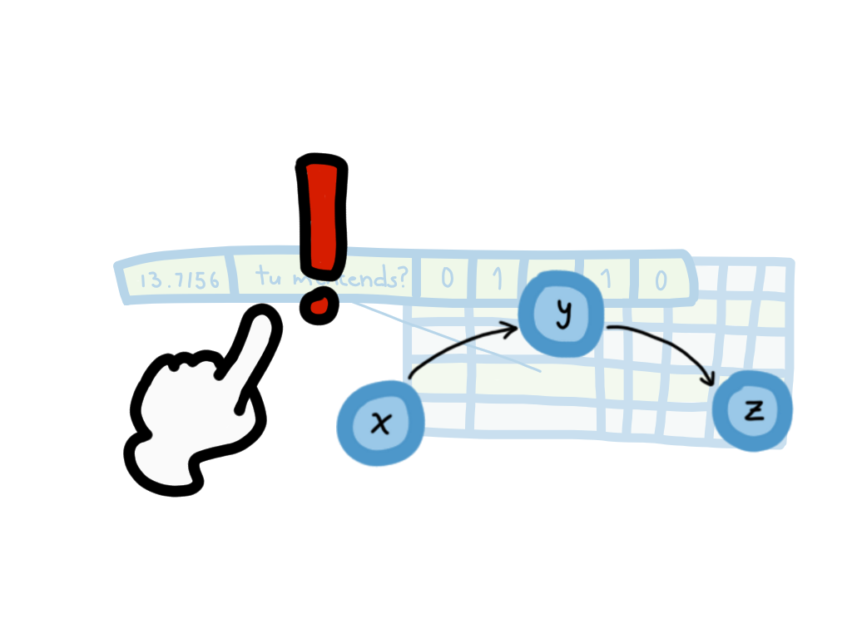
Process Discovery
P1/P2 Independence Assumptions
Creating traces
Dictionaries of dependencies
‘check.reception’: {‘relax.atmosphere’: 1, ‘manage.task’: 0, … }

Slide 8
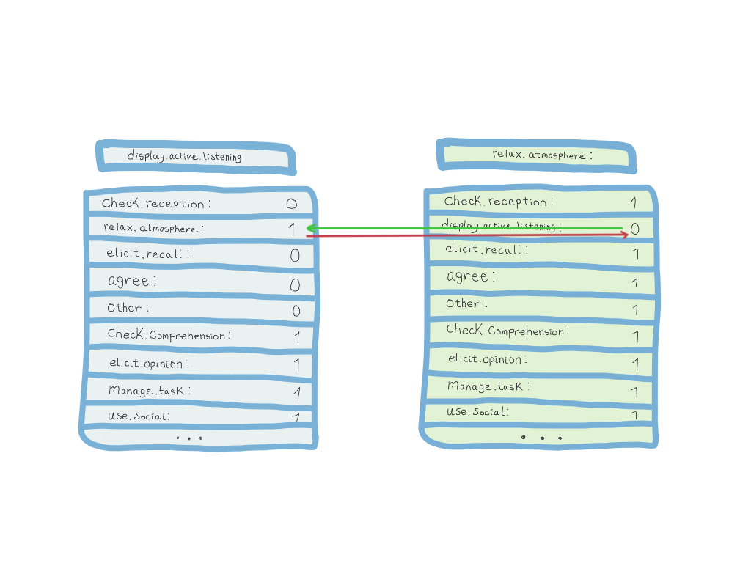
Process Discovery
P1/P2 Independence Assumptions
Creating traces
Dictionaries of dependencies
‘check.reception’: {‘relax.atmosphere’: 1, ‘manage.task’: 0, … }

Slide 9
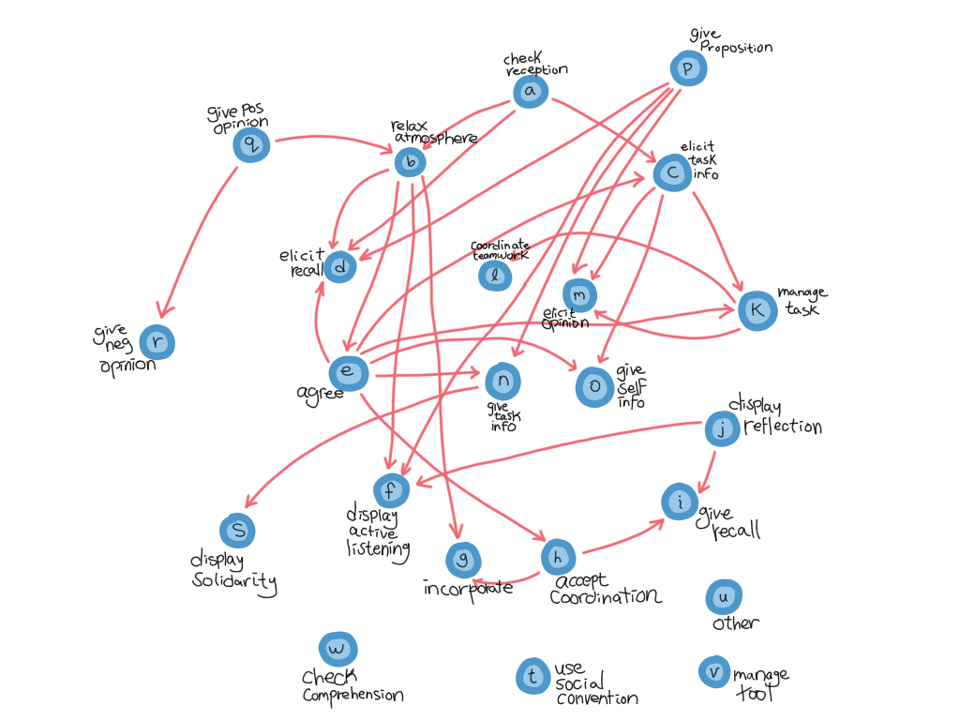
P1

Slide 10
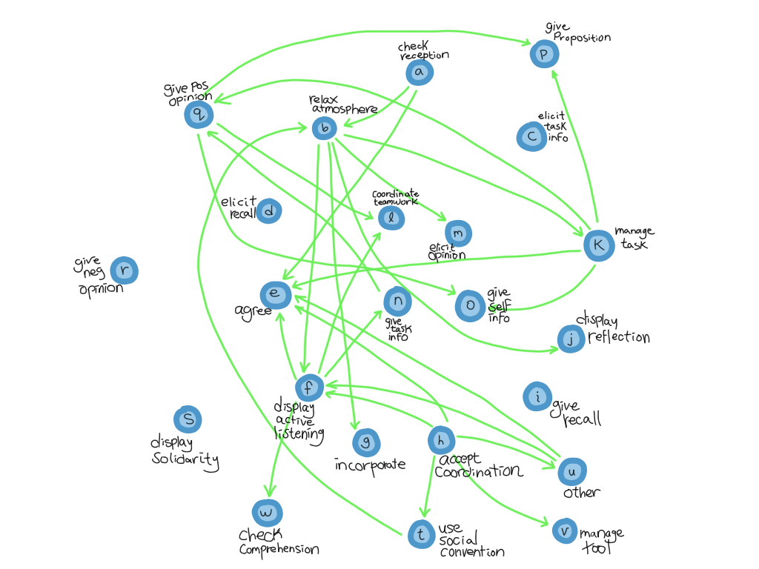
P2

Slide 11
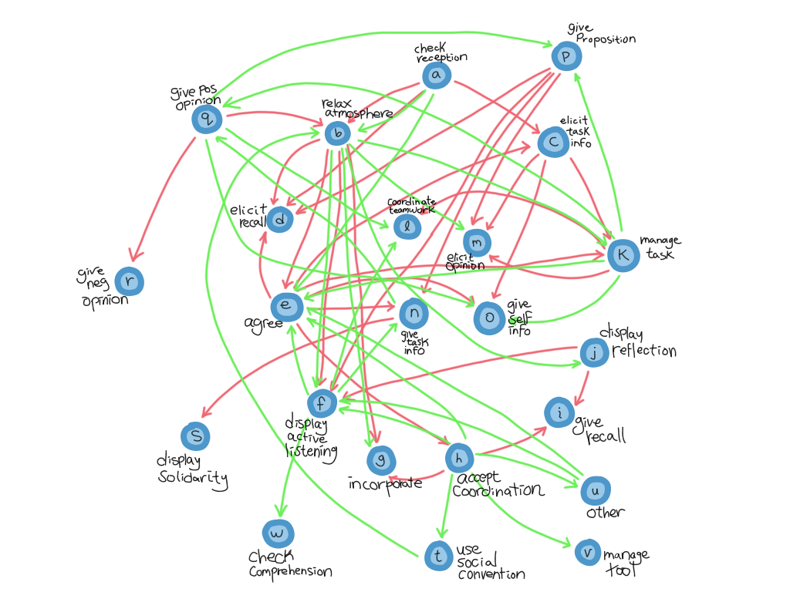
P1&P2

Slide 12

P1&P2

Slide 13
P1&P2
Notes:
P1 goes from manage task to agree, and P2 goes from agree to manage task.
Individually, and in this small isolated context, this may not be the most important revelation, but it shows us that there are formations of concepts and patterns that are emerging that we can start to rationalize (maybe one person takes the lead)

Slide 14
P1&P2
Notes:
P1 goes from manage task to agree, and P2 goes from agree to manage task.
Individually, and in this small isolated context, this may not be the most important revelation, but it shows us that there are formations of concepts and patterns that are emerging that we can start to rationalize (maybe one person takes the lead)

Slide 15
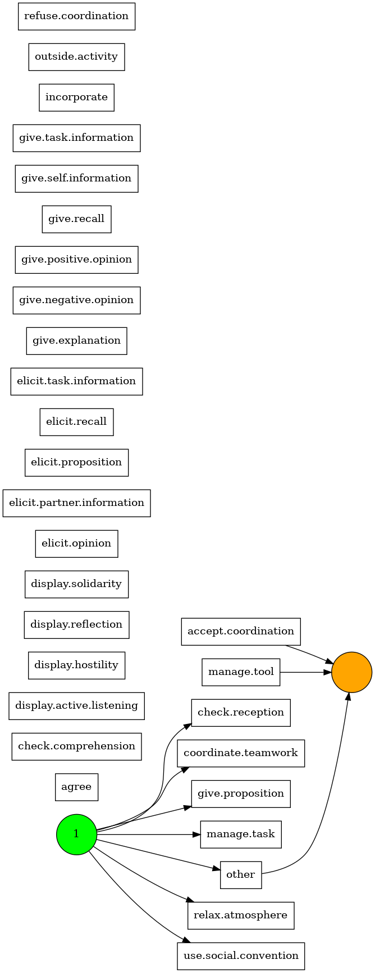
PM4Py
Notes:
Note here that the green is the starting node with activities
And the orange is the ender

Slide 16
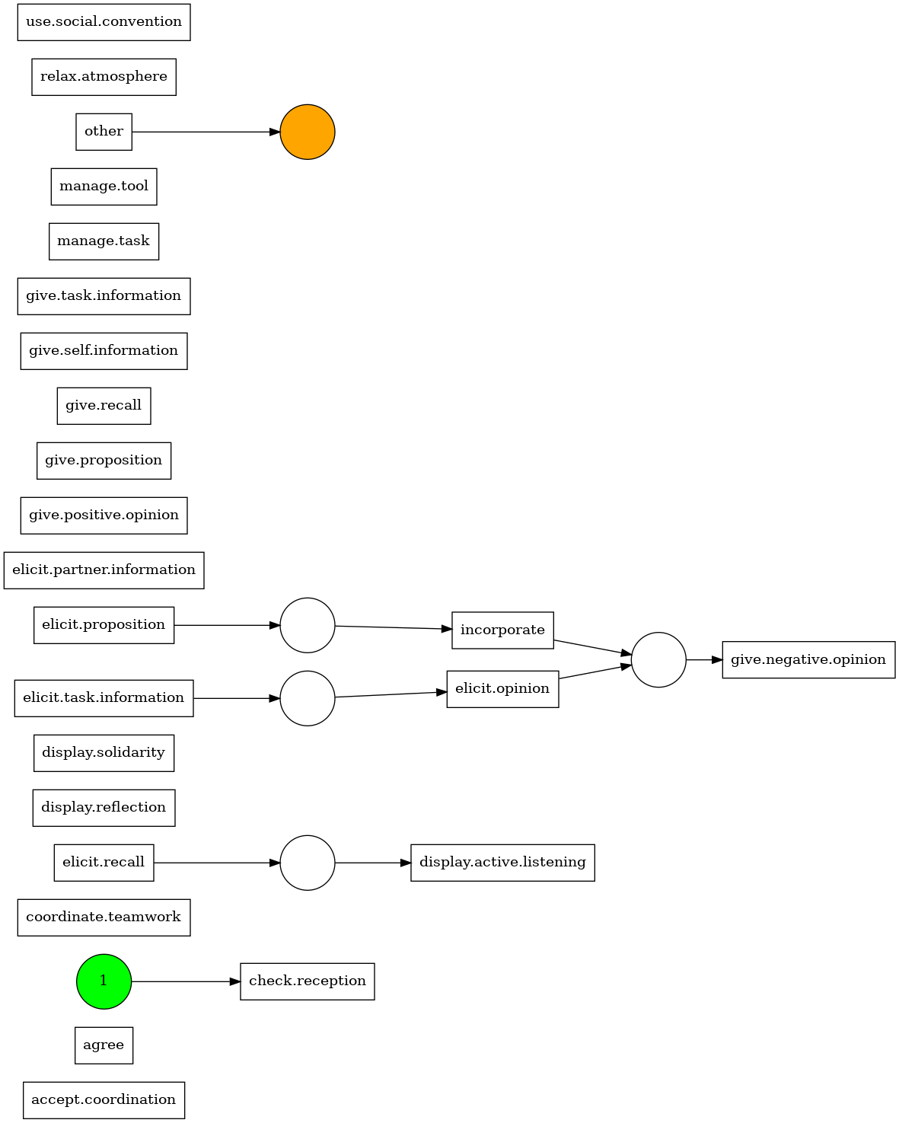
PM4Py
Notes:
Individual actions alpha mining doesn’t really tell us a whole lot, but we see some small small scale trends.
These might warrant as informative on how we approach pre-processing/data manipulation

Slide 17
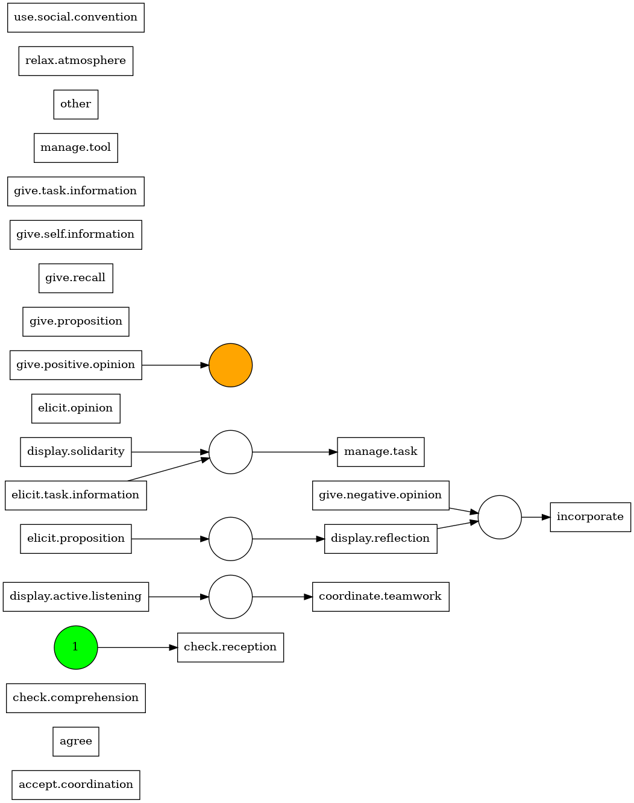
PM4Py

Slide 18
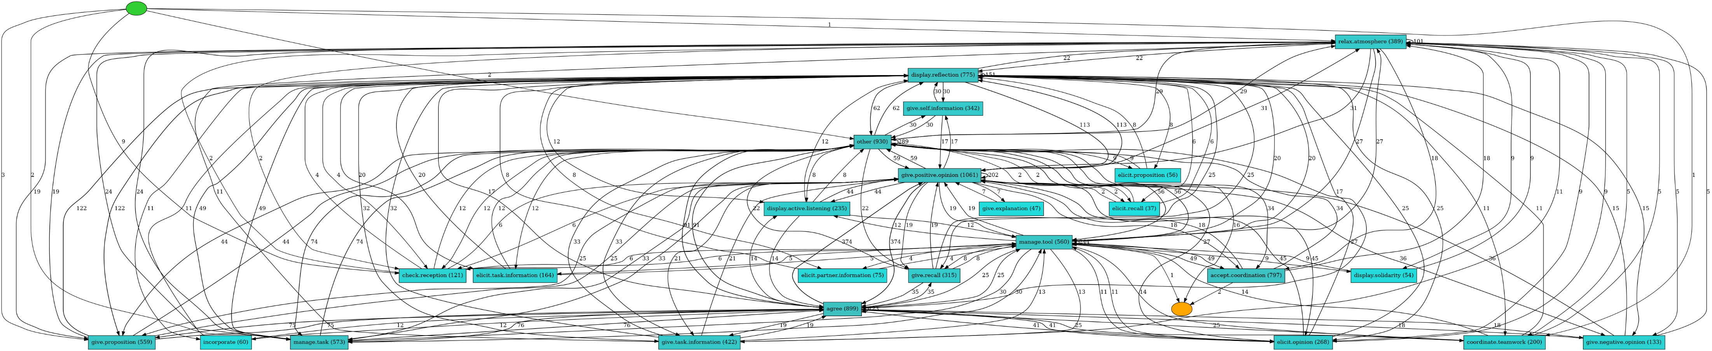
PM4Py
Notes:
Obviously note here that it is hard to see and we may want to be able to zoom in (which we can do on powerpoint during presentation with zoom scroll)
We can probably find some useful/interesting information here (not from the visual, but the object itself? We’ll search the option)

Slide 19
PM4Py
Notes:
Obviously note here that it is hard to see and we may want to be able to zoom in (which we can do on powerpoint during presentation with zoom scroll)
We can probably find some useful/interesting information here (not from the visual, but the object itself? We’ll search the option)

Slide 20
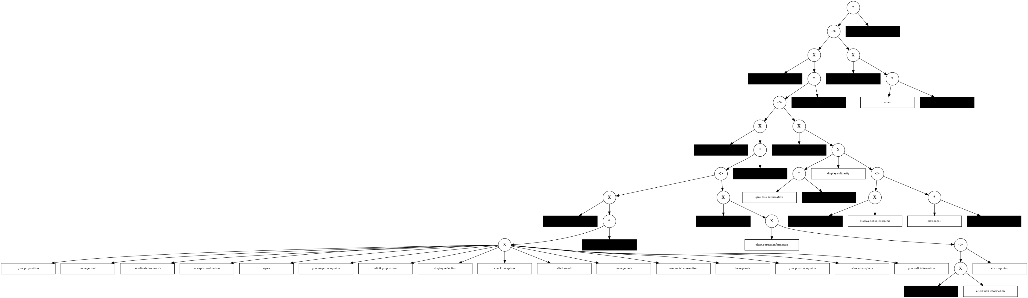
PM4Py

Slide 21
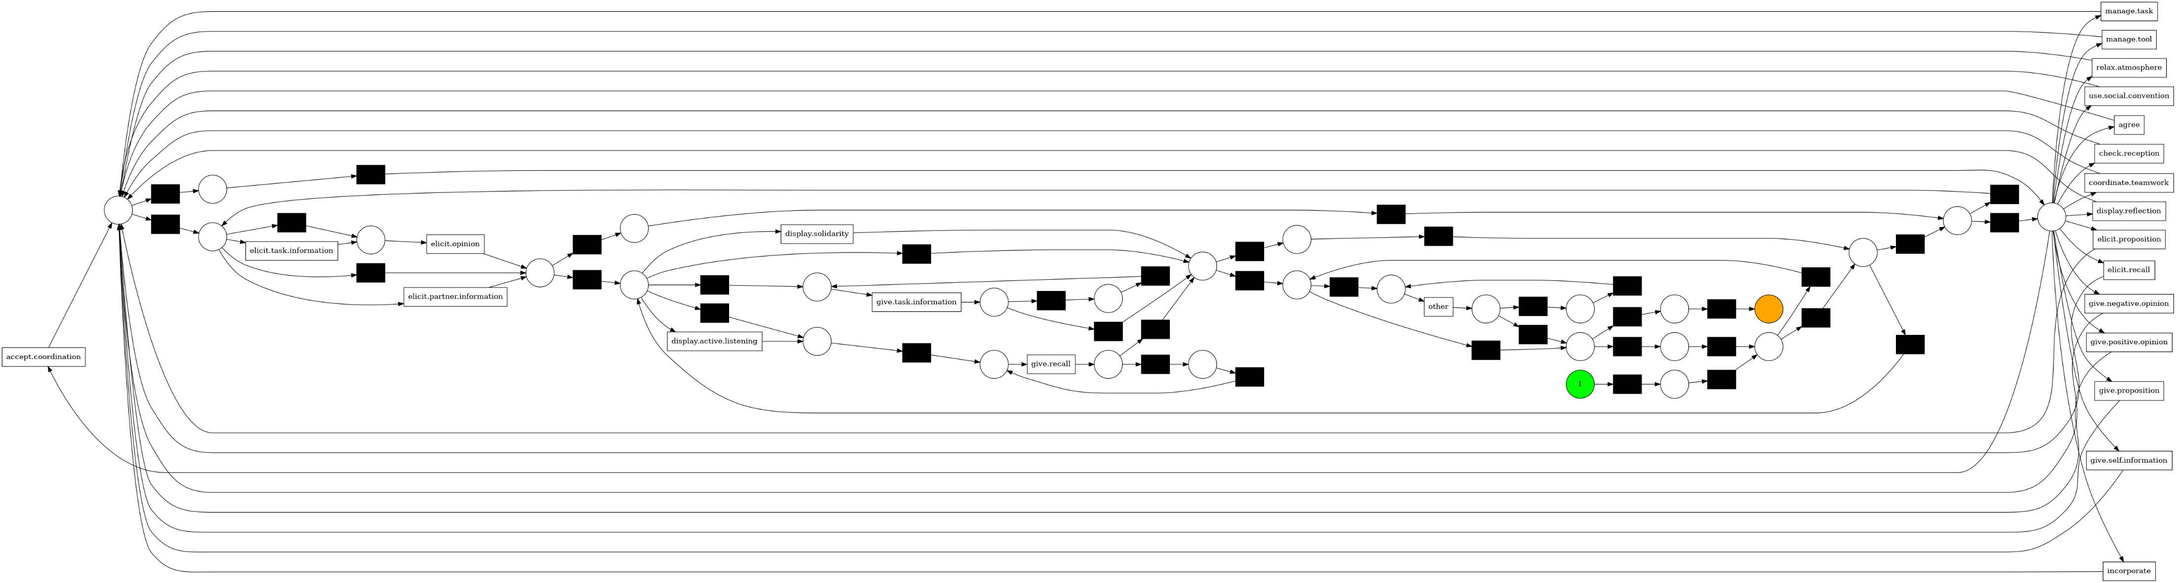
PM4Py

Slide 22
Libraries and tools
PM4Py
ProM
bupaR
Apromore
Process Discovery
Conformance Checking
Process Trees
XES, CSV
Data Filtering
Petri Nets
Event logs
Plugins
Creating event logs
Import XES files
Data pre-processing
Exploratory data analysis
Process Discovery
Conformance Checking
Process Discovery
Visual filtering
Performance mining
Conformance checking
Predictive process monitoring
Stage-based mining
Notes:
Process Dicovery: alpha miner, heurisitic miner, inductive miner directly-follow graphs (another class of process models where the nodes represent the activity in the log and edges are present between nodes if there is at least a trace in the log where the source activity is followed by the target activity)
Conformance checking is a techniques to compare a process model with an event log of the same process. The goal is to check if the event log conforms to the model, and, vice versa
Process trees: Visualitzation of trees, conversion to petri nets, and generation of a log from the trees.
ProM: a plugin-based framework for process mining and is centered around:
Objects (event logs: process models in the form of petri nets and BPMN (business process model and notation) diagrams
Plugins: filter event logs or create an analysis notebook on event log/discover process models from event logs/check conformance of events logs
But ProM is not well documented compared to PM4Py
BupaR: bupaR is a collection of R-packages for the handling and analysis of business process data.
We can connect bupaR to the PM4Py package
Ability to create event logs/ or import XES files and turn them into event logs
Text pre-processing (filtering data, grouping similar data, and other data manipulation methods)
EDA: creating and describing process maps, process map visualization (map, trace explorer, dotted charts, precedence matrix)
Process discovery with alpha, heuristic, and inductive miners
APROMORE: application that supports the full spectrum of process mining functionality from automated discovery of process models to data analysis
Discovery of process maps and BPMN models
Reduce the complexity of the process execution data by slicing and dicing the event logs by case variant, timeframe, a wide range of performance measures, specific execution paths, etc.
Analyze frequencies and durations of activities
Train machine learning models to predict different process characteristics. Train models for a variety of prediction problems, including case outcome, remaining time, next activity and case continuation.
Discover logical phases of the processes and measure performance at each phase of the process lifecycle.

