Slide 1
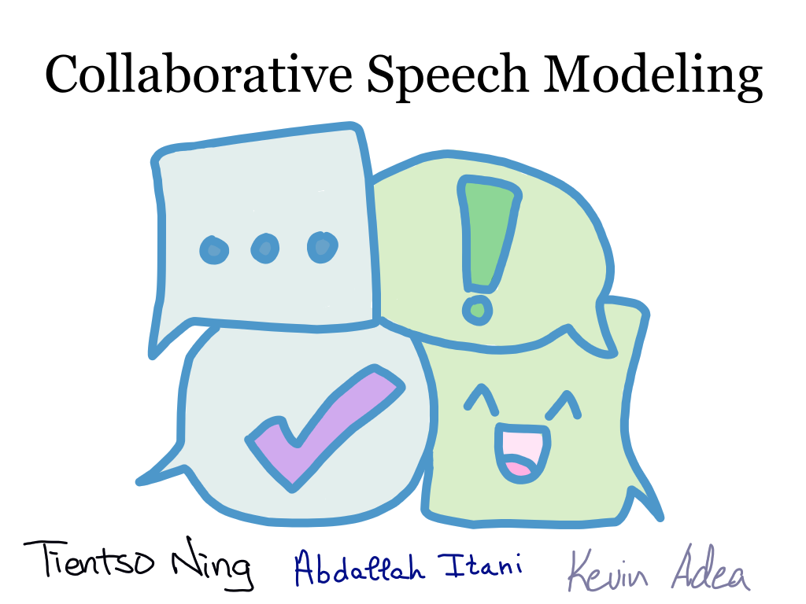

Slide 2
Overarching Goal
Goal: To make conversation go smoothly from the beginning to the end of the conversation.
Context: Modelling a collaborative conversation between two people working on a common goal.
Notes:
How: Creating a model that reflects the data provided by Sunny in the Psychology department.

Slide 3
Session Goals

Slide 4
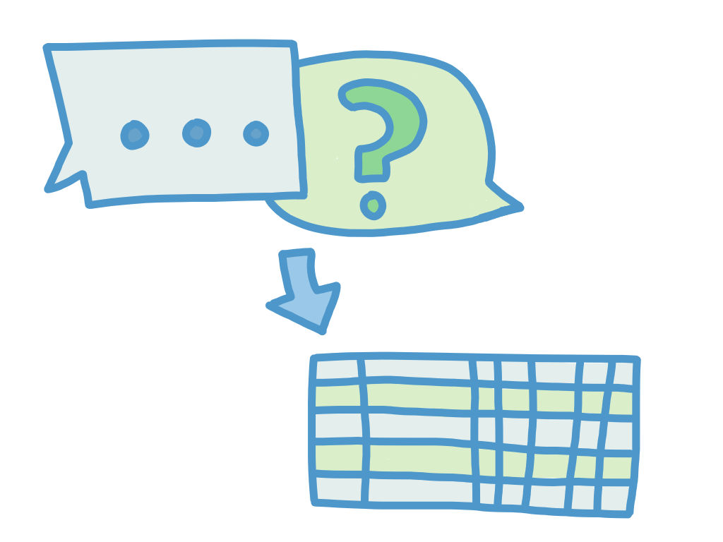
Flowchart – Semester Goals

Slide 5
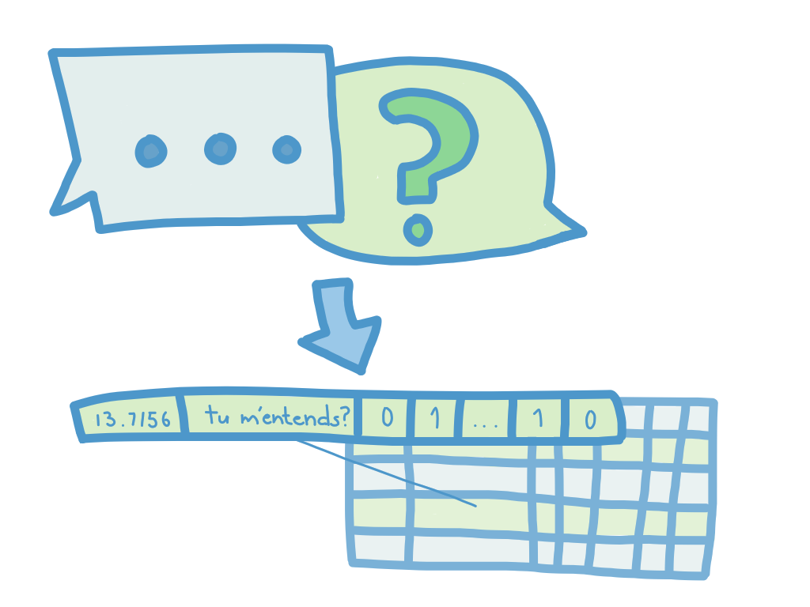
Flowchart – Semester Goals

Slide 6
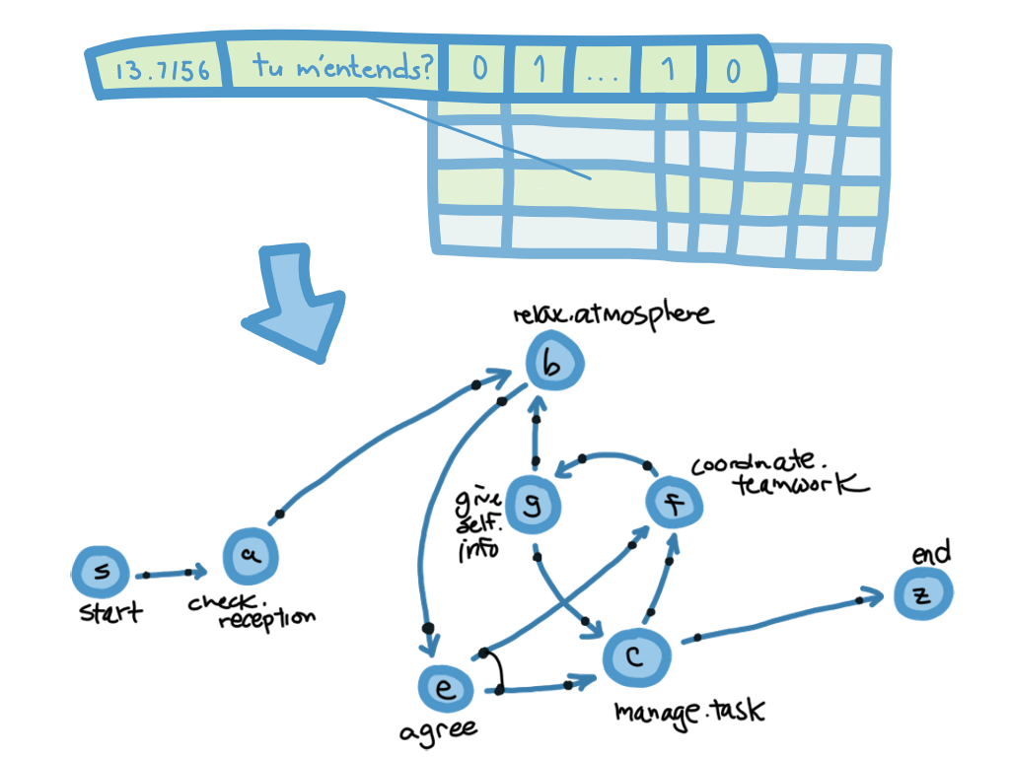
Flowchart – Semester Goals

Slide 7
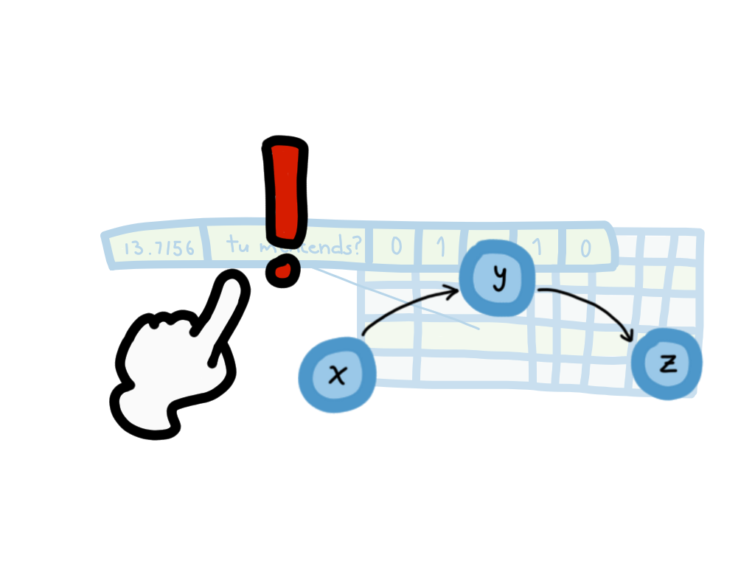
Process Discovery
P1/P2 Independence Assumptions
Creating traces
Dictionaries of dependencies
‘check.reception’: {‘relax.atmosphere’: 1, ‘manage.task’: 0, … }

Slide 8
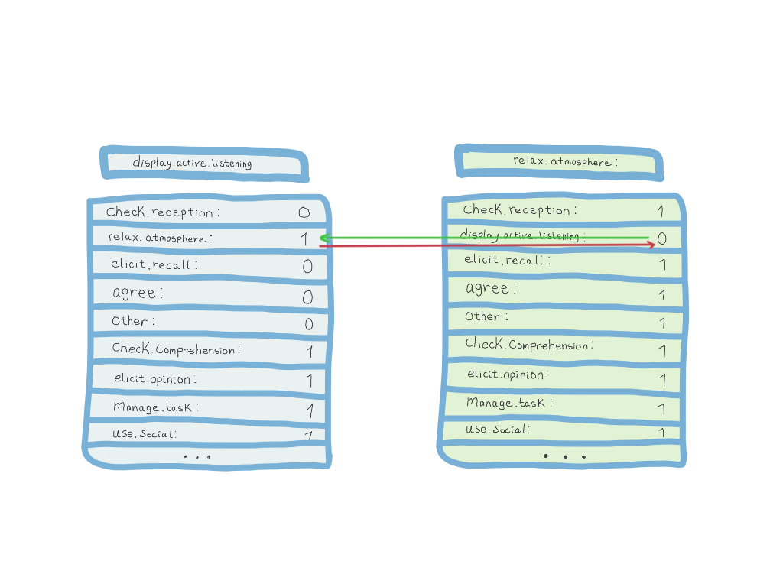
Process Discovery
P1/P2 Independence Assumptions
Creating traces
Dictionaries of dependencies
‘check.reception’: {‘relax.atmosphere’: 1, ‘manage.task’: 0, … }

Slide 9
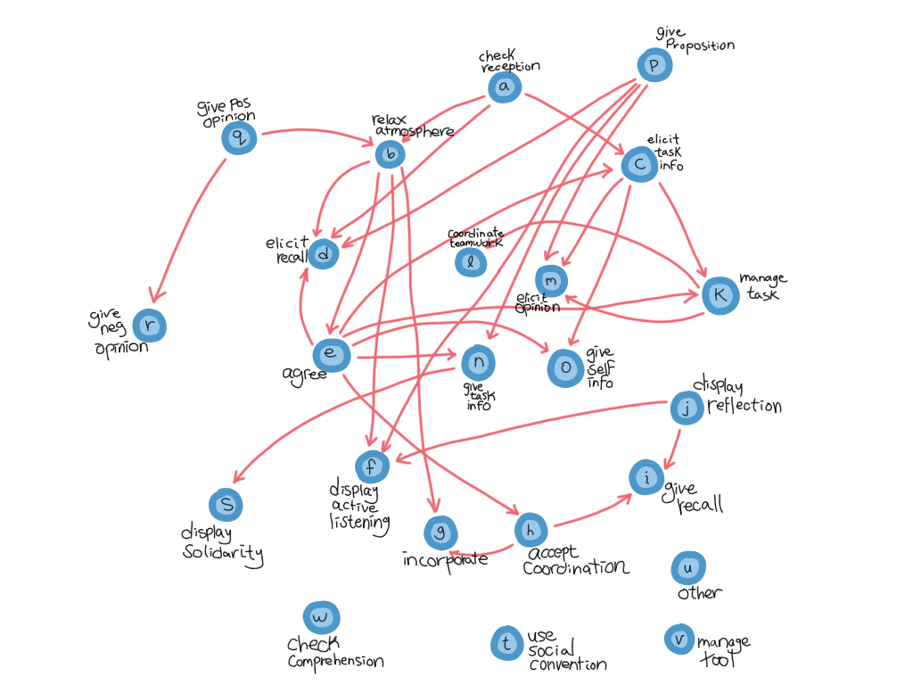
P1

Slide 10
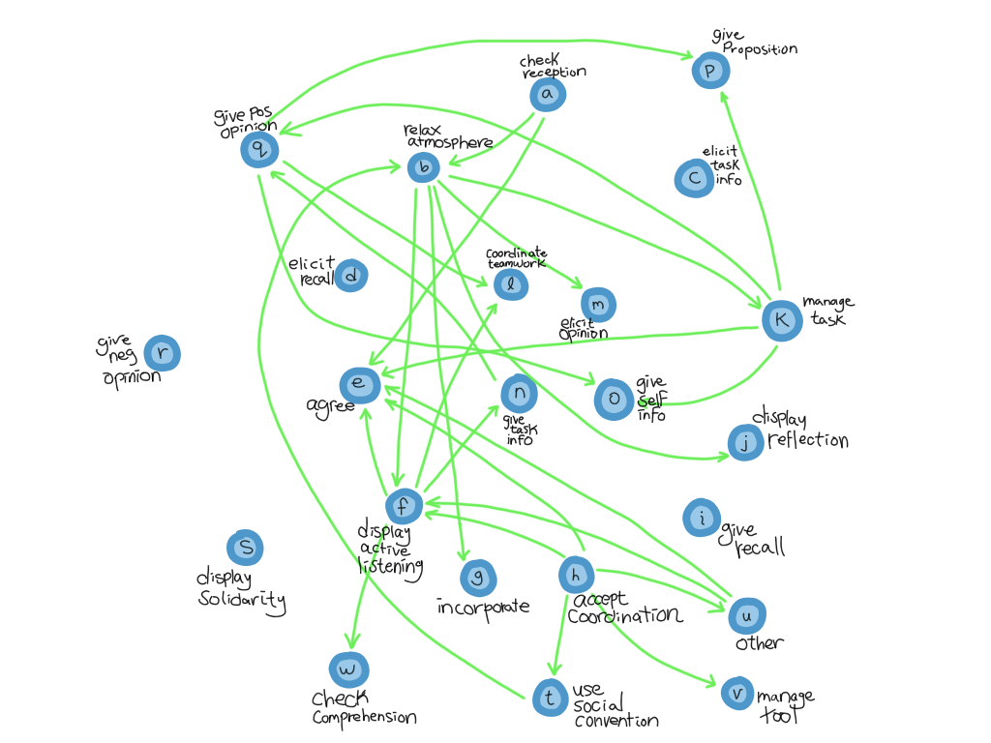
P2

Slide 11
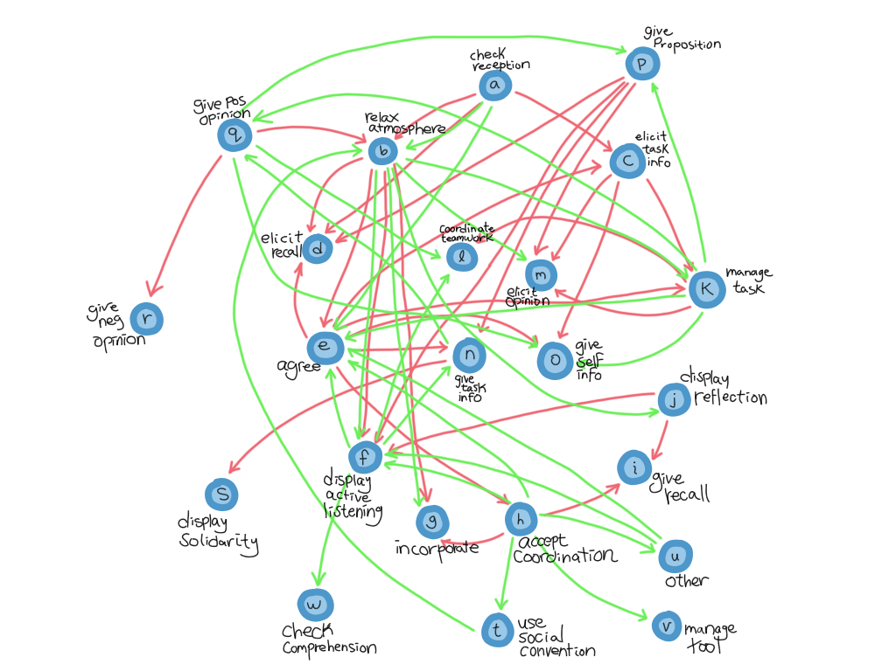
P1&P2

Slide 12
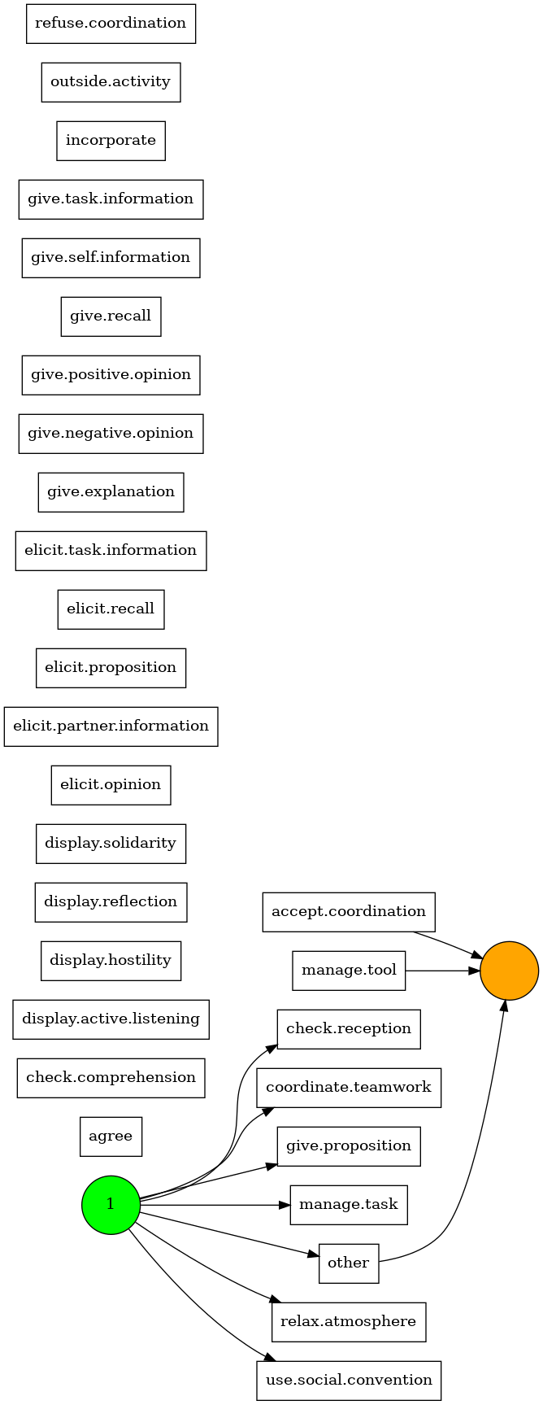
PM4Py

Slide 13
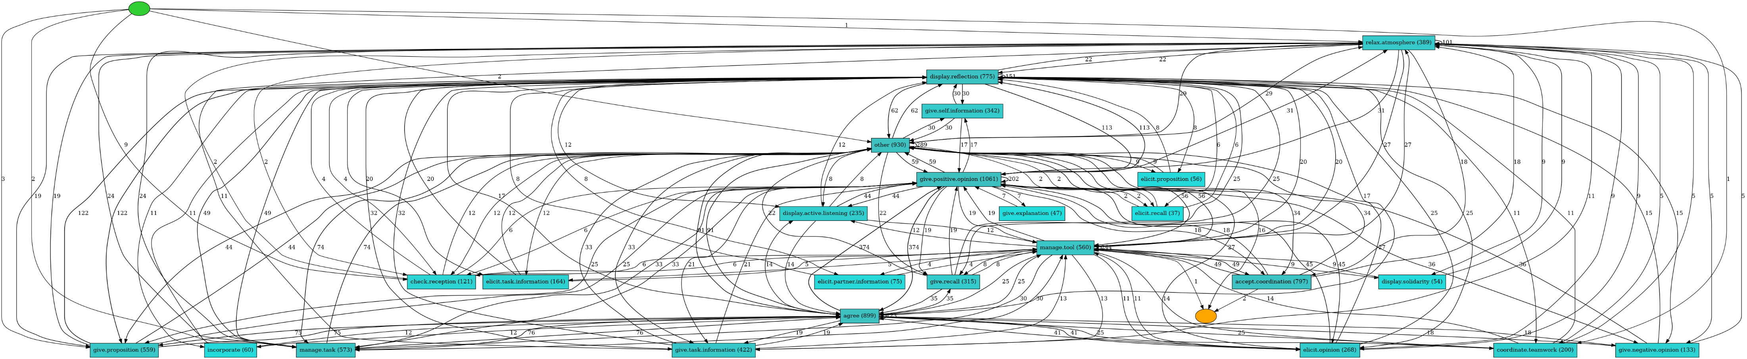
PM4Py

