Slide 1
Quantum Map Checkpoint 1
Kevin Adea
Tientso Ning

Slide 2
Description of Game
3D, first-person puzzle game, where objective is to reach exit room at each stage.
Eye movement tracking essential to completing objective.
Facial features tracked to make game easier when player seems frustrated/stressed.

Slide 3
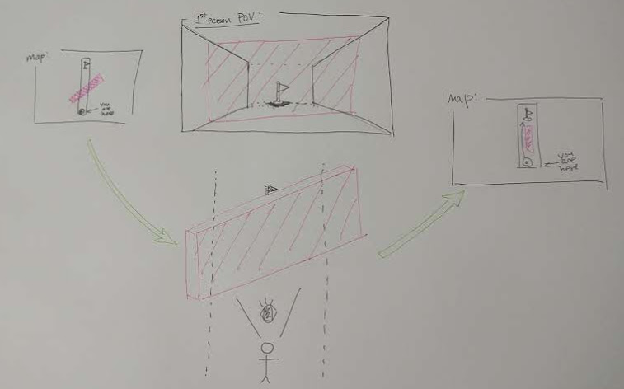

Slide 4
Goals for Checkpoint 1
Learn Unity: Watch tutorials, go through demos.
Start project: Create a base/foundation.
Determine all objects and scripts needed for our game.

Slide 5
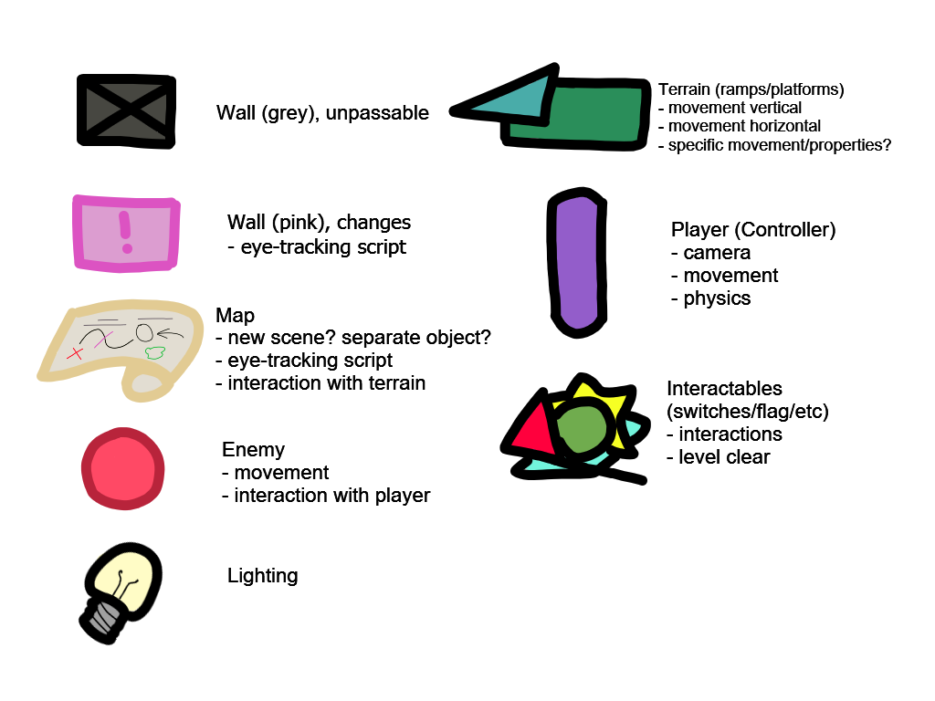
Objects/Scripts Required

Slide 6
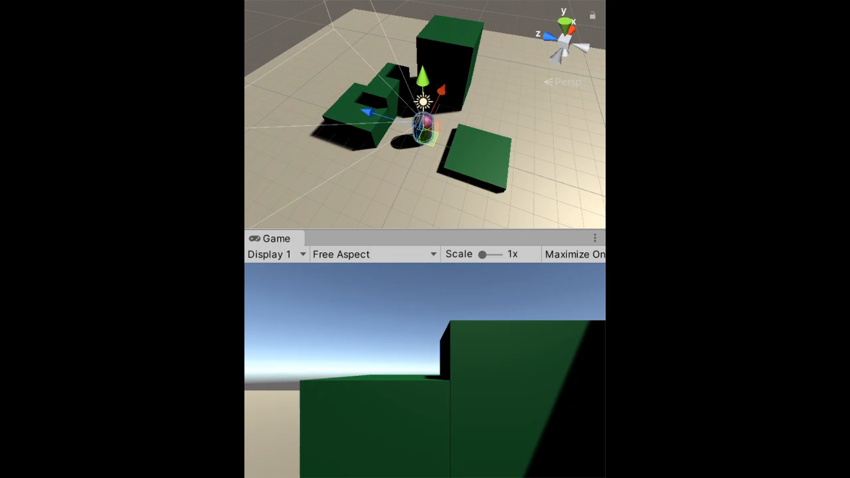
Demo

Slide 7
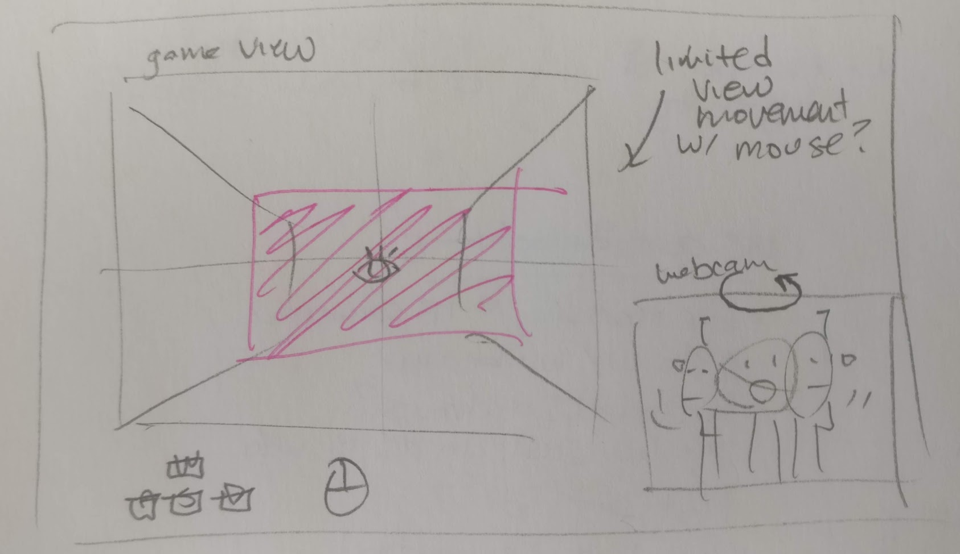
Considerations per COVID19

Slide 8
Goals for Checkpoint 2
Complete implementation of scripts and objects for game.

