Slide 1
Collaborative Speech Acts Modeling
By:
Kense
Abdallah Itani
Kevin Adea

Slide 2
Overarching Goal
Goal: To make conversation go smoothly from the beginning to the end of the conversation.
Context: Modelling a collaborative conversation between two people working on a common goal.
Notes:
How: Creating a model that reflects the data provided by Sunny in the Psychology department.

Slide 3
Resources
Coding Scheme of the collaborative acts, provided by Sunny.
Collaborative Data, in excel format.
Process Mining Textbook.

Slide 4
Schedule
First half of the semester:
Representing the data as a model.
Second half of the semester:
Checking the model and applying it to solve problems.
Notes:
Coding in second half

Slide 5
Session Goals
Overall big-picture of goals and concepts.
Learning background information regarding the field.
Figuring out the best model for our project.

Slide 6
Session Goals
Previously: Collaborative Speech Acts, LTL, Causal Nets
Currently: Causal Nets & Algorithms, Coding considerations

Slide 7
Session Goals
Previously: Collaborative Speech Acts, LTL, Causal Nets & Algorithms, Coding considerations
Currently: Process Discovery & Coding language finalization

Slide 8
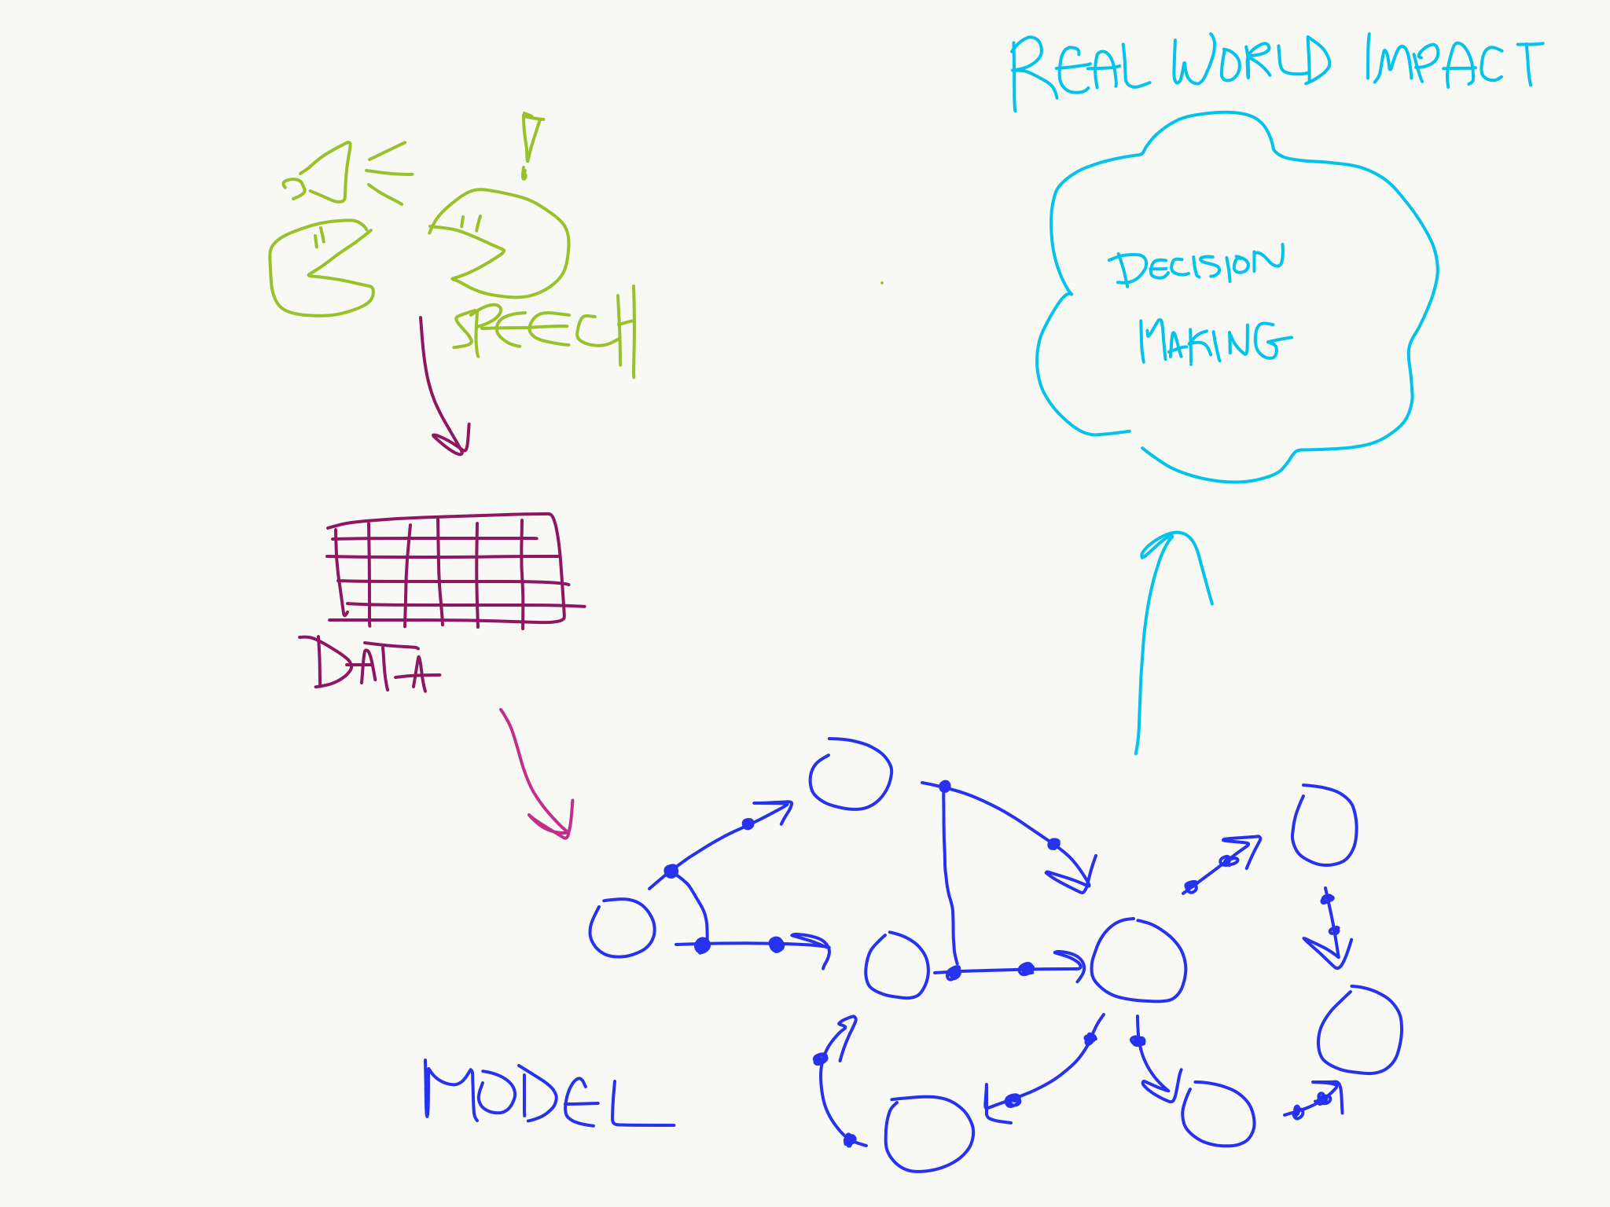
Flowchart – Semester Goals

Slide 9
Collaborative Speech Act
Speech utterances involved in the process of collaboration between two people.
Many categories: Relationship Management, Interaction Management, Information Management, Argumentation Management, Task Management, Tool Management, Other, Outside Activity.
Many different acts within those categories: Check comprehension, Elicit Opinion, Agree, etc.

Slide 10
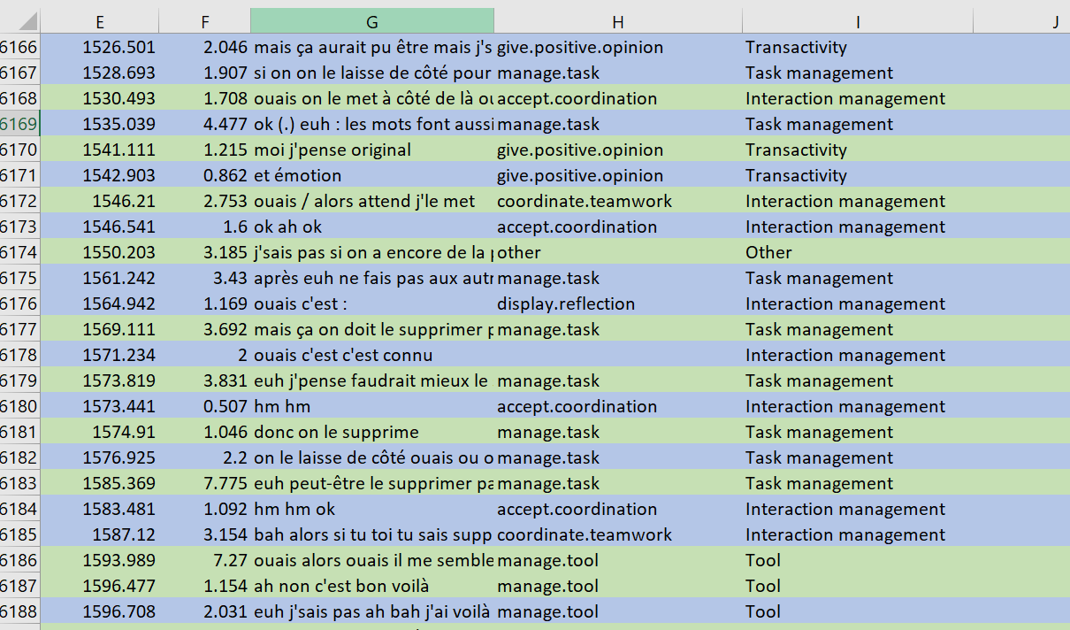
Notes:
Notice time and duration (col E and F) as well as notice the categories and actions (col I and H respectively)

Slide 11
Linear Temporal Logic
Similar to the CTL we examined before in class.
Addition of new logics:
Release (R)
Weak Until (W)
Strong Release (M)
“Give Recall releases Check Reception” as an example

Slide 12
Process Mining
“Process Mining aims to exploit event data […] to provide insights, identify bottlenecks, anticipate problems, […] and streamline processes.” - Wil van der Aalst
Discovery and Conformance
Notes:
Discovery: To generate a model to reflect events seen (what we will be doing with the speech act data we are given (i.e: blue in flowchart)
Conformance: Checking whether a model and seen events reflect one another (i.e: can be used to anticipate problems, or predict collaboration paths)

Slide 13
Causal Nets
Nodes and Causal Dependencies
Input/output Bindings
$C=(A, a_{i},a_{o},D,I,O)$
A is the finite set of activities
$a_{i}$ is the start activity
$a_{o}$ is the end activity
D is a dependency relation
I is the possible input bindings
O is the possible output bindings
Notes:
Nodes represent activities and arcs represents causal dependencies

Slide 14
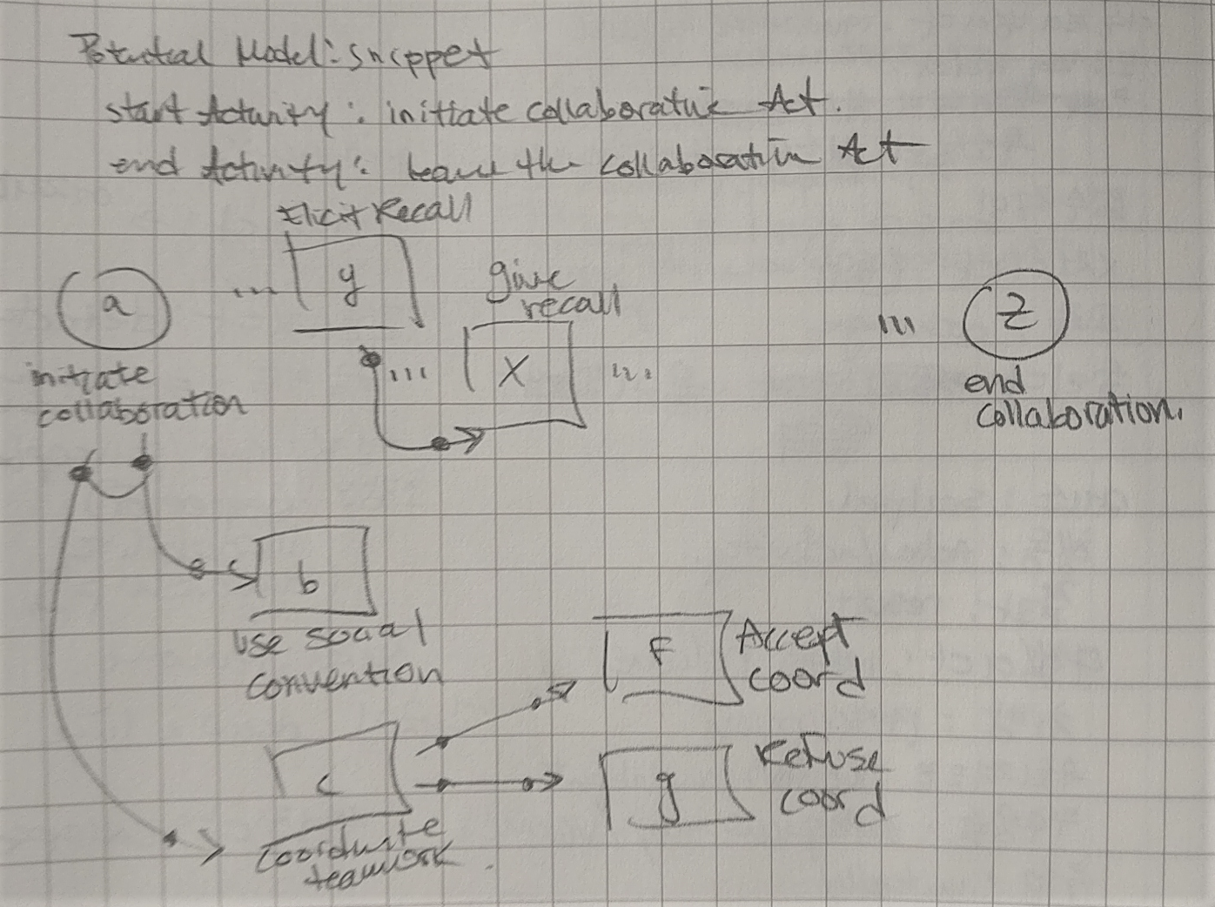

Slide 15
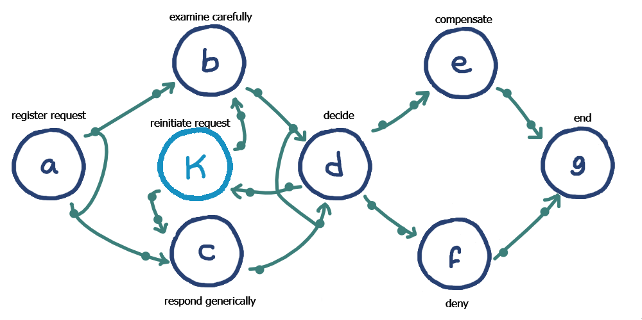
Causal Nets - Review
Notes:
C = (A, ai, ao, D, I, O)
- Go over each of the parts of the Causal Net again as a reminder, this time with better formalisms, referencing the image
- Be more specific this time on D, which is the dependency aspect as well as the definition of AS

Slide 16

Causal Nets – New
$AS=\left\{x⊆Ρ\left(A\right)\right| x=\left\{∅\right\}∨∅∉x\}$
$B=\left\{\left(a, {as}^{I}, {as}^{O}\right) ∈A ×P\left(A\right)×P\left(A\right) \right| {as}^{I}∈I\left(a\right)∧{as}^{O}∈O(a)\}$
Notes:
Explain how this definition of AS is really just a guarantee that only ai and ao have the ending states
Explain briefly how this definition of AS includes Powerset, which just means sets of sets (meaning a set of set of activities)
Explain B is the activity bindings, represented as a tuple, or a binding sequence

Slide 17

Causal Nets - Soundness
Binding Sequence
$S= ℬ(A×A)$, state space
$s∈S$, a state
$Ψ\left(σ\right)$, state after executing binding sequence $σ$
Notes:
The net is causality based, so we have to have some notion of predecessor bindings agreeing with successor bindings
This brings us to the notion of states
Mention that there is a really extensively formal definition for states, but its mostly a definition for the implementation of checking soundness, which we will look at in detail at a later point in time

Slide 18
Causal Nets – Soundness
Managing obligations of the net
Input bindings remove obligations
Output bindings create obligations
Notes:
Predecessor bindings and success bindings need to agree
Obligations are kind of “we’ve reached this state, we need some sort of managing to make sure we know when we reach the end state”
This makes sense because input bindings mean that we try to move from one activity to the next, and output means that we arrive at a new activity
**Checking for soundness is a task for later! But it is a good consideration to know now

Slide 19
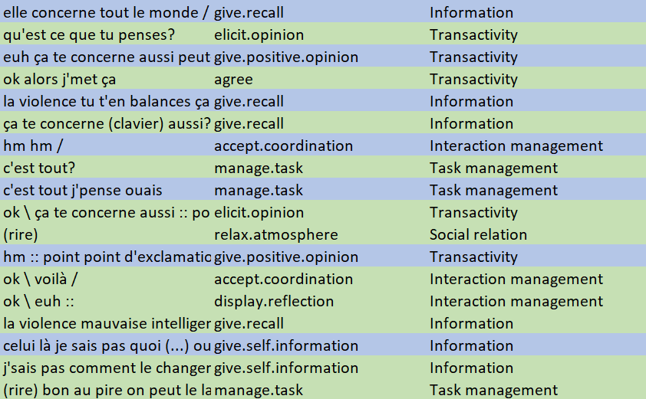
Process Discovery – Event Log
Notes:
Remind that this is the first step in our goals! (draw connections to flow chart)
Put things into context, our choice of process model is causal nets!
We have to consider how to simplify/adapt our event logs (data)!

Slide 20

Process Discovery – Algorithm
Basic algorithm: $α$-algorithm
Causal dependencies
Footprints
Notes:
Outline the basic idea of the a-algorithm, indicate that this is the first algorithm presented by the book and is told to be basic/insufficient, but good for demonstrating the idea of an algorithm (it is intuitive)
Talk about the concept of causal dependency and how “if a is followed by b and b is never followed by a then there is an assumed causal dependency between a and b”
Of course we can go into detail about how that may not be the case, but flexibility of causal nets can be useful and a-algorithm is still just a basic tool, we would be looking deeper later on
Talk about the footprints table, and how that is used to build upon each step, and ultimately creates a net from multiple sets
Check which activities appear
2&3. check the start and end activities
4&5. footprinting, finding out dependencies
6&7. constructing the arcs and transitions formally
8. Net from sets

Slide 21
Process Discovery – Process Model
Event Log -> Algorithm* -> Process Model
Need for pre-processing
Algorithm on top of LTL?
Notes:
Give an outline of the steps we went through.
Indicate that we are at the stage of looking for an appropriate algorithm that would fit our needs.
Can think about tweeking the algorithm once we find something more advanced/suitable, but a-algorithm gave us an intuition for what it looks like.
Talk about how we could think about applying LTL logic to the event logs, and have an algorithm that works on that as well.
EXCITING EXCITING

Slide 22
Coding Language
Appropriate for modeling: speed, efficiency, syntax, and readability
Swift
C/C++
Rust
Java
ProM
Notes:
Swift is considered to be fast an efficient like we saw in the previous course, and it has plenty of libraries we can use including the one used the modeling course. It has familiar syntax and supports functional programming and other paradigms
C offers a large number of libraries and optimization, has an efficient compiler
C++ offers support object-oriented programming, but this is not necessary for our application
Rust supports concurrency, memory safety and large-scale apps, and doesn’t have the memory-related bugs we see in C and C++
Java is a high-level language, meaning that it closely resembles human language. In contrast to low-level languages that resemble machine code, this simplifies development, making code easier to write, read, and maintain, but this will lead to it underperforming in terms of compilation speed, and making the code more complex (verbose)

Slide 23
Process Discovery – Quality
Fitness
Simplicity
Precision
Generalization
Notes:
Fitness is determining whether or not the model can replay or trace the events of the log, and some metric to which you score that.
Simplicity is how complex we think the model is, this of course is very arbitrary, but we can determine based on a notion of nodes/arcs, as well as more complex methods like entropy.
Precision and Generalization are related: Precision is about not underfitting a log, while generalization is about not overfitting.
We can think about how a model that is too general would be a flower model (central hub, everything is connected) which really tells us nothing, and a model that is too precise is just a singular trace of an event log.

Slide 24
Process Discovery – Concerns
Representational Bias
Exceptional Behavior
Completeness Assumptions
Notes:
Representational Bias is the idea that there are some choices that are inherent about a model. In choosing a certain type of model you may lose some functionality you could end up needing. And then, no algorithm choice will solve. This is tough because it requires some intuition. For us, we are less concerned about this for now since it seems like our choices don’t have any glaring issues in representational bias.
Exceptional Behavior in a model doesn’t really tell us any meaningful information, since we care about mainstream behavior. This intuition may seem a little strange, but in context makes a lot of sense. We don’t really need to evaluate exceptional behavior in a conversation because it is not representative of the conversation at large.
We need to be careful about assumptions of how complete the event log is. For instance, if we assume that the events seen in this one event log is all possible cases, that’s a strong completeness assumption. Which is probably bad.

Slide 25
Process Discovery – Approaches
Direct/Algorithm Approach
Two-Step Approach
Divide and Conquer
Computationally Intelligent Approach
Notes:
Direct Approaches tend to try and discover some footprint in the event logs (think a-algorithm)
Two step approach goes with a lower level model first, maybe just transitions, and then taking that to a higher level model (perhaps what we were thinking with “pre-processing” with LTL first)
Divide and Conquer – Split into sub logs and smaller problems to work with
Computationally Intelligent – ML methods, we will not really be working with this, but it is part of the literature

Slide 26


Process Discovery – Heuristic Mining
$α$-algorithm’s Causal Dependencies
Concept of Frequency
Dependency Charts
Event Log Replays

Slide 27

Process Discovery – Data Exploration
38 unique participants, 19 groups
Some groups more than others
Collaborative Categories/Processes
Notes:
For instance, some groups averaging 300 exchanges each, other maybe max 50 exchanges each side

Slide 28
Process Discovery – Data Exploration
Transactivity: 3036
Interaction Management: 2201
Information: 1402
Other: 930
Task management: 573
Tool: 560
Social relation: 504
Outside activity: 54
Notes:
These are the collaborative CATEGORIES
Transactivity: building upon the partner’s reasoning

Slide 29
Process Discovery – Data Exploration
“Display Hostility” count at 1
“Give positive opinion” vs “Give negative opinion” disparity
“Elicit Opinion” vs “Give positive opinion”
“Other” count second highest
Management actions, giving actions, are high
Notes:
Positive @ 1061 vs Negative @ 133
“other” processes are things like: okay, laughing, mmm, ahh. And not necessarily off-task things, there’s a separate section called “outside tasks”
Here, “Elicit Opinion” happens at a way lower frequency than give positive opinion, which leads me to believe that giving positive opinion does not necessitate an elicitation of that opinion. Which I guess makes sense
Management and giving are both high, maybe this leads us to believe that one person is taking charge more and one person is defaulting to the other more in an exchange?

