Slide 1
Collaborative Speech Acts Modeling
By:
Kense
Abdallah Itani
Kevin Adea

Slide 2
Presentation Flow
Introduction
Overarching goal (What is our goal and why are we doing this)
How are we reaching our goal
Resources that will help us achieve this goal
Flowchart (amazing flowchart created by Kense)
Our goal for this presentation (What we wanted to do and have done so far)
Details
Collaborative Speech Acts
LTL
Process Mining
Causal Nets
Conclusion
Repeat of overarching goal and how we are going to reach it
What we did for this session
What our goals are for our next session

Slide 3
Overarching Goal
Goal: To make conversation go smoothly from the beginning to the end of the conversation.
Context: Modelling a collaborative conversation between two people working on a common goal.
Notes:
How: Creating a model that reflects the data provided by Sunny in the Psychology department.

Slide 4
Resources
Coding Scheme of the collaborative acts, provided by Sunny.
Collaborative Data, in excel format.
Process Mining Textbook.

Slide 5
Schedule
First half of the semester:
Representing the data as a model.
Second half of the semester:
Checking the model and applying it to solve problems.
Notes:
Coding in second half

Slide 6
Session Goals
Overall big-picture of goals and concepts.
Learning background information regarding the field.
Figuring out the best model for our project.

Slide 7
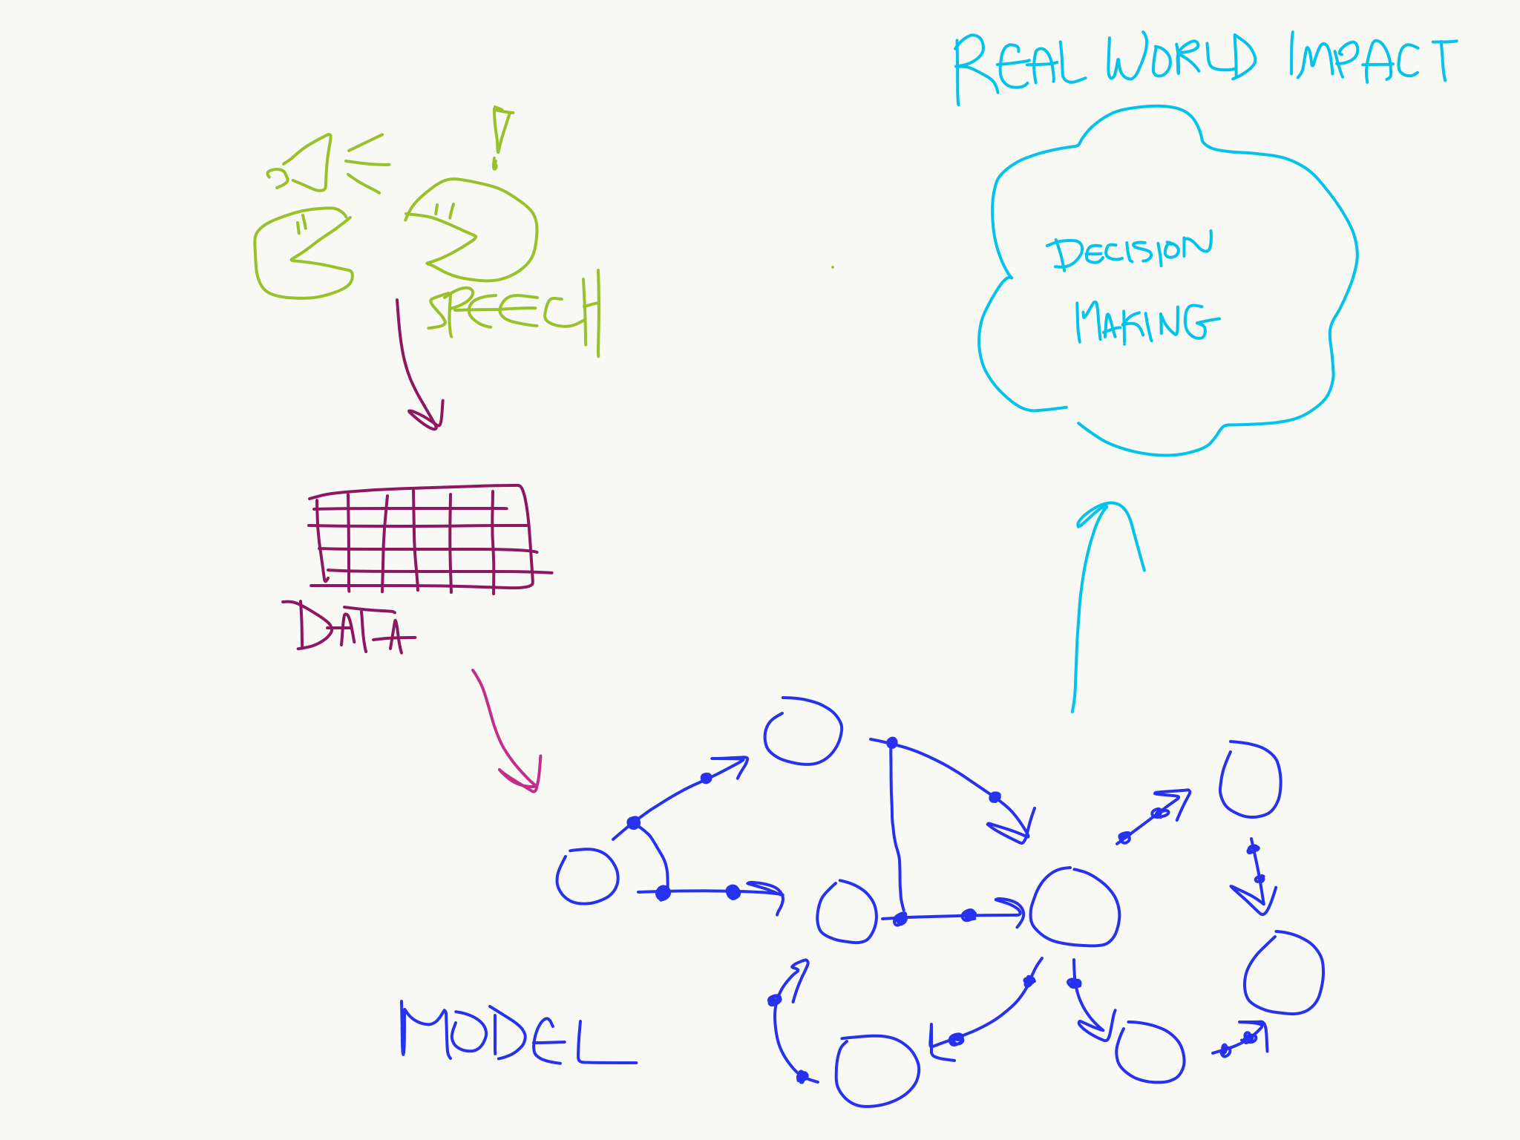
Flowchart – Semester Goals

Slide 8
Collaborative Speech Act
Speech utterances involved in the process of collaboration between two people.
Many categories: Relationship Management, Interaction Management, Information Management, Argumentation Management, Task Management, Tool Management, Other, Outside Activity.
Many different acts within those categories: Check comprehension, Elicit Opinion, Agree, etc.

Slide 9
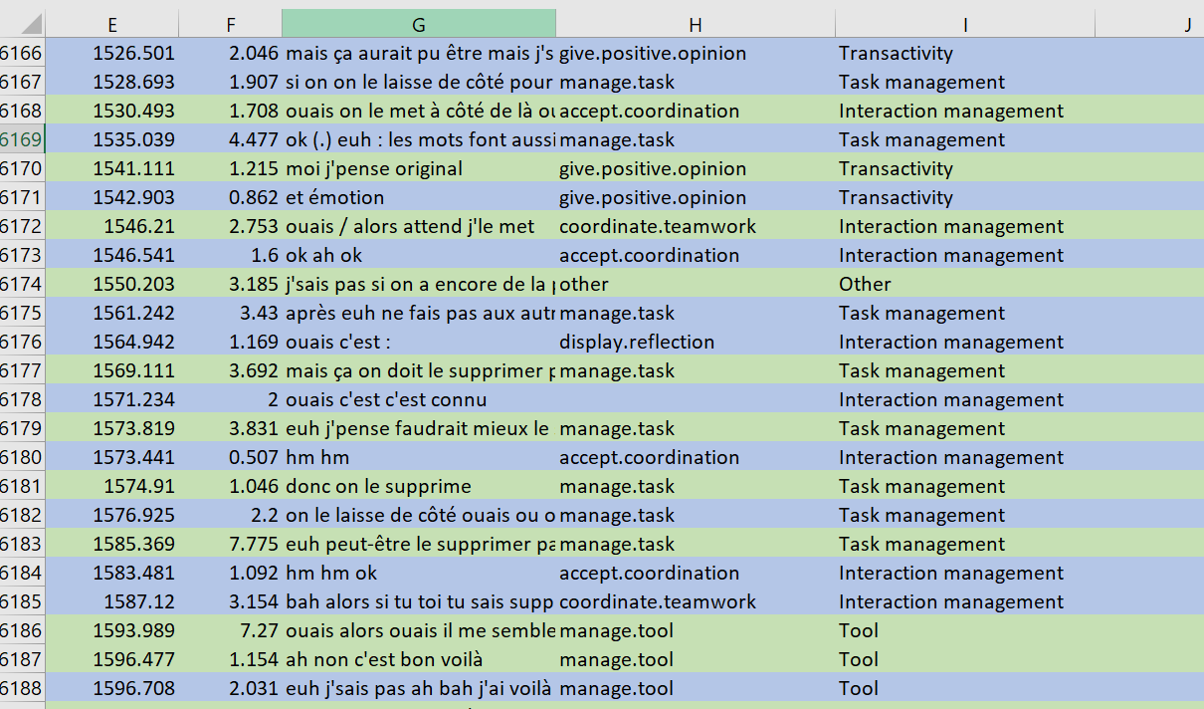
Notes:
Notice time and duration (col E and F) as well as notice the categories and actions (col I and H respectively)

Slide 10
Linear Temporal Logic
Similar to the CTL we examined before in class.
Addition of new logics:
Release (R)
Weak Until (W)
Strong Release (M)
“Give Recall releases Check Reception” as an example

Slide 11
Process Mining
“Process Mining aims to exploit event data […] to provide insights, identify bottlenecks, anticipate problems, […] and streamline processes.” - Wil van der Aalst
Discovery and Conformance
Notes:
Discovery: To generate a model to reflect events seen (what we will be doing with the speech act data we are given (i.e: blue in flowchart)
Conformance: Checking whether a model and seen events reflect one another (i.e: can be used to anticipate problems, or predict collaboration paths)

Slide 12

Causal Nets
Nodes and Causal Dependencies
Input/output Bindings
$C=(A, a_{i},a_{o},D,I,O)$
A is the finite set of activities
$a_{i}$ is the start activity
$a_{o}$ is the end activity
D is a dependency relation
I is the possible input bindings
O is the possible output bindings
Notes:
Nodes represent activities and arcs represents causal dependencies

Slide 13
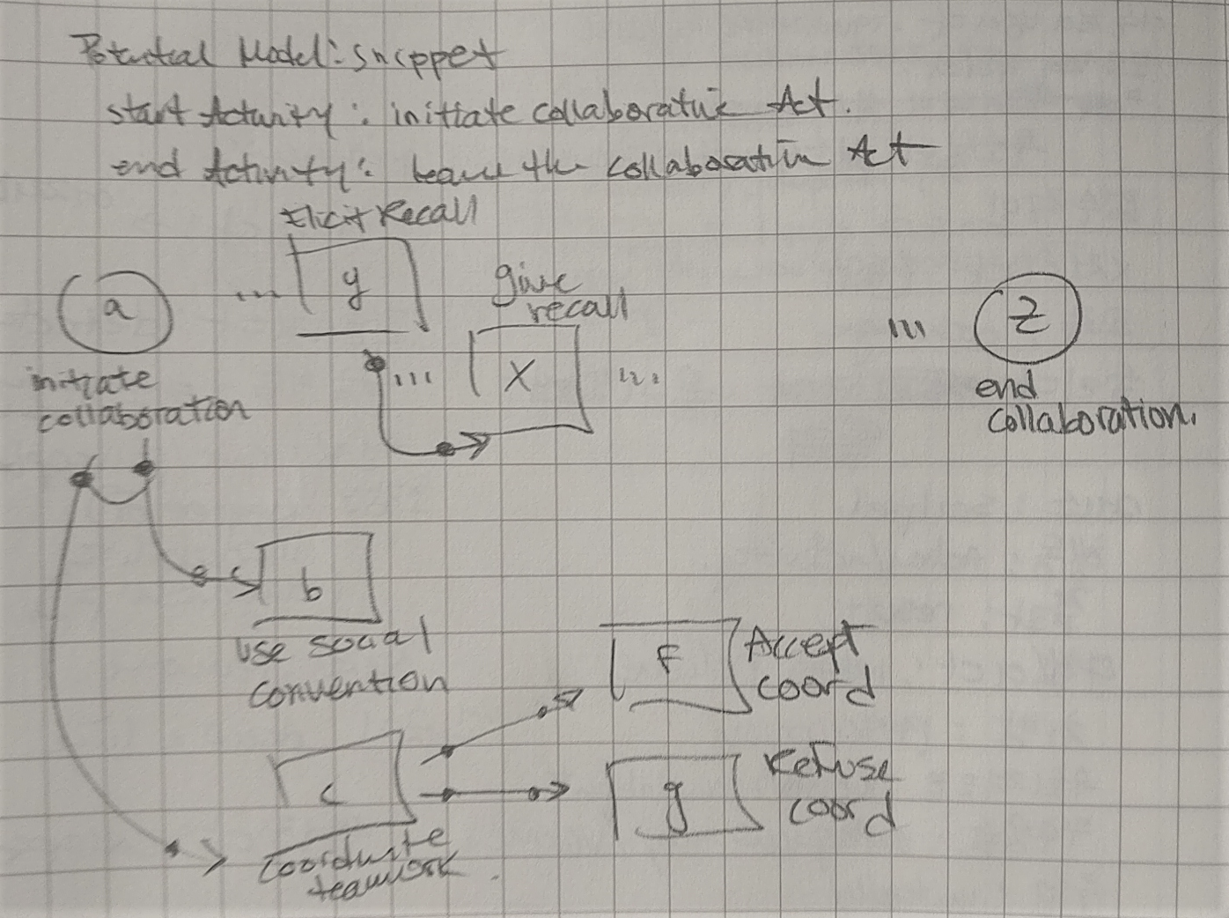

Slide 14
Status Update
Overall big-picture of goals and concepts.
Solidify a method of reasoning about a session of collaborative acts.
Determining which modeling logic is appropriate to represent this type of domain
Background information regarding the field.
LTL, Collaborative Speech Acts, Process Mining and Causal Nets
Figuring out the best model for our project.
The model will be created mainly using Linear Temporal Logic (LTL)

Slide 15
Goals for the next session
Find an appropriate representation of the model from the data.
Notes:
Looking at different types of models
Seeing which ones represent the provided data the best

