Slide 1
Securing Your Credentials
Step 1: Knowing if you have vulnerabilities
Does your password have enough entropy?
Do you store your data well?
Do the companies that have your data secure your data well?
Check if you were part of a data-breach: https://haveibeenpwned.com/

Slide 2
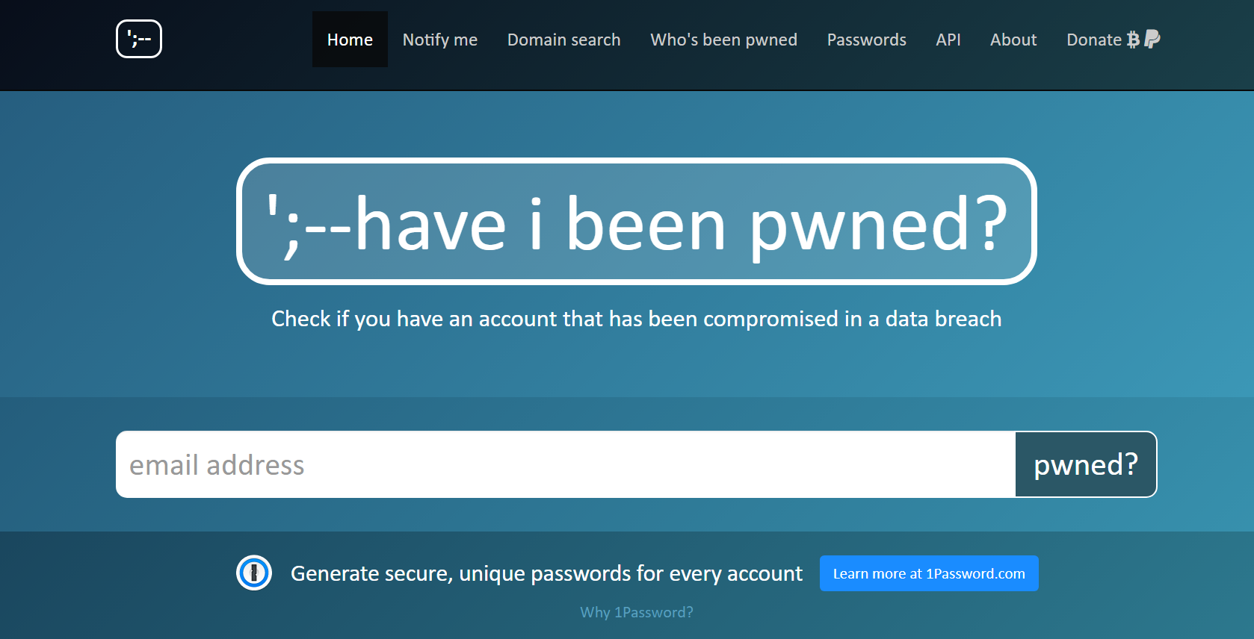

Slide 3
Securing Your Credentials
Step 2: Preventing password reuse
How many passwords can you remember?
How many of those passwords have good enough entropy?
Example: “nWS67H%waxyb” 12 char
Example: “tinygoblinpeoplehaveme” 22 char (from xkcd’s “Password Strength” https://xkcd.com/936/ )
But eventually you will forget.

Slide 4
Securing Your Credentials
Step 3: Understanding risks
Nothing is perfect.
You won’t remember everything.
How much do you have to lose/Are you worth attacking?
Even if you’re perfect, is this how you want to live your life?

Slide 5
Securing Your Credentials
Step 5: Use the features, and additional help from 2FA
Password generation
What is “random?” How random is it? (True vs Pseudo) Do we know?
Radioactive Decay/physical phenomenon vs seeding
Hardware mixed with algorithmic solutions
But in the end, passwords are not the end-all-be-all

