Slide 1
Technologies du Web Sémantique
Kevin Adea
Tientso Ning

Slide 2
Achieved Tasks
Evaluated the CS-Ontology GraphML file using yEd
Noticed the construction of Nodes and Links
Considered the over-arching view of the graphs
Pruned the CS-Ontology GraphML file (minimally) to fit our needs
Manually entered the ontology into Protégé
Class Hierarchy
Object Properties

Slide 3
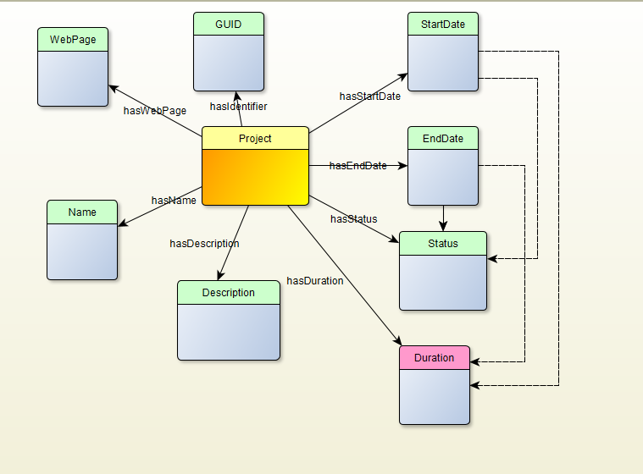

Slide 4
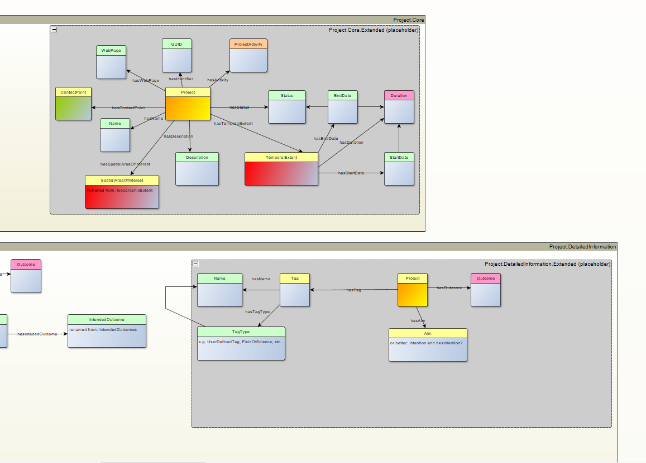

Slide 5
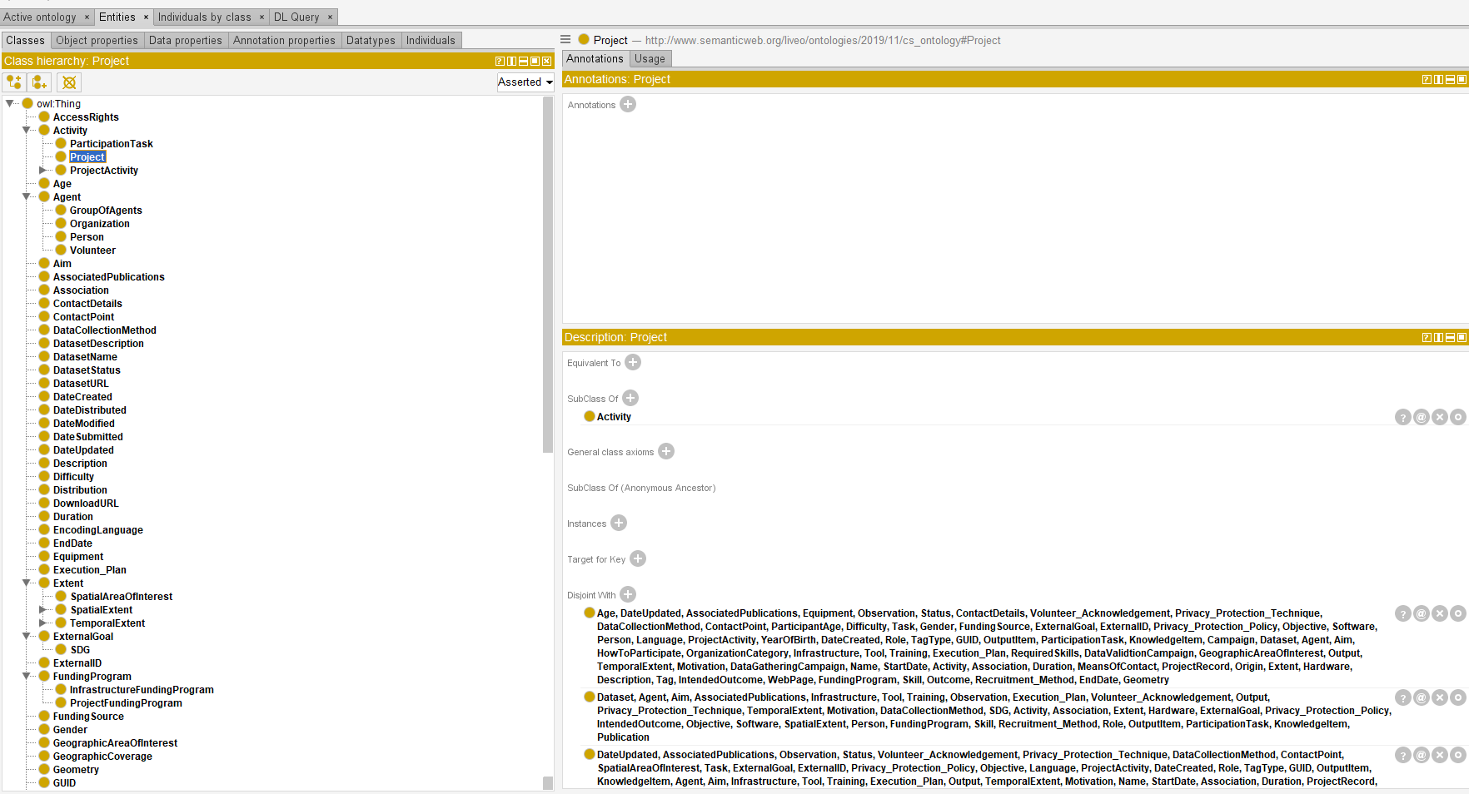

Slide 6
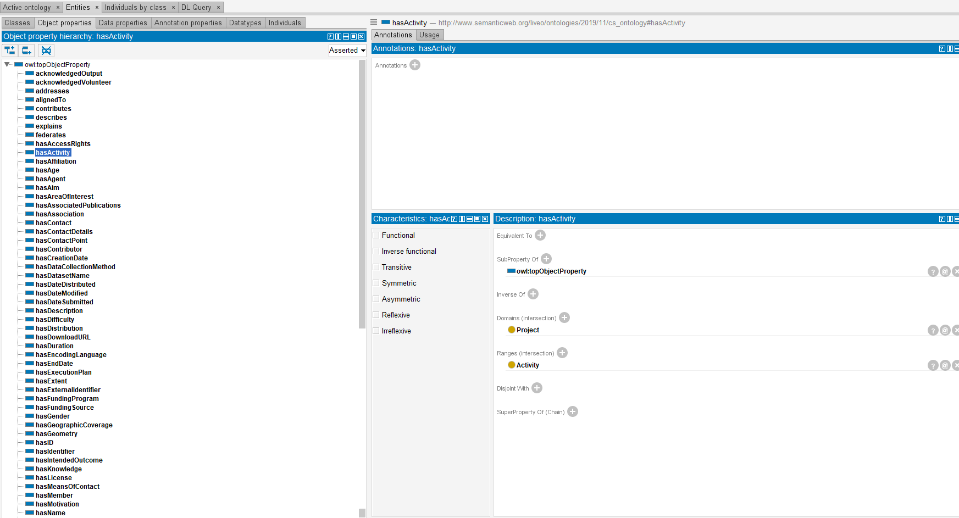

Slide 7
In Progress
Writing rules and axioms in Protégé
Testing ontology by loading sample triples (manually)
Testing the reasoner by running “reasoner” in Protégé
Editing triples for uploading onto GraphDB
Transfer the ontology onto GraphDB
Putting it all together

Slide 8
Special Considerations

