Slide 1
Technologies du Web Sémantique
Kevin Adea
Tientso Ning

Slide 2
Achieved Tasks
Evaluated the CS-Ontology GraphML file using yEd
Noticed the construction of Nodes and Links
Considered the over-arching view of the graphs
Pruned the CS-Ontology GraphML file (minimally) to fit our needs
Examined the TTL files for potential areas of editing
Manually entered our layout as an ontology into Protégé
Class Hierarchy
Object Properties

Slide 3
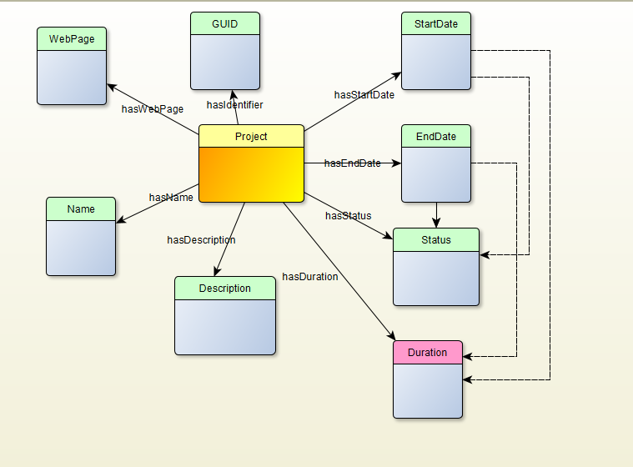

Slide 4
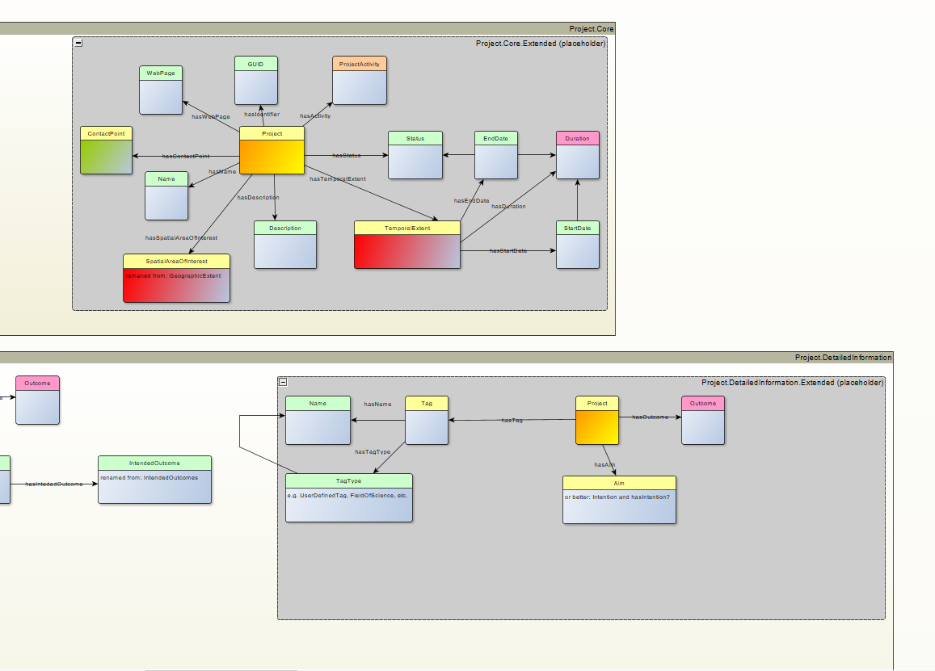

Slide 5
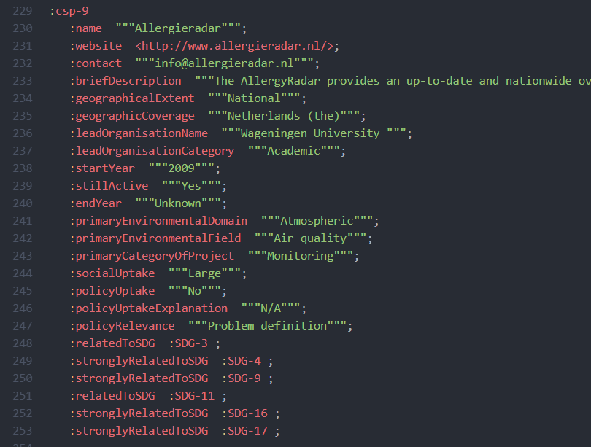

Slide 6
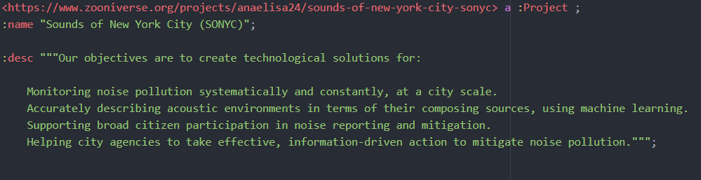

Slide 7
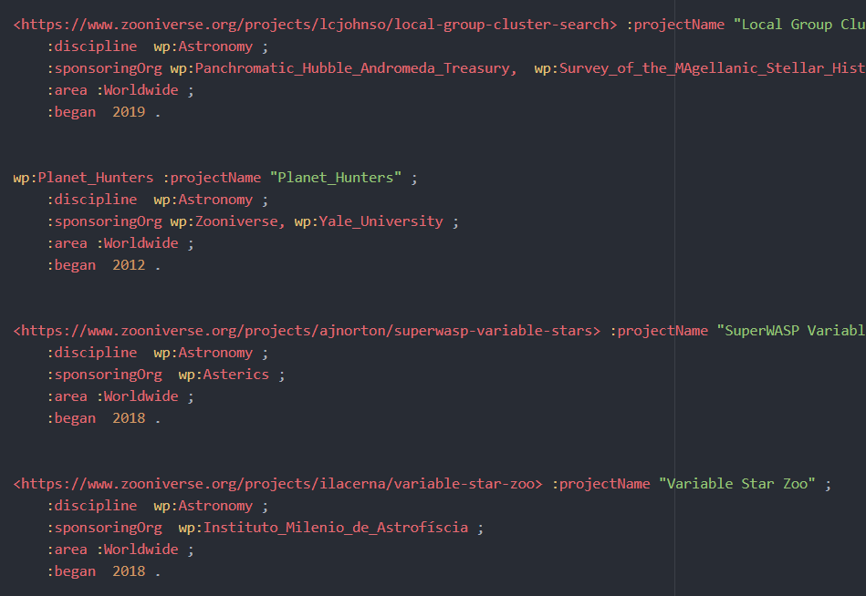

Slide 8
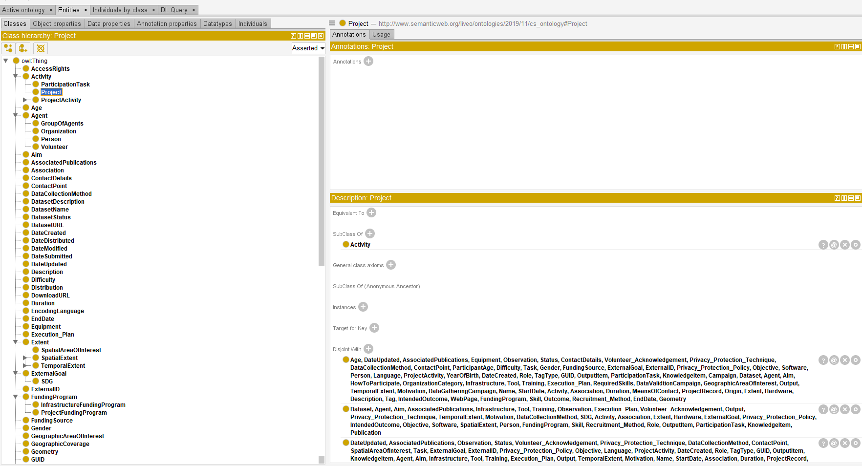

Slide 9
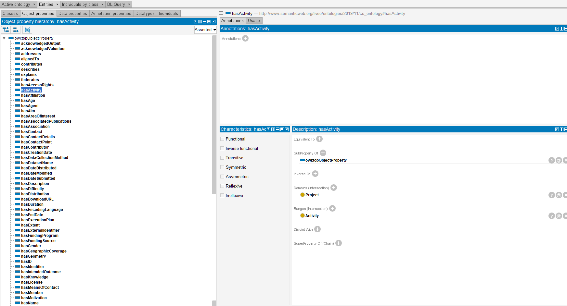

Slide 10
In Progress
Adding additional Class Objects to categorize disciplines
Writing rules and axioms in Protégé, testing using the reasoner
Editing triples for uploading onto GraphDB (parsing, reformatting) along with the ontology
Displaying queries

Slide 11
Additional Considerations
Data Properties in Protégé (We need to turn some of the Class properties we have now (ie: DateStart) into Data Properties)
Creating more Class objects that delineate disciplines (by ourselves, as per the project)
Do all the rest of the stuff

