Slide 1
Unsupervised Machine Translation Using Monolingual Data Only
Guillaume Lample, Alex Conneau, et al
Presented by Tientso Ning

Slide 2
Goal
To create a Unsupervised NMT model that only utilizes monolingual data.
Translate a sentence from one language to another
By creating a translator
Using different language data that have no connection

Slide 3
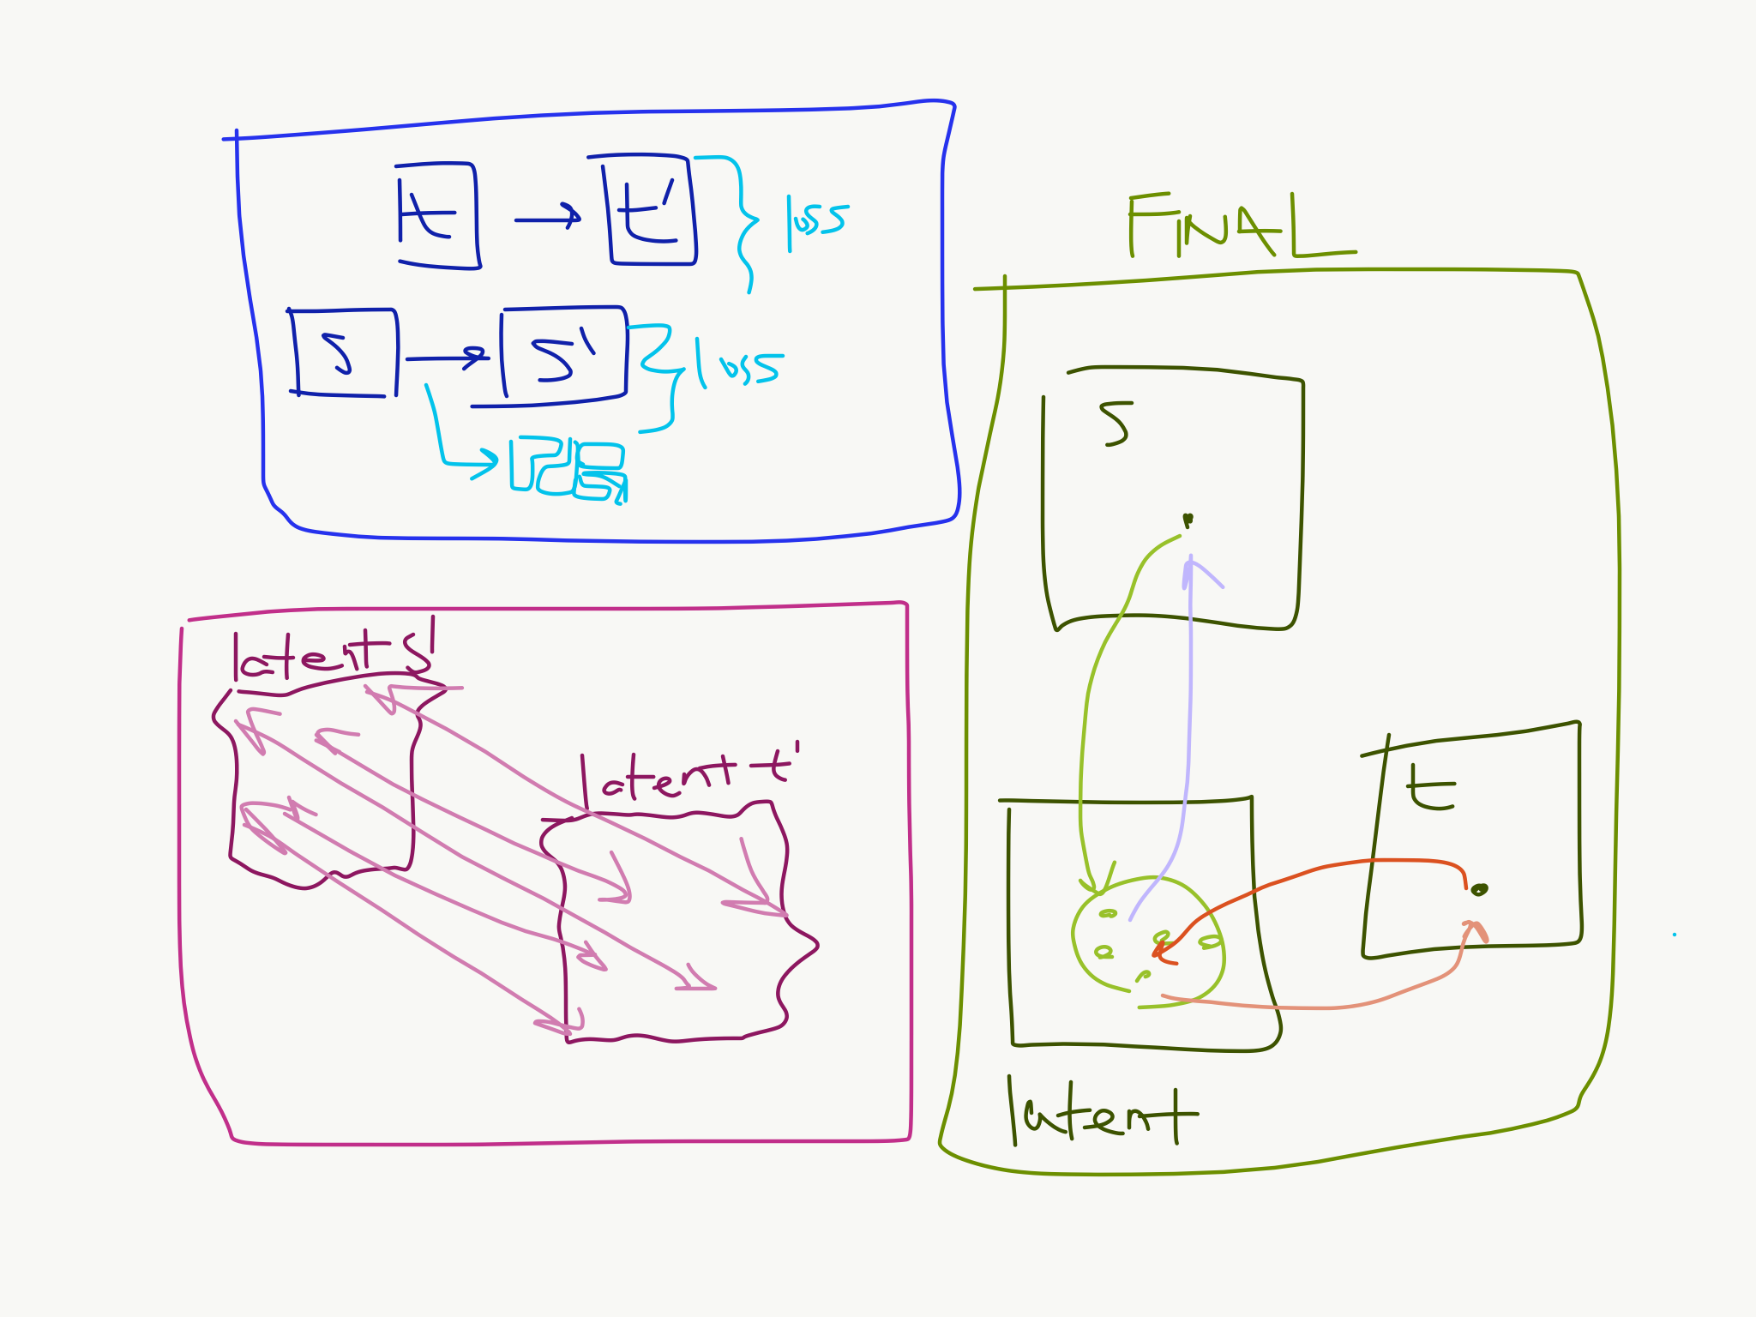
Overview – Task at Hand
Blue: Reconstructions
Word-Embeddings
Encoder/Decoder
Red: Alignment of Latent Space
Noisy Reconstructions
Adversarial Training
Green: All Together
Translation Intuition

Slide 4
How it is done – Parallel vs Monolingual
Corpus – a collection of text documents in a given language.
Parallel Corpus – a collection of the same text documents in both source and target language (rare).
Monolingual Corpus – a corpus in a given language.
Supervised Training vs Unsupervised Training
In this research, we work with monolingual data.
Keeping things fully Unsupervised, everything can be derived from monolingual data.

Slide 5
How it is done – Word Embeddings
Relationship of words, i.e: “King -> Queen, Man -> Woman”
Word-Embeddings – fancy way to say “turn words into numbers.”
This simplification gives us enough to talk about how words are related.
The space (“latent space”) of words, and the relationship of words.

Slide 6
How it is done – Encoder/Decoder
Encoder – sentences to latent space
Input: sentence, language direction (src -> tgt)
Output: hidden-states (using word-embeddings)
Decoder – reconstruct latent space to sentences (translated)
Input: hidden-states
Output: sentence
Note that the Decoder generates by iteratively returning words of the highest probability.
Making the model a Seq2Seq with Attention.

Slide 7
More Details – Latent Space Reconstruction
Aligning the two “latent spaces”
What is a “noisy reconstruction?”
Corrupted Constructions are useful in translating from source to target language?
The model needs to reconstruct in both directions.
How is the adversarial element is key to effectiveness?

Slide 8
More Details – Cross Domain Training
Think of it as alignment of latent spaces.
Map source language to target language.
Generate a “corrupted translation” by applying the current model.
Reconstruct the original input given the “corrupted translation.”
Learn the Encoder-Decoder model that can reconstruct.
Process is iterative.

Slide 9
More Details - Adversarial
Not as cool as it sounds – simultaneous min-max to achieve optimal
Why do we need adversarial training?
Problem of the decoder being too dependent on the encoder settings
Goal is to achieve decoding into a target language regardless of the source language used by the encoder.
Discriminator – classify source vs target language encodings (“predict the language”).

Slide 10
Review – Task at Hand
Things that we obtain:
Encoder Decoder
Latent Space
Discriminator
Generated Resources (Dictionaries, etc.)
Iterative: Starts with an initial model setup. Train and align latent space. Encoder Decoder is trained at each iteration. New translation model is setup for next iteration.
The guarantee: “as long as some information is retained about the input, the encoder is trained to map to a cleaner version in the latent space.”

Slide 11
Evaluation – BLEU score
BLEU – Bilingual Evaluation Understudy
Idea is to judge a machine translation based on how different it is to a human-translation.
Most popular scoring method.
Scale of 0.0 to 1.0 (worst to best).
Assigning appearance of words in translation compared to words in reference, with a cap on max-appearances, along with n-grams considerations.
Some concerns such as meaning, structure, etc.

Slide 12
Results and Implications
Baseline – word for word translation: 16.77 and 10.09
Single Iteration – 27.48 and 12.10
Few Iterations – 32.76 and 15.05
Compared to Supervised NMT – same performance on 100,000 parallel sentences (small, but impressive).
Potential for semi-supervised models.
Additional tests done for parts of the model, saved for brevity.

Slide 13
Review of Unsupervised Machine Translation Using Monolingual Data Only
Guillaume Lample, Alex Conneau, et al
Review by Tientso Ning

Slide 14
Evaluating Strengths of the Paper
Structure (Progression, build-up, etc.)
Review of Related Works is well defined.
Explanations are concise and logical.

Slide 15
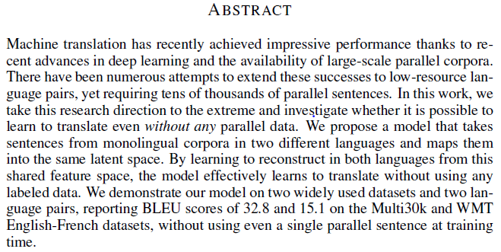
Evaluating the Abstract

Slide 16
Abstract
Clear and Concise.
Missing implication of the work at the very end.

Slide 17
Evaluating the Results/Implications
BLEU score is a good baseline, but since BLEU doesn’t consider meaning very well, we may be concerned with the Unsupervised translation results in terms of meaning (especially since it is something that requires supervision)
English and French have similar sentence structure. How are we on English-Japanese or English-Vietnamese, English-Korean? Perhaps even the idiomatic-expressions for languages such as Chinese?
Problem can be “solved” with more parallel corpora, however, it is still important to consider the possibility.

Slide 18
Evaluating the Related Works Section
Related works section is extensive and detailed, but does not explicitly define what parts are different from their own research in this section.
Discussions of related works but in a different domain (vision).

Slide 19
Overall Impressions
Strong paper
Interesting topic
Carves a nice distinction between other works in the introduction.
Some mild concerns about related works section and the implications of the research, but overall it seems like this paper was presented at the conference because it contributes well to the field.

Slide 20
Summary
We looked at the model that is constructed to do Unsupervised machine translation using monolingual data.
We learned about common approaches in the domain, and the new one presented by the paper.
We evaluated the paper’s merits and areas for improvement.
I hope we found new appreciation for language-learning and translation.

Slide 21
Questions?

