Slide 1
Unsupervised Machine Translation Using Monolingual Data Only
Guillaume Lample, Alex Conneau, et al
Presented by Tientso Ning

Slide 2
Overview – Task at Hand
//insert image of overview
//intuition and how it feels like how people would naturally translate between two languages

Slide 3
How it is done – Parallel vs Monolingual
Corpus – a collection of text documents in a given language.
Parallel Corpus – a collection of the same text documents in both source and target language (rare).
Monolingual Corpus – a corpus in a given language.
Supervised Training vs Unsupervised Training
In this research, we work with monolingual data.
Keeping things fully Unsupervised, everything can be derived from monolingual data.

Slide 4
How it is done – Word Embeddings
//insert picture example here of distance of words and how they’re related, etc.
Word-Embeddings – fancy way to say “turn words into numbers.”
This simplification gives us enough to talk about how words are related.
The space (“latent space”) of words, and the relationship of words.

Slide 5
How it is done – Encoder/Decoder
Encoder – sentences to latent space
Input: sentence, language direction (src -> tgt)
Output: hidden-states (using word-embeddings)
Decoder – reconstruct latent space to sentences (translated)
Input: hidden-states
Output: sentence
Note that the Decoder generates by iteratively returns word of highest probability.
Making the model a Seq2Seq with Attention.

Slide 6
More Details – Latent Space Reconstruction
Why “noisy reconstruction?”
Corrupted Constructions proving useful in translating from source to target language?
The model needs to reconstruct in both directions.
How the adversarial element is key to effectiveness?

Slide 7
More Details – Cross Domain Training
Think of it as alignment of latent spaces.
Map source language to target language.
Generate a “corrupted translation.”
Reconstruct the original input given the “corrupted translation.”
Process is iterative.

Slide 8
More Details - Adversarial
//probably need an image here too
Why do we need adversarial training?
Problem of the decoder being too dependent on the encoder settings
Goal is to achieve decoding into a target language regardless of the source language used by the encoder.
Discriminator – classify source vs target language encodings (“predict the language”).

Slide 9
Review – Task at Hand
Things that we obtain:
Encoder Decoder
Latent Space
Discriminator
Generated Resources (Dictionaries, etc.)
Iterative: Starts with an initial model setup. Train and align latent space. Encoder Decoder is trained at each iteration. New translation model is setup for next iteration.
The guarantee: “as long as some information is retained about the input, the encoder is trained to map to a cleaner version in the latent space.”

Slide 10
Results and Implications
//explain what a BLEU score is, and mention it as a benchmark

Slide 11
Review of Unsupervised Machine Translation Using Monolingual Data Only
Guillaume Lample, Alex Conneau, et al
Review by Tientso Ning

Slide 12
Evaluating Strengths of the Paper
Structure (Progression, build-up, etc.)
Review of Related Works is well defined.
Explanations are concise and logical.

Slide 13
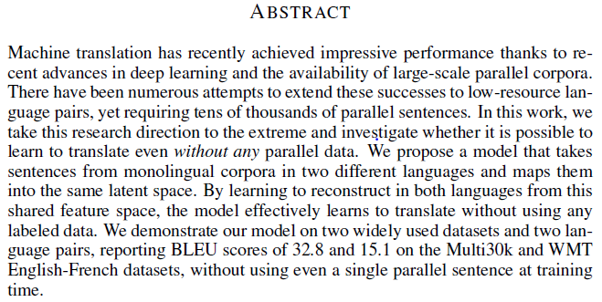
Evaluating the Abstract

Slide 14
Evaluating the Results/Implications
//potential that lack of experience makes analysis/evaluation of results incomplete/incorrect, but we should indicate potential areas of concern/vagueness.

Slide 15
Evaluating the Related Works Section
//Compare the related works and maybe how they do things differently.
//Think about another potential solution to the problem? Is it well addressed in the paper?

Slide 16
Overall Impressions
Strong paper
Interesting topic
Carves a nice distinction between other works
Some concerns about //…

Slide 17
Room for Improvement

Slide 18
Summary
We looked at the model that is constructed to do Unsupervised machine translation using monolingual data.
We learned about common approaches in the domain, and the new one presented by the paper.
We evaluated the paper’s merits and areas for improvement.
I hope we found new appreciation for language-learning.

