Slide 1
The Effect of Lowering PSI Charges
A Case Study - Danish Experiences
Morten Lind (mli@mbbl.dk)

Slide 2

Introduction
Photo is not from of the actual incident
2

Slide 3
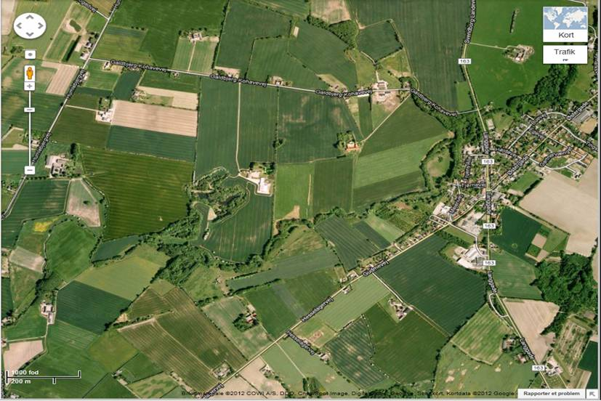
Introduction
Dirt road not in GPS!
GPS Nav
Fire engine here!
Map is not from the actual incident
3

Slide 4
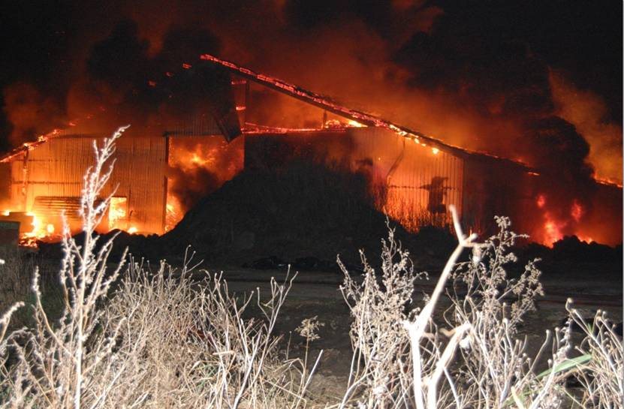
Introduction
Photo is not from of the actual incident
4

Slide 5
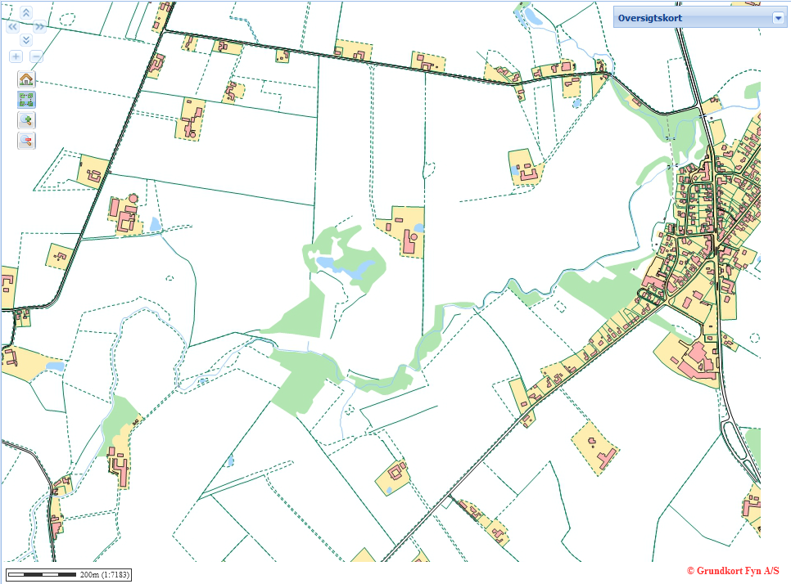
Introduction
Dirt road is in public base map (PSI)!
Map is not from the actual incident
5

Slide 6
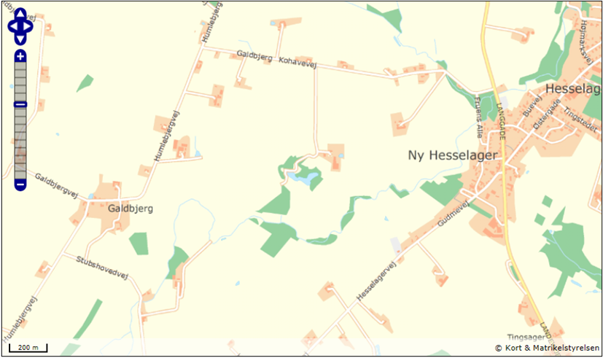
Introduction
Dirt road is in public base map (PSI)!
Map is not from the actual incident
6

Slide 7
Lesson learnt?
Poor re-use of public sector information causes:
Insufficient commercial products/services (e.g. GPS)
Reduced efficiency in public services (e.g. emergency)
Loss of assets – and potentially also health and lives
And … and …

Slide 8
Case Study on DK Address Data

Slide 9
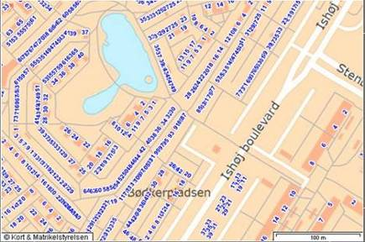
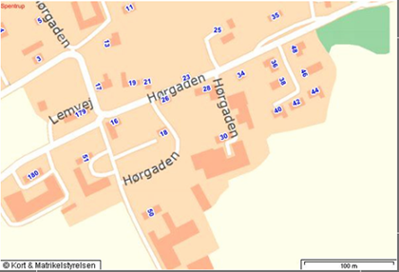
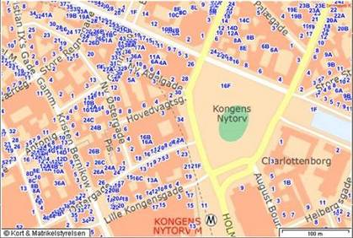
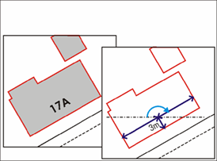
Address data collected & harmonized 1996-2001
Mun StrC AdNo X-coord. Y-coord. Arc.
--- ---- ---- -------,-- -------,-- -----
619 4605 _17A 248.510,45 153.345,08 175,0
Suburban
Rural
City

Slide 10
Deadlock situation Faced in 2002
Situation:
State of the art address data, 97 % with HQ geo codes
Very large potential for use; Could be joined with data from other public base registries
Large user demand from: emergency, police, county administration, transport sector, utilities, health sector …
But:
Data owned by 275 individual municipalities; no common license agreement or data distribution
Therefore:
Almost no re-use of data outside municipalities; but competing private sector collections/datasets

Slide 11
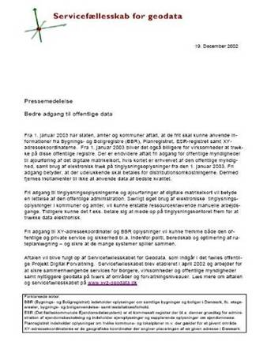
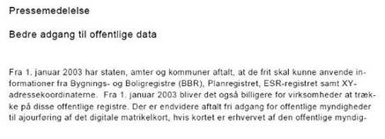
2002…: Free of Charge Data Agreement
Prepared by DK eGov Taskforce
Covered full public/private sector re-use of address data
Available at marginal costs of distribution
No license fee or similar charging based on IPR
Re-distribution for commercial and non-commercial purposes
December 2002: The data agreement announced,

Slide 12
Purpose of Agreement
E-Government
Research
Health care
Local Government
Digital mapping
Utilities
Energy, Environment
Transport services
Postal services
Emergency services
Mobile services, GPS
x1000
Common base for re-use and application development
x1
Addr
Official address file maintained
by the municipalities
Notes:
The concept of good management of reference data:
Collect and compile once by the public; use as a common reference in many different applications, (developed primarily by private companies).

Slide 13
Expected Impact of Agreement
PSI address data re-use
Best
Future
Better
agreement
Good
Start
Impact of
Average
2000
2005
2010
2015
Notes:
K

Slide 14
2010: Assessment of Value for Society
PSI address data re-use
Best
Future
Better
Direct, measurable economic benefits first five years: >60 mill. EUR
agreement
Good
Start
Impact of
’Zero’
Average
2000
2005
2010
2015
Notes:
K

Slide 15
The PSI Benefit Flow
Re-distribution
End users
Municipalities
ADDR
Central hub
Distribution without IPR restrictions
Reuse/sharing without license restrictions
2nd level
3rd
4th
5th
Nth …

Slide 16
Details of Assessment for 2010
Direct, measurable economic benefits from re-use of PSI address data in 2010: ~ 14 mill. EUR (~ 6 EUR / address)
Cost of data agreement 2010: ~ 0.2 mill. EUR (~ 0,09 EUR / address)
In 2010 the ROI seems to be ~ 70 : 1
Results confirmed and extended by the 2011 EC POPSIS report
Extra employees in private sector
Add tax revenue

Slide 17
Socio Economic Benefits of PSI re-use
Provides PSI for re-use
Reuses PSI and …
Provides infrastructure
Public
sector
Private
sector
Delivers tax revenue
… which underpins PS efficiency
develops products and services …
17

Slide 18
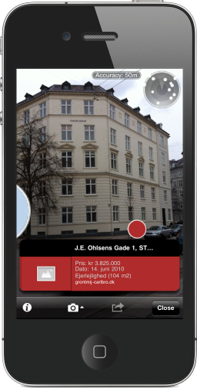
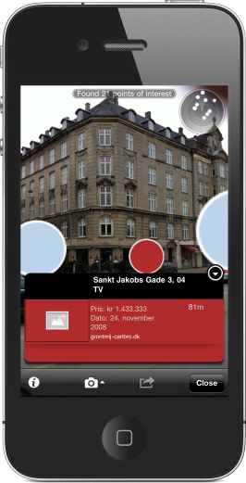
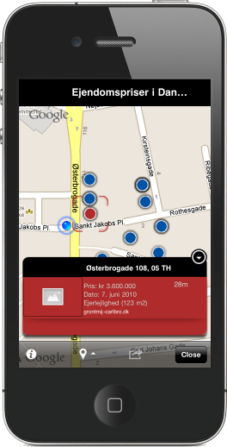
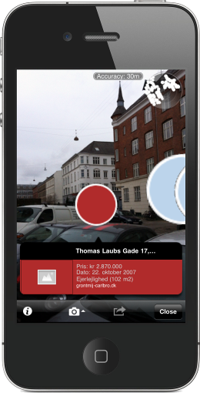
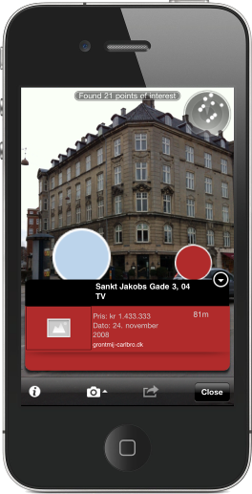
Business Opportunities in PSI Re-use
Courtesy of Grontmij
Morten Lind - mli@mbbl.dk Ministry of Housing, Urban and Rural Affairs, Denmark (MBBL)

